Slide 1
HTML Styles - CSS

Slide 2
CSS
CSS stands for Cascading Style Sheets.
CSS describes how HTML elements are to be displayed on screen, paper, or in other media.
CSS saves a lot of work. It can control the layout of multiple web pages all at once.

Slide 3
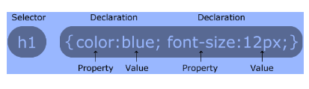
HTML Styles - CSS
CSS stands for Cascading Style Sheets
HTML just describes the layout of the elements in a web page
used to apply the styles for those elements.
CSS saves a lot of work, when you work with multiple web pages in a single web site by applying styles to all pages from a single file.
CSS syntax:

Slide 4
CSS - Techniques
CSS can be added to HTML elements in 3 ways:
Inline - by using the style attribute in HTML elements
Internal - by using a <style> element in the <head> section
External - by using an external CSS file

Slide 5
Inline CSS
An inline CSS is used to apply a unique style to a single HTML element.
An inline CSS uses the style attribute of an HTML element.

Slide 6
Inline CSS
<!DOCTYPE html>
<html>
<body>
<h1 style="color:blue;">This is a Blue Heading</h1>
</body>
</html>

Slide 7
Internal CSS
An internal CSS is used to define a style for a single HTML page.
An internal CSS is defined in the <head> section of an HTML page, within a <style> element:

Slide 8
Internal CSS
<!DOCTYPE html>
<html>
<head>
<style>
body {background-color: powderblue;}
h1 {color: blue;}
p {color: red;}
</style>
</head>
<body>
<h1>This is a heading</h1>
<p>This is a paragraph.</p>
</body>
</html>

Slide 9
External CSS
An external style sheet is used to define the style for many HTML pages.
With an external style sheet, you can change the look of an entire web site, by changing one file!
To use an external style sheet, add a link to it in the <head> section of the HTML page:

Slide 10
External CSS
<!DOCTYPE html>
<html>
<head>
<link rel="stylesheet" href="styles.css">
</head>
<body>
<h1>This is a heading</h1>
<p>This is a paragraph.</p>
</body>
</html>

Slide 11
External CSS
An external style sheet can be written in any text editor. The file must not contain any HTML code, and must be saved with a .css extension.
Here is how the "styles.css" looks:
body { background-color: powderblue; } h1 { color: blue; } p { color: red; }

Slide 12
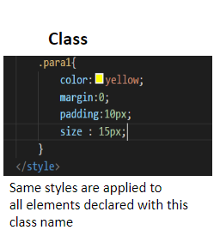
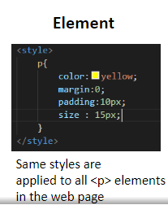
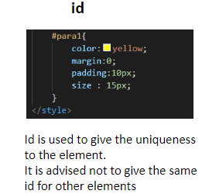
CSS Selectors
CSS selectors are used to identify the element to apply the styles
Element is identified using the following selectors
element
id
class

Slide 13
CSS Fonts
<!DOCTYPE html>
<html>
<head>
<style>
h1 {
font-size: 40px;
color:orange;
font-family: verdana;
}
h2 {
font-size: 30px;
color: blue;
font-family:arial;
}
p {
font-size: 14px;
color: green;
font-family:arial;
}
</style>
</head>
The CSS color property defines the text color to be used.
The CSS font-family property defines the font to be used.
The CSS font-size property defines the text size to be used.
<body>
<h1>This is heading 1</h1>
<h2>This is heading 2</h2>
<p>This is a paragraph.</p>
<p>This is another paragraph.</p>
</body>
</html>

Slide 14
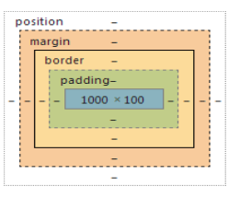
CSS Box Model
All HTML elements are considered as boxes.
Box Model refers to the design and layout of an HTML element.
CSS box model , is box that is wrapped around every HTML element.
It consists of
Margin
Border
Padding
Actual Content.

Slide 15
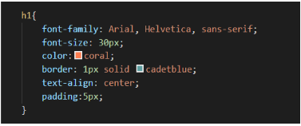
CSS Heading
Headings in HTML will come with default styles
Headings are block level elements , which occupies the complete width of the viewport
Usually we apply the following styles headings
font-family ( used to set the font type)
font-size ( used to set the font size , default is 36px (h1))
color ( used to set the color )
border ( used to set the border )
margin ( used to set the margin )
padding ( used to set the padding )
text-align (used to align the text )

Slide 16
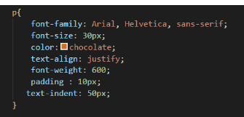
CSS Paragraph
Paragraph comes with default style
margin (top and bottom ) : 16px
font-size : 16px
Paragraph is a block element
Usually we apply the following styles for <p>
font-family ( used to set the font type)
font-size ( used to set the font size , default is 16px )
font-weight ( used to set the boldness )
color ( used to set the color )
margin ( used to set the margin )
padding ( used to set the padding )
text-align (used to align the text )

Slide 17
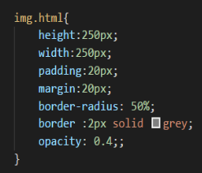
CSS Image
Images are inline elements , they occupy the space based on the size of the image ( height and width )
Usually we apply the following styles for <img>
height
width
Max-width
Border-radius
opacity
Border
box-shadow

Slide 18
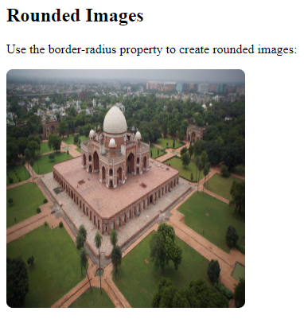
CSS Image
<!DOCTYPE html>
<html>
<head>
<style>
img {
border-radius: 8px;
border: 5px solid #ddd;
}
</style>
</head>
<body>
<h2>Rounded Images</h2>
<p>Use the border-radius property to create rounded images:</p>
<img src="paris.jpg" alt="Paris" width="300" height="300">
</body>
</html>

Slide 19
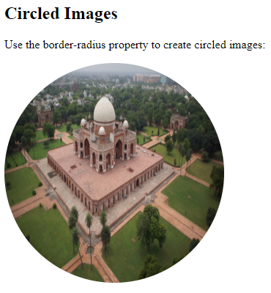
CSS Image
<!DOCTYPE html>
<html>
<head>
<style>
img {
border-radius: 50%;
}
</style>
</head>
<body>
<h2>Circled Images</h2>
<p>Use the border-radius property to create circled images:</p>
<img src="paris.jpg" alt="Paris" width="300" height="300">
</body>
</html>

Slide 20
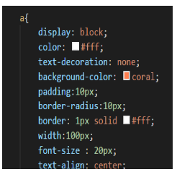
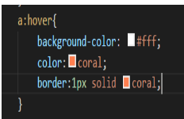
CSS Hyperlink
<a> tag comes with default styling for visited, non-visited, active
Usually we apply the following styles for <a>
Display ( from inline to block )
Color
text-decoration
width
margin
background
border-radius
Border
text-decoration

Slide 21
CSS Hyperlink
<!DOCTYPE html>
<html>
<head>
<style>
a.one:link {color:#ff0000;}
a.one:visited {color:#0000ff;}
a.one:hover {color:#ffcc00;}
a.two:link {color:#ff0000;}
a.two:visited {color:#0000ff;}
a.two:hover {font-size:150%;}
a.three:link {color:#ff0000;}
a.three:visited {color:#0000ff;}
a.three:hover {background:#66ff66;}
a.four:link {color:#ff0000;}
a.four:visited {color:#0000ff;}
a.four:hover {font-family:monospace;}
a.five:link {color:#ff0000;text-decoration:none;}
a.five:visited {color:#0000ff;text-decoration:none;}
a.five:hover {text-decoration:underline;}
</style>
</head>
<body>
<p>Mouse over the links and watch them change layout:</p>
<p><b><a class="one" href="default.asp" target="_blank">This link changes color</a></b></p>
<p><b><a class="two" href="default.asp" target="_blank">This link changes font-size</a></b></p>
<p><b><a class="three" href="default.asp" target="_blank">This link changes background-color</a></b></p>
<p><b><a class="four" href="default.asp" target="_blank">This link changes font-family</a></b></p>
<p><b><a class="five" href="default.asp" target="_blank">This link changes text-decoration</a></b></p>
</body>
</html>

Slide 22
CSS Border
The CSS border property defines a border around an HTML element:

Slide 23
HTML <div> Tag
The <div> tag defines a division or a section in an HTML document.
The <div> element is often used as a container for other HTML elements to style them with CSS or to perform certain tasks with JavaScript.
<!DOCTYPE html>
<html>
<body>
<p>This is some text.</p>
<div style="background-color:lightblue">
<h3>This is a heading in a div element</h3>
<p>This is some text in a div element.</p>
</div>
<p>This is some text.</p>
</body>
</html>

Slide 24
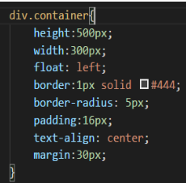
Div CSS
Usually we will apply the following styles for div
height
width
float
display
margin
padding
text-align
border
border-radius

Slide 25
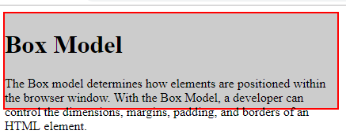
Div CSS
<html>
<head>
<style type="text/css">
#box {
width: 420px;
height:120;
border-width: 2px;
border-style:solid;
border-color:red;
background: #CCC;
}
</style>
</head>
<body>
<div id="box">
<h1>Box Model</h1>
<p>
The Box model determines how elements are positioned within the
browser window. With the Box Model, a developer can control the
dimensions, margins, padding, and borders of an HTML element.
</p>
</div>
</body>
</html>

Slide 26
Styling lists
Usually we use list to display the navigation lists
Uses the following styles:
ul {
text-decoration : none;
margin : 0 auto;
}
ul li{
display : inline;
padding : 1em 0;
}

Slide 27
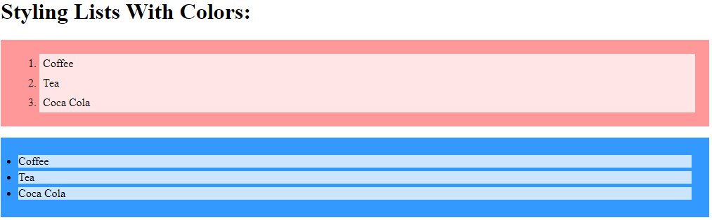
Styling lists
<!DOCTYPE html>
<html>
<head>
<style>
ol {
background: #ff9999;
padding: 20px;
}
ul {
background: #3399ff;
padding: 20px;
}
ol li {
background: #ffe5e5;
padding: 5px;
margin-left: 35px;
}
ul li {
background: #cce5ff;
margin: 5px;
}
</style>
</head>
<body>
<h1>Styling Lists With Colors:</h1>
<ol>
<li>Coffee</li>
<li>Tea</li>
<li>Coca Cola</li>
</ol>
<ul>
<li>Coffee</li>
<li>Tea</li>
<li>Coca Cola</li>
</ul>
</body>
</html>

Slide 28
Styling table
<!DOCTYPE html>
<html>
<head>
<style>
table, td, th {
border: 1px solid black;
}
table {
border-collapse: collapse;
width: 100%;
}
th {
height: 50px;
}
</style>
</head>
<body>
<table>
<tr>
<th>Firstname</th>
<th>Lastname</th>
<th>Savings</th>
</tr>
<tr>
<td>Peter</td>
<td>Griffin</td>
<td>$100</td>
</tr>
<tr>
<td>Lois</td>
<td>Griffin</td>
<td>$150</td>
</tr>
</table></body></html>
<!DOCTYPE html>
<html>
<head>
<style>
table, th, td {
border: 1px solid black;
}
</style>
</head>
<body>
<h2>Add a border to a table:</h2>
<table>
<tr>
<th>Firstname</th>
<th>Lastname</th>
</tr>
<tr>
<td>Peter</td>
<td>Griffin</td>
</tr>
</table> </body> </html>

Slide 29
Styling table
<!DOCTYPE html>
<html>
<head>
<style>
table, td, th {
border: 1px solid #ddd;
text-align: left;
}
table {
border-collapse: collapse;
width: 100%;
}
th, td {
padding: 15px;
}
</style>
</head>
<body>
<table>
<tr> <th>Firstname</th> <th>Lastname</th> <th>Savings</th> </tr>
<tr> <td>Peter</td> <td>Griffin</td> <td>$100</td> </tr>
</table> </body> </html>
<!DOCTYPE html>
<html>
<head>
<style>
table {
border-collapse: collapse;
width: 100%;
}
th, td {
padding: 8px;
text-align: left;
border-bottom: 1px solid #ddd;
}
tr:hover {background-color:#f5f5f5;}
</style>
</head>
<body>
<h2>Hoverable Table</h2>
<p>Move the mouse over the table rows to see the effect.</p>
<table>
<tr> <th>First Name</th> <th>Last Name</th> <th>Points</th> </tr>
<tr> <td>Peter</td> <td>Griffin</td> <td>$100</td> </tr>
</table> </body> </html>

Slide 30
CSS with Form
<!DOCTYPE html>
<html>
<style>
input[type=text], select {
width: 100%;
padding: 12px 20px;
margin: 8px 0;
display: inline-block;
border: 1px solid #ccc;
border-radius: 4px;
box-sizing: border-box;
}
input[type=submit] {
width: 100%;
background-color: #4CAF50;
color: white;
padding: 14px 20px;
margin: 8px 0;
border: none;
border-radius: 4px;
cursor: pointer;
}
input[type=submit]:hover {
background-color: #45a049;
}
div {
border-radius: 5px;
background-color: #f2f2f2;
padding: 20px;
}
</style>
<body>
<h3>Using CSS to style an HTML Form</h3>
<div>
<form action="/action_page.php">
<label for="fname">First Name</label>
<input type="text" id="fname" name="firstname" placeholder="Your name..">
<label for="lname">Last Name</label>
<input type="text" id="lname" name="lastname" placeholder="Your last name..">
<label for="country">Country</label>
<select id="country" name="country">
<option value="australia">Australia</option>
<option value="canada">Canada</option>
<option value="usa">USA</option>
</select>
<input type="submit" value="Submit">
</form>
</div>
</body> </html>

