Slide 1
HBase: The Hadoop Database

Slide 2
What is Hbase?
It is an open-source platform and is horizontally scalable.
It is the database which distributed based on the column-oriented.
It is built on topmost of the Hadoop file system.
It is based on the nonrelational database system (NoSQL).
HBase is a true and faithful, open-source implementation devised on Google’s Bigtable.

Slide 3
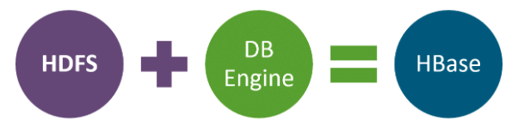
Hbase
Column-oriented databases are those databases that store the data tables in terms of sections or columns of data instead of rows of data.
HBase manages to shift the load and failures elegantly and clearly to the client-side. Scalability is built-in and clusters can be grown or shrunk while the system is still production stage.

Slide 4
Why do we need HBase?
There are number of limitations in RDBMS are as follows–
Not preferable for unstructured data.
Works very well for a limited number of records
Doesn’t contain de-normalized data.
Schema-oriented database.

Slide 5
Features : HBase
The features of HBase are as follows–
Easy java API for a client for better understanding.
Integrates with Hadoop, both as a source and destination.
It is schema-less so it doesn’t follow the concept of fixed columns schema and defines only column families.
Good only for semi-structured as well as structured data.
Automatic failure support.
Provides data replication or copy across clusters.

Slide 6
Characteristics : HBase
HBase is a type of NoSQL database and is classified as a key-value store. Some characteristics of HBase are:
Value is identified with a key.
Both key and values are Byte Array, which means binary formats can be stored easily.
Values are stored in key-orders.
Values can be quickly accessed by their keys

Slide 7
Architecture : HBase Cluster
It contains the following components:
Zookeeper –Centralized services which are used to preserve configuration information for Hbase.
Catalog Tables – Keep track of locations region servers.
Master – Monitors all the region server instances in the single cluster
Region Servers – It is responsible for serving and managing regions
Region – A set of tables belonging to the table column and holds a subset of table’ rows based on partition.

Slide 8
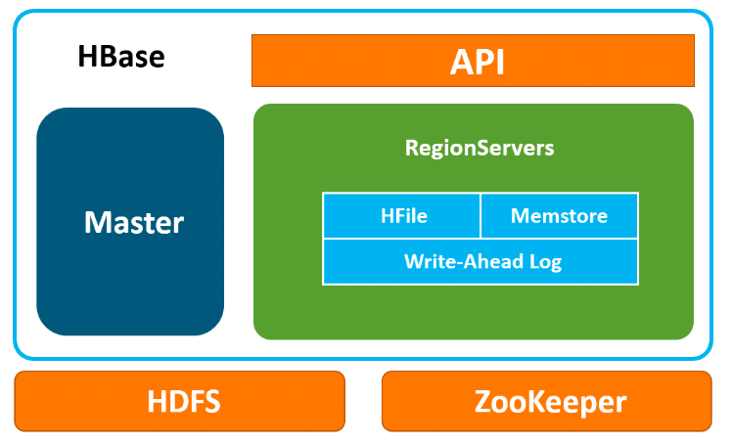
Architecture : HBase Cluster
It contains the following components:
Zookeeper –Centralized services which are used to preserve configuration information for Hbase.
Catalog Tables – Keep track of locations region servers.
Master – Monitors all the region server instances in the single cluster
Region Servers – It is responsible for serving and managing regions
Region – A set of tables belonging to the table column and holds a subset of table’ rows based on partition.

Slide 9
Applications : HBase
There are a number of HBase applications across various industries, from healthcare to e-commerce to sports sector. For instance:
In the healthcare sector, HBase is used for storing genome sequences and disease history of people or a particular area.
In the field of e-commerce, HBase is used for storing logs about customer search history and it also performs analytics and target advertisement for better business insights.
In sports, HBase is used to store match details and the history of each match. It uses this data for better prediction.

Slide 10
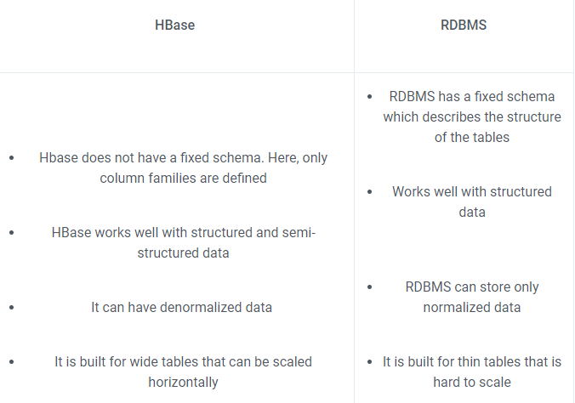
HBase vs RDBMS

Slide 11
Demo: HBase
list //Lists down all the tables present in HBase
create ‘newtbl’, ‘knowledge’ //Creates a new table
describe ‘newtbl’ //Checks if the table was created
status ‘summary’ //Checks the status of HBase

Slide 12
Demo: HBase
Now that we have created a new table, let’s put some data into it.
put ‘newtbl’, ‘r1’, ‘knowledge:sports’, ‘cricket’
put ‘newtbl’, ‘r1’, ‘knowledge:science’, ‘chemistry’
put ‘newtbl’, ‘r1’, ‘knowledge:science’, ‘physics’
put ‘newtbl’, ‘r2’, ‘knowledge:economics’, ‘macro economics’
put ‘newtbl’, ‘r2’, ‘knowledge:music’, ‘pop music’

Slide 13

Demo: HBase
Let’s now list the contents of the table by typing:
scan ‘newtbl’

Slide 14

Demo: HBase
get ‘newtbl’, ‘r1’//Displays the results for r1

