Slide 1

MapReduce

Slide 2
What is MapReduce?
MapReduce is a Java-based, distributed execution framework within the Apache Hadoop Eco System.
It takes away the complexity of distributed programming by exposing two processing steps that developers implement:
1) Map
2) Reduce.
In the Mapping step, data is split between parallel processing tasks. Transformation logic can be applied to each chunk of data.
In the Reduce phase takes over to handle aggregating data from the Map set..
In general, MapReduce uses HDFS for both input and output.
However, some technologies built on top of it, such as Sqoop, allow access to relational systems.

Slide 3
How does MapReduce work?
A MapReduce system is usually composed of three steps.
The MapReduce operations are:
Map: The input data is first split into smaller blocks.
The Hadoop framework then decides how many mappers to use, based on the size of the data to be processed and the memory block available on each mapper server.
Each block is then assigned to a mapper for processing.
Each ‘worker’ node applies the map function to the local data and writes the output to temporary storage.
The primary (master) node ensures that only a single copy of the redundant input data is processed.

Slide 4
How does MapReduce work?
Shuffle, combine and partition: worker nodes redistribute data based on the output keys (produced by the map function), such that all data belonging to one key is located on the same worker node.
As an optional process the combiner (a reducer) can run individually on each mapper server to reduce the data on each mapper even further making reducing the data footprint and shuffling and sorting easier.
Partition is the process that decides how the data has to be presented to the reducer and also assigns it to a particular reducer.

Slide 5
How does MapReduce work?
Reduce: A reducer cannot start while a mapper is still in progress.
Worker nodes process each group of <key,value> pairs output data, in parallel to produce <key,value> pairs as output.
All the map output values that have the same key are assigned to a single reducer, which then aggregates the values for that key.
Unlike the map function which is mandatory to filter and sort the initial data, the reduce function is optional.

Slide 6
Advantages of MapReduce
Scalability
Flexibility
Security and authentication
Faster processing of data
Very simple programming model
Availability and resilient nature

Slide 7
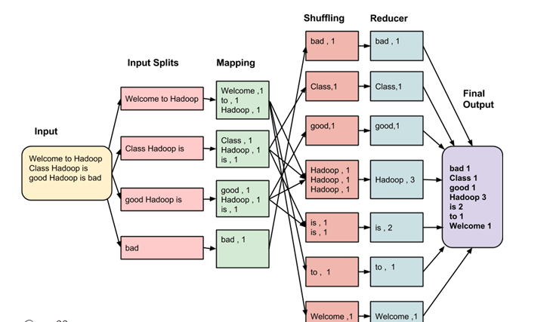
MapReduce Architecture :Example
Consider input:
Welcome to Hadoop Class
Hadoop is good
Hadoop is bad

Slide 8
MapReduce Architecture :Example
The data goes through the following phases of MapReduce in Big Data
Input Splits:
An input to a MapReduce in Big Data job is divided into fixed-size pieces called input splits Input split is a chunk of the input that is consumed by a single map

Slide 9
MapReduce Architecture :Example
The data goes through the following phases of MapReduce in Big Data
Mapping
This is the very first phase in the execution of map-reduce program. In this phase data in each split is passed to a mapping function to produce output values.
In example, a job of mapping phase is to count a number of occurrences of each word from input splits and prepare a list in the form of <word, frequency>

Slide 10
MapReduce Architecture :Example
The data goes through the following phases of MapReduce in Big Data
Shuffling
This phase consumes the output of Mapping phase. Its task is to consolidate the relevant records from Mapping phase output.
In example, the same words are clubed together along with their respective frequency.

Slide 11
MapReduce Architecture :Example
The data goes through the following phases of MapReduce in Big Data
Reducing
In this phase, output values from the Shuffling phase are aggregated.
This phase combines values from Shuffling phase and returns a single output value.
In short, this phase summarizes the complete dataset.

Slide 12
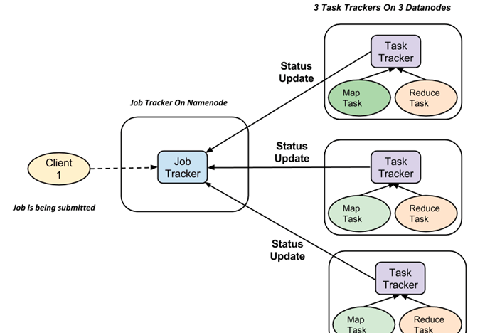
How MapReduce Organizes Work?
It divides the job into tasks.
There are two types of tasks:
Map tasks (Splits & Mapping)
Reduce tasks (Shuffling, Reducing)
The complete execution process (execution of Map and Reduce tasks, both) is controlled by two types of entities called a
Jobtracker: Acts like a master (responsible for complete execution of submitted job)
Multiple Task Trackers: Acts like slaves, each of them performing the job
For every job submitted for execution in the system
There is one Jobtracker that resides on Namenode
There are multiple tasktrackers which reside on Datanode

Slide 13
How MapReduce Organizes Work?
A job is divided into multiple tasks which are then run onto multiple data nodes in a cluster.
It is the responsibility of job tracker to coordinate the activity by scheduling tasks to run on different data nodes.
Execution of individual task is then to look after by task tracker, which resides on every data node executing part of the job.
Task tracker’s responsibility is to send the progress report to the job tracker.
In addition, task tracker periodically sends ‘heartbeat’ signal to the Jobtracker so as to notify him of the current state of the system.
Thus job tracker keeps track of the overall progress of each job.
In the event of task failure, the job tracker can reschedule it on a different task tracker.

Slide 15
Hadoop YARN

Slide 16
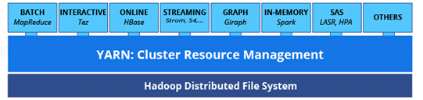
What is Hadoop YARN?
Apache Hadoop YARN (Yet Another Resource Negotiator) is a resource management layer in Hadoop.
YARN came into the picture with the introduction of Hadoop 2.x.
It allows various data processing engines such as interactive processing, graph processing, batch processing, and stream processing to run and process data stored in HDFS (Hadoop Distributed File System).

Slide 17
Why is YARN Hadoop Used?
Despite being thoroughly proficient at data processing and computations, Hadoop 1.x had some shortcomings like delays in batch processing, scalability issues, etc. as it relied on MapReduce for processing big datasets.
With YARN, Hadoop is now able to support a variety of processing approaches and has a larger array of applications.
Hadoop YARN clusters are now able to run stream data processing and interactive querying side by side with MapReduce batch jobs.
YARN framework runs even the non-MapReduce applications, thus overcoming the shortcomings of Hadoop 1.x.

Slide 18
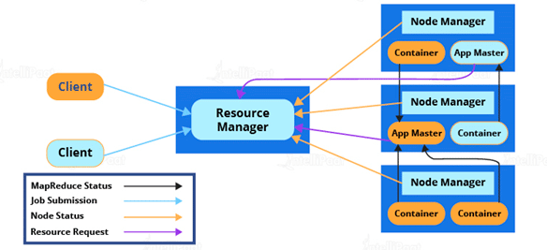
Hadoop YARN Architecture
Despite being thoroughly proficient at data processing and computations, Hadoop 1.x had some shortcomings like delays in batch processing, scalability issues, etc. as it relied on MapReduce for processing big datasets.
With YARN, Hadoop is now able to support a variety of processing approaches and has a larger array of applications.
Hadoop YARN clusters are now able to run stream data processing and interactive querying side by side with MapReduce batch jobs.
YARN framework runs even the non-MapReduce applications, thus overcoming the shortcomings of Hadoop 1.x.

Slide 19
Hadoop YARN Architecture
Resource Manager
Resource Manager is the master daemon of YARN.
responsible for managing several other applications, along with the global assignments of resources such as CPU and memory, used for job scheduling.
Resource Manager has two components:
Scheduler: Schedulers’ task is to distribute resources to the running applications.
It only deals with the scheduling of tasks and hence it performs no tracking and no monitoring of applications.
Application Manager: The application Manager manages applications running in the cluster.
Tasks, such as the starting of Application Master or monitoring, are done by the Application Manager.

Slide 20
Hadoop YARN Architecture
Node Manager
Node Manager is the slave daemon of YARN.
It has the following responsibilities:
Node Manager has to monitor the container’s resource usage, along with reporting it to the Resource Manager.
The health of the node on which YARN is running is tracked by the Node Manager.
It takes care of each node in the cluster while managing the workflow, along with user jobs on a particular node.
It keeps the data in the Resource Manager updated
Node Manager can also destroy or kill the container if it gets an order from the Resource Manager to do so.

Slide 21
Hadoop YARN Architecture
Application Master
Every job submitted to the framework is an application, and every application has a specific Application Master associated with it. Application Master performs the following tasks:
It coordinates the execution of the application in the cluster, along with managing the faults.
It negotiates resources from the Resource Manager.
It works with the Node Manager for executing and monitoring other components’ tasks.
At regular intervals, heartbeats are sent to the Resource Manager for checking its health, along with updating records according to its resource demands.

Slide 22
Hadoop YARN Architecture
Container
A container is a set of physical resources (CPU cores, RAM, disks, etc.) on a single node.
The tasks of a container are listed below:
grants the right to an application to use a specific amount of resources (memory, CPU, etc.) on a specific host.

Slide 23
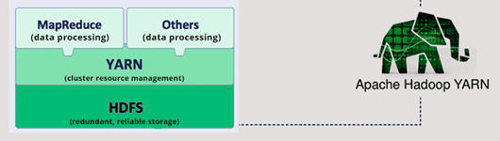
How does Apache Hadoop YARN work?
YARN separates HDFS and MapReduce, making the Hadoop environment more suitable for applications that can’t wait for the batch processing jobs to get finished.
This architecture lets you process data with multiple processing engines using real-time streaming, interactive SQL, batch processing, handling of data stored in a single platform, and working with analytics in a completely different manner.
It can be considered as the basis of the next generation of the Hadoop Eco System.

Slide 24
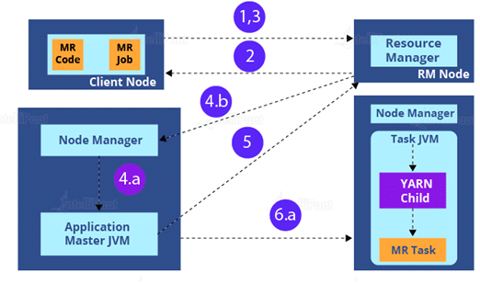
How is an application submitted in Hadoop YARN?
1. Submit the job
2. Get an application ID
3. Retrieval of the context of application submission
Start Container Launch
Launch Application Master
4. Allocate Resources.
Container
Launching
5. Executing

Slide 25
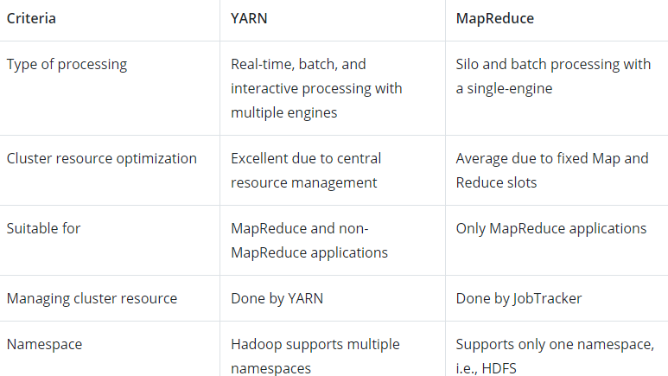
YARN vs MapReduce
In Hadoop 1.x, the batch processing framework MapReduce was closely paired with HDFS.
With the addition of YARN to these two components, giving birth to Hadoop 2.x, came a lot of differences in how Hadoop worked. Let’s go through these differences.

