Slide 1
Pig

Slide 2
What is Pig in Hadoop?
Pig Hadoop is basically a high-level programming language that is helpful for the analysis of huge datasets.
Pig Hadoop was developed by Yahoo!
Pig is generally used with Hadoop to perform a lot of data administration operations.

Slide 3
Why Apache Pig?
Apache Pig is used with Hadoop and Hadoop is based on the Java programming language.
The need for Apache Pig came up when many programmers weren’t comfortable with Java and were facing a lot of struggle working with Hadoop, especially, when MapReduce tasks had to be performed.
Apache Pig came into the Hadoop world as a boon for all such programmers.

Slide 4
Why Apache Pig?
After the introduction of Pig Latin, now, programmers are able to work on MapReduce tasks without the use of complicated codes as in Java.
To reduce the length of codes, the multi-query approach is used by Apache Pig, which results in reduced development time by 16 folds.
Since Pig Latin is very similar to SQL, it is comparatively easy to learn Apache Pig if have little knowledge of SQL.
For supporting data operations such as filters, joins, ordering, etc., Apache Pig provides several in-built operations.

Slide 5
Features of Pig Hadoop
There are several features of Apache Pig:
In-built operators: Apache Pig provides a very good set of operators for performing several data operations like sort, join, filter, etc.
Ease of programming: Since Pig Latin has similarities with SQL, it is very easy to write a Pig script.
Automatic optimization: The tasks in Apache Pig are automatically optimized. This makes the programmers concentrate only on the semantics of the language.
Handles all kinds of data: Apache Pig can analyze both structured and unstructured data and store the results in HDFS.

Slide 6
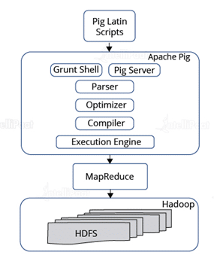
Apache Pig Architecture
Pig Hadoop framework has four main components:
Parser: When a Pig Latin script is sent to Hadoop Pig, it is first handled by the parser. The parser is responsible for checking the syntax of the script, along with other miscellaneous checks. Parser gives an output in the form of a Directed Acyclic Graph (DAG) that contains Pig Latin statements, together with other logical operators represented as nodes.
Optimizer: After the output from the parser is retrieved, a logical plan for DAG is passed to a logical optimizer. The optimizer is responsible for carrying out the logical optimizations.
Compiler: The role of the compiler comes in when the output from the optimizer is received. The compiler compiles the logical plan sent by the optimizing The logical plan is then converted into a series of MapReduce tasks or jobs.
Execution Engine: After the logical plan is converted to MapReduce jobs, these jobs are sent to Hadoop in a properly sorted order, and these jobs are executed on Hadoop for yielding the desired result.

Slide 7
Components of Pig
There are two major components of the Pig:
Pig Latin script language
The Pig Latin script is a procedural data flow language.
It contains syntax and commands that can be applied to implement business logic.
Examples of Pig Latin are LOAD and STORE.
A runtime engine
The runtime engine is a compiler that produces sequences of MapReduce programs.
It uses HDFS to store and retrieve data.
It is also used to interact with the Hadoop system (HDFS and MapReduce).

Slide 9
Hadoop Hive

Slide 10
What is Hive in Hadoop?
To avoid tedious task using MapReduce jobs, using Hadoop Hive we can just go ahead and submit SQL queries and perform MapReduce jobs.
So, if we are comfortable with SQL, then Hive is the right tool for us as we will be able to work on MapReduce tasks efficiently.
Similar to Pig, Hive has its own language, called HiveQL (HQL).
similar to SQL.
HQL translates SQL-like queries into MapReduce jobs, like what Pig Latin does.
The best part is that owe dn’t need to learn Java to work with Hadoop Hive.

Slide 11
Applications of Hive
Facebook uses Hive to address its various requirements, like running thousands of tasks on the cluster, along with thousands of users for a huge variety of applications.
Since Facebook has a huge amount of raw data, i.e., 2 PB, Hadoop Hive is used for storing this voluminous data.
It regularly loads around 15 TB of data on a daily basis.
Now, many companies, such as IBM, Amazon, Yahoo!, and many others, are also using and developing Hive.

Slide 12
Why do we need Hadoop Hive?
Basically, there were a lot of challenges faced by Facebook before they had finally implemented Apache Hive.
One of those challenges was the size of data that has been generated on a daily basis. Traditional databases, such as RDBMS and SQL, weren’t able to handle the pressure of such a huge amount of data.
It started using MapReduce in the beginning to overcome this problem.
But, it was very difficult to work with MapReduce as it needed mandatory programming expertise in SQL.
Later on, Facebook realized that Hadoop Hive had the potential to actually overcome the challenges it faced.

Slide 13
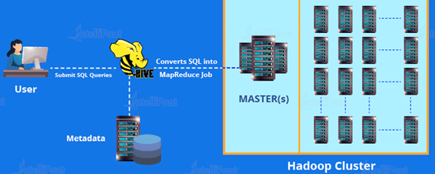
Hive Architecture

Slide 14
Hive Architecture
The components of Apache Hive are as follows:
Driver: The driver acts as a controller receiving HiveQL statements. It begins the execution of statements by creating sessions.
Metastore: A metastore stores metadata of all tables. Since Hive includes partition metadata, it helps the driver in tracking the progress of various datasets that have been distributed across a cluster, hence keeping track of data.
Compiler: The compiler performs the compilation of a HiveQL query. It transforms the query into an execution plan that contains tasks.
Optimizer: An optimizer performs many transformations on the execution plan for providing an optimized DAG.
Executor: After the processes of compilation and optimization are completed, the execution of the task is done by the executor. It is responsible for pipelining the tasks.

Slide 15
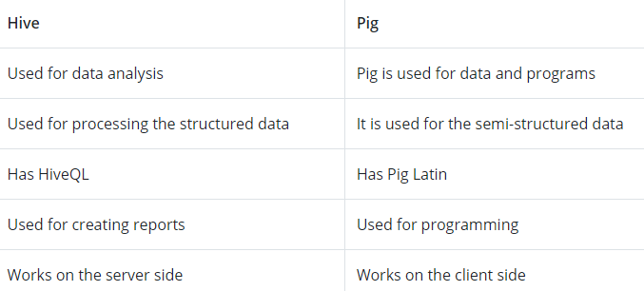
Hive VS PIG

Slide 16
Hive VS PIG
The components of Apache Hive are as follows:
Driver: The driver acts as a controller receiving HiveQL statements. It begins the execution of statements by creating sessions.
Metastore: A metastore stores metadata of all tables. Since Hive includes partition metadata, it helps the driver in tracking the progress of various datasets that have been distributed across a cluster, hence keeping track of data.
Compiler: The compiler performs the compilation of a HiveQL query. It transforms the query into an execution plan that contains tasks.
Optimizer: An optimizer performs many transformations on the execution plan for providing an optimized DAG.
Executor: After the processes of compilation and optimization are completed, the execution of the task is done by the executor. It is responsible for pipelining the tasks.

Slide 17
Features : Apache Hive
Hive provides easy data summarization and analysis and query support.
Hive supports external tables, making it feasible to process data without having to store it into HDFS.
Hadoop can process external data using Hive.

Slide 18
Limitations : Apache Hive
Apache Hive doesn’t offer any real-time queries.
Online transaction processing is not well-supported by Apache Hive.
There can be a delay while performing Hive queries.

Slide 19
Example : Apache Hive
Suppose there is a json file test.json with following keys ecode, ename, sal
We need to retrieve data from json file and make some analytical query:
1) create table json_sample(str string);
2) load data inpath 'home/hduser/test.json' into table json_sample;
3) select * from json_sample;
4) select get_json_object(str,'$.ecode') as ecode, get_json_object(str,'$.ename') as ename ,get_json_object(str,'$.sal') as salary from json_sample;

Slide 20
Hive in Real time projects – When and Where to Use
When
When working with strong and powerful statistical functions on Hadoop ecosystem
When working with structured and Semi structured data processing
As data warehouse tool with Hadoop
Real time data ingestion with HBASE, Hive can be used
Where
For ease usage of ETL and data warehousing tool
To provide SQL type environment and to query like SQL using HIVEQL
To use and deploy custom specified map and reducer scripts for the specific client requirements

