Slide 1
DevOps
Development and operations

Slide 2
Introduction:
Hello, everyone! Welcome to this DevOps journey.
Today, we're going to delve into the fascinating world of DevOps, exploring key concepts and tools that play a crucial role in modern software development.
If you're already familiar with Linux fundamentals and have a basic understanding of Git, you're in the right place. Let's get started

Slide 3
Introduction to DevOps
First things first, what is DevOps? DevOps is not just a set of tools; it's a cultural and philosophical approach to software development and IT operations. It aims to break down silos between development and operations teams, fostering collaboration and efficiency throughout the software development life cycle.

Slide 4
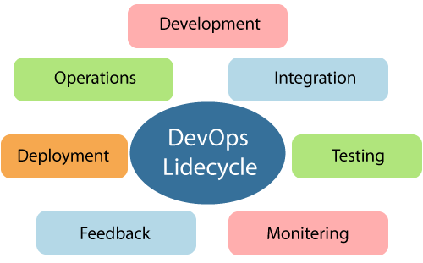
DevOps Lifecycle:
DevOps defines an agile relationship between operations and Development. It is a process that is practiced by the development team and operational engineers together from beginning to the final stage of the product. These are the steps mentioned above. Continuous Development, Continuous Integration, Continuous Testing, Continuous Monitoring, Continuous Feedback, Continuous Deployment, Continuous Operations.

Slide 5
Introduction to Docker & Containerization:
Ever heard of Docker? It's a star player in containerization. Think of it as a lightweight, portable package for our applications. Docker makes sure our code runs the same everywhere, from development to production.

Slide 6
CI/CD with Jenkins:
Jenkins is the rockstar of continuous integration and continuous deployment. It automates the building, testing, and deployment of our code. That means faster releases and fewer headaches.

Slide 7
Introduction to Kubernetes & Container Orchestration:
Now, enter Kubernetes, the maestro of container orchestration. It automates the deployment, scaling, and management of containerized applications. It's like having a symphony conductor for your containers.
In the upcoming videos, we'll deep-dive into each of these topics. We'll explore Docker's magic, dance with Jenkins in CI/CD, and orchestrate containers with Kubernetes. Subscribe, hit that like button, and let's embark on this DevOps journey together.

Slide 8
Explanation Link:

Slide 9


