Slide 1
Introduction to Computer Graphics with WebGL
Ed Angel
Professor Emeritus of Computer Science
Founding Director, Arts, Research, Technology and Science Laboratory
University of New Mexico
Angel and Shreiner: Interactive Computer Graphics 7E © Addison-Wesley 2015

Slide 2
What is Computer Graphics?
Ed Angel
Professor Emeritus of Computer Science,
University of New Mexico
Angel and Shreiner: Interactive Computer Graphics 7E © Addison-Wesley 2015

Slide 3
Computer Graphics
Computer graphics deals with all aspects of creating images with a computer
  Hardware
  Software
  Applications
Angel and Shreiner: Interactive Computer Graphics 7E © Addison-Wesley 2015

Slide 4

Example
Where did this image come from?
What hardware/software did we use to produce it?
Angel and Shreiner: Interactive Computer Graphics 7E © Addison-Wesley 2015

Slide 5
Preliminary Answer
Application: The object is an artist’s rendition of the sun for an animation to be shown in a domed environment (planetarium)
Software: Maya for modeling and rendering but Maya is built on top of OpenGL
Hardware: PC with graphics card for modeling and rendering
Angel and Shreiner: Interactive Computer Graphics 7E © Addison-Wesley 2015

Slide 6
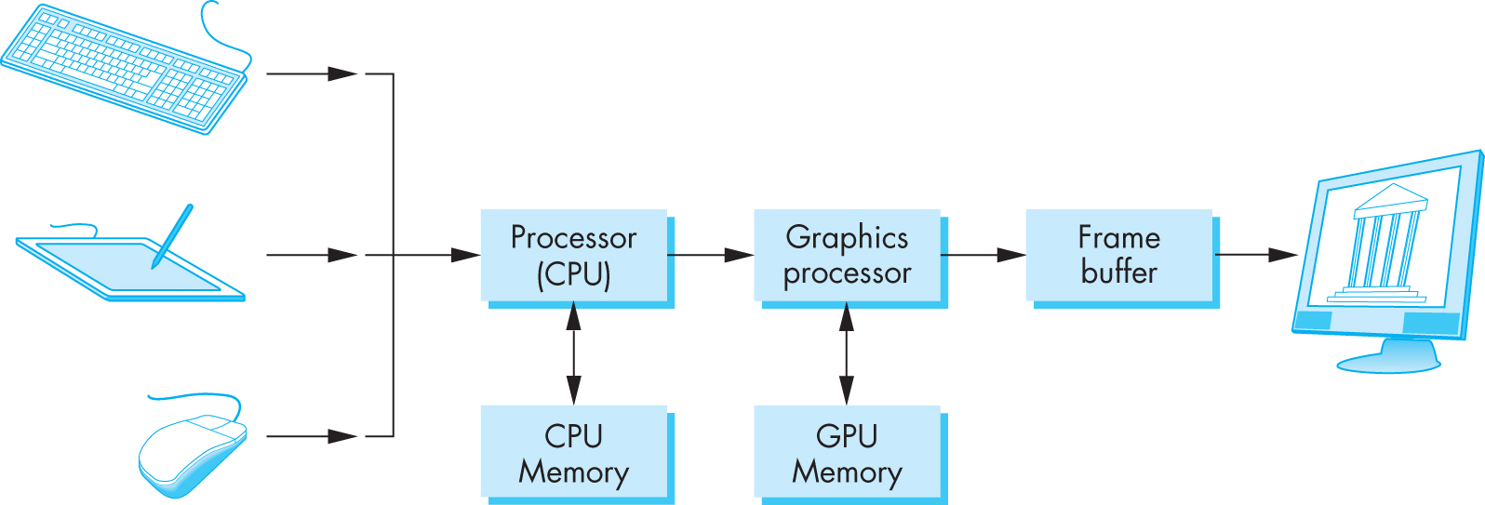
Basic Graphics System
Output device
Input devices
Image formed in frame buffer
Angel and Shreiner: Interactive Computer Graphics 7E © Addison-Wesley 2015

Slide 7
Computer Graphics: 1950-1960
Computer graphics goes back to the earliest days of computing
  Strip charts
  Pen plotters
  Simple displays using A/D converters to go from computer to calligraphic CRT
Cost of refresh for CRT too high
  Computers slow, expensive, unreliable
Angel and Shreiner: Interactive Computer Graphics 7E © Addison-Wesley 2015

Slide 8
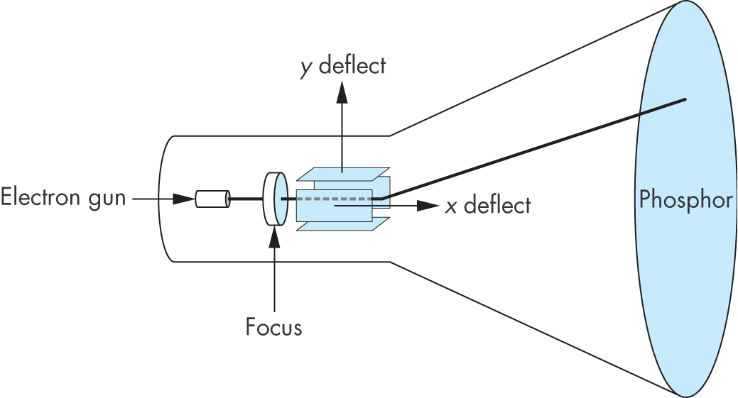
Cathode Ray Tube (CRT)
Can be used either as a line-drawing device (calligraphic) or to display contents of frame buffer (raster mode)
Angel and Shreiner: Interactive Computer Graphics 7E © Addison-Wesley 2015

Slide 9
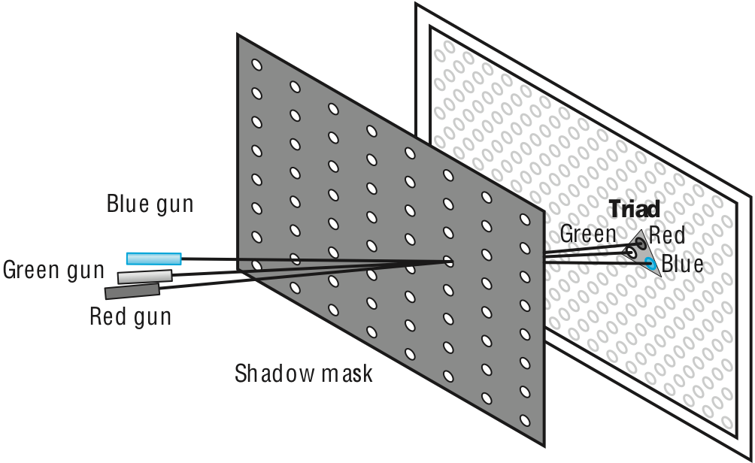
Shadow Mask CRT
Angel and Shreiner: Interactive Computer Graphics 7E © Addison-Wesley 2015

Slide 10
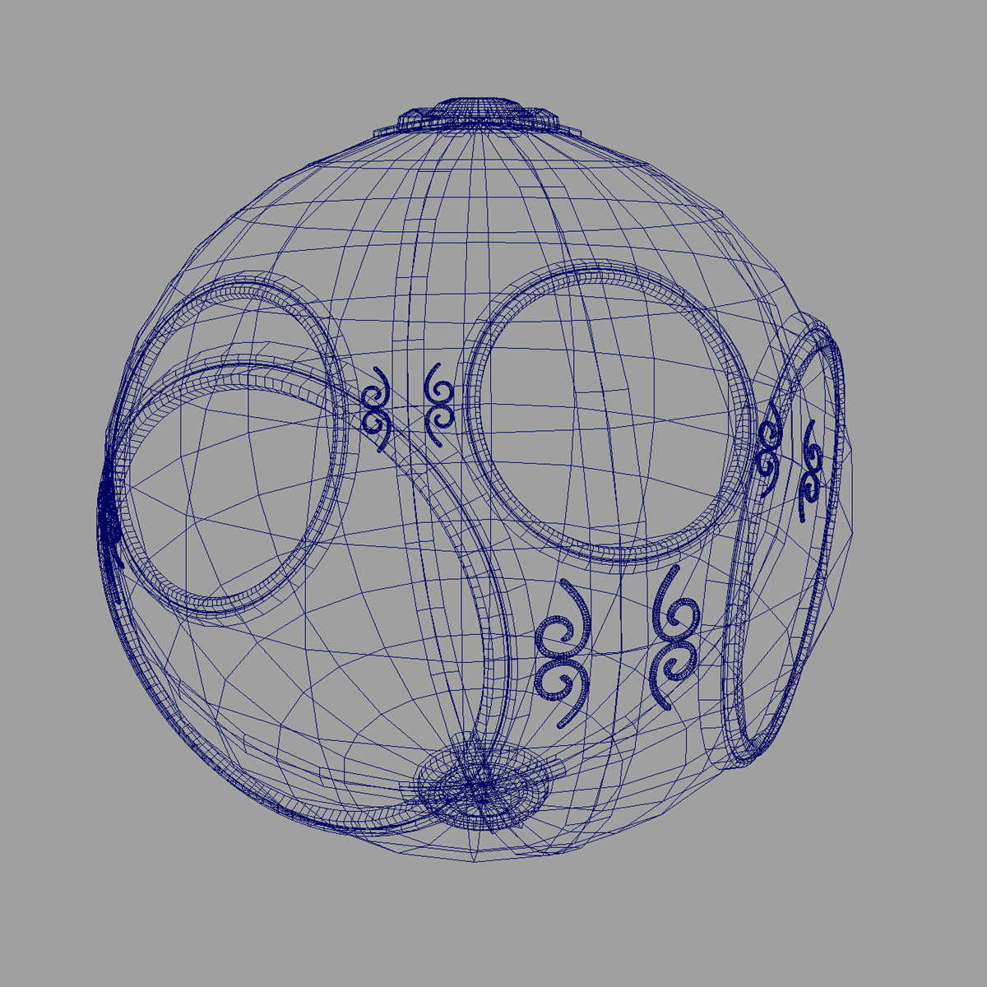
Computer Graphics: 1960-1970
Wireframe graphics
  Draw only lines
Sketchpad
Display Processors
Storage tube
wireframe representation
of sun object
Angel and Shreiner: Interactive Computer Graphics 7E © Addison-Wesley 2015

Slide 11
Sketchpad
Ivan Sutherland’s PhD thesis at MIT
  Recognized the potential of man-machine interaction
  Loop
    Display something
    User moves light pen
    Computer generates new display
  Sutherland also created many of the now common algorithms for computer graphics
Angel and Shreiner: Interactive Computer Graphics 7E © Addison-Wesley 2015

Slide 12
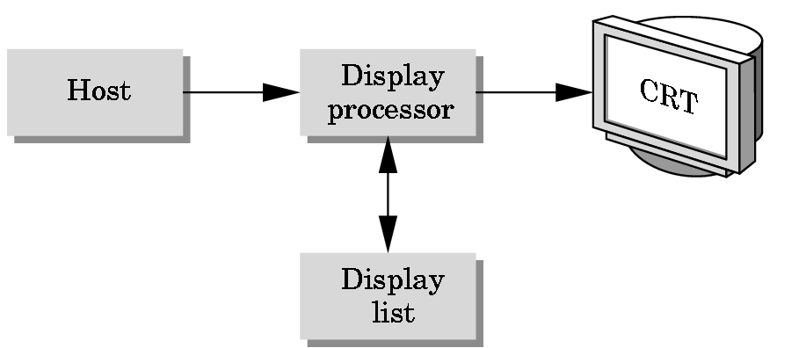
Display Processor
Rather than have the host computer try to refresh display use a special purpose computer called a display processor (DPU)
Graphics stored in display list (display file) on display processor
Host compiles display list and sends to DPU
Angel and Shreiner: Interactive Computer Graphics 7E © Addison-Wesley 2015

Slide 13
Computer Graphics: 1970-1980
Raster Graphics
Beginning of graphics standards
  IFIPS
    GKS: European effort
      Becomes ISO 2D standard
    Core: North American effort
      3D but fails to become ISO standard
Workstations and PCs
Angel and Shreiner: Interactive Computer Graphics 7E © Addison-Wesley 2015

Slide 14
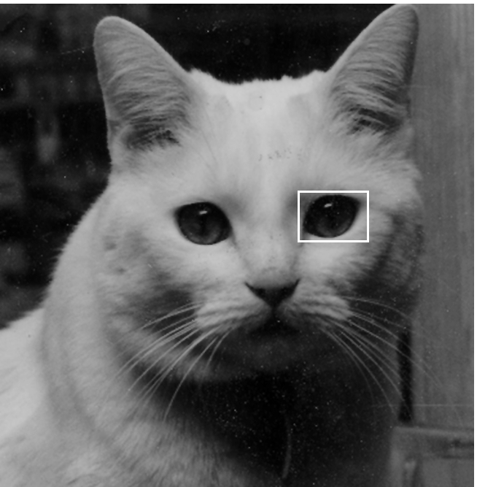
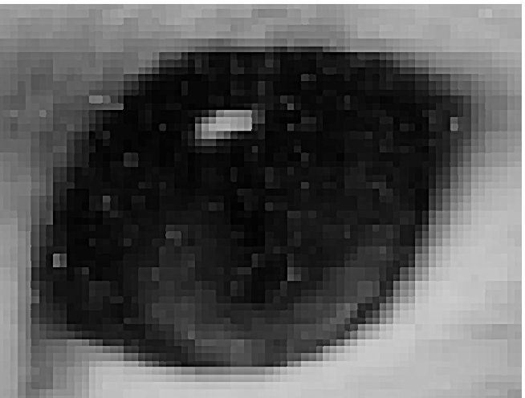
Raster Graphics
Image produced as an array (the raster) of picture elements (pixels) in the frame buffer
Angel and Shreiner: Interactive Computer Graphics 7E © Addison-Wesley 2015

Slide 15
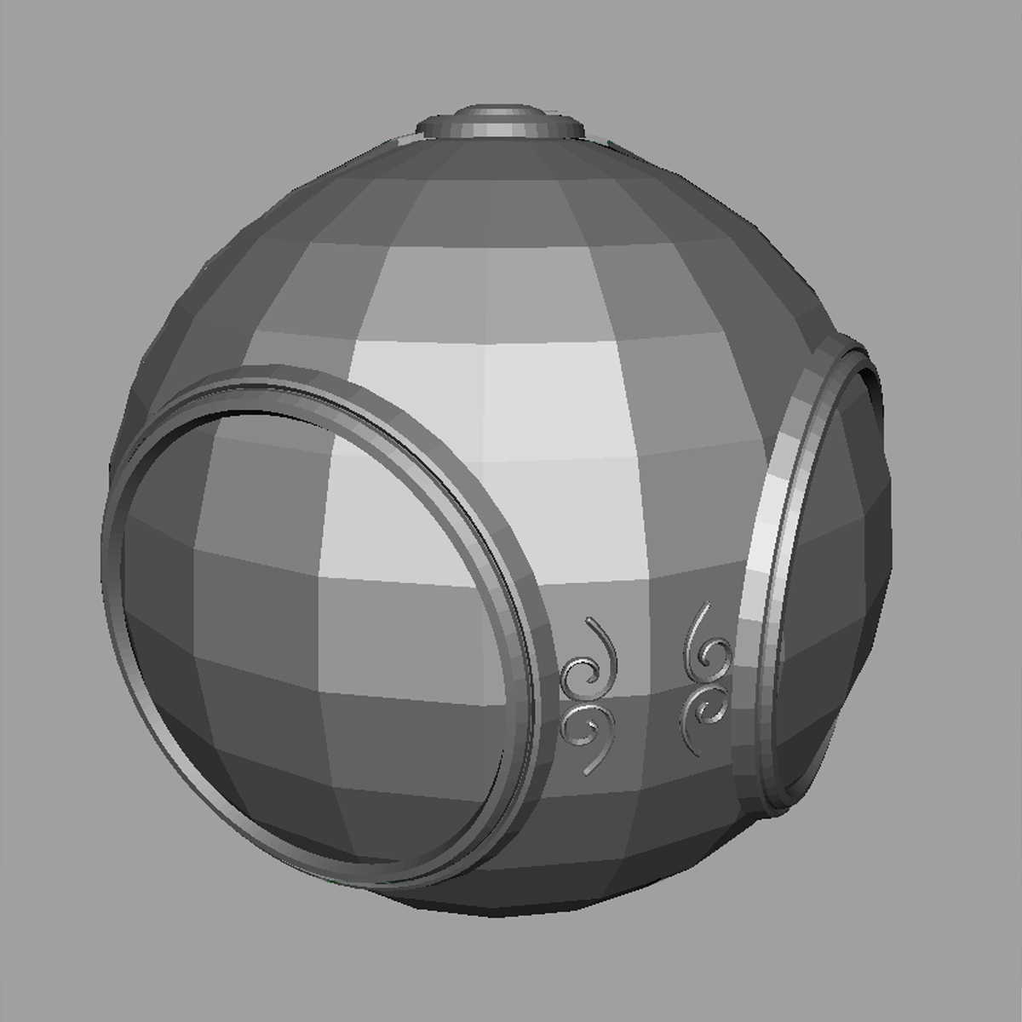
Raster Graphics
Allows us to go from lines and wire frame images to filled polygons
Angel and Shreiner: Interactive Computer Graphics 7E © Addison-Wesley 2015

Slide 16
PCs and Workstations
Although we no longer make the distinction between workstations and PCs, historically they evolved from different roots
  Early workstations characterized by
    Networked connection: client-server model
    High-level of interactivity
  Early PCs included frame buffer as part of user memory
    Easy to change contents and create images
Angel and Shreiner: Interactive Computer Graphics 7E © Addison-Wesley 2015

Slide 17



Computer Graphics: 1980-1990
Realism comes to computer graphics
smooth shading
environment
mapping
bump mapping
Angel and Shreiner: Interactive Computer Graphics 7E © Addison-Wesley 2015

Slide 18
Computer Graphics: 1980-1990
Special purpose hardware
  Silicon Graphics geometry engine
    VLSI implementation of graphics pipeline
Industry-based standards
  PHIGS
  RenderMan
Networked graphics: X Window System
Human-Computer Interface (HCI)
Angel and Shreiner: Interactive Computer Graphics 7E © Addison-Wesley 2015

Slide 19
Computer Graphics: 1990-2000
OpenGL API
Completely computer-generated feature-length movies (Toy Story) are successful
New hardware capabilities
  Texture mapping
  Blending
  Accumulation, stencil buffers
Angel and Shreiner: Interactive Computer Graphics 7E © Addison-Wesley 2015

Slide 20
Computer Graphics: 2000-2010
Photorealism
Graphics cards for PCs dominate market
  Nvidia, ATI
Game boxes and game players determine direction of market
Computer graphics routine in movie industry: Maya, Lightwave
Programmable pipelines
New display technologies
Angel and Shreiner: Interactive Computer Graphics 7E © Addison-Wesley 2015

Slide 21
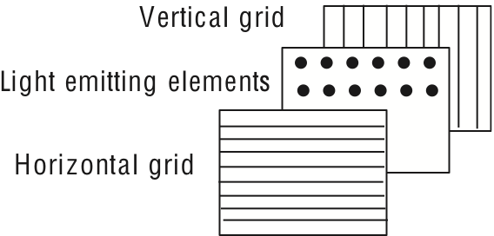
Generic Flat Panel Display
Angel and Shreiner: Interactive Computer Graphics 7E © Addison-Wesley 2015

Slide 22
Computer Graphics 2011-
Graphics is now ubiquitous
  Cell phones
  Embedded
OpenGL ES and WebGL
Alternate and Enhanced Reality
3D Movies and TV
Angel and Shreiner: Interactive Computer Graphics 7E © Addison-Wesley 2015

