Slide 1
Introduction to Computer Graphics with WebGL
Ed Angel
Professor Emeritus of Computer Science
Founding Director, Arts, Research, Technology and Science Laboratory
University of New Mexico
Angel and Shreiner: Interactive Computer Graphics 7E © Addison-Wesley 2015

Slide 2
Incremental and
Quaternion Rotation
Ed Angel
Professor Emeritus of Computer Science
University of New Mexico
Angel and Shreiner: Interactive Computer Graphics 7E © Addison-Wesley 2015

Slide 3
Objectives
This is an optional lecture that
  Illustrates the difference between using direction angles and Euler angles
  Considers issues with incremental rotation
  Introduces quaternions as an alternate to rotation matrices
Angel and Shreiner: Interactive Computer Graphics 7E © Addison-Wesley 2015

Slide 4
Specifying a Rotation
Pre 3.1 OpenGL had a function glRotate (theta, dx, dy dz) which incrementally changed the current rotation matrix by a rotation with fixed point of the origin about a vector in the direction (dx, dy, dz)
We implemented rotate in MV.js
Implementations of Rotate often decompose the general rotation into a sequence of rotations about the coordinate axes as in Chapter 4.
Angel and Shreiner: Interactive Computer Graphics 7E © Addison-Wesley 2015

Slide 5
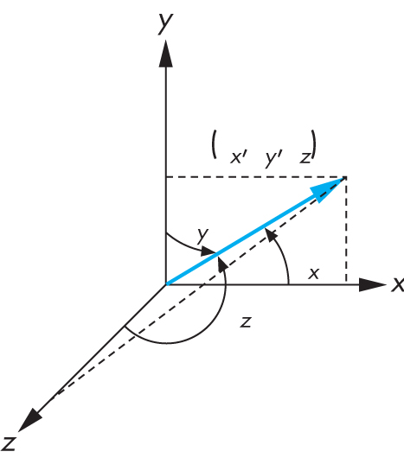
Euler from Direction Angles
Angel and Shreiner: Interactive Computer Graphics 7E © Addison-Wesley 2015

Slide 6
Efficiency
should be able to write as
If we knew the angles, we could use RotateX, RotateY
and RotateZ from mat.h
But is this an efficient method?
No, we can do better with quaterions
Angel and Shreiner: Interactive Computer Graphics 7E © Addison-Wesley 2015

Slide 7
Incremental Rotation
where θ_{x}, θ_{y} and θ_{z} are small angles
For small angles
Angel and Shreiner: Interactive Computer Graphics 7E © Addison-Wesley 2015

Slide 8

Great Circles
Angel and Shreiner: Interactive Computer Graphics 7E © Addison-Wesley 2015

Slide 9
Rotation and Great Circles
Shortest path between two points on a sphere is the great circle passing through the two points
Corresponding to each great circle is vector normal to the circle
Rotation about this vector carries us from the first point to the second
Angel and Shreiner: Interactive Computer Graphics 7E © Addison-Wesley 2015

Slide 10
Quaterion Rotation
Definition:
Quaterian Arithmetic:
Representing a 3D point:
Representing a Rotation:
Rotating a Point:
Angel and Shreiner: Interactive Computer Graphics 7E © Addison-Wesley 2015

Slide 11
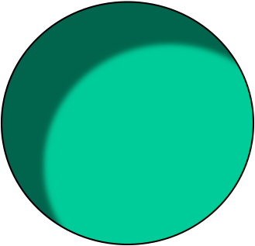
Looking at the North Star
θ
φ
Angel and Shreiner: Interactive Computer Graphics 7E © Addison-Wesley 2015

Slide 12
At North Pole
θ = 90^{ο}
φ = ?
Angel and Shreiner: Interactive Computer Graphics 7E © Addison-Wesley 2015

Slide 13
Gimbal Lock
Suppose you rotate about the y axis by 90º
This action removes a degree of freedom
Angel and Shreiner: Interactive Computer Graphics 7E © Addison-Wesley 2015

Slide 14
Quaternions and Computer Graphics
(Re)discovered by both aerospace and animation communities
Used for head mounted display in virtual and augmented reality
Used for smooth camera paths
Caveat: quaternions do not preserve up direction
Angel and Shreiner: Interactive Computer Graphics 7E © Addison-Wesley 2015

Slide 15
Working with Quaternians
Quaternion arithmetic works well for representing rotations around the origin
There is no simple way to convert a quaternion to a matrix representation
Usually copy elements back and forth between quaternions and matrices
Can use directly without rotation matrices in the virtual trackball
Quaternion shaders are simple
Angel and Shreiner: Interactive Computer Graphics 7E © Addison-Wesley 2015

