Slide 1
Introduction to Computer Graphics with WebGL
Ed Angel
Professor Emeritus of Computer Science
Founding Director, Arts, Research, Technology and Science Laboratory
University of New Mexico
Angel and Shreiner: Interactive Computer Graphics 7E © Addison-Wesley 2015

Slide 2
Orthogonal Projection Matrices
Ed Angel
Professor Emeritus of Computer Science
University of New Mexico
Angel and Shreiner: Interactive Computer Graphics 7E © Addison-Wesley 2015

Slide 3
Objectives
Derive the projection matrices used for standard orthogonal projections
Introduce oblique projections
Introduce projection normalization
Angel and Shreiner: Interactive Computer Graphics 7E © Addison-Wesley 2015

Slide 4
Normalization
Rather than derive a different projection matrix for each type of projection, we can convert all projections to orthogonal projections with the default view volume
This strategy allows us to use standard transformations in the pipeline and makes for efficient clipping
Angel and Shreiner: Interactive Computer Graphics 7E © Addison-Wesley 2015

Slide 5
Pipeline View
modelview
transformation
projection
transformation
perspective
division
4D → 3D
nonsingular
clipping
projection
3D → 2D
against default cube
Angel and Shreiner: Interactive Computer Graphics 7E © Addison-Wesley 2015

Slide 6
Notes
We stay in four-dimensional homogeneous coordinates through both the modelview and projection transformations
  Both these transformations are nonsingular
  Default to identity matrices (orthogonal view)
Normalization lets us clip against simple cube regardless of type of projection
Delay final projection until end
  Important for hidden-surface removal to retain depth information as long as possible
Angel and Shreiner: Interactive Computer Graphics 7E © Addison-Wesley 2015

Slide 7
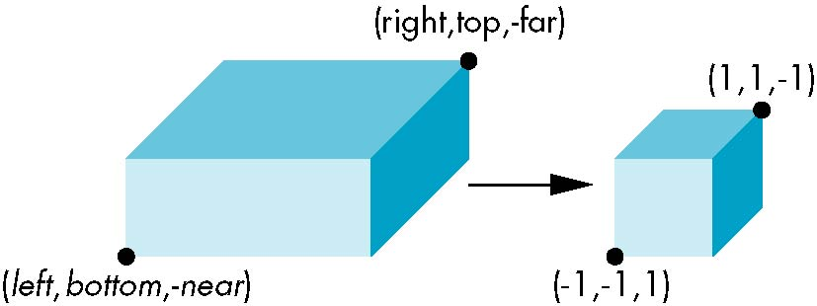
Orthogonal Normalization
ortho(left,right,bottom,top,near,far)
normalization ⇒ find transformation to convert
specified clipping volume to default
Angel and Shreiner: Interactive Computer Graphics 7E © Addison-Wesley 2015

Slide 8
Orthogonal Matrix
Two steps
  Move center to origin
    T(-(left+right)/2, -(bottom+top)/2,(near+far)/2))
  Scale to have sides of length 2
    S(2/(left-right),2/(top-bottom),2/(near-far))
P = ST =
Angel and Shreiner: Interactive Computer Graphics 7E © Addison-Wesley 2015

Slide 9
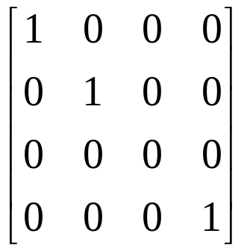
Final Projection
Set z =0
Equivalent to the homogeneous coordinate transformation
Hence, general orthogonal projection in 4D is
M_{orth} =
P = M_{orth}ST
Angel and Shreiner: Interactive Computer Graphics 7E © Addison-Wesley 2015

Slide 10
Oblique Projections
The OpenGL projection functions cannot produce general parallel projections such as
However if we look at the example of the cube it appears that the cube has been sheared
Oblique Projection = Shear + Orthogonal Projection
Angel and Shreiner: Interactive Computer Graphics 7E © Addison-Wesley 2015

Slide 11
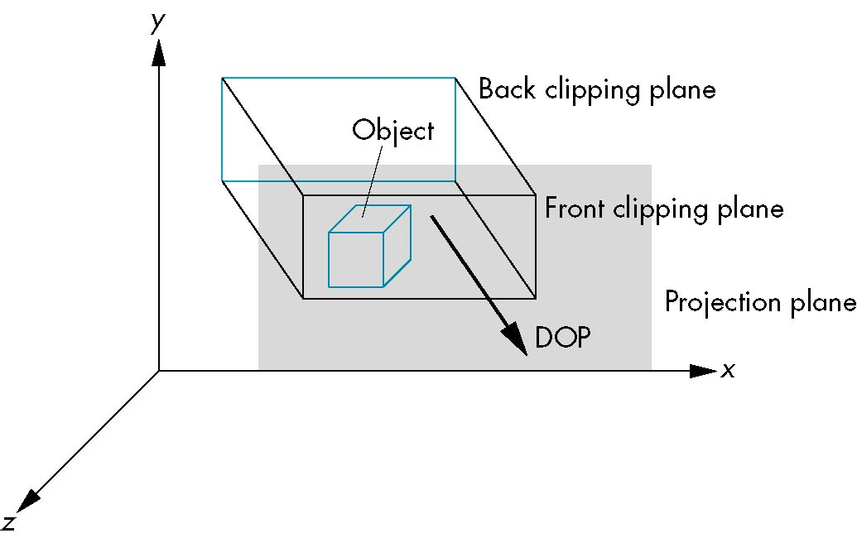
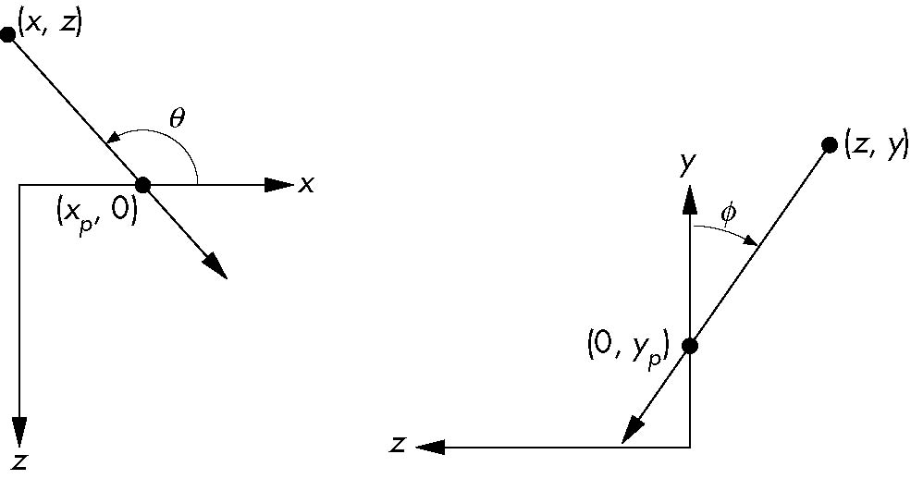
General Shear
top view
side view
Angel and Shreiner: Interactive Computer Graphics 7E © Addison-Wesley 2015

Slide 12
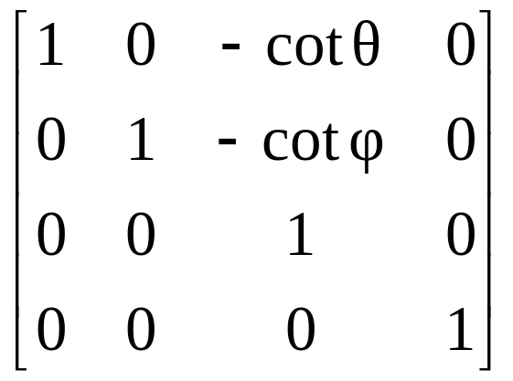
Shear Matrix
xy shear (z values unchanged)
Projection matrix
General case:
H(θ,φ) =
P = M_{orth} H(θ,φ)
P = M_{orth} STH(θ,φ)
Angel and Shreiner: Interactive Computer Graphics 7E © Addison-Wesley 2015

Slide 13
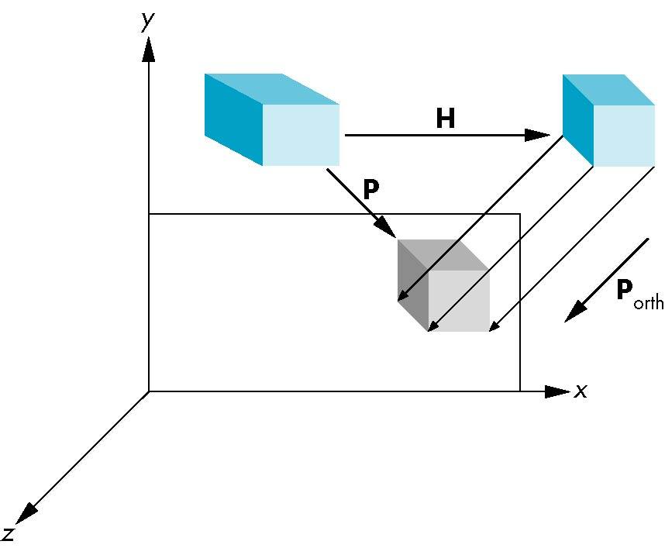
Equivalency
Angel and Shreiner: Interactive Computer Graphics 7E © Addison-Wesley 2015

Slide 14
Effect on Clipping
The projection matrix P = STH transforms the original clipping volume to the default clipping volume
object
top view
z = 1
DOP
DOP
x = -1
x = 1
far plane
z = -1
clipping
volume
near plane
distorted object
(projects correctly)
Angel and Shreiner: Interactive Computer Graphics 7E © Addison-Wesley 2015

