Slide 1
Introduction to Computer Graphics with WebGL
Ed Angel
Professor Emeritus of Computer Science
Founding Director, Arts, Research, Technology and Science Laboratory
University of New Mexico
Angel and Shreiner: Interactive Computer Graphics 7E © Addison-Wesley 2015

Slide 2
Polygonal Shading
Ed Angel
Professor Emeritus of Computer Science
University of New Mexico
Angel and Shreiner: Interactive Computer Graphics 7E © Addison-Wesley 2015

Slide 3
Polygonal Shading
In per vertex shading, shading calculations are done for each vertex
  Vertex colors become vertex shades and can be sent to the vertex shader as a vertex attribute
  Alternately, we can send the parameters to the vertex shader and have it compute the shade
By default, vertex shades are interpolated across an object if passed to the fragment shader as a varying variable (smooth shading)
We can also use uniform variables to shade with a single shade (flat shading)
Angel and Shreiner: Interactive Computer Graphics 7E © Addison-Wesley 2015

Slide 4
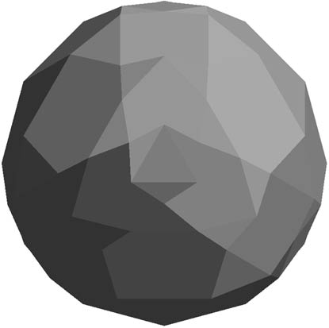
Polygon Normals
Triangles have a single normal
  Shades at the vertices as computed by the modified Phong model can be almost same
  Identical for a distant viewer (default) or if there is no specular component
Consider model of sphere
Want different normals at
each vertex even though
this concept is not quite
correct mathematically
Angel and Shreiner: Interactive Computer Graphics 7E © Addison-Wesley 2015

Slide 5
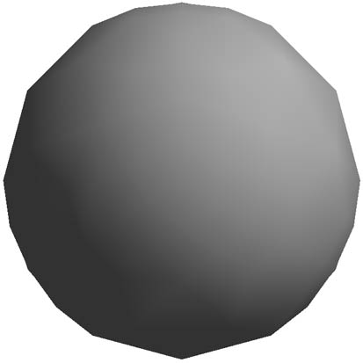
Smooth Shading
We can set a new normal at each vertex
Easy for sphere model
  If centered at origin n = p
Now smooth shading works
Note silhouette edge
Angel and Shreiner: Interactive Computer Graphics 7E © Addison-Wesley 2015

Slide 6
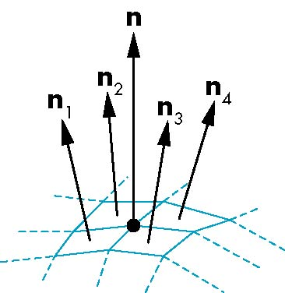
Mesh Shading
The previous example is not general because we knew the normal at each vertex analytically
For polygonal models, Gouraud proposed we use the average of the normals around a mesh vertex
n = (n₁+n₂+n₃+n₄)/ |n₁+n₂+n₃+n₄|
Angel and Shreiner: Interactive Computer Graphics 7E © Addison-Wesley 2015

Slide 7
Gouraud and Phong Shading
Gouraud Shading
  Find average normal at each vertex (vertex normals)
  Apply modified Phong model at each vertex
  Interpolate vertex shades across each polygon
Phong shading
  Find vertex normals
  Interpolate vertex normals across edges
  Interpolate edge normals across polygon
  Apply modified Phong model at each fragment
Angel and Shreiner: Interactive Computer Graphics 7E © Addison-Wesley 2015

Slide 8
Comparison
If the polygon mesh approximates surfaces with a high curvatures, Phong shading may look smooth while Gouraud shading may show edges
Phong shading requires much more work than Gouraud shading
  Until recently not available in real time systems
  Now can be done using fragment shaders
Both need data structures to represent meshes so we can obtain vertex normals
Angel and Shreiner: Interactive Computer Graphics 7E © Addison-Wesley 2015

