Slide 1
Introduction to Computer Graphics with WebGL
Ed Angel
Professor Emeritus of Computer Science
Founding Director, Arts, Research, Technology and Science Laboratory
University of New Mexico
Angel and Shreiner: Interactive Computer Graphics 7E © Addison-Wesley 2015

Slide 2
Buffers
Ed Angel
Professor Emeritus of Computer Science
University of New Mexico
Angel and Shreiner: Interactive Computer Graphics 7E © Addison-Wesley 2015

Slide 3
Objectives
Introduce additional WebGL buffers
Reading and writing buffers
Buffers and Images
Angel and Shreiner: Interactive Computer Graphics 7E © Addison-Wesley 2015

Slide 4
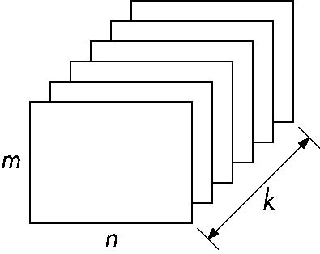
Buffer
Define a buffer by its spatial resolution (n x m) and its depth (or precision) k, the number of bits/pixel
pixel
Angel and Shreiner: Interactive Computer Graphics 7E © Addison-Wesley 2015

Slide 5
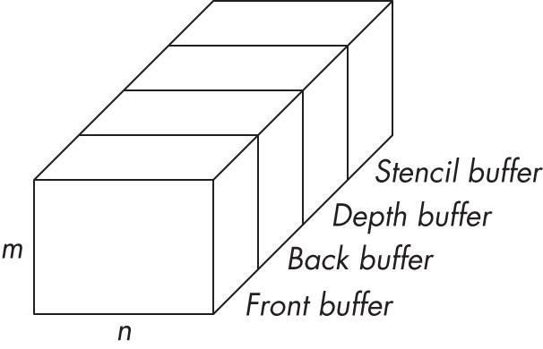
WebGL Frame Buffer
Angel and Shreiner: Interactive Computer Graphics 7E © Addison-Wesley 2015

Slide 6
Where are the Buffers?
HTML5 Canvas
  Default front and back color buffers
  Under control of local window system
  Physically on graphics card
Depth buffer also on graphics card
Stencil buffer
  Holds masks
Most RGBA buffers 8 bits per component
Latest are floating point (IEEE)
Angel and Shreiner: Interactive Computer Graphics 7E © Addison-Wesley 2015

Slide 7
Other Buffers
desktop OpenGL supported other buffers
  auxiliary color buffers
  accumulation buffer
  these were on application side
  now deprecated
GPUs have their own or attached memory
  texture buffers
  off-screen buffers
    not under control of window system
    may be floating point
Angel and Shreiner: Interactive Computer Graphics 7E © Addison-Wesley 2015

Slide 8
Images
Framebuffer contents are unformatted
  usually RGB or RGBA
  one byte per component
  no compression
Standard Web Image Formats
  jpeg, gif, png
WebGL has no conversion functions
  Understands standard Web formats for texture images
Angel and Shreiner: Interactive Computer Graphics 7E © Addison-Wesley 2015

Slide 9
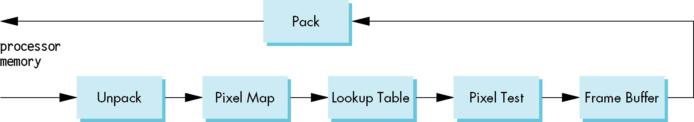
The (Old) Pixel Pipeline
OpenGL has a separate pipeline for pixels
  Writing pixels involves
    Moving pixels from processor memory to the frame buffer
    Format conversions
    Mapping, Lookups, Tests
  Reading pixels
    Format conversion
Angel and Shreiner: Interactive Computer Graphics 7E © Addison-Wesley 2015

Slide 10
Packing and Unpacking
Compressed or uncompressed
Indexed or RGB
Bit Format
  little or big endian
WebGL (and shader-based OpenGL) lacks most functions for packing and unpacking
  use texture functions instead
  can implement desired functionality in fragment shaders
Angel and Shreiner: Interactive Computer Graphics 7E © Addison-Wesley 2015

Slide 11
Deprecated Functionality
glDrawPixels
glCopyPixels
glBitMap
Angel and Shreiner: Interactive Computer Graphics 7E © Addison-Wesley 2015

Slide 12
Buffer Reading
WebGL can read pixels from the framebuffer with gl.readPixels
Returns only 8 bit RGBA values
In general, the format of pixels in the frame buffer is different from that of processor memory and these two types of memory reside in different places
  Need packing and unpacking
  Reading can be slow
Drawing through texture functions and off-screen memory (frame buffer objects)
Angel and Shreiner: Interactive Computer Graphics 7E © Addison-Wesley 2015

Slide 13
WebGL Pixel Function
gl.readPixels(x,y,width,height,format,type,myimage)
start pixel in frame buffer
size
type of pixels
type of image
pointer to processor
memory
var myimage[512*512*4];
gl.readPixels(0,0, 512, 512, gl.RGBA,
gl.UNSIGNED_BYTE, myimage);
Angel and Shreiner: Interactive Computer Graphics 7E © Addison-Wesley 2015

Slide 14
Render to Texture
GPUs now include a large amount of texture memory that we can write into
Advantage: fast (not under control of window system)
Using frame buffer objects (FBOs) we can render into texture memory instead of the frame buffer and then read from this memory
  Image processing
  GPGPU
Angel and Shreiner: Interactive Computer Graphics 7E © Addison-Wesley 2015

