Slide 1
Introduction to Computer Graphics with WebGL
Ed Angel
Professor Emeritus of Computer Science
Founding Director, Arts, Research, Technology and Science Laboratory
University of New Mexico
Angel and Shreiner: Interactive Computer Graphics 7E © Addison-Wesley 2015

Slide 2
Texture Mapping
Ed Angel
Professor Emeritus of Computer Science
University of New Mexico
Angel and Shreiner: Interactive Computer Graphics 7E © Addison-Wesley 2015

Slide 3
Objectives
Introduce Mapping Methods
  Texture Mapping
  Environment Mapping
  Bump Mapping
Consider basic strategies
  Forward vs backward mapping
  Point sampling vs area averaging
Angel and Shreiner: Interactive Computer Graphics 7E © Addison-Wesley 2015

Slide 4
The Limits of Geometric Modeling
Although graphics cards can render over 10 million polygons per second, that number is insufficient for many phenomena
  Clouds
  Grass
  Terrain
  Skin
Angel and Shreiner: Interactive Computer Graphics 7E © Addison-Wesley 2015

Slide 5
Modeling an Orange
Consider the problem of modeling an orange (the fruit)
Start with an orange-colored sphere
  Too simple
Replace sphere with a more complex shape
  Does not capture surface characteristics (small dimples)
  Takes too many polygons to model all the dimples
Angel and Shreiner: Interactive Computer Graphics 7E © Addison-Wesley 2015

Slide 6
Modeling an Orange (2)
Take a picture of a real orange, scan it, and “paste” onto simple geometric model
  This process is known as texture mapping
Still might not be sufficient because resulting surface will be smooth
  Need to change local shape
  Bump mapping
Angel and Shreiner: Interactive Computer Graphics 7E © Addison-Wesley 2015

Slide 7
Three Types of Mapping
Texture Mapping
  Uses images to fill inside of polygons
Environment (reflection mapping)
  Uses a picture of the environment for texture maps
  Allows simulation of highly specular surfaces
Bump mapping
  Emulates altering normal vectors during the rendering process
Angel and Shreiner: Interactive Computer Graphics 7E © Addison-Wesley 2015

Slide 8

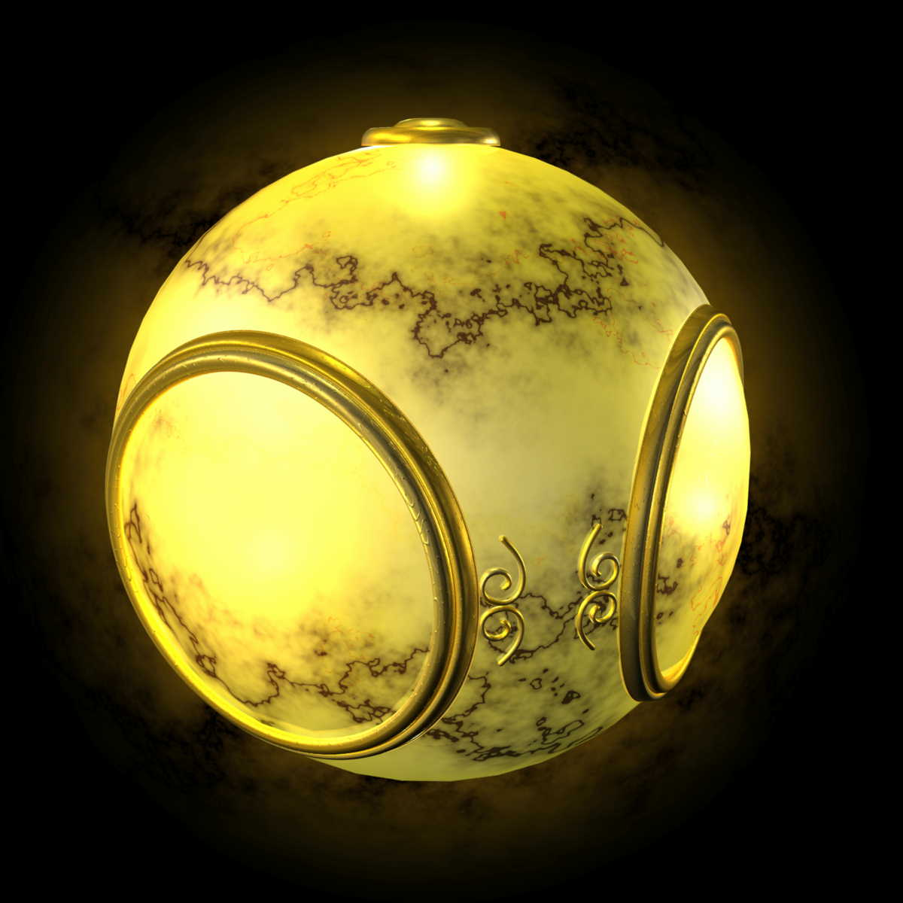
Texture Mapping
geometric model
texture mapped
Angel and Shreiner: Interactive Computer Graphics 7E © Addison-Wesley 2015

Slide 9

Environment Mapping
Angel and Shreiner: Interactive Computer Graphics 7E © Addison-Wesley 2015

Slide 10

Bump Mapping
Angel and Shreiner: Interactive Computer Graphics 7E © Addison-Wesley 2015

Slide 11
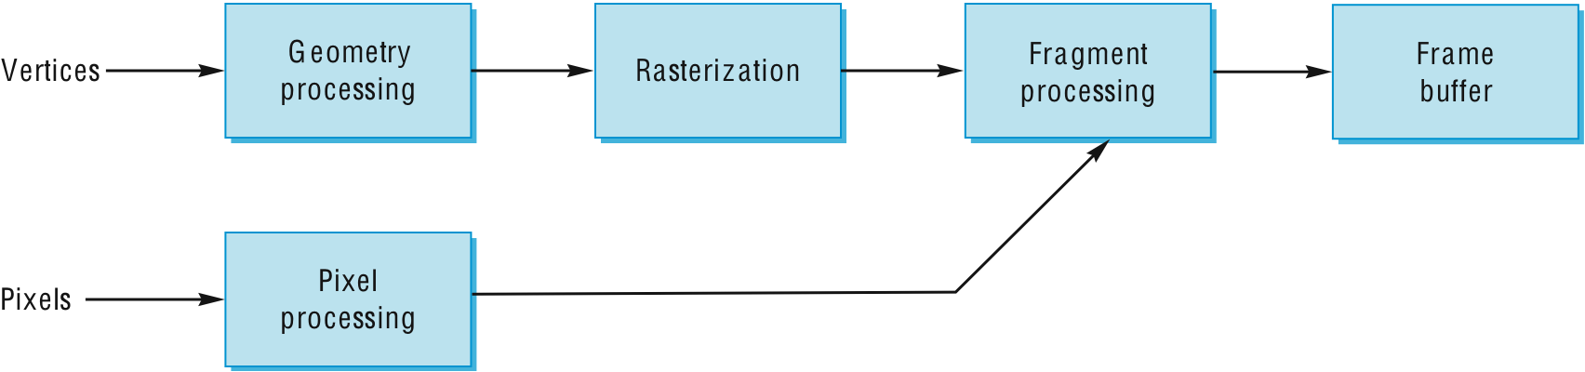
Where does mapping take place?
Mapping techniques are implemented at the end of the rendering pipeline
  Very efficient because few polygons make it past the clipper
Angel and Shreiner: Interactive Computer Graphics 7E © Addison-Wesley 2015

