Slide 1
Introduction to Computer Graphics with WebGL
Ed Angel
Professor Emeritus of Computer Science
Founding Director, Arts, Research, Technology and Science Laboratory
University of New Mexico
Angel and Shreiner: Interactive Computer Graphics 7E © Addison-Wesley 2015

Slide 2
Texture Mapping
Ed Angel
Professor Emeritus of Computer Science
University of New Mexico
Angel and Shreiner: Interactive Computer Graphics 7E © Addison-Wesley 2015

Slide 3
Objectives
Basic mapping strategies
  Forward vs backward mapping
  Point sampling vs area averaging
Angel and Shreiner: Interactive Computer Graphics 7E © Addison-Wesley 2015

Slide 4
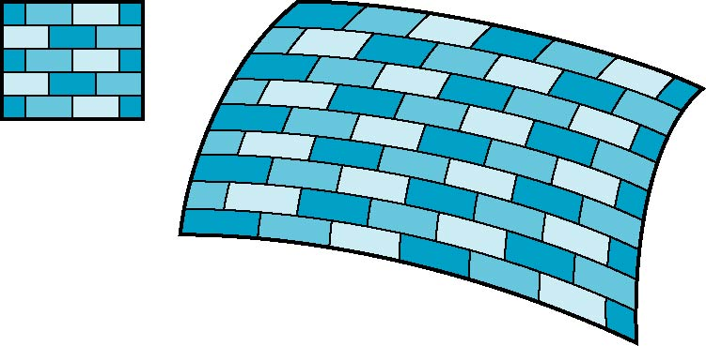
Is it simple?
Although the idea is simple---map an image to a surface---there are 3 or 4 coordinate systems involved
2D image
3D surface
Angel and Shreiner: Interactive Computer Graphics 7E © Addison-Wesley 2015

Slide 5
Coordinate Systems
Parametric coordinates
  May be used to model curves and surfaces
Texture coordinates
  Used to identify points in the image to be mapped
Object or World Coordinates
  Conceptually, where the mapping takes place
Window Coordinates
  Where the final image is really produced
Angel and Shreiner: Interactive Computer Graphics 7E © Addison-Wesley 2015

Slide 6
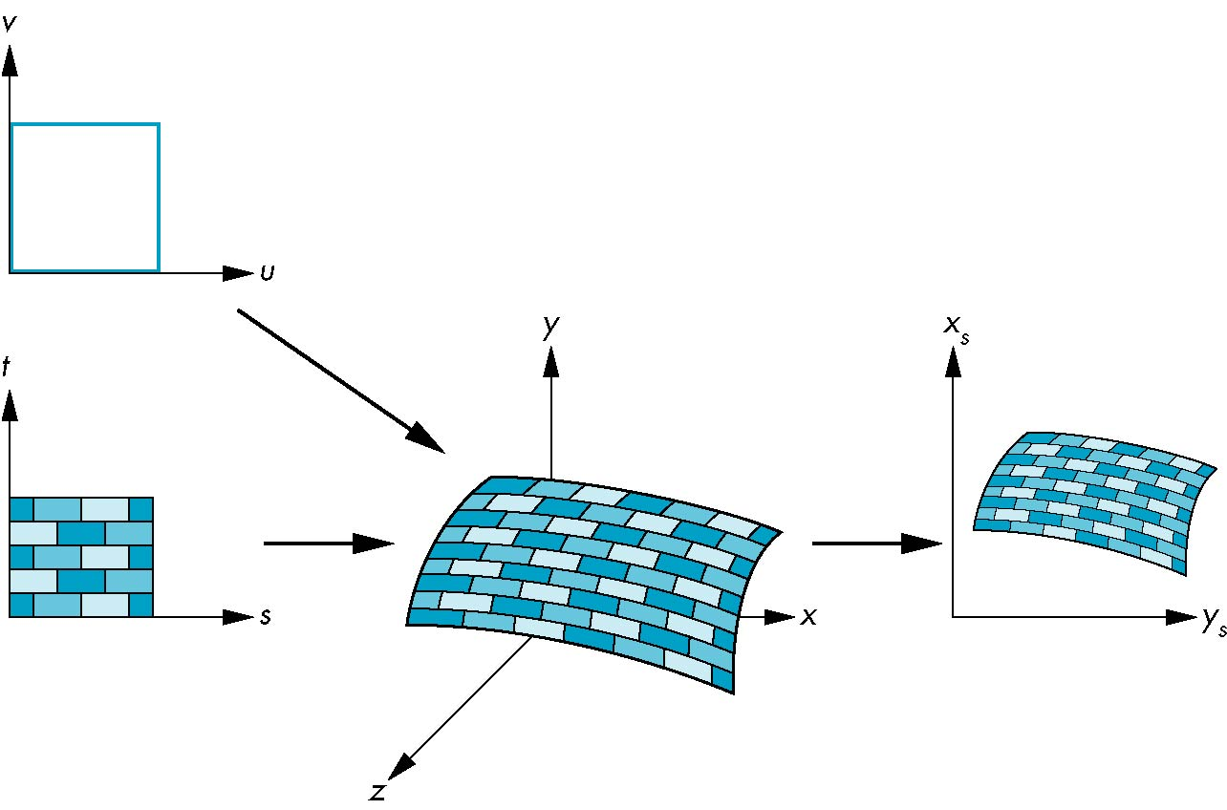
Texture Mapping
parametric coordinates
texture coordinates
window coordinates
world coordinates
Angel and Shreiner: Interactive Computer Graphics 7E © Addison-Wesley 2015

Slide 7
Mapping Functions
Basic problem is how to find the maps
Consider mapping from texture coordinates to a point a surface
Appear to need three functions
  x = x(s,t)
  y = y(s,t)
  z = z(s,t)
But we really want
to go the other way
(x,y,z)
t
s
Angel and Shreiner: Interactive Computer Graphics 7E © Addison-Wesley 2015

Slide 8
Backward Mapping
We really want to go backwards
  Given a pixel, we want to know to which point on an object it corresponds
  Given a point on an object, we want to know to which point in the texture it corresponds
Need a map of the form
    s = s(x,y,z)
    t = t(x,y,z)
Such functions are difficult to find in general
Angel and Shreiner: Interactive Computer Graphics 7E © Addison-Wesley 2015

Slide 9
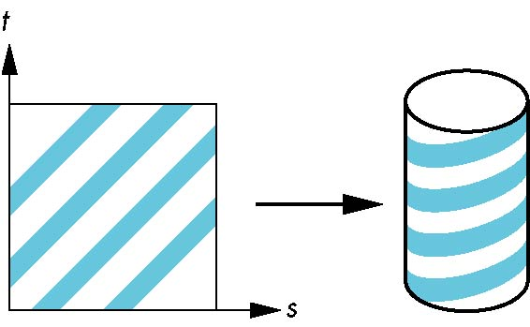
Two-part mapping
One solution to the mapping problem is to first map the texture to a simple intermediate surface
Example: map to cylinder
Angel and Shreiner: Interactive Computer Graphics 7E © Addison-Wesley 2015

Slide 10
Cylindrical Mapping
parametric cylinder
x = r cos 2π u
y = r sin 2πu
z = v/h
maps rectangle in u,v space to cylinder
of radius r and height h in world coordinates
s = u
t = v
maps from texture space
Angel and Shreiner: Interactive Computer Graphics 7E © Addison-Wesley 2015

Slide 11
Spherical Map
We can use a parametric sphere
x = r cos 2πu
y = r sin 2πu cos 2πv
z = r sin 2πu sin 2πv
in a similar manner to the cylinder
but have to decide where to put
the distortion
Spheres are used in environmental maps
Angel and Shreiner: Interactive Computer Graphics 7E © Addison-Wesley 2015

Slide 12
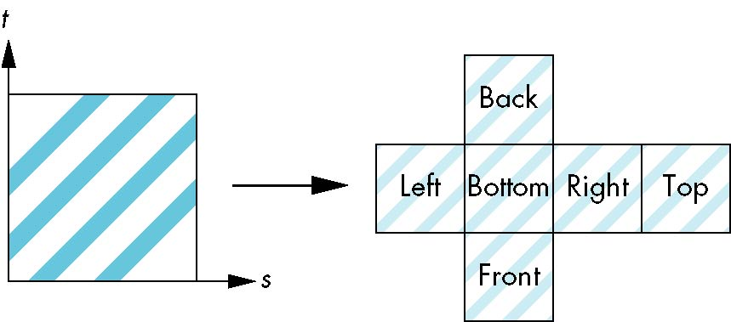
Box Mapping
Easy to use with simple orthographic projection
Also used in environment maps
Angel and Shreiner: Interactive Computer Graphics 7E © Addison-Wesley 2015

Slide 13
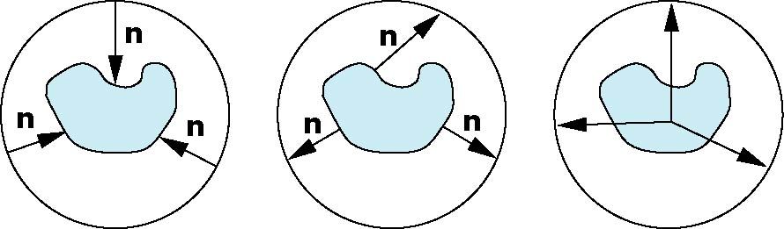
Second Mapping
Map from intermediate object to actual object
  Normals from intermediate to actual
  Normals from actual to intermediate
  Vectors from center of intermediate
actual
intermediate
Angel and Shreiner: Interactive Computer Graphics 7E © Addison-Wesley 2015

Slide 14
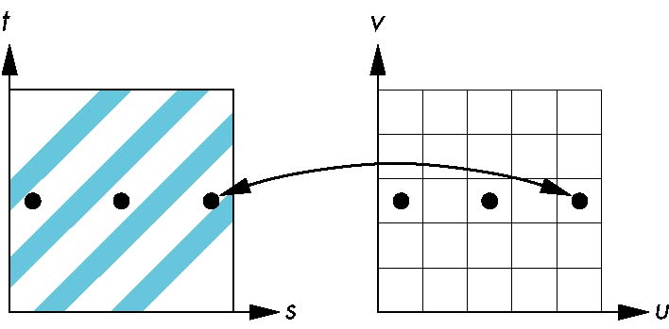
Aliasing
Point sampling of the texture can lead to aliasing errors
miss blue stripes
point samples in u,v
(or x,y,z) space
point samples in texture space
Angel and Shreiner: Interactive Computer Graphics 7E © Addison-Wesley 2015

Slide 15
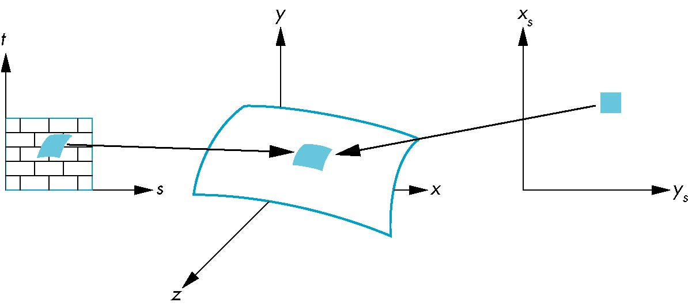
Area Averaging
A better but slower option is to use area averaging
pixel
preimage
Note that preimage of pixel is curved
Angel and Shreiner: Interactive Computer Graphics 7E © Addison-Wesley 2015

