Slide 1
Introduction to Computer Graphics with WebGL
Ed Angel
Professor Emeritus of Computer Science
Founding Director, Arts, Research, Technology and Science Laboratory
University of New Mexico
Angel and Shreiner: Interactive Computer Graphics 7E © Addison-Wesley 2015

Slide 2
Reflection and Environment Maps
Ed Angel
Professor Emeritus of Computer Science
University of New Mexico
Angel and Shreiner: Interactive Computer Graphics 7E © Addison-Wesley 2015

Slide 3
Objectives
Texture Mapping Applications
Reflection (Environment) Maps
  Cube Maps
  Spherical Maps
Bump Maps
Angel and Shreiner: Interactive Computer Graphics 7E © Addison-Wesley 2015

Slide 4



Mapping Variations
smooth shading
environment
mapping
bump mapping
Angel and Shreiner: Interactive Computer Graphics 7E © Addison-Wesley 2015

Slide 5
Environment Mapping
Environmental (reflection) mapping is way to create the appearance of highly reflective surfaces without ray tracing which requires global calculations
Introduced in movies such as The Abyss and Terminator 2
Prevalent in video games
It is a form of texture mapping
Angel and Shreiner: Interactive Computer Graphics 7E © Addison-Wesley 2015

Slide 6
Reflecting the Environment
N
V
R
Angel and Shreiner: Interactive Computer Graphics 7E © Addison-Wesley 2015

Slide 7
Mapping to a Sphere
N
V
R
Angel and Shreiner: Interactive Computer Graphics 7E © Addison-Wesley 2015

Slide 8
Hemisphere Map as a Texture
If we map all objects to hemisphere, we cannot tell if they are on the sphere or anywhere else along the reflector
Use the map on the sphere as a texture that can be mapped onto the object
Can use other surfaces as the intermediate
  Cube maps
  Cylinder maps
Angel and Shreiner: Interactive Computer Graphics 7E © Addison-Wesley 2015

Slide 9
Cube Map
Angel and Shreiner: Interactive Computer Graphics 7E © Addison-Wesley 2015

Slide 10
Indexing into Cube Map
Compute R = 2(N·V)N-V
Object at origin
Use largest magnitude component of R to determine face of cube
Other two components give texture coordinates
V
R
Angel and Shreiner: Interactive Computer Graphics 7E © Addison-Wesley 2015

Slide 11
OpenGL Implementation
WebGL supports only cube maps
  desktop OpenGL also supports sphere maps
First must form map
  Use images from a real camera
  Form images with WebGL
Texture map it to object
Angel and Shreiner: Interactive Computer Graphics 7E © Addison-Wesley 2015

Slide 12
Cube Maps
We can form a cube map texture by defining six 2D texture maps that correspond to the sides of a box
Supported by WebGL through cubemap sampler
  vec4 texColor = textureCube(mycube, texcoord);
Texture coordinates must be 3D
  usually are given by the vertex location so we don’t need compute separate tex coords
Angel and Shreiner: Interactive Computer Graphics 7E © Addison-Wesley 2015

Slide 13
Environment Maps with Shaders
Environment maps are usually computed in world coordinates which can differ from object coordinates because of the modeling matrix
  May have to keep track of modeling matrix and pass it to the shaders as a uniform variable
Can also use reflection map or refraction map for effects such as simulating water
Angel and Shreiner: Interactive Computer Graphics 7E © Addison-Wesley 2015

Slide 14
Issues
Must assume environment is very far from object (equivalent to the difference between near and distant lights)
Object cannot be concave (no self reflections possible)
No reflections between objects
Need a reflection map for each object
Need a new map if viewer moves
Angel and Shreiner: Interactive Computer Graphics 7E © Addison-Wesley 2015

Slide 15
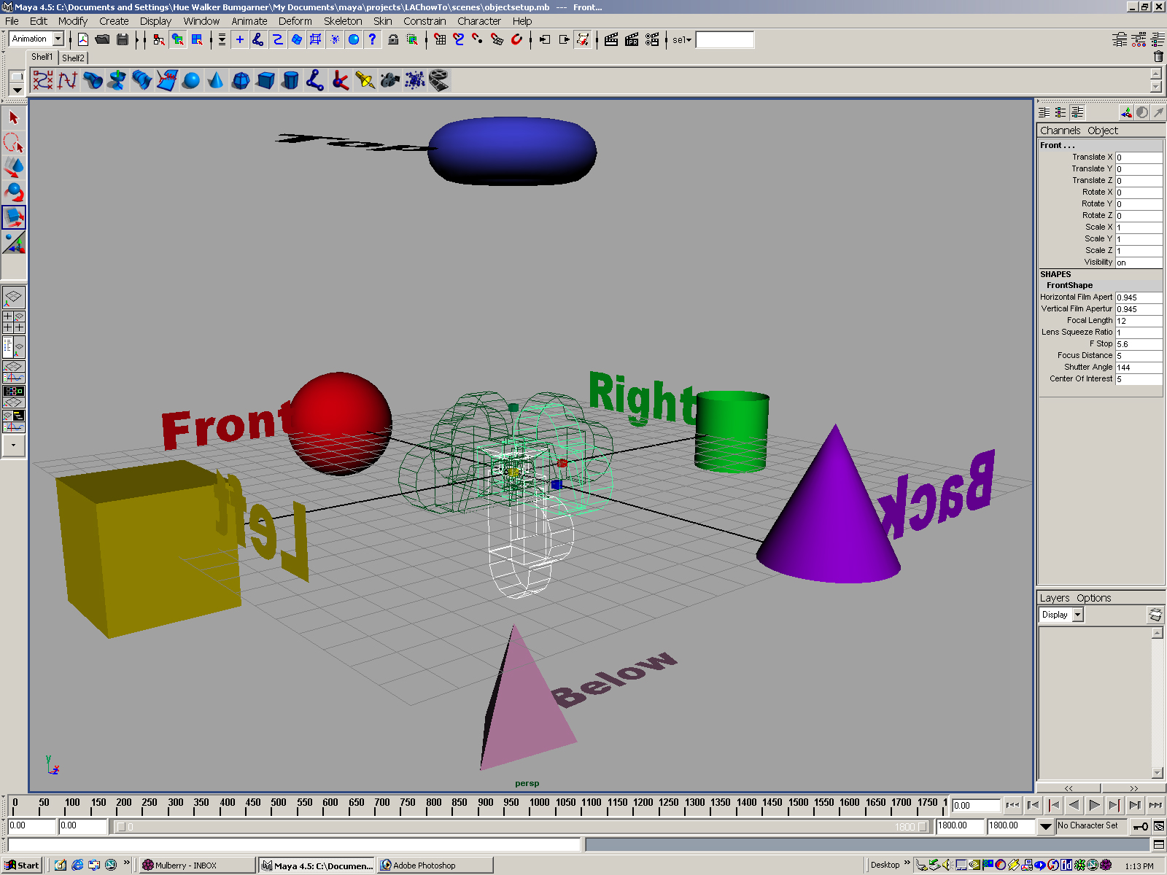
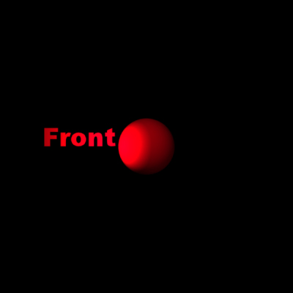

Forming Cube Map
Use six cameras, each with a 90 degree angle of view
Angel and Shreiner: Interactive Computer Graphics 7E © Addison-Wesley 2015

Slide 16
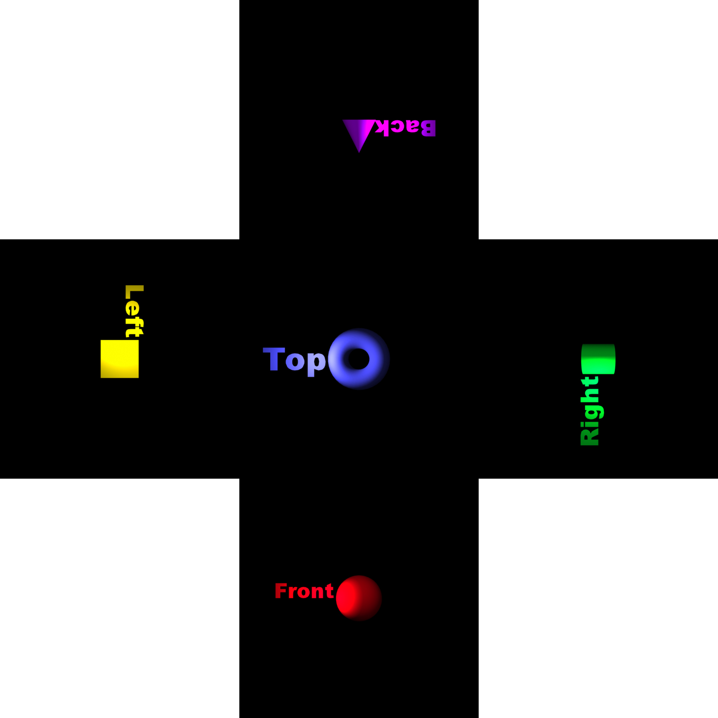
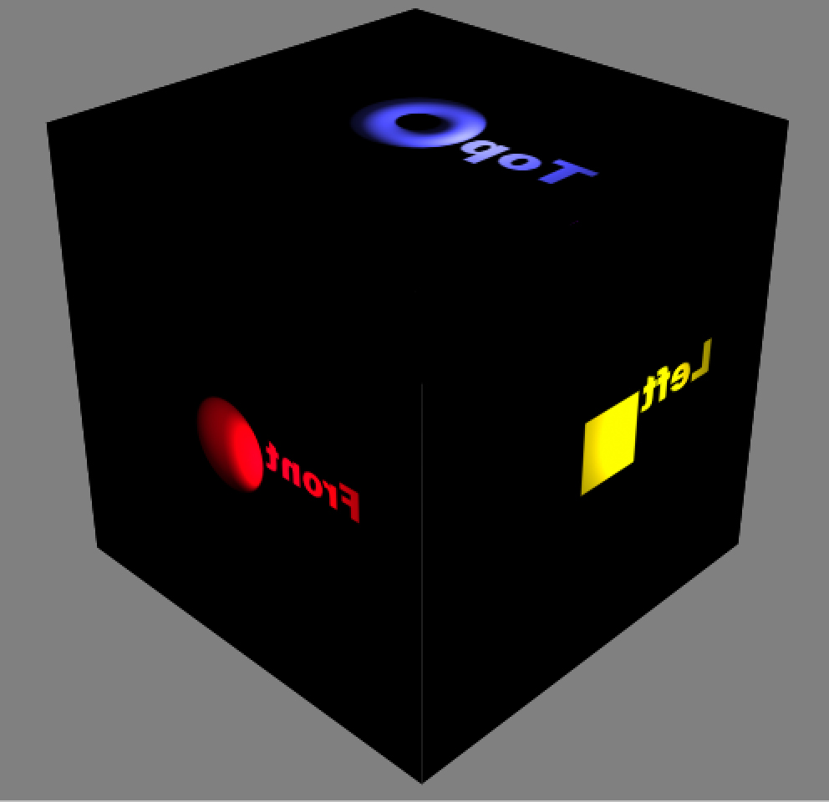
vs Cube Image
Angel and Shreiner: Interactive Computer Graphics 7E © Addison-Wesley 2015

Slide 17
Doing it in WebGL
gl.textureMap2D(
gl.TEXTURE_CUBE_MAP_POSITIVE_X,
level, rows, columns, border, gl.RGBA,
gl.UNSIGNED_BYTE, image1)
Same for other five images
Make one texture object out of the six images
Angel and Shreiner: Interactive Computer Graphics 7E © Addison-Wesley 2015

Slide 18
Example
Consider rotating cube inside a cube that reflects the color of the walls
Each wall is a solid color (red, green, blue, cyan, magenta, yellow)
  Each face of room can be a texture of one texel
var red = new Uint8Array([255, 0, 0, 255]);
var green = new Uint8Array([0, 255, 0, 255]);
var blue = new Uint8Array([0, 0, 255, 255]);
var cyan = new Uint8Array([0, 255, 255, 255]);
var magenta = new Uint8Array([255, 0, 255, 255]);
var yellow = new Uint8Array([255, 255, 0, 255]);
Angel and Shreiner: Interactive Computer Graphics 7E © Addison-Wesley 2015

Slide 19
Texture Object
cubeMap = gl.createTexture();
gl.bindTexture(gl.TEXTURE_CUBE_MAP, cubeMap);
gl.texImage2D(gl.TEXTURE_CUBE_MAP_POSITIVE_X, 0, gl.RGBA,
1, 1, 0, gl.RGBA,gl.UNSIGNED_BYTE, red);
gl.texImage2D(gl.TEXTURE_CUBE_MAP_NEGATIVE_X, 0, gl.RGBA,
1, 1, 0, gl.RGBA,gl.UNSIGNED_BYTE, green);
gl.texImage2D(gl.TEXTURE_CUBE_MAP_POSITIVE_Y, 0, gl.RGBA,
1, 1, 0, gl.RGBA,gl.UNSIGNED_BYTE, blue);
gl.texImage2D(gl.TEXTURE_CUBE_MAP_NEGATIVE_Y, 0, gl.RGBA,
1, 1, 0, gl.RGBA,gl.UNSIGNED_BYTE, cyan);
gl.texImage2D(gl.TEXTURE_CUBE_MAP_POSITIVE_Z, 0, gl.RGBA,
1, 1, 0, gl.RGBA,gl.UNSIGNED_BYTE, yellow);
gl.texImage2D(gl.TEXTURE_CUBE_MAP_NEGATIVE_Z, 0, gl.RGBA,
1, 1, 0, gl.RGBA,gl.UNSIGNED_BYTE, magenta);
gl.activeTexture( gl.TEXTURE0 );
gl.uniform1i(gl.getUniformLocation(program, "texMap"),0);
Angel and Shreiner: Interactive Computer Graphics 7E © Addison-Wesley 2015

Slide 20
Vertex Shader
varying vec3 R;
attribute vec4 vPosition;
attribute vec4 vNormal;
uniform mat4 modelViewMatrix;
uniform mat4 projectionMatrix;
uniform vec3 theta;
void main(){
vec3 angles = radians( theta );
// compute rotation matrices rx, ry, rz here
mat4 ModelViewMatrix = modelViewMatrix*rz*ry*rx;
gl_Position = projectionMatrix*ModelViewMatrix*vPosition;
vec4 eyePos = ModelViewMatrix*vPosition;
vec4 N = ModelViewMatrix*vNormal;
R = reflect(eyePos.xyz, N.xyz); }
Angel and Shreiner: Interactive Computer Graphics 7E © Addison-Wesley 2015

Slide 21
Fragment Shader
precision mediump float;
varying vec3 R;
uniform samplerCube texMap;
void main()
{
vec4 texColor = textureCube(texMap, R);
gl_FragColor = texColor;
}
Angel and Shreiner: Interactive Computer Graphics 7E © Addison-Wesley 2015

Slide 22
Sphere Mapping
Original environmental mapping technique proposed by Blinn and Newell based in using lines of longitude and latitude to map parametric variables to texture coordinates
OpenGL supports sphere mapping which requires a circular texture map equivalent to an image taken with a fisheye lens
Angel and Shreiner: Interactive Computer Graphics 7E © Addison-Wesley 2015

Slide 23
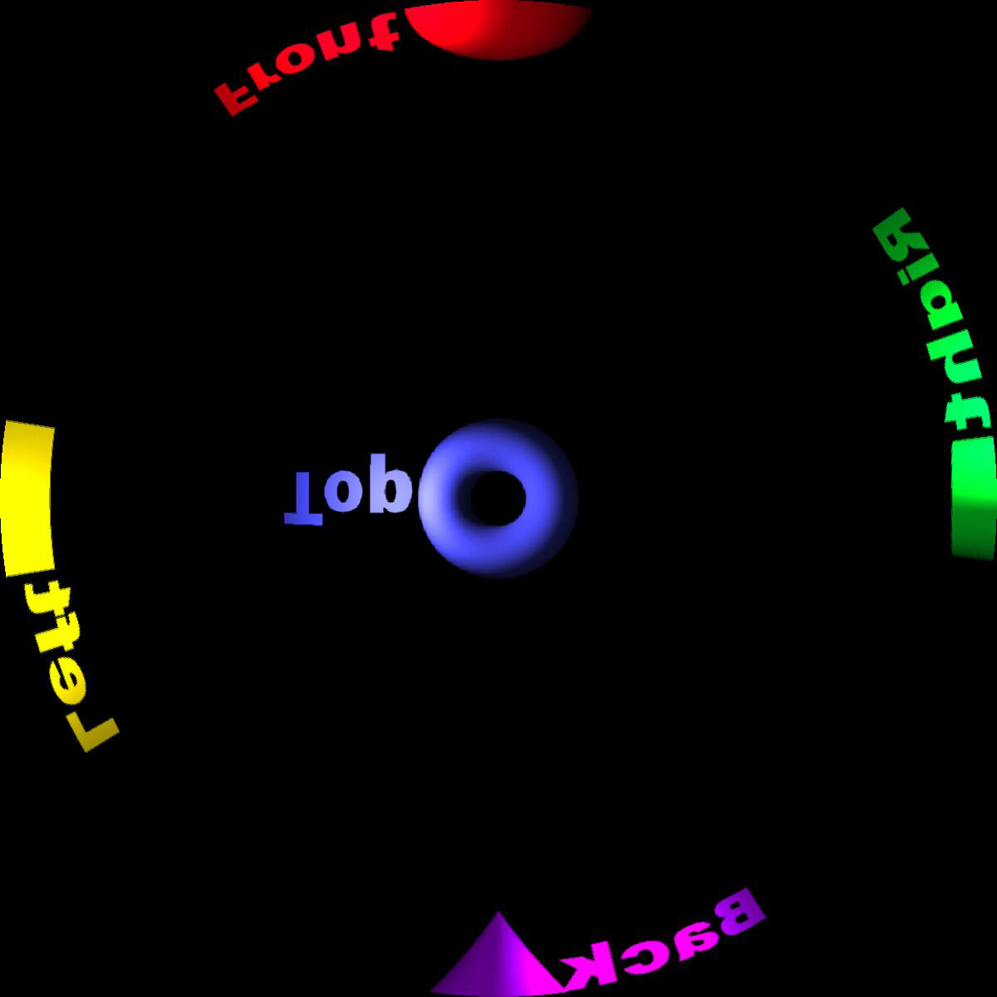
Sphere Map
Angel and Shreiner: Interactive Computer Graphics 7E © Addison-Wesley 2015

