Slide 1
Introduction to Computer Graphics with WebGL
Ed Angel
Professor Emeritus of Computer Science
Founding Director, Arts, Research, Technology and Science Laboratory
University of New Mexico
Angel and Shreiner: Interactive Computer Graphics 7E © Addison-Wesley 2015

Slide 2
Bump Maps
Ed Angel
Professor Emeritus of Computer Science
University of New Mexico
Angel and Shreiner: Interactive Computer Graphics 7E © Addison-Wesley 2015

Slide 3

Objectives
Introduce bump mapping
Angel and Shreiner: Interactive Computer Graphics 7E © Addison-Wesley 2015

Slide 4
Modeling an Orange
Consider modeling an orange
Texture map a photo of an orange onto a surface
  Captures dimples
  Will not be correct if we move viewer or light
  We have shades of dimples rather than their correct orientation
Ideally we need to perturb normal across surface of object and compute a new color at each interior point
Angel and Shreiner: Interactive Computer Graphics 7E © Addison-Wesley 2015

Slide 5
Bump Mapping (Blinn)
Consider a smooth surface
n
p
Angel and Shreiner: Interactive Computer Graphics 7E © Addison-Wesley 2015

Slide 6
Rougher Version
n’
p’
p
Angel and Shreiner: Interactive Computer Graphics 7E © Addison-Wesley 2015

Slide 7
Tangent Plane
p_{v}
n
p_{u}
Angel and Shreiner: Interactive Computer Graphics 7E © Addison-Wesley 2015

Slide 8
Equations
p(u,v) = [x(u,v), y(u,v), z(u,v)]^{T}
p_{u}=[ ∂x/ ∂u, ∂y/ ∂u, ∂z/ ∂u]^{T}
p_{v}=[ ∂x/ ∂v, ∂y/ ∂v, ∂z/ ∂v]^{T}
n = (p_{u} × p_{v} ) / | p_{u} × p_{v} |
Angel and Shreiner: Interactive Computer Graphics 7E © Addison-Wesley 2015

Slide 9
Displacement Function
p’ = p + d(u,v) n
d(u,v) is the bump or displacement function
|d(u,v)| << 1
Angel and Shreiner: Interactive Computer Graphics 7E © Addison-Wesley 2015

Slide 10
Perturbed Normal
n’ = p’_{u} × p’_{v}
p’_{u} = p_{u} + (∂d/∂u)n + d(u,v)n_{u}
p’_{v} = p_{v} + (∂d/∂v)n + d(u,v)n_{v}
If d is small, we can neglect last term
Angel and Shreiner: Interactive Computer Graphics 7E © Addison-Wesley 2015

Slide 11
Approximating the Normal
n’ = p’_{u} × p’_{v}
≈ n + (∂d/∂u)n × p_{v} + (∂d/∂v)n × p_{u}
The vectors n × p_{v} and n × p_{u} lie
in the tangent plane
Hence the normal is displaced in the tangent plane
Must precompute the arrays ∂d/ ∂u and ∂d/ ∂v
Finally,we perturb the normal during shading
Angel and Shreiner: Interactive Computer Graphics 7E © Addison-Wesley 2015

Slide 12
Image Processing
Suppose that we start with a function d(u,v)
We can sample it to form an array D=[d_{ij}]
Then ∂d/ ∂u ≈ d_{ij} – d_{i-1,j}
and ∂d/ ∂v ≈ d_{ij} – d_{i,j-1}
Embossing: multipass approach using floating point buffer
Angel and Shreiner: Interactive Computer Graphics 7E © Addison-Wesley 2015

Slide 13
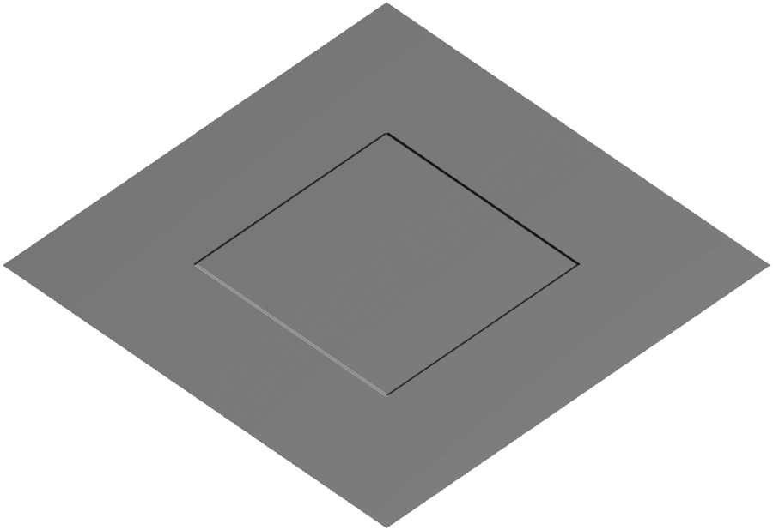
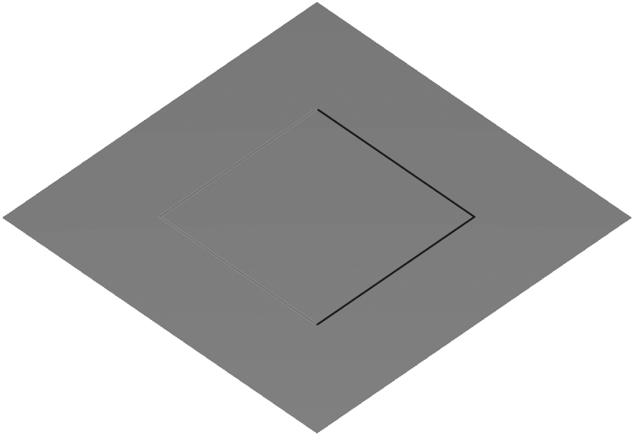
Example
Single Polygon and a Rotating Light Source
Angel and Shreiner: Interactive Computer Graphics 7E © Addison-Wesley 2015

Slide 14
How to do this?
The problem is that we want to apply the perturbation at all points on the surface
Cannot solve by vertex lighting (unless polygons are very small)
Really want to apply to every fragment
Can’t do that in fixed function pipeline
But can do with a fragment program!!
See bumpmap.html and bumpmap.js
Angel and Shreiner: Interactive Computer Graphics 7E © Addison-Wesley 2015

