Slide 1
Introduction to Computer Graphics with WebGL
Ed Angel
Professor Emeritus of Computer Science
Founding Director, Arts, Research, Technology and Science Laboratory
University of New Mexico
Angel and Shreiner: Interactive Computer Graphics 7E © Addison-Wesley 2015

Slide 2
Imaging Applications
Ed Angel
Professor Emeritus of Computer Science
University of New Mexico
Angel and Shreiner: Interactive Computer Graphics 7E © Addison-Wesley 2015

Slide 3
Objectives
Use the fragment shader to do image processing
  Image filtering
  Pseudo Color
Use multiple textures
  matrix operations
Introduce GPGPU
Angel and Shreiner: Interactive Computer Graphics 7E © Addison-Wesley 2015

Slide 4
Accumulation Techniques
Compositing and blending are limited by resolution of the frame buffer
  Typically 8 bits per color component
The accumulation buffer was a high resolution buffer (16 or more bits per component) that avoided this problem
Could write into it or read from it with a scale factor
Slower than direct compositing into the frame buffer
Now deprecated but can do techniques with floating point frame buffers
Angel and Shreiner: Interactive Computer Graphics 7E © Addison-Wesley 2015

Slide 5
Multirendering
Composite multiple images
Image Filtering (convolution)
  add shifted and scaled versions of an image
Whole scene antialiasing
  move primitives a little for each render
Depth of Field
  move viewer a little for each render keeping one plane unchanged
Motion effects
Angel and Shreiner: Interactive Computer Graphics 7E © Addison-Wesley 2015

Slide 6
Fragment Shaders and Images
Suppose that we send a rectangle (two triangles) to the vertex shader and render it with an n x m texture map
Suppose that in addition we use an n x m canvas
There is now a one-to-one correspondence between each texel and each fragment
Hence we can regard fragment operations as imaging operations on the texture map
Angel and Shreiner: Interactive Computer Graphics 7E © Addison-Wesley 2015

Slide 7
GPGPU
Looking back at these examples, we can note that the only purpose of the geometry is to trigger the execution of the imaging operations in the fragment shader
Consequently, we can look at what we have done as large matrix operations rather than graphics operations
Leads to the field of General Purpose Computing with a GPU (GPGPU)
Angel and Shreiner: Interactive Computer Graphics 7E © Addison-Wesley 2015

Slide 8
Examples
Add two matrices
Multiply two matrices
Fast Fourier Transform
Uses speed and parallelism of GPU
But how do we get out results?
  Floating point frame buffers
  OpenCL (WebCL)
  Compute shaders
Angel and Shreiner: Interactive Computer Graphics 7E © Addison-Wesley 2015

Slide 9
Using Multiple Texels
Suppose we have a 1024 x 1024 texture in the texture object “image”
sampler2D(image, vec2(x,y)) returns the the value of the texture at (x,y)
sampler2D(image, vec2(x+1.0/1024.0), y); returns the value of the texel to the right of (x,y)
We can use any combination of texels surrounding (x, y) in the fragment shader
Angel and Shreiner: Interactive Computer Graphics 7E © Addison-Wesley 2015

Slide 10
Image Enhancer
precision mediump float;
varying vec2 fTexCoord;
uniform sampler2D texture;
void main()
{
float d = 1.0/256.0; //spacing between texels
float x = fTexCoord.x;
float y = fTexCoord.y;
gl_FragColor = 10.0*abs( texture2D( texture, vec2(x+d, y))
- texture2D( texture, vec2(x-d, y)))
+10.0*abs( texture2D( texture, vec2(x, y+d))
- texture2D( texture, vec2(x, y-d)));
gl_FragColor.w = 1.0;
}
Angel and Shreiner: Interactive Computer Graphics 7E © Addison-Wesley 2015

Slide 11

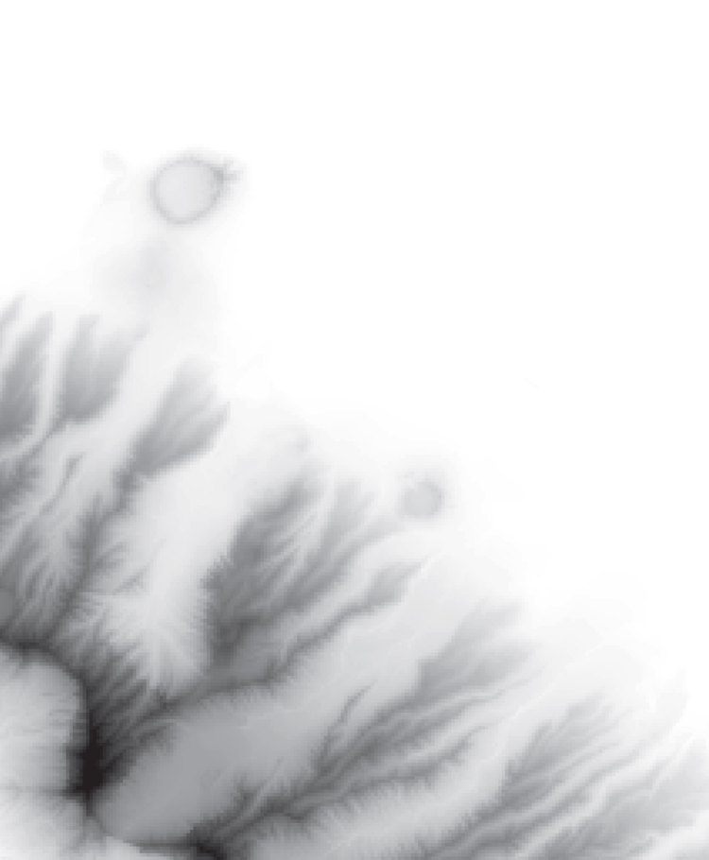
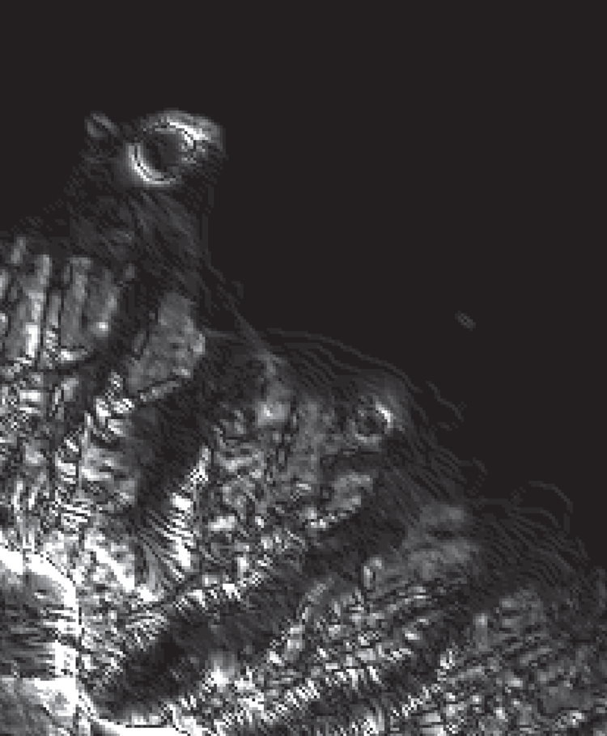
Honolulu Image
original
enhanced
Angel and Shreiner: Interactive Computer Graphics 7E © Addison-Wesley 2015

Slide 12
Sobel Edge Detector
Nonlinear
Find approximate gradient at each point
Compute smoothed finite difference approximations to x and y components separately
Display magnitude of approximate gradient
Simple with fragment shader
Angel and Shreiner: Interactive Computer Graphics 7E © Addison-Wesley 2015

Slide 13
Sobel Edge Detector
vec4 gx = 3.0*texture2D( texture, vec2(x+d, y))
+ texture2D( texture, vec2(x+d, y+d))
+ texture2D( texture, vec2(x+d, y-d))
- 3.0*texture2D( texture, vec2(x-d, y))
- texture2D( texture, vec2(x-d, y+d))
- texture2D( texture, vec2(x-d, y-d));
vec4 gy = 3.0*texture2D( texture, vec2(x, y+d))
+ texture2D( texture, vec2(x+d, y+d))
+ texture2D( texture, vec2(x-d, y+d))
- 3.0*texture2D( texture, vec2(x, y-d))
- texture2D( texture, vec2(x+d, y-d))
- texture2D( texture, vec2(x-d, y-d));
gl_FragColor = vec4(sqrt(gx*gx + gy*gy), 1.0);
gl_FragColor.w = 1.0;
Angel and Shreiner: Interactive Computer Graphics 7E © Addison-Wesley 2015

Slide 14
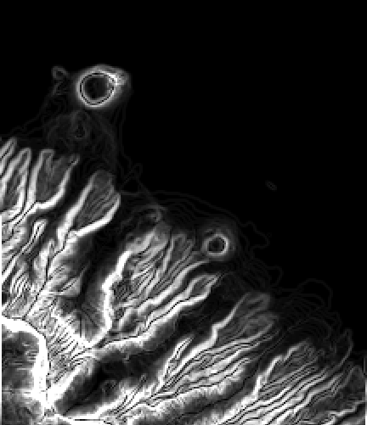
Sobel Edge Detector
Angel and Shreiner: Interactive Computer Graphics 7E © Addison-Wesley 2015

Slide 15
Using Multiple Textures
Example: matrix addition
Create two samplers, texture1 and texture2, that contain the data
In fragment shader
gl_FragColor =
sampler2D(texture1, vec2(x, y)) +sampler2D(texture2, vec2(x,y));
Angel and Shreiner: Interactive Computer Graphics 7E © Addison-Wesley 2015

Slide 16
Using 4 Way Parallelism
Recent GPUs and graphics cards support textures up to 8K x 8K
For scalar imaging, we can do twice as well using all four color components
Angel and Shreiner: Interactive Computer Graphics 7E © Addison-Wesley 2015

Slide 17
Indexed and Pseudo Color
Display luminance (2D) image as texture map
Treat pixel value as independent variable for separate functions for each color component
void main(){
vec4 color = texture2D(texture, fTexCoord);
if(color.g<0.5) color.g = 2.0*color.g;
else color.g = 2.0 - 2.0*color.g;
color.b = 1.0-color.b;
gl_FragColor = color;
}
Angel and Shreiner: Interactive Computer Graphics 7E © Addison-Wesley 2015

Slide 18
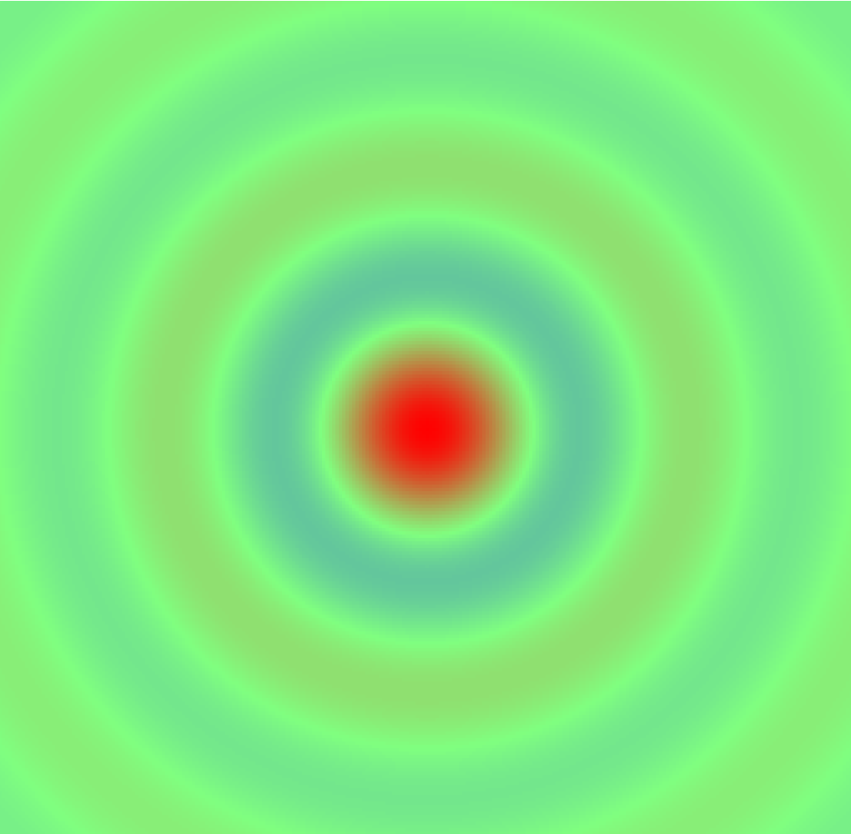

Top View of 2D Sinc
Angel and Shreiner: Interactive Computer Graphics 7E © Addison-Wesley 2015

Slide 19
The Next Step
Need more storage for most GPGPU calculations
Example: filtering
Example: iteration
Need shared memory
Solution: Use texture memory and off-screen rendering
Angel and Shreiner: Interactive Computer Graphics 7E © Addison-Wesley 2015

