Slide 1
Introduction to Computer Graphics with WebGL
Ed Angel
Professor Emeritus of Computer Science
Founding Director, Arts, Research, Technology and Science Laboratory
University of New Mexico

Slide 2
Render to Texture
Ed Angel
Professor Emeritus of Computer Science
University of New Mexico

Slide 3
Objectives
Examples of render-to-texture
Render a triangle to texture, then use this texture on a rectangle
Introduce buffer pingponging
Angel and Shreiner: Interactive Computer Graphics 7E © Addison-Wesley 2015

Slide 4
Program Objects and Shaders
For most applications of render-to-texture we need multiple program objects and shaders
  One set for creating a texture
  Second set for rendering with that texture
Applications that we consider later such as buffer pingponging may require additional program objects
Angel and Shreiner: Interactive Computer Graphics 7E © Addison-Wesley 2015

Slide 5
Program Object 1 Shaders
pass through vertex shader:
attribute vec4 vPosition;
void main()
{
gl_Position = vPosition;
}
fragment shader to get a red triangle:
precision mediump float;
void main()
{
gl_FragColor = vec4(1.0, 0.0, 0.0, 1.0);
}
Angel and Shreiner: Interactive Computer Graphics 7E © Addison-Wesley 2015
Notes:
Vertex positions are assumed to be in clip coordinates.

Slide 6
Program Object 2 Shaders
// vertex shader
attribute vec4 vPosition;
attribute vec2 vTexCoord;
varying vec2 fTexCoord;
void main()
{
gl_Position = vPosition;
fTexCoord = vTexCoord;
}
// fragment shader
precision mediump float;
varying vec2 fTexCoord;
uniform sampler2D texture;
void main()
{
gl_FragColor = texture2D( texture,
fTexCoord);
}
Angel and Shreiner: Interactive Computer Graphics 7E © Addison-Wesley 2015
Notes:
Here too we assume vertex positions are given in clip coordinates to simplify example.

Slide 7
First Render (to Texture)
gl.useProgram( program1 );
var buffer1 = gl.createBuffer();
gl.bindBuffer( gl.ARRAY_BUFFER, buffer1 );
gl.bufferData( gl.ARRAY_BUFFER, flatten(pointsArray), gl.STATIC_DRAW );
// Initialize the vertex position attribute from the vertex shader
var vPosition = gl.getAttribLocation( program1, "vPosition" );
gl.vertexAttribPointer( vPosition, 2, gl.FLOAT, false, 0, 0 );
gl.enableVertexAttribArray( vPosition );
// Render one triangle
gl.viewport(0, 0, 64, 64);
gl.clearColor(0.5, 0.5, 0.5, 1.0);
gl.clear(gl.COLOR_BUFFER_BIT );
gl.drawArrays(gl.TRIANGLES, 0, 3);
Angel and Shreiner: Interactive Computer Graphics 7E © Addison-Wesley 2015
Notes:
By binding the buffer we allocated, we render to the off screen buffer. Otherwise rendering is as rendering to the frame buffer.

Slide 8
Set Up Second Render
// Bind to default window system framebuffer
gl.bindFramebuffer(gl.FRAMEBUFFER, null);
gl.disableVertexAttribArray(vPosition);
gl.useProgram(program2);
// Assume we have already set up a texture object with null texture image
gl.activeTexture(gl.TEXTURE0);
gl.bindTexture(gl.TEXTURE_2D, texture1);
// set up vertex attribute arrays for texture coordinates and rectangle as usual
Angel and Shreiner: Interactive Computer Graphics 7E © Addison-Wesley 2015
Notes:
First we bind to the window system frame buffer. We then send the data for our quad. We make the texture we created the active texture so it is available for the normal rendering.

Slide 9
Data for Second Render
var buffer2 = gl.createBuffer();
gl.bindBuffer( gl.ARRAY_BUFFER, buffer2);
gl.bufferData(gl.ARRAY_BUFFER, new flatten(vertices),
gl.STATIC_DRAW);
var vPosition = gl.getAttribLocation( program2, "vPosition" );
gl.vertexAttribPointer( vPosition, 2, gl.FLOAT, false, 0, 0 );
gl.enableVertexAttribArray( vPosition );
var buffer3 = gl.createBuffer();
gl.bindBuffer( gl.ARRAY_BUFFER, buffer3);
gl.bufferData( gl.ARRAY_BUFFER, flatten(texCoord),
gl.STATIC_DRAW);
var vTexCoord = gl.getAttribLocation( program2, "vTexCoord");
gl.vertexAttribPointer( vTexCoord, 2, gl.FLOAT, false, 0, 0 );
gl.enableVertexAttribArray( vTexCoord );
Angel and Shreiner: Interactive Computer Graphics 7E © Addison-Wesley 2015
Notes:
Note that we are using the texture object we created earlier but now it has a texture image to use.

Slide 10

Render a Quad with Texture
gl.uniform1i( gl.getUniformLocation(program2, "texture"), 0);
gl.viewport(0, 0, 512, 512);
gl.clearColor(0.0, 0.0, 1.0, 1.0);
gl.clear( gl.COLOR_BUFFER_BIT );
gl.drawArrays(gl.TRIANGLES, 0, 6);
Angel and Shreiner: Interactive Computer Graphics 7E © Addison-Wesley 2015
Notes:
The texture was created as a 256 x 256 image and the second rendering is to a 512 x 512 frame buffer using point sampling, we see some jaggedness in the resulting image.

Slide 11
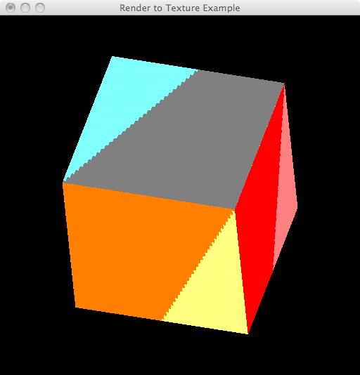
Dynamic 3D Example
Angel and Shreiner: Interactive Computer Graphics 7E © Addison-Wesley 2015
Notes:
The code for this example replaces the second rendering of a single quad from our previous example with the code from our cube examples. The colors are determined by blending the cube colors with the texture colors:
in vec4 color;
in vec2 texCoord;
uniform sampler2D texture;
void main()
{
gl_FragColor = 0.5*color + 0.5*texture2D( texture, texCoord );
}

Slide 12
Buffer Ping-ponging
Iterative calculations can be accomplished using multiple render buffers
Original data in texture buffer 1
Render to texture buffer 2
Swap buffers and rerender to texture
Angel and Shreiner: Interactive Computer Graphics 7E © Addison-Wesley 2015

Slide 13
Particle System Example
Random motion of a particle
  Render as a point
  Diffuse rendered image to create motion blur effect
  Insert particle again in new position
Example use Sierpinski gasket as initial background
Uses three program objects
Angel and Shreiner: Interactive Computer Graphics 7E © Addison-Wesley 2015

Slide 14
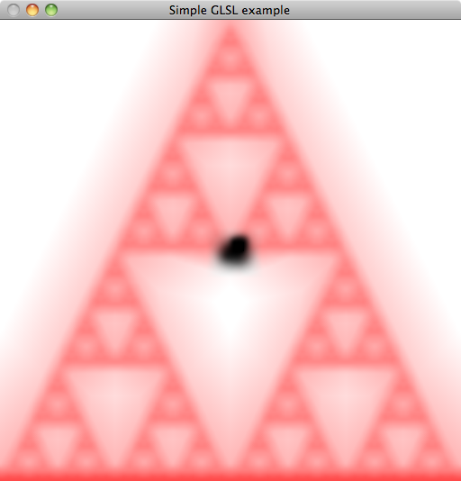
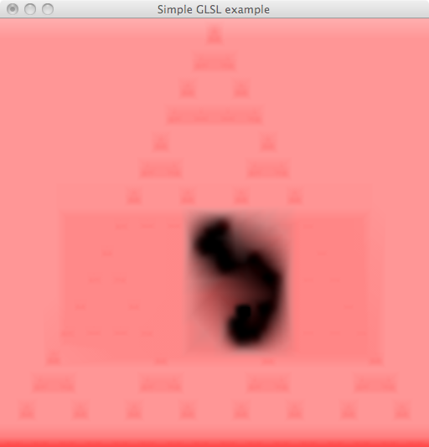
Screen Shots
Angel and Shreiner: Interactive Computer Graphics 7E © Addison-Wesley 2015

