Slide 1
Introduction to Computer Graphics with WebGL
Ed Angel
Professor Emeritus of Computer Science
Founding Director, Arts, Research, Technology and Science Laboratory
University of New Mexico
Angel and Shreiner: Interactive Computer Graphics 7E © Addison-Wesley 2015

Slide 2
Hierarchical Modeling I
Ed Angel
Professor Emeritus of Computer Science,
University of New Mexico
Angel and Shreiner: Interactive Computer Graphics 7E © Addison-Wesley 2015

Slide 3
Objectives
Examine the limitations of linear modeling
  Symbols and instances
Introduce hierarchical models
  Articulated models
  Robots
Introduce Tree and DAG models
Angel and Shreiner: Interactive Computer Graphics 7E © Addison-Wesley 2015

Slide 4
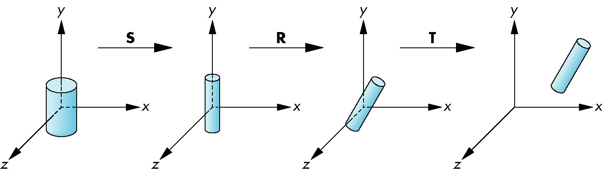
Instance Transformation
Start with a prototype object (a symbol)
Each appearance of the object in the model is an instance
  Must scale, orient, position
  Defines instance transformation
Angel and Shreiner: Interactive Computer Graphics 7E © Addison-Wesley 2015

Slide 5
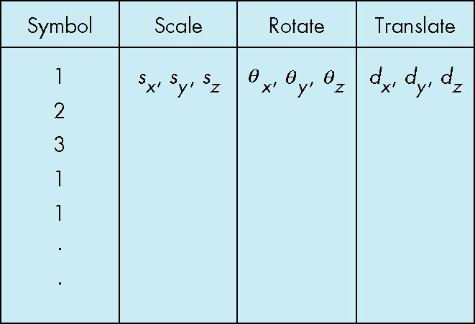
Symbol-Instance Table
Can store a model by assigning a number to each symbol and storing the parameters for the instance transformation
Angel and Shreiner: Interactive Computer Graphics 7E © Addison-Wesley 2015

Slide 6
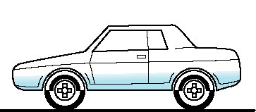
Relationships in Car Model
Symbol-instance table does not show relationships between parts of model
Consider model of car
  Chassis + 4 identical wheels
  Two symbols
Rate of forward motion determined by rotational speed of wheels
Angel and Shreiner: Interactive Computer Graphics 7E © Addison-Wesley 2015

Slide 7
Structure Through Function Calls
car(speed)
{
chassis()
wheel(right_front);
wheel(left_front);
wheel(right_rear);
wheel(left_rear);
}
Fails to show relationships well
Look at problem using a graph
Angel and Shreiner: Interactive Computer Graphics 7E © Addison-Wesley 2015

Slide 8
Graphs
Set of nodes and edges (links)
Edge connects a pair of nodes
  Directed or undirected
Cycle: directed path that is a loop
loop
Angel and Shreiner: Interactive Computer Graphics 7E © Addison-Wesley 2015

Slide 9
Tree
Graph in which each node (except the root) has exactly one parent node
  May have multiple children
  Leaf or terminal node: no children
root node
leaf node
Angel and Shreiner: Interactive Computer Graphics 7E © Addison-Wesley 2015

Slide 10
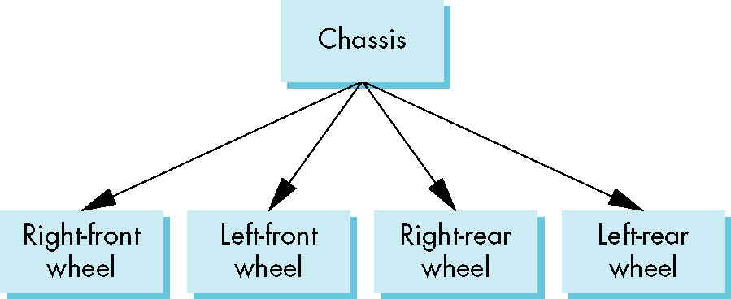
Tree Model of Car
Angel and Shreiner: Interactive Computer Graphics 7E © Addison-Wesley 2015

Slide 11
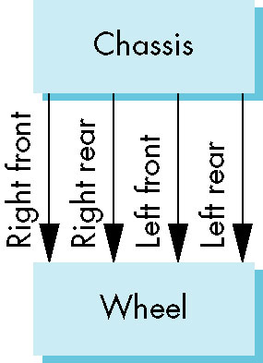
DAG Model
If we use the fact that all the wheels are identical, we get a directed acyclic graph
  Not much different than dealing with a tree
Angel and Shreiner: Interactive Computer Graphics 7E © Addison-Wesley 2015

Slide 12
Modeling with Trees
Must decide what information to place in nodes and what to put in edges
Nodes
  What to draw
  Pointers to children
Edges
  May have information on incremental changes to transformation matrices (can also store in nodes)
Angel and Shreiner: Interactive Computer Graphics 7E © Addison-Wesley 2015

Slide 13
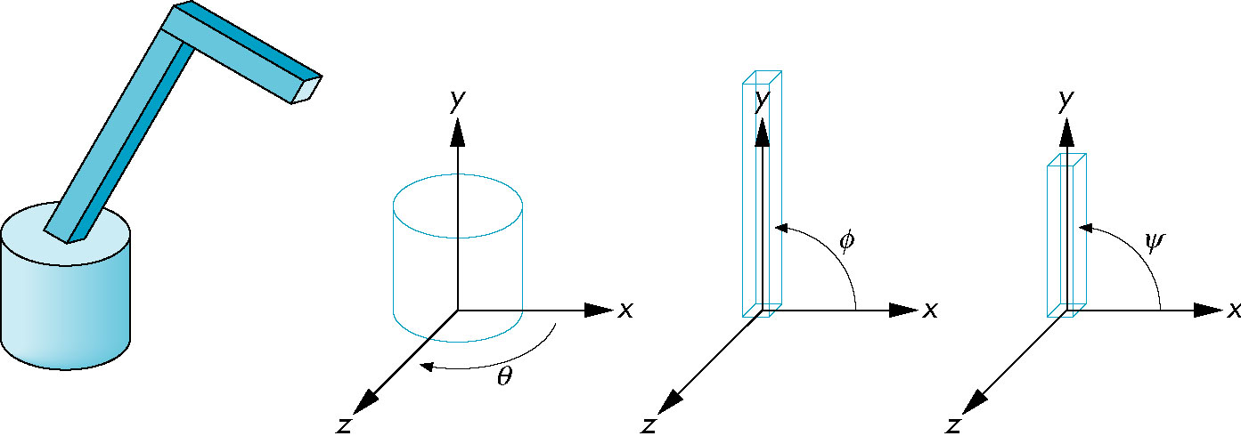
Robot Arm
parts in their own
coodinate systems
robot arm
Angel and Shreiner: Interactive Computer Graphics 7E © Addison-Wesley 2015

Slide 14
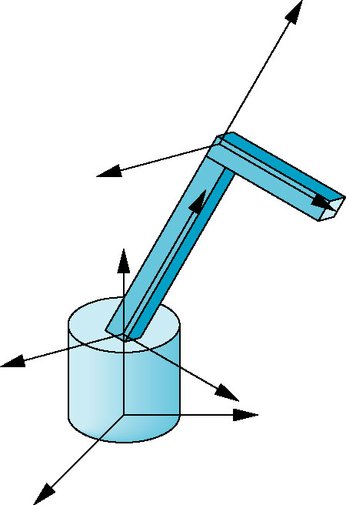
Articulated Models
Robot arm is an example of an articulated model
  Parts connected at joints
  Can specify state of model by
  giving all joint angles
Angel and Shreiner: Interactive Computer Graphics 7E © Addison-Wesley 2015

Slide 15
Relationships in Robot Arm
Base rotates independently
  Single angle determines position
Lower arm attached to base
  Its position depends on rotation of base
  Must also translate relative to base and rotate about connecting joint
Upper arm attached to lower arm
  Its position depends on both base and lower arm
  Must translate relative to lower arm and rotate about joint connecting to lower arm
Angel and Shreiner: Interactive Computer Graphics 7E © Addison-Wesley 2015

Slide 16
Required Matrices
Rotation of base: R_{b}
  Apply M = R_{b} to base
Translate lower arm relative to base: T_{lu}
Rotate lower arm around joint: R_{lu}
  Apply M = R_{b} T_{lu} R_{lu} to lower arm
Translate upper arm relative to upper arm: T_{uu}
Rotate upper arm around joint: R_{uu}
  Apply M = R_{b} T_{lu} R_{lu} T_{uu} R_{uu} to upper arm
Angel and Shreiner: Interactive Computer Graphics 7E © Addison-Wesley 2015

Slide 17
WebGL Code for Robot
var render = function() {
gl.clear( gl.COLOR_BUFFER_BIT | gl.DEPTH_BUFFER_BIT );
modelViewMatrix = rotate(theta[Base], 0, 1, 0 );
base();
modelViewMatrix = mult(modelViewMatrix,
translate(0.0, BASE_HEIGHT, 0.0));
modelViewMatrix = mult(modelViewMatrix,
rotate(theta[LowerArm], 0, 0, 1 ));
lowerArm();
modelViewMatrix = mult(modelViewMatrix,
translate(0.0, LOWER_ARM_HEIGHT, 0.0));
modelViewMatrix = mult(modelViewMatrix,
rotate(theta[UpperArm], 0, 0, 1) );
upperArm();
requestAnimFrame(render);
}
Angel and Shreiner: Interactive Computer Graphics 7E © Addison-Wesley 2015

Slide 18
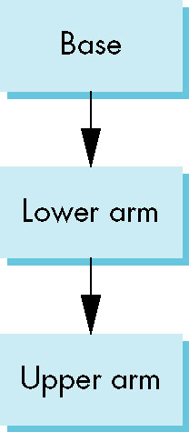
Tree Model of Robot
Note code shows relationships between parts of model
  Can change “look” of parts easily without altering relationships
Simple example of tree model
Want a general node structure
for nodes
Angel and Shreiner: Interactive Computer Graphics 7E © Addison-Wesley 2015

Slide 19
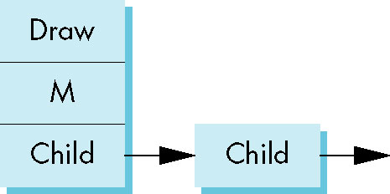
Possible Node Structure
Code for drawing part or
pointer to drawing function
linked list of pointers to children
matrix relating node to parent
Angel and Shreiner: Interactive Computer Graphics 7E © Addison-Wesley 2015

Slide 20
Generalizations
Need to deal with multiple children
  How do we represent a more general tree?
  How do we traverse such a data structure?
Animation
  How to use dynamically?
  Can we create and delete nodes during execution?
Angel and Shreiner: Interactive Computer Graphics 7E © Addison-Wesley 2015

