Slide 1
Introduction to Computer Graphics with WebGL
Ed Angel
Professor Emeritus of Computer Science
Founding Director, Arts, Research, Technology and Science Laboratory
University of New Mexico
Angel and Shreiner: Interactive Computer Graphics 7E © Addison-Wesley 2015

Slide 2
Ray Tracing
Ed Angel
Professor Emeritus of Computer Science
University of New Mexico
Angel and Shreiner: Interactive Computer Graphics 7E © Addison-Wesley 2015

Slide 3
Objectives
Develop a basic recursive ray tracer
Computer intersections for quadrics and polygons
Angel and Shreiner: Interactive Computer Graphics 7E © Addison-Wesley 2015

Slide 4
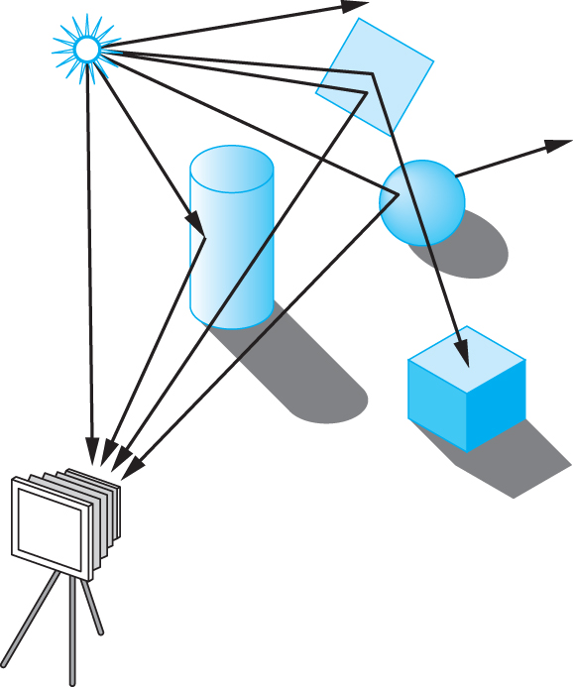
Ray Tracing
Follow rays of light from a point source
Can account for reflection and transmission
Angel and Shreiner: Interactive Computer Graphics 7E © Addison-Wesley 2015

Slide 5
Computation
Should be able to handle all physical interactions
Ray tracing paradigm is not computational
Most rays do not affect what we see
Scattering produces many (infinite) additional rays
Alternative: ray casting
Angel and Shreiner: Interactive Computer Graphics 7E © Addison-Wesley 2015

Slide 6
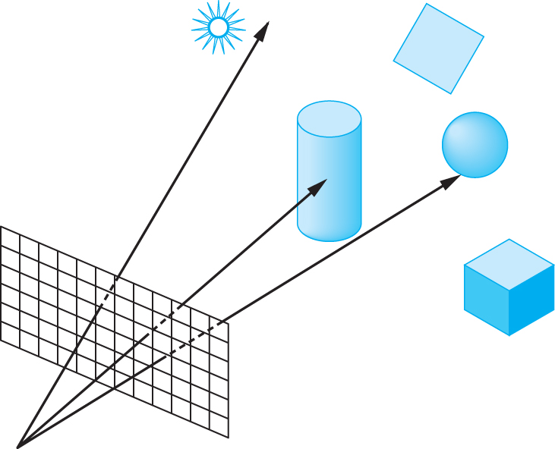
Ray Casting
Only rays that reach the eye matter
Reverse direction and cast rays
Need at least one ray per pixel
Angel and Shreiner: Interactive Computer Graphics 7E © Addison-Wesley 2015

Slide 7
Ray Casting Quadrics
Ray casting has become the standard way to visualize quadrics which are implicit surfaces in CSG systems
Constructive Solid Geometry
  Primitives are solids
  Build objects with set operations
  Union, intersection, set difference
Angel and Shreiner: Interactive Computer Graphics 7E © Addison-Wesley 2015

Slide 8

Ray Casting a Sphere
Ray is parametric
Sphere is quadric
Resulting equation is a scalar quadratic equation which gives entry and exit points of ray (or no solution if ray misses)
Angel and Shreiner: Interactive Computer Graphics 7E © Addison-Wesley 2015

Slide 9
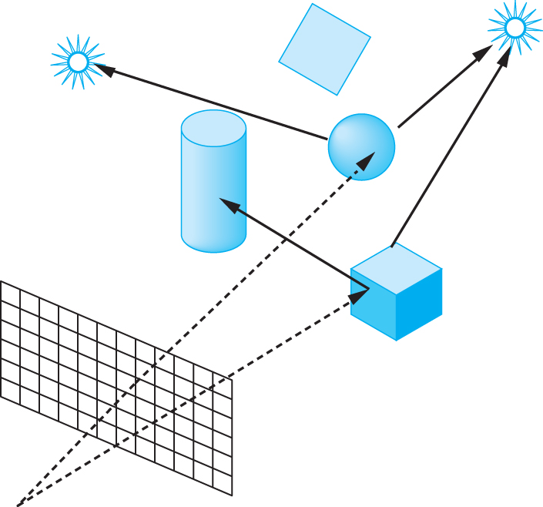
Shadow Rays
Even if a point is visible, it will not be lit unless we can see a light source from that point
Cast shadow or feeler rays
Angel and Shreiner: Interactive Computer Graphics 7E © Addison-Wesley 2015

Slide 10
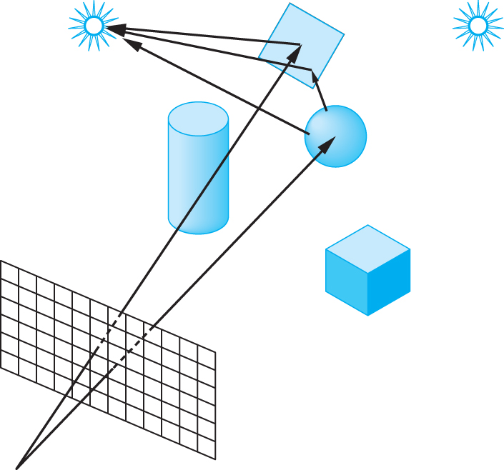
Reflection
Must follow shadow rays off reflecting or transmitting surfaces
Process is recursive
Angel and Shreiner: Interactive Computer Graphics 7E © Addison-Wesley 2015

Slide 11
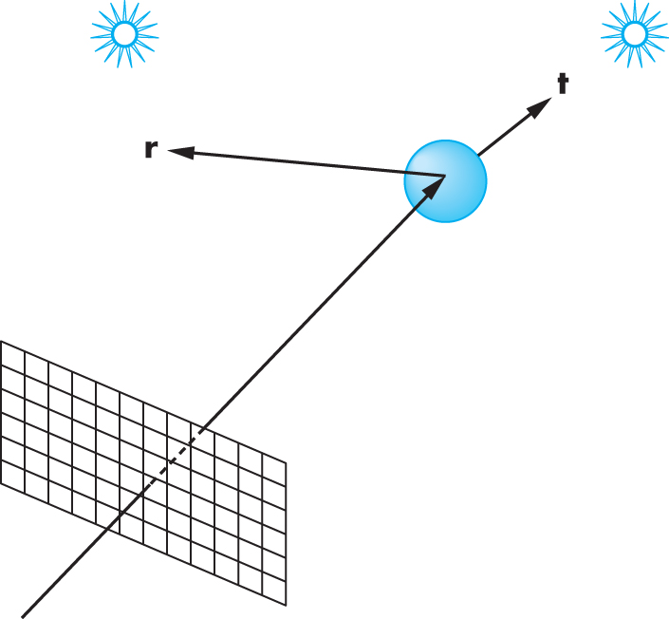
Reflection and Transmission
Angel and Shreiner: Interactive Computer Graphics 7E © Addison-Wesley 2015

Slide 12
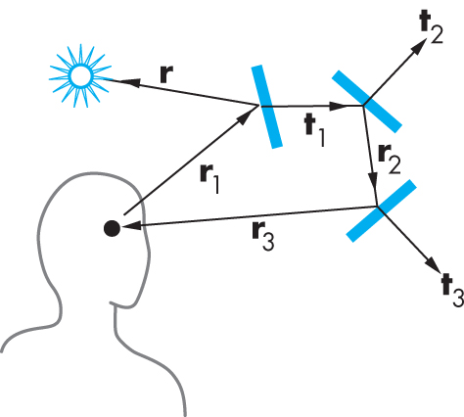
Ray Trees
Angel and Shreiner: Interactive Computer Graphics 7E © Addison-Wesley 2015

Slide 13
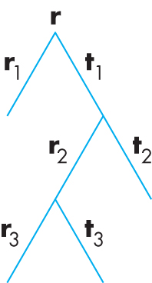
Ray Tree
Angel and Shreiner: Interactive Computer Graphics 7E © Addison-Wesley 2015

Slide 14
Diffuse Surfaces
Theoretically the scattering at each point of intersection generates an infinite number of new rays that should be traced
In practice, we only trace the transmitted and reflected rays but use the modified Phong model to compute shade at point of intersection
Radiosity works best for perfectly diffuse (Lambertian) surfaces
Angel and Shreiner: Interactive Computer Graphics 7E © Addison-Wesley 2015

Slide 15
Building a Ray Tracer
Best expressed recursively
Can remove recursion later
Image based approach
  For each ray …….
Find intersection with closest surface
  Need whole object database available
  Complexity of calculation limits object types
Compute lighting at surface
Trace reflected and transmitted rays
Angel and Shreiner: Interactive Computer Graphics 7E © Addison-Wesley 2015

Slide 16
When to stop
Some light will be absorbed at each intersection
  Track amount left
Ignore rays that go off to infinity
  Put large sphere around problem
Count steps
Angel and Shreiner: Interactive Computer Graphics 7E © Addison-Wesley 2015

Slide 17
Recursive Ray Tracer
color c = trace(point p, vector d, int step)
{
color local, reflected,
transmitted;
point q;
normal n;
if(step > max)
return(background_color);
Angel and Shreiner: Interactive Computer Graphics 7E © Addison-Wesley 2015

Slide 18
Recursive Ray Tracer
q = intersect(p, d, status);
if(status==light_source) return(light_source_color);
if(status==no_intersection) return(background_color);
n = normal(q);
r = reflect(q, n);
t = transmit(q,n);
Angel and Shreiner: Interactive Computer Graphics 7E © Addison-Wesley 2015

Slide 19
Recursive Ray Tracer
local = phong(q, n, r);
reflected = trace(q, r, step+1);
transmitted = trace(q,t, step+1);
return(local+reflected+
transmitted);
Angel and Shreiner: Interactive Computer Graphics 7E © Addison-Wesley 2015

Slide 20
Computing Intersections
Implicit Objects
  Quadrics
Planes
Polyhedra
Parametric Surfaces
Angel and Shreiner: Interactive Computer Graphics 7E © Addison-Wesley 2015

Slide 21
Implicit Surfaces
Ray from p₀ in direction d
p(t) = p₀ +t d
General implicit surface
f(p) = 0
Solve scalar equation
f(p(t)) = 0
General case requires numerical methods
Angel and Shreiner: Interactive Computer Graphics 7E © Addison-Wesley 2015

Slide 22
Quadrics
General quadric can be written as
  p^{T}Ap + b^{T}p +c = 0
Substitute equation of ray
p(t) = p₀ +t d
to get quadratic equation
Angel and Shreiner: Interactive Computer Graphics 7E © Addison-Wesley 2015

Slide 23
Sphere
(p – p_{c}) • (p – p_{c}) – r² = 0
p(t) = p₀ +t d
p₀ • p₀ t²+ 2 p₀ • (d – p₀) t + (d – p₀) • (d – p₀)
– r² = 0
Angel and Shreiner: Interactive Computer Graphics 7E © Addison-Wesley 2015

Slide 24
Planes
p • n + c = 0
p(t) = p₀ +t d
t = -(p₀ • n + c)/ d • n
Angel and Shreiner: Interactive Computer Graphics 7E © Addison-Wesley 2015

Slide 25
Polyhedra
Generally we want to intersect with closed convex objects such as polygons and polyhedra rather than planes
Hence we have to worry about inside/outside testing
For convex objects such as polyhedra there are some fast tests
Angel and Shreiner: Interactive Computer Graphics 7E © Addison-Wesley 2015

Slide 26
Ray Tracing Polyhedra
If ray enters an object, it must enter a front facing polygon and leave a back facing polygon
Polyhedron is formed by intersection of planes
Ray enters at furthest intersection with front facing planes
Ray leaves at closest intersection with back facing planes
If entry is further away than exit, ray must miss the polyhedron
Angel and Shreiner: Interactive Computer Graphics 7E © Addison-Wesley 2015

