Slide 1

Virtual Session
20th March 2020

Slide 2
NLU Hands-on Workshop
Nayer Wanas
Principal RSDE Manager

Slide 3
NLU Basics
Explaining the basics of a NLU extraction

Slide 4

Conversational AI What is Conversational AI?
Conversational AI is a subfield of artificial intelligence focused on producing natural and seamless conversations between humans and computers
A new user interface paradigm
Exposes software services through conversational interface
In apps, browser and on IoT devices

Slide 5
What is Natural Language Understanding (NLU)?
NLU directly enables Human-Computer Interaction (HCI) in the form of dialogues/conversations.
Enables computers to understand commands without the formalized syntax of computer languages
Enables computers to communicate back to humans in their own languages.
NLU is tasked with communicating with untrained individuals and understanding their intent, and entities meaning that NLU goes beyond understanding words and interprets meaning.
NLU should be programmed with the ability to understand meaning despite common human errors like mispronunciations or transposed letters or words.

Slide 6
Definitions: Intents, Entities and dialogues
Intent: An intent represents the purpose of a user's input. You define an intent for each type of user request you want your application to support.
Entity: An entity represents a term or object that is relevant to your intents and that provides a specific context for an intent.
Dialog: A dialog is a branching conversation flow that defines responses to the defined intents and entities

Slide 7
Dialogues: What we need?
Task – Oriented Dialogs
“User has a question”: User needs to consume Information
What is today’s agenda?
What does MSFT stand for?
“User needs to get something done”: User needs to complete some task
Book me a flight from Cairo to Seattle
Reserve me a table at The Kitchen for 5 people at 7 pm
“User need to know what to do”: User needs decision support
Is the Build conference good to attend?
Open – Domain Dialogs:
“User wants to chit-chat”: User wants to talk like a human
Social Chat
Engaging, Human-Like Interaction (Ungrounded)
Task-Oriented
Task Completion, Decision Support (Grounded)

Slide 8


Language Understanding Cognitive Service (LUIS)
The most comprehensive cloud-based service for Natural Language Understanding (NLU), and the simplest to use for developers with no AI expertise
Improve recognition through Machine Learning and Teaching​​
Extract intent and entities from utterances ​
Notes:
Before I go any further could I get a show of hand for those who have do something with Natural Language Understanding?
How many have used LUIS previously?
That is great to see the amount of people who have used NLU, it is a growing area along with the growth in the conversational AI space
LUIS is the cognitive service that performs NLU enabling everyone including developers with limited machine learning knowledge, to create Language understanding models. Machine learning and machine teaching, which is an integration of machine learning with human computer interaction are used to generate the models to perform extraction from user utterances for intents (what a user wants with his/her statement) and the entities, which is what the user is acting upon
Collectively these provide a machine representation of the user utterance that could be used in an E2E solution

Slide 9

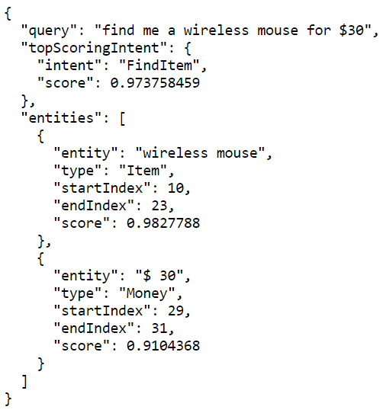
Language Understanding (LUIS) Overview
Your LUIS Application
Your Service
A web service that enables building your own custom intelligent models using utterances in identifying intents and entities
Utterances: Short text up to 500 characters
“Find me a wireless mouse at $30”
Find an Item
Item -> wireless mouse
Money -> $30
“Find me a wireless mouse at $30”
Item
Money

Slide 10
Machine Teaching
Labeled Data Availability
Rule based Approaches
Data Based Approaches
Interleaves ML algorithms with HCI in the form of human teachers who provide interactions on the utterances to achieve improved performance
Leverage huge volumes of unlabeled utterances to improve modeling
Active learning cycle of training, scoring and machine-driven feedback.
Cross fertilization of the human expert with the machine learning algorithms
Select data points that would be labeled to improve efficiency of the models developed.
Plan
Build
Test and Improve
Publish
Connect
Refine

Slide 11
Intents
Design and Considerations

Slide 12
Intent (+Domain) Detection/Classification
Classification problem:
Given a collection of utterances {U} with class/domain labels {C} we need to train a model to estimate labels for a new utterance u
Intent and Domain classification mostly performed jointly
Domain | Intent
Movies | Find_movie
 | Buy_ticket …
Restaurant | Find_restaurant
 | Book_table …
…..
Find me an Italian restaurant in Cairo

Slide 13
How do I define my user intents
As its name implies, user intent tells us what a user is “looking to do/looking for” when providing an utterance.
In case of basic models, intents are action verbs
E.g. greeting, confirmation, request a vacation, place an order, delete an email etc..
Intent take into consideration the words used in the utterance, and intent selection should be driven by this fact

Slide 14


Definitions: Intents, Entities and dialogues
Intents need to be discriminated based on words used
Requesting paid leave Vs Asking about public holidays
Requesting paid leave Vs Requesting sick leave
If intents can’t have a “unique set of words” that define it then it would be ambiguous, and you should reconsider merging these intents and using entities to discriminate them.
Clearly separable intents make for good classification/detection

Slide 15
Entities
Design and Considerations

Slide 16
Entity Extraction
Sequence tagging problem:
Given a collection of tagged word sequences {S} with labels {M} we need to train a model to estimate tags for a new word sequence
Flights from Cairo to Seattle Today
OriginCity
DestinationCity
Date

Slide 17
What are my entities?
User Entities are items or elements the user is taking action about.
In case of basic models, entities are elements of intents that the bot requires to collect and are usually nouns
E.g. date, type of leave, country, name etc..
Entities are divided into common entities/pre-trained and custom entities
Common entities require no learning/training
Custom entities require training
Almost all NLU models would require custom entities.

Slide 18
Common Entities in NLU
Pre-defined Entities: Common entities that are pre-trained/defined and could be used directly. Dates, amounts, duration etc…
Extracting Places, names, organizations etc.
Regular expressions: formal definitions of elements such as product codes, or postal codes

Slide 19
Custom Entities in NLU
Custom entities are required elements that are fundamental to defining the user request.
Custom entities require labeling to enable training
Extraction depends on defining the appropriate sequence of words leading up to the entity.
I want to request a paid leave from Jan 20 to Jan 23
What are the public holidays in France

Slide 20
Language Understanding (LUIS): Entity Types
Simple Entity: Describes a single concept. They learn from context using examples through machine learning
List Entity: A fixed list of words, phrases, and their synonyms that get exact matched in your utterances.
Roles: Named, contextual subtypes of an entity. Extract more information by adding roles to your entities. Roles can be applied to any kind of entity.
Prebuilt Entity: Common entities provided by LUIS through open source text recognizers available through GitHub, expanded through the community and driven by Microsoft.
Hierarchical: Represents an entity that has parts. It is made up of one or more entities, including supplementary text.
Regex Entity: An entity that exact matches based on the regular expression defined.
ML
Prebuilt
Regex
List
Simple
Hierarchical
non-ML
Notes:
So this is a more formal description of the entity types, I wouldn’t run you through that
But this is just highlighting that the simple entity is a machine learnt entity extractor as opposed to the list, prebuilt and regex which are non-machine learnt
And that the composite and roles reside on top of all these entity types to form structures that are useful in decomposing entities

Slide 21
Language Understanding (LUIS): Entity Usage
Machine Learning Entity: Should be the entity type to use by default
List Entity: Suitable for a bounded set of elements that rarely change (e.g. pizza size, payment method, etc…)
Roles/Constraints: When the same entity could be used in different contexts (e.g. number could be quantity “three pizzas” or type “four cheese pizza”), when you need to verify that an entity is potentially correct
Prebuilt Entity: Well formed entities that should be leveraged when needed (e.g. datetime, number etc…)
Hierarchical : Used to encode structure, could be multiple entities, or intent/entity elements (e.g. remove {topping})
Regex Entity: Well formed alpha-numeric elements (e.g. product codes)
Prebuilt : Role
List
ML
Intent
List
I’ll order one large pepperoni pizza with extra cheese and remove the mushrooms
Hierarchal
Actional Hierarchal
Notes:
Before moving further, LUIS boosts several entity types that make it a very powerful tool, and I thought I would share with you when each type should be used
So the default entity should be a simple entity, so things like products would be a simple machine learnt entity,
You could use list entities which are exact matches of elements in the list, this is good for a bounded set that doesn’t change like pizza sizes or toppings
You are encouraged to use Prebuilt entities when you have well formed entity extractors like number extractor
You can also place roles on any of these entities, which would define the contextual use of an entity like number here is quantity but in “four cheese pizza” its actually in the pizza type
Composite entities are a structure of entities, so you could form things like quantity, size and type as a composite entity defining a full produce
But you could also use it to bind intents and entities, or actionable composite, where you capture things like remove mushrooms in a composite, and this would be used to present an action as opposed to the intent based approach
Regex entities are good for well formed alpha-numeric elements like product codes
Just a quick tip I communicate with developers that you should over detect entities, its better to have to resolve them downstream with logic if there are overlapping as opposed to missing something in the extraction

Slide 22
Entity Hierarchies
When a group of entities are parented together, they form a hierarchy that move together
Parenting can be nested
Children could be with an offset from each other, and they can include different words that bind parent-child
leave details [{LeaveType}] from {DateRange:{DateStart} to {DateEnd}}
Managing varying hierarchies includes presenting the model with different forms of how it appears
Entity extraction of parents and children could be independent

Slide 23
Pizza Bot
Demonstrating a LUIS model for Pizza Ordering

Slide 24
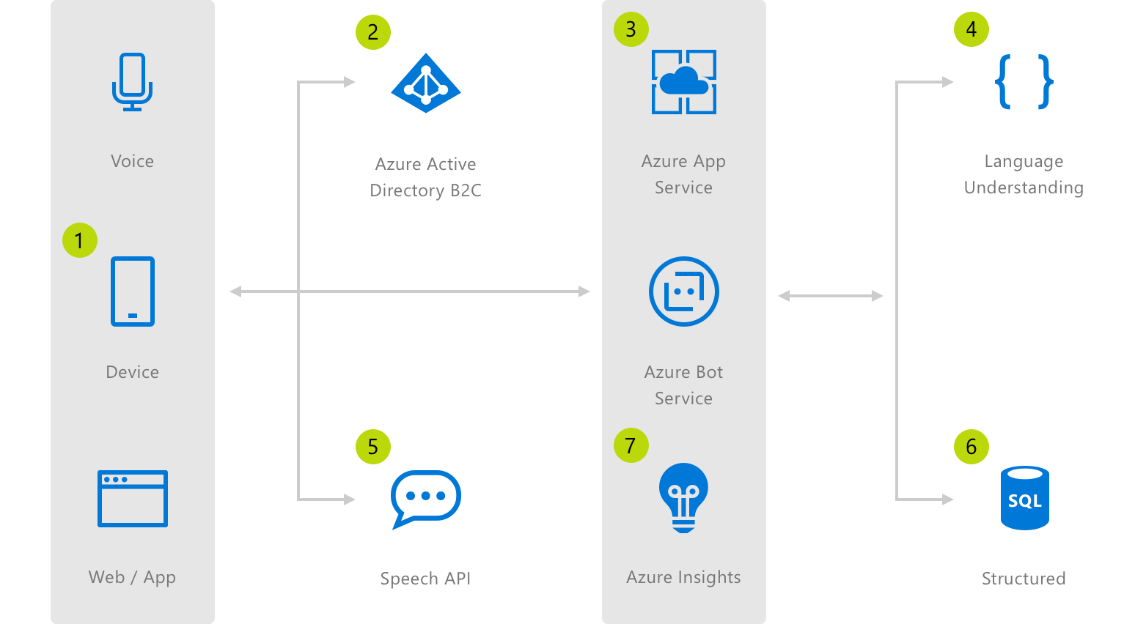

Let’s try a model
Build a model for a Pizza ordering application
Ordering from the full menu
It should handle adding and removing and modifying the contents of a cart
Should be able to handle products and product modifications
Offer different delivery/payment
Handle “niceties” and other general conversational elements
Should handle different input modes (text and speech) and work with an E2E bot scenario
Let’s jump in….
Notes:
So rather than just list the new features we are adding in LUIS addressing core language understanding, I will take this opportunity to run you through an experience of building a model
So this ignite we are going to launch Microsoft Pizza, and definitely needs to be enabled with a Bot…
To do an end to end solution for this we need to be able to integrate with the different platforms, and devices, use speech as an input and complete the picture with some insights, the BF delivers these aspects and builds upon the LUIS model we will create

Slide 25


Pizza Ordering Architecture
Bot Security
Facebook Messenger
Cortana
Inputs
Bot Key Secrets
Google Assistant
Alexa
Bot Logic, UX, Connectors
Bot Intelligence
Text
Voice
iOS App
Bot
Service
App Service
(UX, Logic)
Data & Cache
Language
Understanding
Android App
Text Utterance Data
Web
Logging and Telemetry
Speech Utterance Data
Telegram
QnA Maker
App
Insights
Logs
Menu Data
Channels
Reporting
Speech
Power BI
Notes:
This would be an architecture that would integrate speech with

Slide 26
Resources
https://github.com/Azure/pizza_luis_bot

Slide 27
Advanced Modeling
Features and Ideas

Slide 28
Decompostion
Actionable hierarchies (int-ent-ities):
Mapping actions to entities (such as adding, removing, modifying, canceling etc..) in hierarchies
number
Size
Product
Options
Attribute
Toppings
Options
Qualifier
Toppings
Size
CrustType
Product
Dips
I’ll order one large pepperoni pizza with extra cheese and remove the mushrooms and a medium stuffed crust chicken pizza with ranch
Full Product
Qualified Option
Remove Item
Full Product
"intents“:
{"name": “ModifyOrder"},
{"name": “CancelOrder"},
{"name": "Confirmation"},
{"name": "Greetings"},
{"name": "None"}
"entities":
ML: “Order”
Entity Structures: "FullProductWithModifiers", “ToppingModifiers", "RemoveItem", "ReplaceItem", "SideOrder”
ClosedLists: "CrustType","CutOptions","Dips","ModifyOrderDecor", "OPtionsQualifier”, “OrderType”,"paymentType","PizzaType”,"Sauces","Sizes", "Toppings
PrebuiltEntities: "datetimeV2", "number"

Slide 29
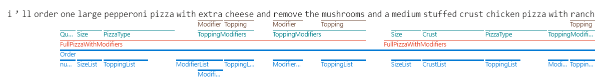
Decomposition
Multi-level parsing
Use staged hierarchy to perform the multi-level parse of an utterance
Allow decomposition of entities
Improve the ability to conceptualize the decomposition
Reduce the amount of rework required with the addition of schema edits
Allow to build more sophisticated with less effort

Slide 30
Model as a Feature
Can we use a recognized “IS-A” relationship as means to improve extraction?
E.g. If I detect part of the utterance IS-A date range is that a good indication that a vacation request is submitted?
E.g. I detected the utterance IS-A food order, then “Chinese” is a cuisine
Injecting extractions and/or classifications as features will improve classification
When should you use model as a feature
When extraction of IS-A elements is easy (using dictionaries or common entities)
When the IS-A element is a clear indication of the entity (or intent for that matter)

Slide 31
Model as a Feature
Can we use a recognized “IS-A” relationship as means to improve extraction?
E.g. If I detect part of the utterance IS-A date range is that a good indication that a vacation request is submitted?
E.g. I detected the utterance IS-A food order, then “Chinese” is a cuisine
Injecting extractions and/or classifications as features will improve classification
When should you use model as a feature
When extraction of IS-A elements is easy (using dictionaries or common entities)
When the IS-A element is a clear indication of the entity (or intent for that matter)

Slide 32
Advanced Modeling
Features and Ideas

Slide 33
Think differently about utterances you add
More utterances the better?
Having just volume of utterances is not enough, and sometimes counter productive
Utterances should have high “variance” representing the actual usage by end users
Making sure your utterances have appropriate variations
Make sure words are present in the variety of their used synonyms. Make sure utterances such as “Request a vacation”, “Place a vacation”, “vacation request” etc.. all exist
In bots people sometime use sentences that are not necessarily making grammatic sense, if utterances used follow this trend add them with the right labels. Make sure to capture different forms of utterances users say, including slang and different ways users express their request
Add utterances which have only the entities marked up. For example, in a food ordering app, your user may just say 'Pizza' instead of 'I would like some Pizza’. Users would expect the same behavior.
If you have many entities structured together make sure the different manner which they are ordered are captured. “I would like to order a large extra cheese pepperoni pizza” and “extra cheese large pepperoni pizza”
Make sure prepositions are well varied in your data

Slide 34
Training your model, where do I get the data?
Sampling from actual usage data
Make sure that sampling preserves distribution
If actual usage data is not present, then collect actual data
Make sure the data collected represents the diversity in usage
If no data exists, you could bootstrap the model using generated data. Data should
Follow different ways that users provide utterances
Could have non-grammatically correct sentences that could be used
Make permutations of structured entities
Provide different forms of the structured entities, including missing entities
Provide utterances and entities with varying length when meaningful
Try variations with as many prepositions.
Generated data should be used to bootstrap the model to collect unlabeled utterance if no other approach is possible.

Slide 35
Some common Dos and Don’ts
Dos |  | Don’ts
Define discriminative intents |  | Use LUIS as a training platform
Find a sweet spot between generic and specific |  | Add many examples of the same format
Build your app iteratively |  | Ignore other formats for examples
Add Descriptor lists in later iterations |  | Mix the definition of intents and entities
Remember to define what the bot will not address |  | Train and publish with every single example
Monitor the performance of your app |  | Mix-up NLU and resolution
Make sure labeling is consistent

Slide 36
Entity only utterances
Conversations are multi-turn and sometimes could be addressing a very specific entity request. E.g. in a flow you could find the user addressing the question, “what is the type of vacation you are requesting?”
To allow for such cases to trigger post-LUIS actions, you will have to add an utterance with only the entity and no other words. You would have to mark up the entity though.

Slide 37
Handling Negative Utterances
So what happens when you want to say
Show me holidays in January vs don’t show me holidays in January
You could define two intents, but this would be ambiguous
You are better to define this negative aspect as an entity and capture it accordingly in your logic.

Slide 38
Consideration for models using Speech
Use utterances as produced from Speech-To-Text (STT) in labeling
Make sure utterances span the errors produced by the STT
STT may produce recognitions that are divided/structured as separate words
E.g. 756 -> seven five six
Model such entities as hierarchies of smaller elements as presented

Slide 39
Improving the Schema
Periodically you should go through utterances and check if the schema is functional
The utterance is triggered with the correct intent and entities and the utterance (with the entities abstracted out) is available in the examples list of the intent exactly, word for word. No action has to be taken here. This is the state all utterances have to be in over time.
The utterance is triggered with the wrong intent and the utterance is not in the examples set of the corresponding intent. Then add the utterance to the example set of the correct intent and mark the entities if any.
The utterance is triggered with the wrong intent but the utterance is in the given examples set. See if the same or similar utterance is available in the examples set of another intent. In such a case, you will have to remove the example from one of the intents, to remove the conflict. If this is not the case then raise a ticket to the Slang support team.
The utterance is triggered with the correct intent but the entities are not recognized properly. If the entity is a non-ML entity, try adding the value to the entity. In the ML models, make sure the labeling is consistent and that the sequence is present in multiple forms
The utterance is unrecognized. Add the utterance to the examples list of the corresponding intent.
Integrating this measurement, through evaluation in the CI/CD helps keep the model current

Slide 40
HR Bot
Working to develop and HR Bot

Slide 41
Human Resource Management Model
Human Resource Management: one of the most utilized scenarios in the enterprise for LUIS has been addressing the internal employee actions/interactions. Several customers have been implementing solutions that scope the different services and span both local and global services. To that end the following are the group of functions covered in this model
Employee HR questions: in this scenario employee should have the ability to ask about their vacation limits, employment benefits, employment history and record retrieval.
Employees are defined by name, employee number, home office location, and locale. They also are defined by level and function. The latter could be supplied as closed lists or generated from a data source into a list.
The bot should exchange a dialogue to obtain the employee information prior to the crafted intents.
The employee can inquire about his/her vacation limits and usage. They can ask about procedures for applying for different eligible vacations (QnA makes using an FAQ setup) and apply for a vacation by determining the type of possible vacations. These vacation types could be retrieved from a database of the enterprise and used as a closed list.
The employee could request a customizable HR letter, which would indicate several dimensions including salary, length of employment, addressed to etc..
The employee could organize and manage the interview process, including scheduling, providing and asking for feedback
Notes:
So rather than just list the new features we are adding in LUIS addressing core language understanding, I will take this opportunity to run you through an experience of building a model
So this ignite we are going to launch Microsoft Pizza, and definitely needs to be enabled with a Bot…
To do an end to end solution for this we need to be able to integrate with the different platforms, and devices, use speech as an input and complete the picture with some insights, the BF delivers these aspects and builds upon the LUIS model we will create

Slide 42
Resources
https://github.com/nawanas/MVPSummit2020

Slide 43
ChatBot Lifecycle
Steps to developing a chatbot

Slide 44
Steps for a Chatbot Development
Determine the role of the BOT and set goals
Create the conversational architecture
Design dialogs and storyboards
Collect Bot Data
Pick platform and start implementing
Implement Dialogue and Engineer the NLU

Slide 45
Determine the Role of the Bot and Set Goals
Before you start anything, identify what you want your bot to do and be specific. Identify all required features and address the implementation tasks. Doing this upfront will lead to a robust chatbot and ideally one that can deal with the majority of topics your contact center handles today, including strategies on how to handle unknown answers to questions.
Researching targeted users: Who are your users? What are their objectives, needs, and expectations? What is the context for their interaction with the bot? What is their environment? How will your bot help? What services should your bot provide?
Defining bot personas: How should your bot look (for instance, an avatar)? What should it be called? ? What are your bot’s values? What is your bot’s personality? What tone of voice should your bot use? How would your bot handle in different situations? How should your bot respond (proactive, reactive, exception management)?

Slide 46
Create the Conversational Architecture
The conversational architecture enables creation of a fulfilling experience to your user. You would need to identify the scope of our bot, and how you will manage workflows. Do you have context? Is this a single turn or multi-turn bot?
Evaluate and pick the channel: Where are you carrying this new experience? Is this channel creating app fatigue?
Design your integrations: are there already existing integrations and/or data that be used to support the bot experience?

Slide 47
Design Dialogs and Storyboards.
You need to think about how your bot will respond to they users, and how you would need to start thinking about the bot design. This would define the experience the bot would demonstrate in different points in the conversation.
Storyboarding bot scenarios: What is the user journey for your bot’s targeted users? What should your bot do and not do? What are the priorities of your bot’s use cases?
Designing conversation flow: What conversational flows can you expect for your main use cases? Simple QA, push notifications, step-by-step instructions, or more complex interactions?

Slide 48
Collect Chat Data
No matter what platform you use to create your bot, one of the most important resources you will need is a collection of sentences reflecting different ways to express each one of the intents and entity values your bot will need to recognize. This resource needs to be highly tied to the actual usage of the bot, and not an automated process that fuzzes data.
I already have the data: an ideal resource is actual conversational content with the customers. Make sure to plan the use of the data you have to include data for actual conversations
I don’t have the data, designing data collection: Remember diversity is key, and make sure that the data itself comes with the actual representation, including errors users use.

Slide 49
Pick a Platform and a Development Approach
Starting to bring things together in this step: the conversational architecture, the dialogue flow and storyboard, the platform you have selected, and the data you have collected.
Determine how to map incoming text to output: are you using rules? Is this a FAQ bot? Do I leverage Machine Learning in this mapping?
Determine the best platform to develop your bot: what simplifies your development, deployment and maintainability? Always look ahead

Slide 50


















Knowledge
Sources
Conversational AI
Cognitive Services
Channels
General Knowledge
Manuals (PDF)
Data Sources
BOT Intelligence
Azure Bot
Services
Search
Business Process
User
Input
Speech
On premise
Tap
Adaptive Cards
IFTTT
QnA
Vision
Type
Speak
Language Understanding
Devices
3rd Party
Assistants
IoT Edge

Slide 51
Implement Dialogue and Engineer the NLU
Bot Framework Composer is an integrated development tool for developers and multi-disciplinary teams to build bots and conversational experiences with the Microsoft Bot Framework. Within this tool, you'll find everything you need to build a sophisticated conversational experience.
https://github.com/microsoft/BotFramework-Composer
Adaptive Dialogs is a new way to model conversations that takes the best of waterfall dialogs and prompts and simplifies sophisticated conversation modelling primitives like building a dialog dispatcher and ability to handle interruptions elegantly. The new Adaptive dialog and the event model simplify sophisticated conversation modelling primitives, eliminate much of the boiler plate code and helps you focus on the model of the conversation rather than the mechanics of dialog management. An Adaptive dialog is a derivative of a Dialog and interacts with the rest of the SDK dialog system.
https://github.com/Microsoft/BotBuilder-Samples/tree/master/experimental/adaptive-dialog

Slide 52
NLUDevOps (https://github.com/Microsoft/NLU.DevOps)
overall_1_132241972397315101 columns_1_132241972397315101
Source Control for LUIS models, and training and testing data
Unit/Batch testing of LUIS applications
Configuring an Azure CI/CD pipeline and continuous improvement of a LUIS model

Slide 54
Sponsors

