Slide 1
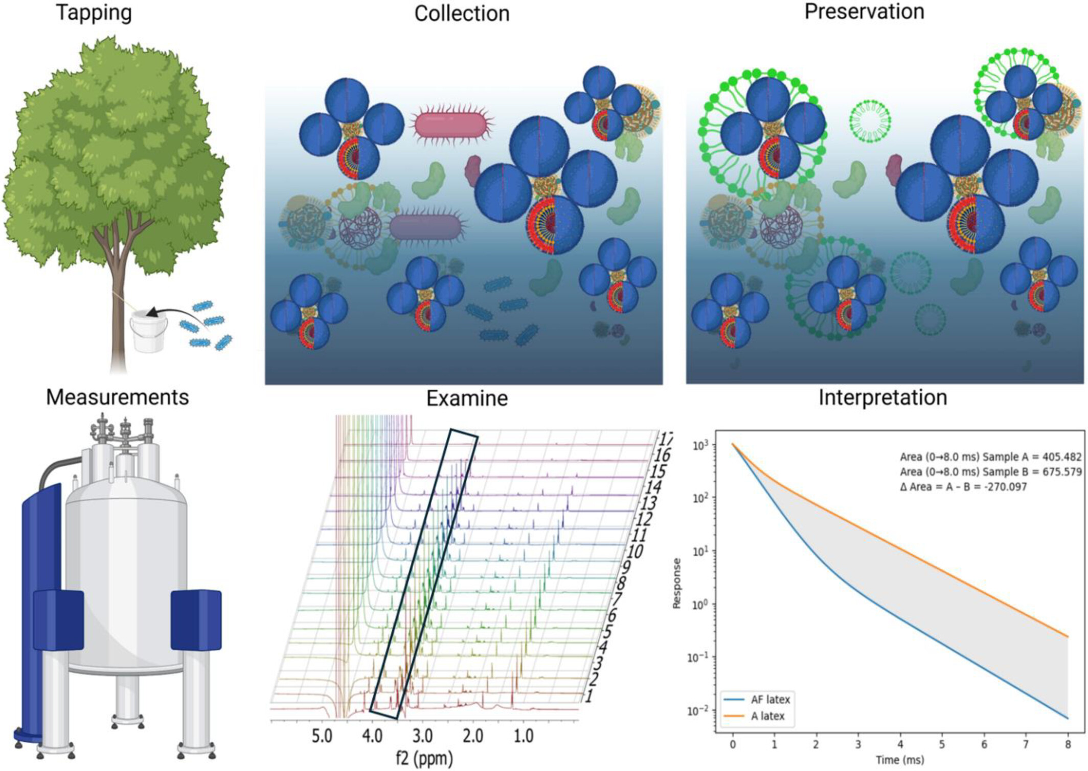
Characterization of Natural Rubber Latex With High‐Sensitivity, Diffusion‐Ordered, and Time Domain NMR
Polymer Engineering & Sci, Volume: 65, Issue: 10, Pages: 5109-5123, First published: 03 July 2025, DOI: (10.1002/pen.70041)
Notes:
Ammonia‐free system preparation and time domain NMR analysis.
IF THIS IMAGE HAS BEEN PROVIDED BY OR IS OWNED BY A THIRD PARTY, AS INDICATED IN THE CAPTION LINE, THEN FURTHER PERMISSION MAY BE NEEDED BEFORE ANY FURTHER USE. PLEASE CONTACT WILEY'S PERMISSIONS DEPARTMENT ON PERMISSIONS@WILEY.COM OR USE THE RIGHTSLINK SERVICE BY CLICKING ON THE 'REQUEST PERMISSIONS' LINK ACCOMPANYING THIS ARTICLE. WILEY OR AUTHOR OWNED IMAGES MAY BE USED FOR NON-COMMERCIAL PURPOSES, SUBJECT TO PROPER CITATION OF THE ARTICLE, AUTHOR, AND PUBLISHER.

