Slide 1
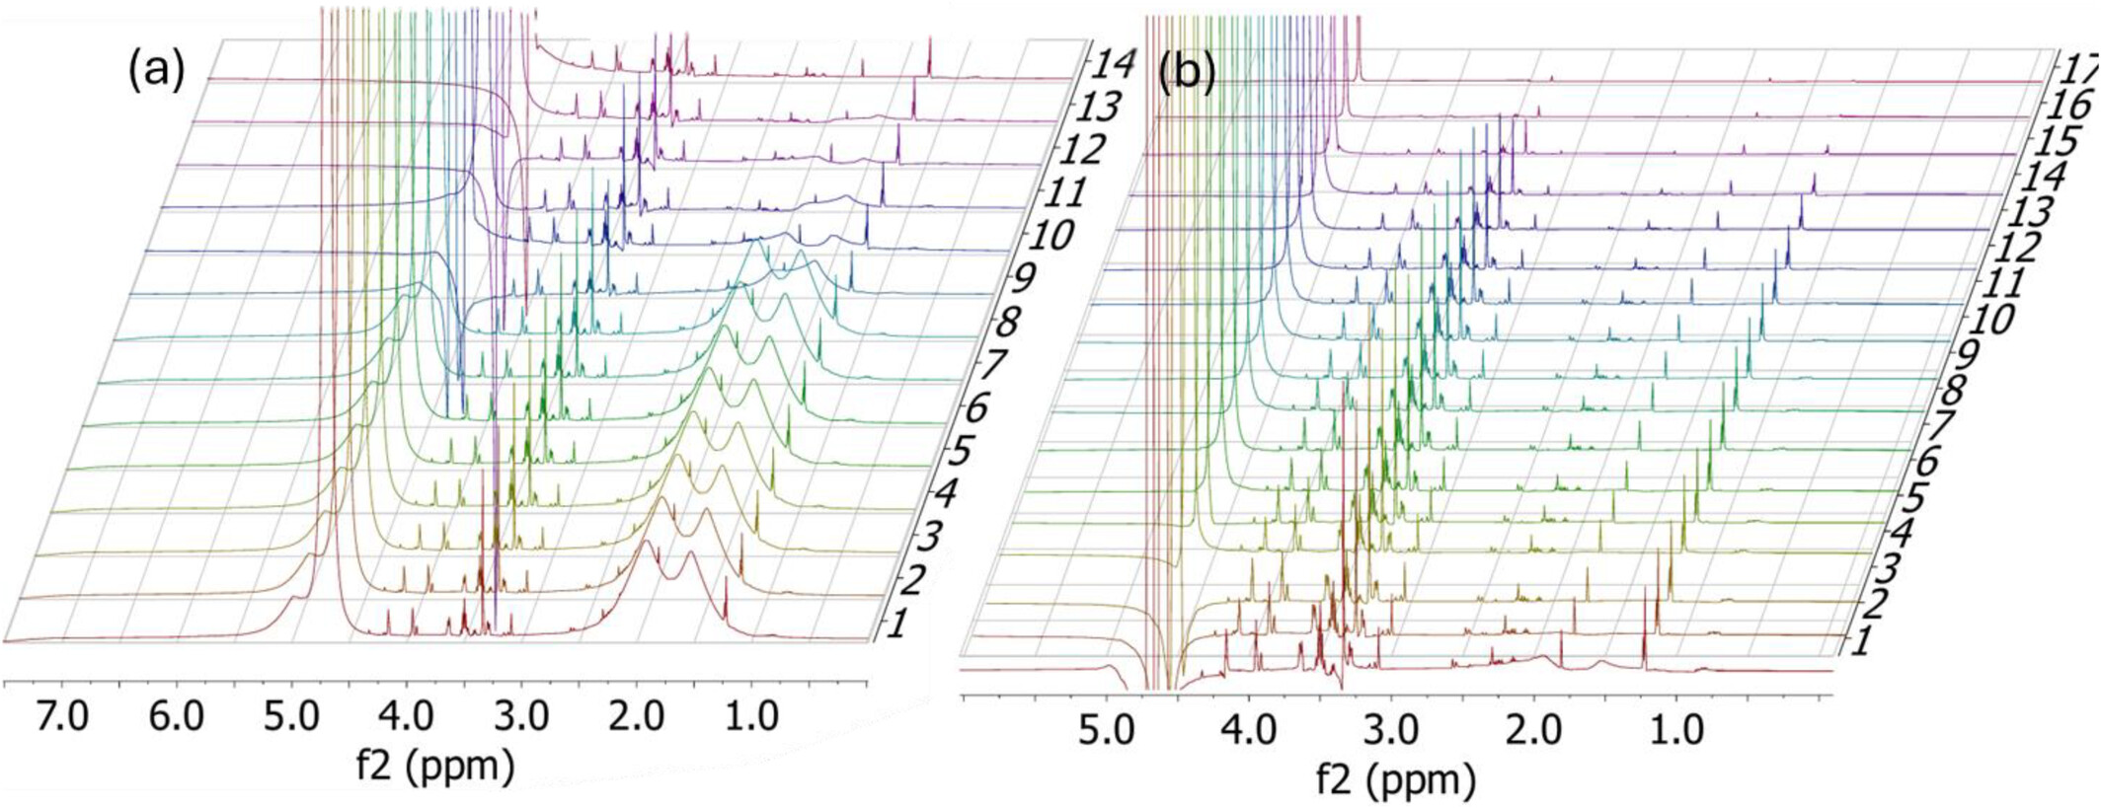
Characterization of Natural Rubber Latex With High‐Sensitivity, Diffusion‐Ordered, and Time Domain NMR
Polymer Engineering & Sci, Volume: 65, Issue: 10, Pages: 5109-5123, First published: 03 July 2025, DOI: (10.1002/pen.70041)
Notes:
FT transferred CMPG data, (a) variable delay optimal for the core, and (b) variable delay optimal for shells such as lipids.
IF THIS IMAGE HAS BEEN PROVIDED BY OR IS OWNED BY A THIRD PARTY, AS INDICATED IN THE CAPTION LINE, THEN FURTHER PERMISSION MAY BE NEEDED BEFORE ANY FURTHER USE. PLEASE CONTACT WILEY'S PERMISSIONS DEPARTMENT ON PERMISSIONS@WILEY.COM OR USE THE RIGHTSLINK SERVICE BY CLICKING ON THE 'REQUEST PERMISSIONS' LINK ACCOMPANYING THIS ARTICLE. WILEY OR AUTHOR OWNED IMAGES MAY BE USED FOR NON-COMMERCIAL PURPOSES, SUBJECT TO PROPER CITATION OF THE ARTICLE, AUTHOR, AND PUBLISHER.

