Slide 1
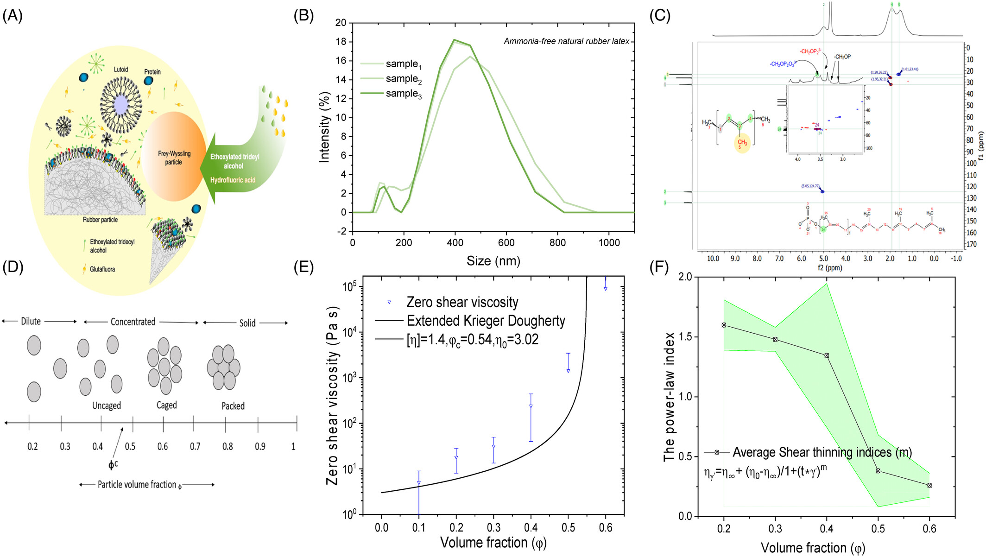
Ammonia‐free natural rubber latex photo‐resin for sustainable 3D printing of highly stretchable and tough elastomers
SPE Polymers, Volume: 6, Issue: 2, First published: 14 April 2025, DOI: (10.1002/pls2.70011)
Notes:
(A) Preservation of NRL using eco‐friendly additives, ethoxylated tridecyl alcohol, and hydrofluoric acid. (B) Size distribution of latex particles. (C) Structural characterization of the repeating unit cis 1,4‐polyisoprene using solution state 2D NMR. (D) Prediction of latex's critical volume fraction (ϕc), illustrating transitions between dilute, concentrated, and solid phases. (E) Viscosity measurements were performed on nine specimens, with error bars indicating standard deviation. (F) Further validation of the critical volume fraction using shear‐thinning indices derived from the Cross model as a function of volume fraction.
IF THIS IMAGE HAS BEEN PROVIDED BY OR IS OWNED BY A THIRD PARTY, AS INDICATED IN THE CAPTION LINE, THEN FURTHER PERMISSION MAY BE NEEDED BEFORE ANY FURTHER USE. PLEASE CONTACT WILEY'S PERMISSIONS DEPARTMENT ON PERMISSIONS@WILEY.COM OR USE THE RIGHTSLINK SERVICE BY CLICKING ON THE 'REQUEST PERMISSIONS' LINK ACCOMPANYING THIS ARTICLE. WILEY OR AUTHOR OWNED IMAGES MAY BE USED FOR NON-COMMERCIAL PURPOSES, SUBJECT TO PROPER CITATION OF THE ARTICLE, AUTHOR, AND PUBLISHER.

