Slide 1
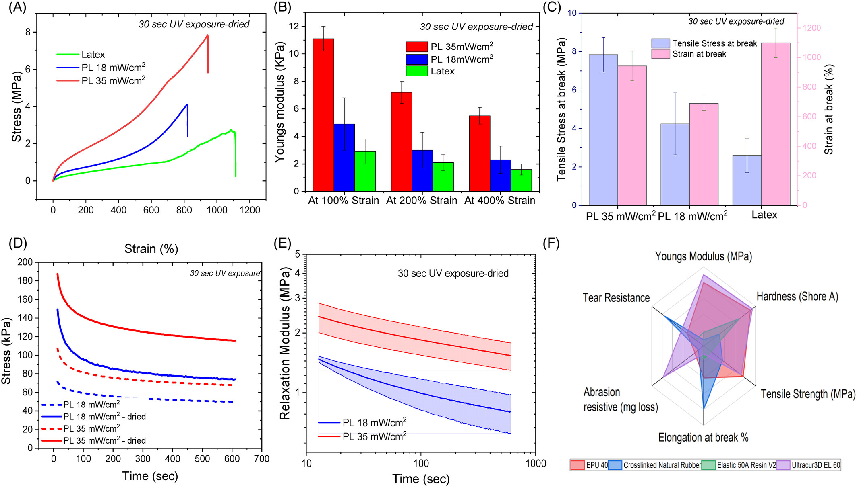
Ammonia‐free natural rubber latex photo‐resin for sustainable 3D printing of highly stretchable and tough elastomers
SPE Polymers, Volume: 6, Issue: 2, First published: 14 April 2025, DOI: (10.1002/pls2.70011)
Notes:
(A) Stress–strain curves for UV‐cured samples at 18 and 35 mW/cm2; each sample was tested in triplicate, and the standard deviation is reported (B‐C) Bar charts comparing tensile strength, elongation at break, and modulus for samples cured at different intensities. (d) Dynamic Mechanical Analysis (DMA) stress relaxation measurements for UV‐cured and dried samples. (E) Relaxation modulus analysis, 35 mW/cm2 samples retain more stress over time, with behaviors described by a power function. (F) Radar plot comparing key mechanical properties (Young's modulus, tear resistance, abrasion resistance, hardness, and elongation at break) between the crosslinked NRL and commercially available elastomeric inks, including EPU 40, Elastic 50A Resin V2, and Ultracur3D EL 60.
IF THIS IMAGE HAS BEEN PROVIDED BY OR IS OWNED BY A THIRD PARTY, AS INDICATED IN THE CAPTION LINE, THEN FURTHER PERMISSION MAY BE NEEDED BEFORE ANY FURTHER USE. PLEASE CONTACT WILEY'S PERMISSIONS DEPARTMENT ON PERMISSIONS@WILEY.COM OR USE THE RIGHTSLINK SERVICE BY CLICKING ON THE 'REQUEST PERMISSIONS' LINK ACCOMPANYING THIS ARTICLE. WILEY OR AUTHOR OWNED IMAGES MAY BE USED FOR NON-COMMERCIAL PURPOSES, SUBJECT TO PROPER CITATION OF THE ARTICLE, AUTHOR, AND PUBLISHER.

