Slide 1
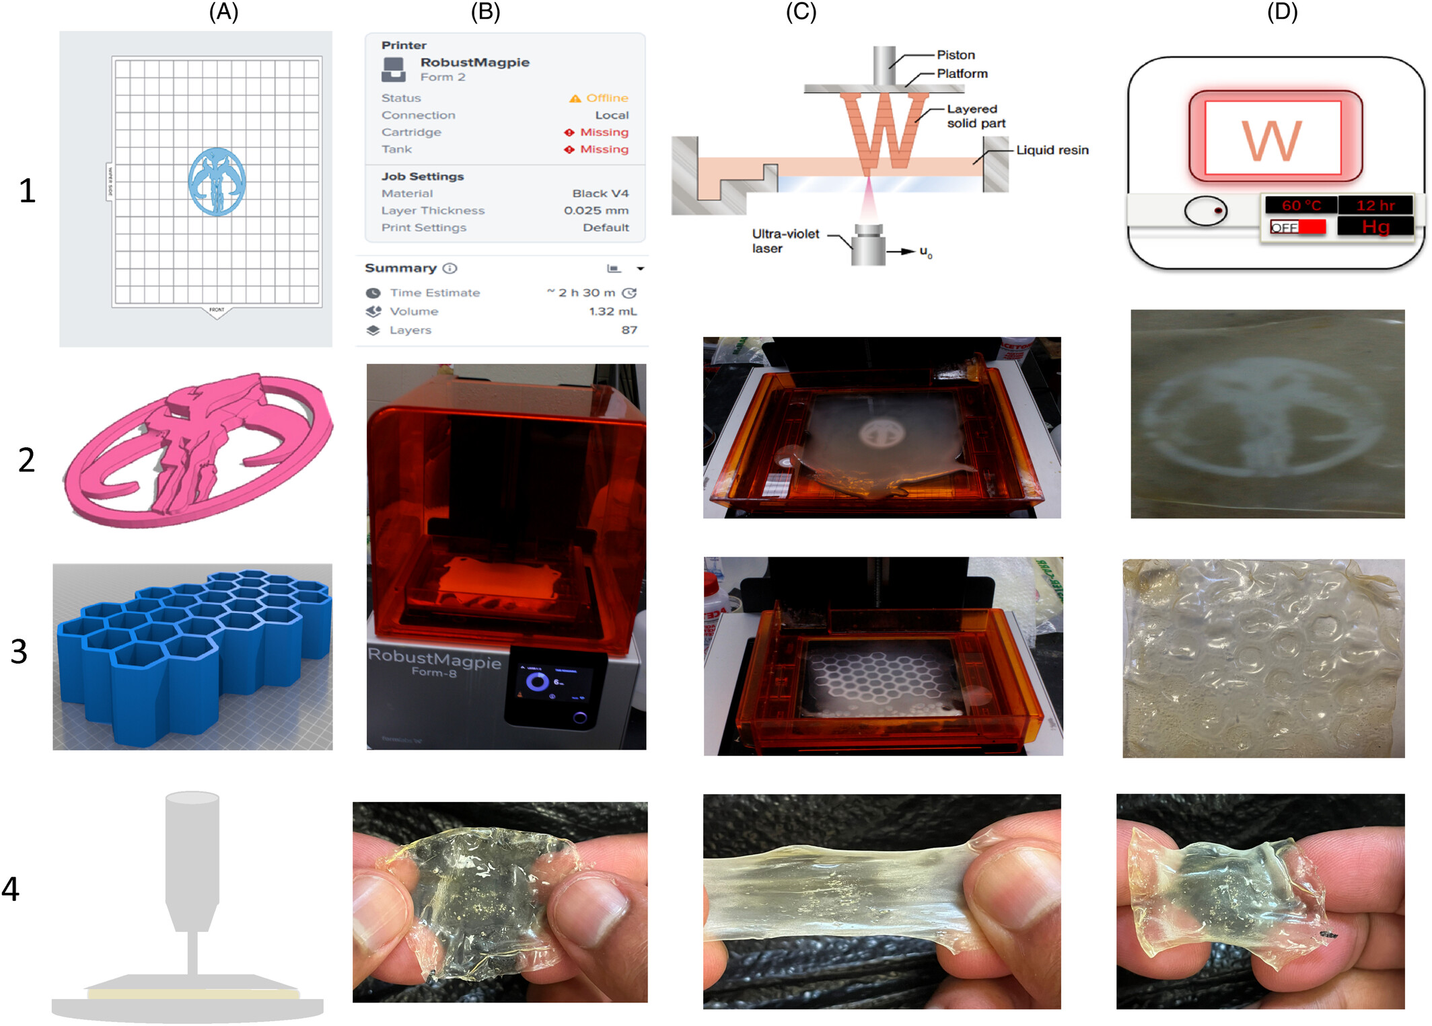
Ammonia‐free natural rubber latex photo‐resin for sustainable 3D printing of highly stretchable and tough elastomers
SPE Polymers, Volume: 6, Issue: 2, First published: 14 April 2025, DOI: (10.1002/pls2.70011)
Notes:
(A)1 CAD model preparation. (B) The printer is set up in offline and open‐access modes, utilizing a commercially available SLA 3D printer. (C) The printing process highlights the successful fabrication of complex structures using the developed ink. (D) Post‐processing workflow, 4, Samples fabricated with an in‐situ rheometer, demonstrating stretchability and recoverability.
IF THIS IMAGE HAS BEEN PROVIDED BY OR IS OWNED BY A THIRD PARTY, AS INDICATED IN THE CAPTION LINE, THEN FURTHER PERMISSION MAY BE NEEDED BEFORE ANY FURTHER USE. PLEASE CONTACT WILEY'S PERMISSIONS DEPARTMENT ON PERMISSIONS@WILEY.COM OR USE THE RIGHTSLINK SERVICE BY CLICKING ON THE 'REQUEST PERMISSIONS' LINK ACCOMPANYING THIS ARTICLE. WILEY OR AUTHOR OWNED IMAGES MAY BE USED FOR NON-COMMERCIAL PURPOSES, SUBJECT TO PROPER CITATION OF THE ARTICLE, AUTHOR, AND PUBLISHER.

