Slide 1
Chapter One
Introduction to C# and .NET Frameworks
Berihun G.

Slide 2
Contents to be discussed
Rapid Application Development
Introduction to C# Programming
.NET Framework

Slide 3
Rapid Application Development
It is a methodology that enables organizations to develop strategically important systems faster while reducing development costs and maintaining quality.
RAD is a process through which the development cycle of an application is expedited.
It enables quality products to be developed faster, saving valuable resources.
The magnitude of such savings is truly RAD!
It prioritizes rapid prototyping and quick feedback over long drawn out development and testing cycles.
Notes:
Challenges in software developmemnt

Slide 4
Why RAD?
Makes new ways of operation possible.
The most revolutionary and successful change in IT business practices today is Rapid Application Development.
Development is a more capable process, as it is much faster and less error prone than hand coding(Hard Coding)

Slide 5
The key benefits and advantages of RAD are:
Enhanced flexibility and adaptability as developers can make adjustments quickly during the development process.
Quick iterations that reduce development time and speed up delivery.
Encouragement of code reuse, which means less manual coding, less room for errors, and shorter testing times.
Increased customer satisfaction due to high-level collaboration and coordination between stakeholders (developers, clients, and end users).
Fewer surprises as, unlike the Waterfall method, RAD includes integrations early on in the software development process.

Slide 6
Advantages and disadvantages of RAD
Advantages of RAD | Disadvantages of RAD
Requirements can be changed at any time | Needs strong team collaboration
Encourages and priorities customer feedback | Cannot work with large teams
Reviews are quick | Needs highly skilled developers
Development time is drastically reduced | Needs user requirement throughout the life cycle of the product
More productivity with fewer people | Only suitable for projects which have a small development time
Time between prototypes and iterations is short | More complex to manage when compared to other models
Integration isn’t a problem, since it integrates from project inception | Only systems which can be modularised can be developed using Rapid application development.

Slide 7
RAD Tools
Advantage of these:
Easy drag and drop(very simple ,easy and clear to use) vs sit-and-code
Can be customized as you want
Inexperienced users can use prebuilt in apps
Can easily create your own processes models
Cross platform tools
Easy integration with other third-party tools
Quick and easy development
Zoho Creator
Kissflow
OutSystems
Bizagi
Appian
RAD in C# and ASP.NET is advisable to use for easy and fast development of soft wares.
Notes:
What are the Top Rapid Application Development Platforms: G Suite, Google App Engine, Microsc Azure, RapidClipse, Ultimate++, Kintone, CUBA Platform, Mendix , 4WS.Platform, EASA, AWS Lambd entellitrak, Amazon Elastic Compute Cloud (EC2), VINYL, Cloud Foundry, Caspio, MIOedg QuickBase, MATS Platform, WEBRATIO, OpenShift, AWS Elastic Beanstalk, IBM Bluemix, Flynn a some of the Top Rapid Application Development Platforms.

Slide 8
Introduction to C# Programming
C# is a multi-paradigm programming language which is based on object-oriented and component-oriented programming disciplines.
It provides a framework for free intermixing constructs from different paradigms.
C# was developed by Microsoft with Anders Hejlsberg as the principal designer and lead architect, within its .NET initiative and it made its appearance in 2000.
Anders Hejlsberg and his team wanted to build a new programming language that would help to write class libraries in a .NET framework. He claimed that C# was much closer to C++ in its design.

Slide 9
Continued …
It is a type of event driven programing language:-
Event driven is a programming paradigm in which the flow of the program is determined by events such as user actions (mouse clicks, key presses), sensor outputs, or message passing from other programs or threads. ===>Visual Basic, Visual C++ and Java are examples of such languages.

Slide 10
Cont.
Design Goals
C# was intended to be a simple, modern, object-oriented language.
The language and implementation had to provide support for software engineering principles like:
  strong type checking,
  array bounds checking and
  automatic garbage collection.
The language was intended for development of software components suitable for deployment in distributed environments.
Source code portability was important for programmers who were familiar with C and C++.
Support for internalization to adapt the software to different languages.

Slide 11
Features of C#
C# is the first “component-oriented” language in the C/C++ family.
The big idea of C# is that everything is an object.
C# is a programming language that directly reflects the underlying Common Language Infrastructure (CLI). Most of its intrinsic types correspond to value-types implemented by the CLI framework.
Type-safety: C# is more type safe than C++. Type safety is the extent to which a programming language discourages or prevents type errors.

Slide 12
Cont.
C#, like C++, but unlike Java, supports operator overloading.
Managed memory is automatically garbage collected.
  Garbage collection addresses the problem of memory leaks by freeing the programmer of responsibility for releasing memory that is no longer needed.
C# provides a pair of methods, accessor (getter) and mutator (setter) encapsulate operations on a single attribute of a class.
In addition to the try...catch construct to handle exceptions, C# has a try...finally construct to guarantee execution of the code in the finally block, whether an exception occurs or not.➔ provides exception handling

Slide 13
Cont.
Multiple inheritance is not supported, although a class can implement any number of interfaces. This was a design decision to avoid complication and simplify architectural requirements throughout CLI.
Unlike Java, C# does not have checked exceptions. This has been a conscious decision based on the issues of scalability and version ability.
C# supports a strict Boolean data type, bool. Statements that take conditions, such as while and if, require an expression of a type that implements the true operator, such as the Boolean type.

Slide 14
Recap:
C# under CLR .NET Framework provides the following:
    It converts the program into native code.
    Handles Exceptions
    Provides type-safety
    Memory management
    Provides security
    Improved performance
    Language independent
    Platform independent
    Garbage collection
    Provides language features such as inheritance, interfaces, and overloading for object-oriented programming

Slide 15
.NET Framework
.NET Framework is a software platform for building systems on the Windows family of operating systems, as well as on numerous non-Microsoft operating systems such as Mac OS X and various Unix/Linux distributions
It is a complete environment that allows developers to develop, run, and deploy the following applications:
  Console applications
  Windows Forms applications
  Windows Presentation Foundation (WPF) applications
  Web applications (ASP.NET applications)
  Web services and Windows services
  Service-oriented applications using Windows Communication Foundation (WCF)
  Workflow-enabled applications using Windows Workflow Foundation (WF)

Slide 16
Cont.
.NET Framework enables a developer to create sharable components to be used in distributed computing architecture
. NET Framework supports the object-oriented programming model for multiple languages, such as Visual Basic, Visual C#, and Visual C++.
.NET Framework supports multiple programming languages in a manner that allows language interoperability.

Slide 17
Core features of .NET
Interoperability with existing code: Existing COM can commingle (i.e., interop) with newer .NET software and vice versa. As of .NET 4.0 onward, interoperability has been further simplified with the addition of the dynamic keyword.
Support for numerous programming languages: .NET applications can be created using any number of programming languages (C#, Visual Basic, F#, etc.
A common runtime engine shared by all .NET-aware languages: One aspect of this engine is a well-defined set of types that each .NET-aware language understands.
N.B: COM (which stands for the Component Object Model) allowed individuals to build libraries of code that could be shared across diverse programming languages binaries

Slide 18
Core features of .NET…
Language integration: .NET supports cross-language inheritance, cross-language exception handling, and cross-language debugging of code. For example, you can define a base class in C#, and extend this type in Visual Basic.
A comprehensive base class library: This library provides shelter from the complexities of low-level API calls and offers a consistent object model used by all .NET-aware languages.
A simplified deployment model: Unlike COM, .NET libraries are not registered into the system registry. Furthermore, the .NET platform allows multiple versions of the same *.dll to exist in harmony on a single machine.

Slide 19
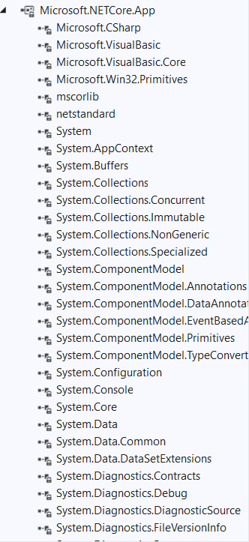

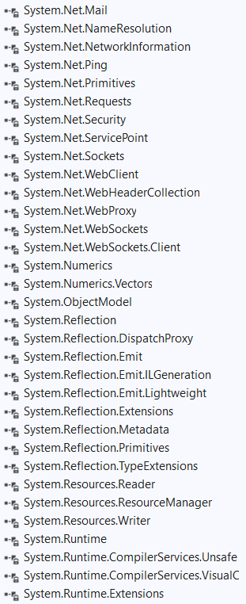
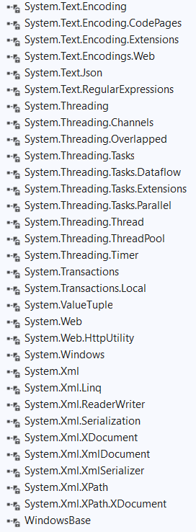
Visual studio .NET framework provides the following sample packages

Slide 20
Main components of .NET Framework
.NET Framework provides enormous advantages to software developers in comparison to the advantages provided by other platforms. [Slide no19]
Microsoft has united various modern as well as existing technologies of software development in .NET Framework.
These technologies are used by developers to develop highly efficient applications for modern as well as future business needs.

Slide 21
Main components of .NET Framework…
The following are the key components of .NET Framework:
  .NET Framework Class Library
  Common Language Runtime
  Dynamic Language Runtimes (DLR)
  Application Domains
  Runtime Host
  Common Type System
  Metadata and Self-Describing Components
  Cross-Language Interoperability
  .NET Framework Security
  Profiling
  Side-by-Side Execution

Slide 22
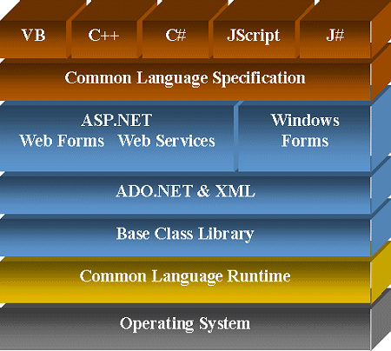
Main components of .NET Framework…

Slide 23
Common Language Specification (CLS)
CLS is a set of basic language features that .Net needed to develop Applications and Services , which are compatible with the .Net Framework.
When there is a situation to communicate Objects written in different .Net Complaint languages , those objects must expose the features that are common to all the languages .
It ensures complete interoperability among applications, regardless of the language used to create the application.
It also defines a subset of Common Type System (CTS) .

Slide 24
Common Type System (CTS)
CTS describes a set of types that can be used in different .Net languages in common .
That is , the CTS ensure that objects written in different .Net languages can interact with each other.
For Communicating between programs written in any .NET complaint language, the types have to be compatible on the basic level .
It provides base set of Data Types which is responsible for cross language integration.
The Common Language Runtime (CLR) can load and execute the source code written in any .Net language, only if the type is described in the CTS.

Slide 25
Roles of CLR in .NET Framework.
CLR (Common Language Runtime) provides an environment to execute .NET applications on target machines.
CLR is also a common runtime environment for all .NET code irrespective of their programming language, as the compilers of respective language in .NET Framework convert every source code into a common language known as MSIL or IL (Intermediate Language).
CLR also provides various services to execute processes, such as memory management service and security services.
CLR performs various tasks to manage the execution process of .NET applications.

Slide 26
Roles of CLR in .NET Framework…
The responsibilities of CLR are listed as follows:
  Automatic memory management
  Garbage Collection
  Code Access Security
  Code verification
  JIT compilation of .NET code

Slide 27
Microsoft Intermediate Language (MSIL)
The .NET Framework is shipped with compilers of all .NET programming languages to develop programs.
There are separate compilers for the Visual Basic, C#, and Visual C++ programming languages in .NET Framework.
Each .NET compiler produces an intermediate code after compiling the source code.
The intermediate code is common for all languages and is understandable only to .NET environment.
This intermediate code is known as MSIL.

Slide 28
Intermediate Language (IL)
Intermediate Language is also known as MSIL (Microsoft Intermediate Language) or CIL (Common Intermediate Language).
All .NET source code is compiled to IL.
IL is then converted to machine code at the point where the software is installed, or at run-time by a Just-In-Time (JIT) compiler.

Slide 29
Role of the JIT compiler in .NET Framework
The JIT compiler is an important element of CLR, which loads MSIL on target machines for execution.
The MSIL is stored in .NET assemblies after the developer has compiled the code written in any .NET-compliant programming language, such as Visual Basic and C#.
JIT compiler translates the MSIL code of an assembly and uses the CPU architecture of the target machine to execute a .NET application.

Slide 30
Role of the JIT compiler in .NET Framework
It also stores the resulting native code so that it is accessible for subsequent calls.
If a code executing on a target machine calls a non-native method, the JIT compiler converts the MSIL of that method into native code.
JIT compiler also enforces type-safety in runtime environment of .NET Framework.
It checks for the values that are passed to parameters of any method.
For example, the JIT compiler detects any event, if a user tries to assign a 32-bit value to a parameter that can only accept 8-bit value.

Slide 31
Managed and Unmanaged code
Managed code is the code that is executed directly by the CLR instead of the operating system. [written in VB,C#,Java]
The code compiler first compiles the managed code to intermediate language (IL) code, also called as MSIL code.
This code doesn't depend on machine configurations and can be executed on different machines.
Unmanaged code is the code that is executed directly by the operating system outside the CLR environment.[written C,C++]
It is directly compiled to native machine code which depends on the machine configuration.
In the managed code, since the execution of the code is governed by CLR, the runtime provides different services, such as garbage collection, type checking, exception handling, and security support

Slide 32
Execution process for managed code
A piece of managed code is executed as follows:
Choosing a language compiler
Compiling the code to MSIL
Compiling MSIL to native code
Executing the code.
Reading Assignment
Read and understand the following concepts from the reference book.
Introduction to Microsoft Visual Studio 2010
  SDI and MDI Forms==>===>you will learn in windows form applications
  Controls

