Slide 1
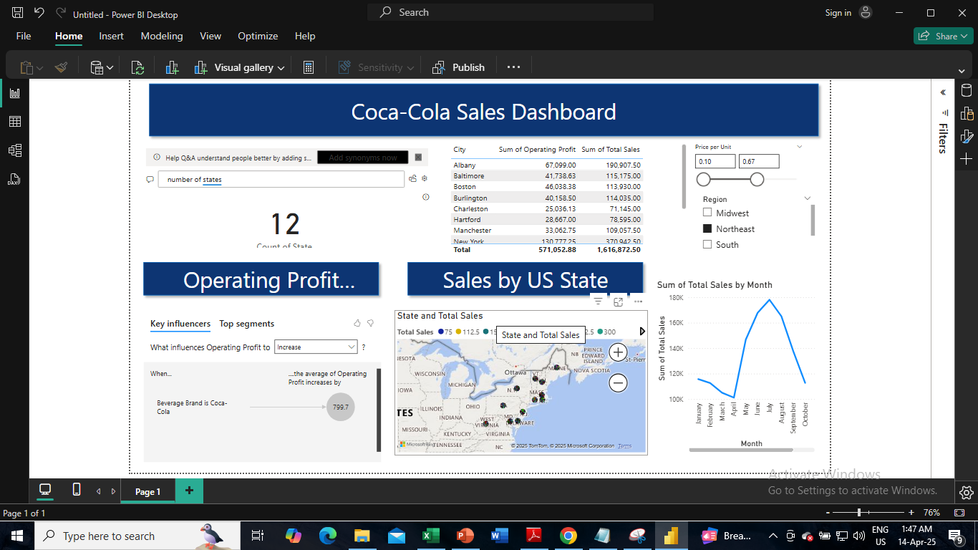
Power BI Dashboard

Slide 2
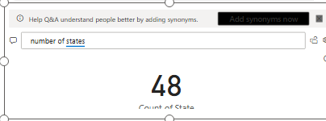
Using Q&A box, we can type any parameter and get the results. Like here, we wrote number of states and got the result to be shown as 48

Slide 3
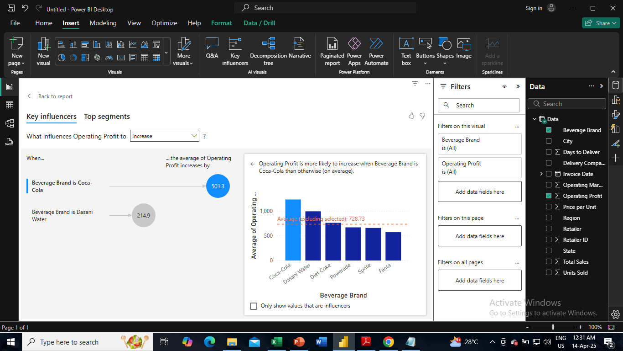
Using key influencers, here we get to see that when the brand is Coca-cola, it is more likely to be profitable

Slide 4
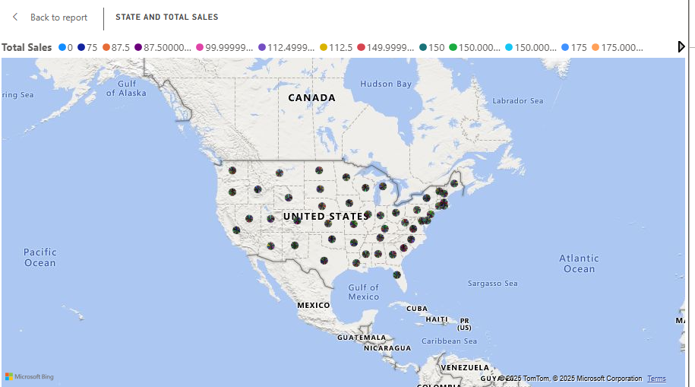
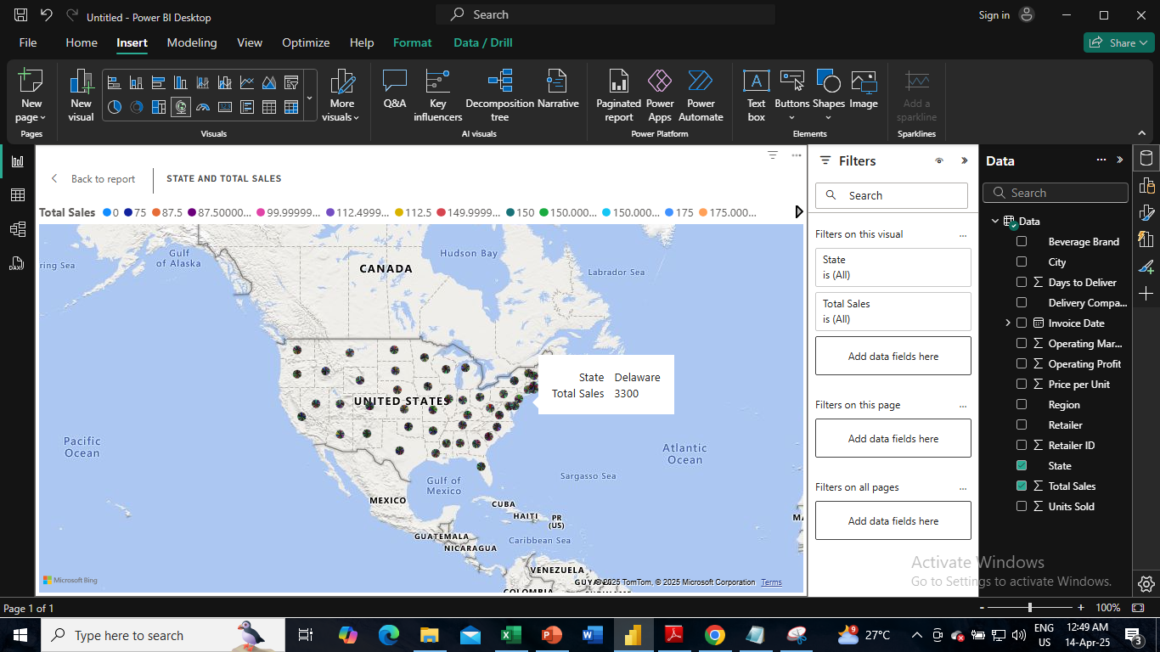
We have used map to show different locations of sales. We can hover over the location and it shows the location name and total sales in the location

Slide 5

Also, we can zoom in and out in the map as we have activated the zoom buttons

Slide 6
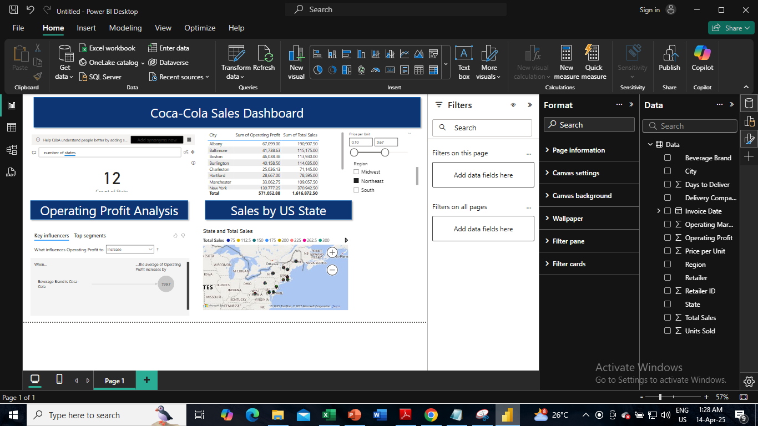


We have inserted here 2 slicers – Units sold and Region, which can be adjusted or selected to give different results

Slide 7
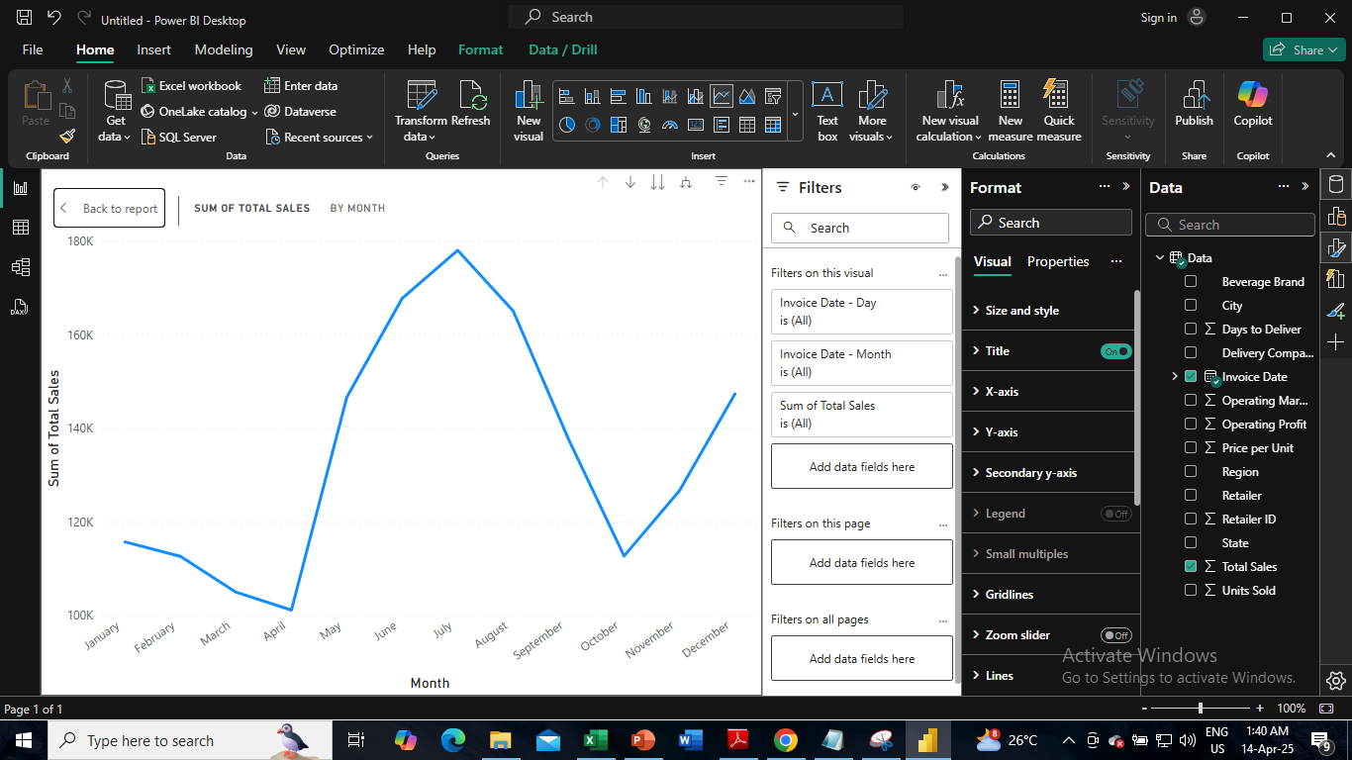
We have done a time-series analysis showing the total sales by month

