Slide 1

Instagram User analysis
By Dibyajyoti Dutta

Slide 2
About the project
User analysis is the process by which we track how users engage and interact with our digital product (software or mobile application) to derive business insights for marketing, product & development teams.
The product team of Instagram and the product manager has asked to provide insights on the questions asked by the management team.

Slide 3
My Overall Approach To Solve The Project
I have read and understood all the questions that are asked in the project.
First, I have created connection in mySql Workbench and started by creating the database as I have given in the document( ig_clone).
Then I have connected the database schema to operate on the given database.
I have run the efficient mySql query operations according to the given tasks by Marketing team and Investors.
I have obtained the required results efficilently with mySql queries and saved the output records in excel sheets separately according to the tasks given.
At last I have put all the recorded tables into Microsoft Power Bi tool to create a data visualizing dashboard in order to give you the clear picture about my study and analysis of the tasks given to me, as visulization is the most easy and impactful way to represent my analytic studies.

Slide 4
Tech-Stack Used
I have used mainly 3 software to complete this project:
MYSQL WORKBENCH 8.0 (to run the SQL queries)
MICROSOFT EXCEL (to store the resulted records)
MICROSOFT POWER BI (to transform data and create dashboard)

Slide 5
Insights
With the Instagram User Analytic project I could learn various tasks and questions related to the application and also how to tackle the challanges and find best business solutions for marketing and investors using data analysis. I have learnt how data analysis plays a vital role in the field of today’s world full of data and problems related to data; how any online business growth requies data analysis to understand and grow with user’s information.

Slide 6
The insights I have observed in this particular project
With Bar Graph representing Most Loyal Users, we can see who has registered into the application at earliest time amongst all users(with respect to created_at datetime).
With the Table data, we can see the inactive users who never posted any photos in the application plateform.
With the Clustered Bar Graph we can determine the photo which got most likes.
With the Area Graph we can easily determine which hashtags are mostly used.
With the Card representation we can see which day of the week most users registered in the application.
With Card again, we can see what is the average numbers of posts users makes in Instagram.
At last, with the Donut Graph, we can see all the Bot Users whoever liked every single photos in the application.

Slide 7
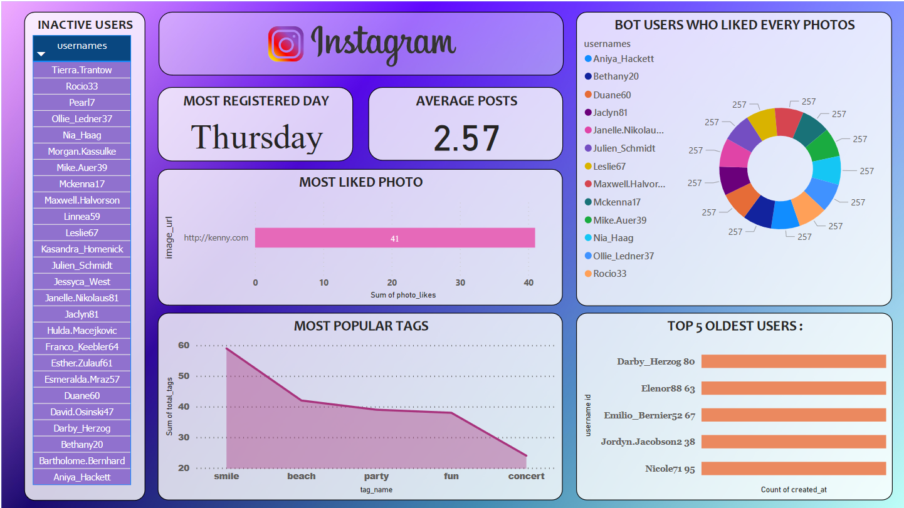

Slide 8
Tasks And SQL Queries
A) Marketing: The marketing team wants to launch some campaigns, so according to their requirments I have created this query reports as following:
Rewarding Most Loyal Users: People who have been using the platform for the longest time.
Task: To find the 5 oldest users of the Instagram from the database.
Sql Query:
>> select username,created_at from users
order by created_at asc
limit 5;

Slide 9
2. Remind Inactive Users to Start Posting: By sending them promotional emails to post their 1st photo.
Task: Find the users who have never posted a single photo on Instagram
Sql Query:
>> select username from users
left join photos on users.id = photos.user_id
where photos.id is null;

Slide 10
3. Declaring Contest Winner: The team started a contest and the user who gets the most likes on a single photo will win the contest now they wish to declare the winner.
Task: Identify the winner of the contest and provide their details to the team
Sql Query:
>> select users.username, photos.id,photos.image_url, count(*) as photo_likes
from likes
join photos
on photos.id = likes.photo_id
join users
on users.id = likes.photo_id
group by photos.id
order by photo_likes desc
limit 1;

Slide 11
4. Hashtag Researching: A partner brand wants to know, which hashtags to use in the post to reach the most people on the platform.
Task: Identify and suggest the top 5 most commonly used hashtags on the platform
Sql Query:
>> select tags.tag_name, photo_tags.tag_id ,count(*) as total_tags
from tags
join photo_tags
on tags.id = photo_tags.tag_id
group by tags.id
order by total_tags desc
limit 5;

Slide 12
5. Launch AD Campaign: The team wants to know, which day would be the best day to launch ADs.
Task: What day of the week do most users register on.
Sql Query:
>> select dayname(created_at) as day, count(*) as total_register
from users
group by day
order by total_register desc
limit 1;

Slide 13
B) Investor Metrics: Our investors want to know if Instagram is performing well and is not becoming redundant like Facebook, they want to assess the app on the following grounds.
User Engagement: Are users still as active and post on Instagram or they are making fewer posts
Task: Provide how many times does average user posts on Instagram.
Sql Query:
>> select (select count(*) from photos) / (select count(*) from users)
as average_post;

Slide 14
Bots & Fake Accounts: The investors want to know if the platform is crowded with fake and dummy accounts.
Task: Provide data on users (bots) who have liked every single photo on the site (since any normal user would not be able to do this).
Sql Query:
>> select username, count(*) as total_likes
from users
right join likes
on users.id = likes.user_id
group by likes.user_id
having total_likes = (select count(*) from photos);

Slide 15
RESULT
I have achieved a good understanding about how SQL queries are used to solve analytical problems. I also have a basic idea to approach a practical problem as well as presenting the result with a dashboard.

Slide 16
THANK YOU
PREPARED BY:
Dibyajyoti Dutta​
dibyadutta222@gmail.com

