Slide 1
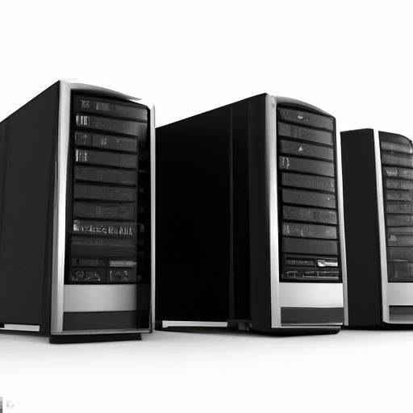


CLIENT
SERVER
DATABASE
FRONT END
BACK END

