Slide 1
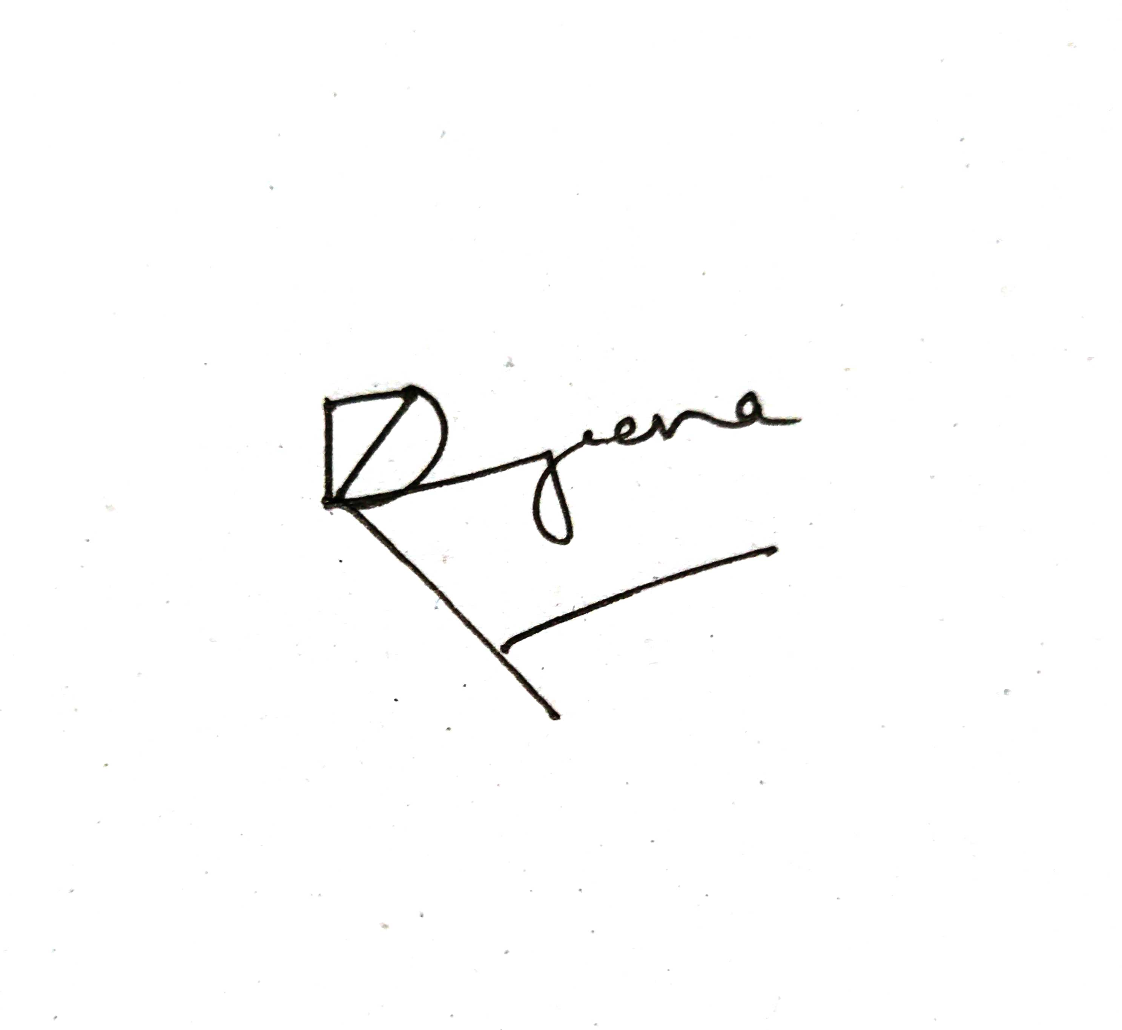
1
2
3
4
5
6
7
8
9
10
11
12
13
14
15
16
17
18
19
20
21
22
23
24
25
26
27
28
29
30
31
32
33
34
35
36
37
38
39
40
41
42
43
44
45
46
47
48
49
50
51
52
53
54
55
56
57
58
59
60

Slide 2
4 Things which are very important to programming language are :
Data Types
Terms - Variable, Function, Class
Action
Best Practices
Data Types: int float bool str list tuple set dictionary none
Terms : Variable , Function, Class
Variable : Which stores a value
Action: When we ask program to do something, example : print will print the output to the console
Best Practices : snake_case, camelCase, PascalCase

Slide 3
