Slide 1
CISCO NETWORKING ACADEMY
Data Analytics Essentials
Internship Completion Presentation
Dibyesh Biswal
IILM University
Roll No: 2410030100
Issued: June 16, 2026

Slide 2
Agenda
01
About the Internship
05
Statistical Analysis Techniques
Program overview, provider and credential details
Basic statistics used to interpret data
02
The Data Analytics Process
06
Hands-on Tools
How raw data is turned into business value
Excel, SQL, Tableau and other lab tools used
03
Characteristics of Data
07
Capstone Project & Portfolio
Formats, availability and acquisition methods
Evaluating and sharing the final project
04
Data Transformation & Preparation
08
Key Learnings & Certificate
Cleaning, structuring and analytics tooling
Skills gained and credential earned
Data Analytics Essentials | Cisco Networking Academy
2

Slide 3
About the Internship
The Data Analytics Essentials internship, delivered through Cisco Networking Academy, provided a student-level, hands-on introduction to the complete data analytics workflow. It combined conceptual learning with practical lab work across industry-standard tools, culminating in a self-directed project portfolio.
DB
Dibyesh Biswal
Course: Data Analytics Essentials
IILM University
Provider: Cisco Networking Academy
Credential Level: Student
Roll No.
2410030100
Certified By: Lynn Bloomer, Director, Cisco Networking Academy
Issued On: June 16, 2026
Successfully achieved student-level credential
Data Analytics Essentials | Cisco Networking Academy
3

Slide 4
The Data Analytics Process
How raw data is transformed into meaningful business value
1
2
3
4
5
Identify
Acquire
Prepare
Analyze
Share
Define the business question and the data needed to answer it
›
Collect data from relevant sources and systems
›
Clean, structure and transform data for analysis
›
Apply statistical and analytical techniques to find patterns
›
Visualize and communicate insights to drive decisions
Data Analytics Essentials | Cisco Networking Academy
4

Slide 5
Characteristics of Data
1
2
3
Formats
Availability
Acquisition Methods
Structured (tables, databases), semi-structured (JSON, XML) and unstructured (text, images, video)
Public/open datasets, internal organizational data, and licensed or subscription data sources
Manual entry, APIs and web scraping, sensors/IoT, surveys and third-party providers
Why it matters
Understanding the format, availability and origin of data determines which tools and techniques are appropriate for cleaning, transforming and analyzing it — the foundation for every later step in the analytics workflow.
Data Analytics Essentials | Cisco Networking Academy
5

Slide 6
Data Transformation & Preparation
✓
Cleaning
Removing duplicates, correcting errors and handling missing values
Raw → Ready
✓
Structuring
Organizing raw data into consistent, analysis-ready tables
✓
Transforming
Converting, merging and reshaping data using analytics tools
✓
Validating
Checking accuracy and consistency before analysis begins
Cleaned dataset ready for statistical analysis
Data Analytics Essentials | Cisco Networking Academy
6

Slide 7
Statistical Analysis Techniques
Basic statistical and data preparation techniques applied during the internship
Descriptive Statistics
Mean, median, mode and standard deviation to summarize datasets
Correlation & Trends
Identifying relationships and patterns between variables
Distribution Analysis
Examining how data values are spread across a range
Outlier Detection
Flagging anomalies that could skew analysis results
Data Analytics Essentials | Cisco Networking Academy
7

Slide 8
Hands-on Tools Used
Completed hands-on labs across multiple industry-standard tools
XL
DB
TB
+
Excel
SQL
Tableau
Other Tools
Data cleaning, formulas, pivot tables and basic visualization
Querying, filtering and aggregating structured datasets
Building interactive dashboards and visual reports
Supplementary analytics utilities used across the labs
Data Analytics Essentials | Cisco Networking Academy
8

Slide 9
Capstone Project & Portfolio
The internship concluded with a self-directed analytics project applying the full workflow — from acquiring and preparing a dataset to analyzing it and presenting findings. The completed work was evaluated and compiled into a shareable project portfolio.
Sample Portfolio Dashboard
1
Define
Scoped a business question and target dataset
2
Build
Applied cleaning, SQL queries and Excel analysis
3
Visualize
Insight: Category A drives over a third of total volume, guiding prioritization in the final recommendations.
Created a Tableau dashboard of key findings
4
Present
Evaluated and shared the final portfolio
Data Analytics Essentials | Cisco Networking Academy
9

Slide 10
Key Learnings & Skills Gained
Explaining how the data analytics process creates value from data
Analyzing data using basic statistical and preparation techniques
✓
✓
Explaining the characteristics of data, including formats, availability and acquisition
Completing hands-on labs using Excel, SQL, Tableau and other tools
✓
✓
Transforming data using analytics tools
Evaluating and sharing a project portfolio
✓
✓
Data Analytics Essentials | Cisco Networking Academy
10

Slide 11
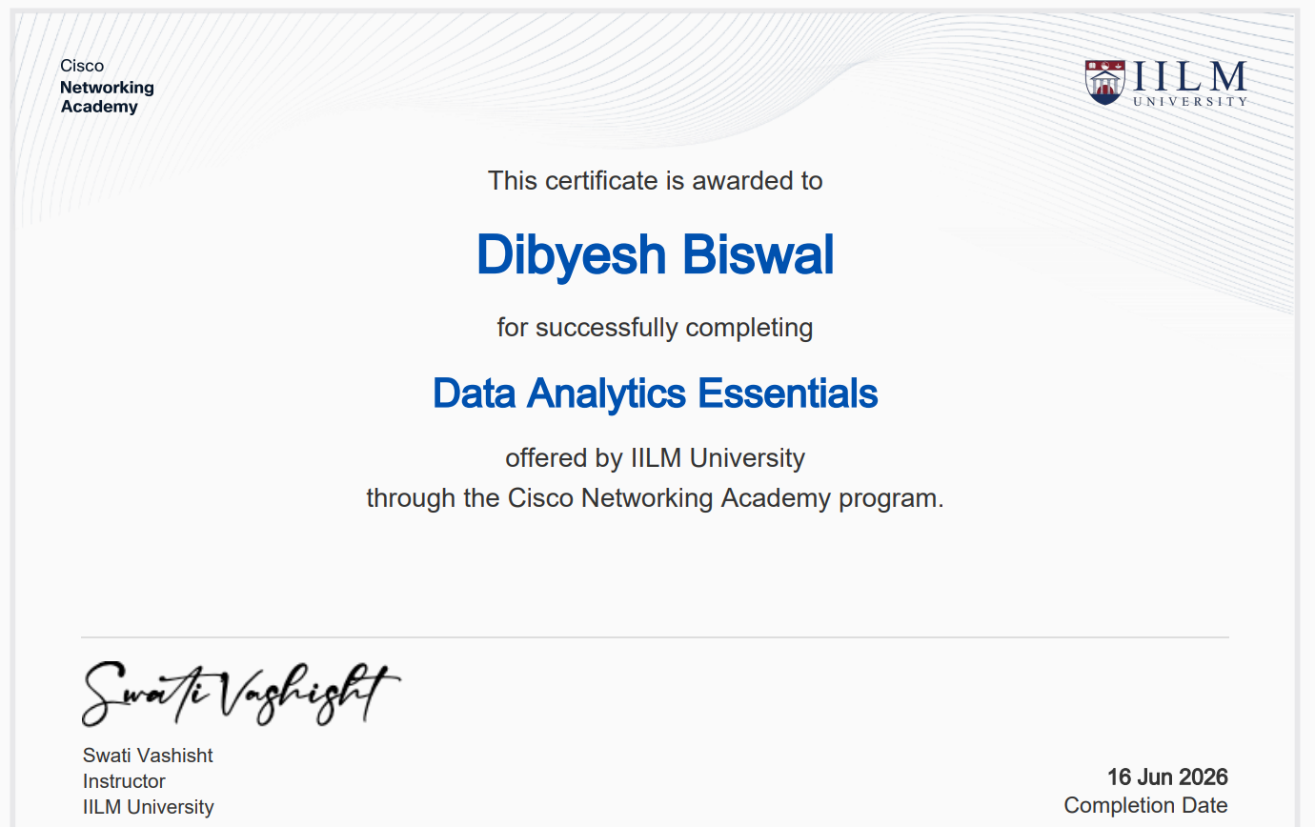
Thank You
Certificate of Course Completion — Data Analytics Essentials
Dibyesh Biswal
IILM University | Roll No: 2410030100
Certified by Lynn Bloomer, Director, Cisco Networking Academy
Issued on June 16, 2026

