Slide 1

Ddsanalytics a case study about attrition
David Camacho

Slide 2
Agenda
Overview
EDA
Process
Most Optimal Model – Predicting Attrition
Conclusion

Slide 3
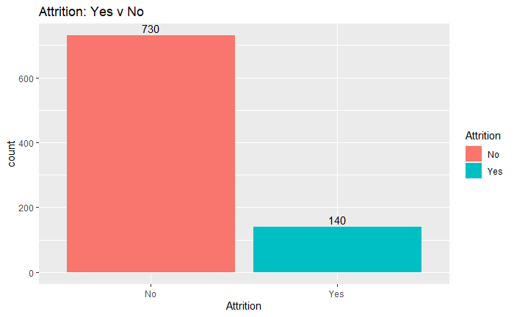
Overview
870 x 36
27 Continuous
9 Categorical
16% Attrition

Slide 4
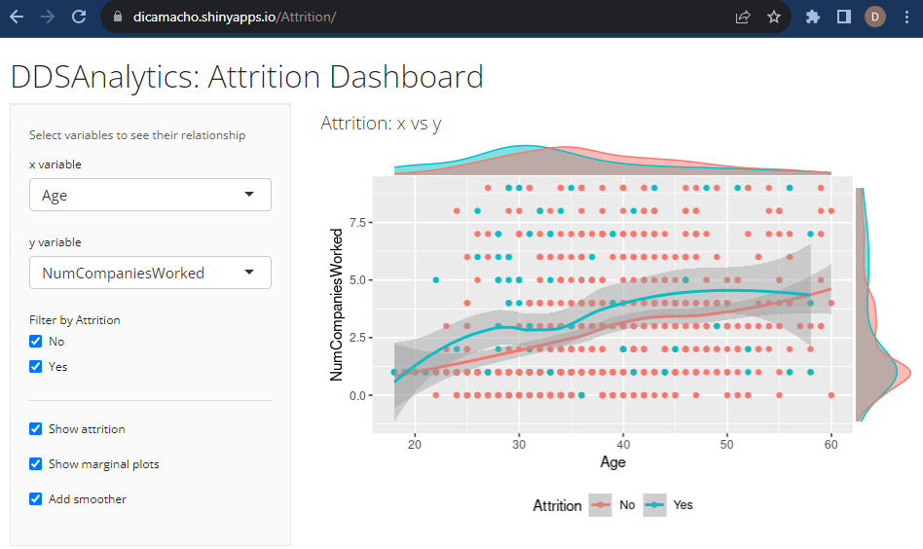
EDA
Dynamic Shiny App
Variable Selection
Attrition Filter
Marginal Plots
Smoother Line

Slide 5
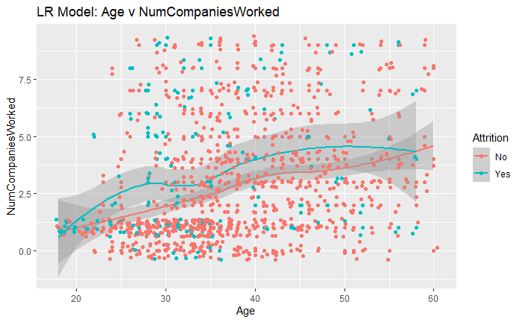
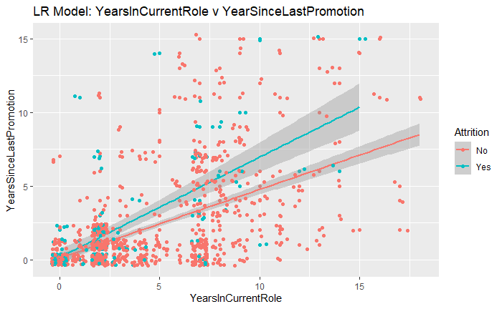
eda

Slide 6
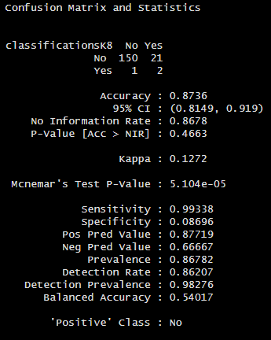
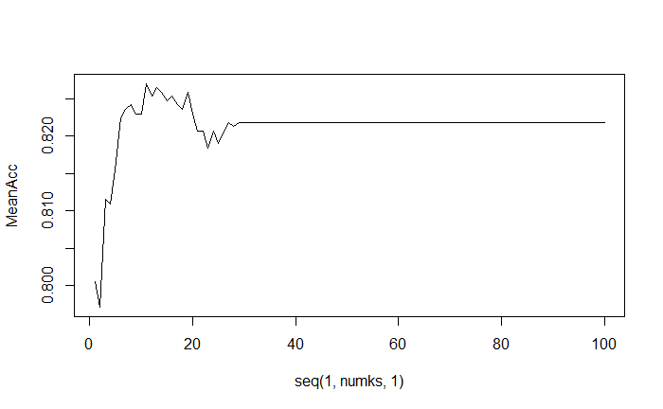
Process: knn
Mean Stats: Age & NumCompaniesWorked
Optimal K = 11 @ 87% Accuracy

Slide 7
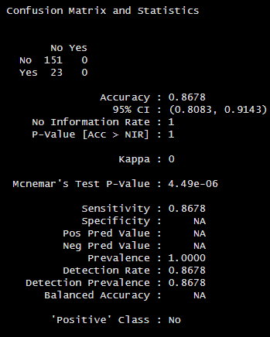
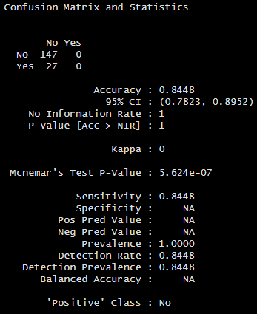
Process: naïve bayes
Mean Stats: Age & NumCompaniesWorked
Mean Stats: Age, NumCompaniesWorked, & JobSatisfaction

Slide 8
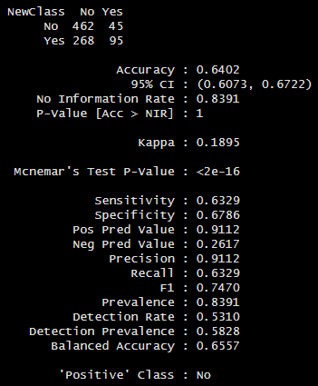
Optimal model: knn adjusted threshold
Adjusted Threshold
140 / 870 = .16
“Yes” > .16
Sensitivity (“No”)
462 correct / 730 Total
Specificity (“Yes”)
95 Correct / 140 Total

Slide 9
Conclusion
Recommendation
KNN Optimal Model
Adjustment Threshold
No under sampling or over sampling
Sensitivity and Specificity > .60

Slide 10
Contact and links
Email: dicamacho@mail.smu.edu
GitHub Repo: https://github.com/dicamacho/CaseStudy2DDS
Personal GitHub Site: https://dicamacho.github.io/
Shiny App: https://dicamacho.shinyapps.io/Attrition/

