Slide 1
Fine-Tuning variations
Unfrozen Matrix W
B = 0
B = 0
B = 0
B = 0
A = 𝒩(0, σ²)
A = 𝒩(0, σ²)
A = 𝒩(0, σ²)
A = 𝒩(0, σ²)
(a) Full Fine-tuning (ΔW)
(b) LoRA (ΔW = BA)
Top - k
Router
(c) LoRA + MOE
ΔW = B₁A₁ + ⋯ + BₙAₙ
Sources: Mixture of LoRA Experts
https://arxiv.org/abs/2404.13628
LoRA: Low-Rank Adaptation of Large Language Models
https://arxiv.org/abs/2106.09685

Slide 2
Assymetric LoRA
Problems with usual LoRA:
Bad performance on heterogenous data
Same A and B matrix capture mixed signals and are tuned jointly for all data
Assymetric LoRA:
Using multiple smaller LoRA heads (B matrices) enhances performance
A matrices learn shared patterns, B matrices capture task/domain specific features
B₁ = 0
B₂ = 0
Bₙ = 0
A = 𝒩(0, σ²)
(d) HydraLoRA / MTL-LoRA
(ΔW = (B₁ + ⋯ + Bₙ)A)
Sources: HydraLoRA: An Asymmetric LoRA Architecture for Efficient Fine-Tuning
https://arxiv.org/abs/2404.19245
MTL-LoRA: Low-Rank Adaptation for Multi-Task Learning
https://arxiv.org/abs/2410.09437

Slide 3
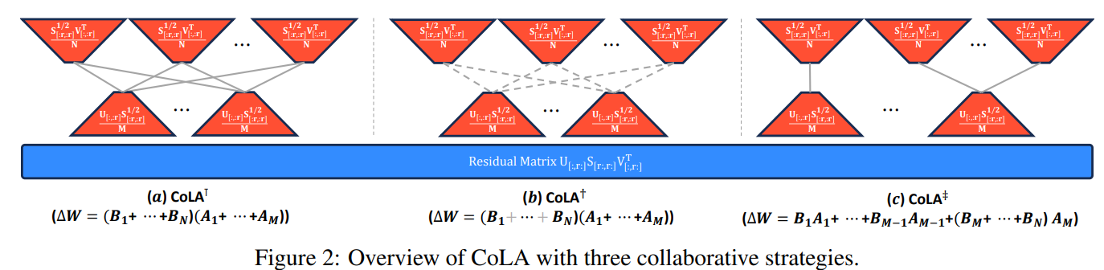
Collaborative LoRA
COLA Collaborative LoRA
Flexible many-to-many A-B relationships, #A #B are hyperparameters
Three collborative strategies
1. All A and B matrices share information during training (cross matrix coupling)
2. randomly pairs A-B combinations
Hybrid one-to-one and many-to-many structures
Sources: CoLA: Collaborative Low-Rank Adaptation
https://arxiv.org/abs/2505.15471

Slide 4
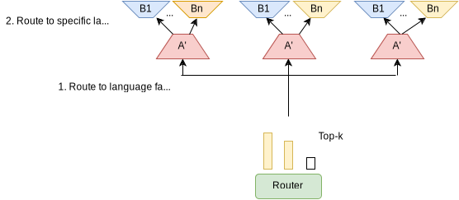
Hierarchical LoRA

Slide 5
Hierarchical LoRA
Technical Details:
Use PiSSA initialization for LoRA modules
Top-k router to route to langueg specific module
Use different A-B relationsships to capture language specific patterns
CoLA: Collaborative LoRA
Hydra LoRA / MTL-LoRA
Fly-LoRa
Replay strategy and Language Prior routing
Reasoning:
Novelty by two stage routing / hierarchical design
200 languages exactly capture the “heterogenous data problems” CoLA and HydraLoRA tackle
Modular and extensible design
Risks:
Unstable training, higher computational demand
With Hydra LoRA we would have two routers
Highly unequal expert use for different languages
Is this what MoE was made for?
More?
Sources:
HydraLoRA: An Asymmetric LoRA Architecture for Efficient Fine-Tuning
https://arxiv.org/abs/2404.19245
MTL-LoRA: Low-Rank Adaptation for Multi-Task Learning
https://arxiv.org/abs/2410.09437
FlyLoRA: Boosting Task Decoupling and Parameter Efficiency via Implicit Rank-Wise Mixture-of-Experts
https://arxiv.org/abs/2510.08396
PiSSA: Principal Singular Values and Singular
Vectors Adaptation of Large Language Models
https://arxiv.org/abs/2404.02948
CoLA: Collaborative Low-Rank Adaptation
https://arxiv.org/abs/2505.15471
Mixture of LoRA Experts
https://arxiv.org/abs/2404.13628

Slide 6
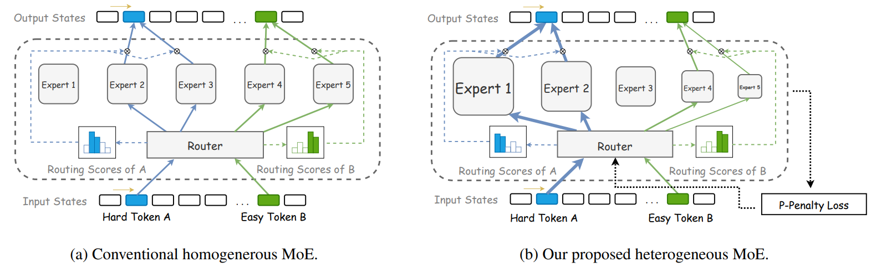
Alternative I
Heterogenous MoE
This can be adapted for adpaers, by just varying the lora rank for different adapters
Idea: If we seperate lora modules by language families, some families shoudl require more parameters depdending on their expert usage
Cons
Does load balacing loss make this uselsee?

Slide 7
Alternative II
Mixture of Depths for adapters
Every token gets same compute at every layer, even when not needed
In each transformer layer, router scores all tokens for importance, model takes only most importatn tokens and they go throught the entire layer, the other tokens pass through
https://arxiv.org/pdf/2404.02258

Slide 8
Alternative III
Best-practices approach
Use SOTA tokenizer extension
SOTA initialization
SOTA Mixture of Aadapter routing / strategy
Mabye a replay strategy

Slide 9
Further
LoRA merging
https://arxiv.org/pdf/2505.22934
https://arxiv.org/pdf/2505.24174
https://arxiv.org/pdf/2502.14502
This seemed very intersting, but hadnt enough time to look into this in depth
Language Fusion for Parameter-Efficient Cross-lingual Transfer https://arxiv.org/pdf/2501.06892

