Slide 1
Gifting Solution by Brett Huffman

Slide 2
My Breakthrough…
set<vector<int> > FindPermutations(const int n, const vector<int> &exclusionSet)

Slide 3

Complexity
C: 1-3
0
LG: 1-3
1
…
MG: 4-6
1,4
2,5
2,4
3,4
1,5
2
3,6
3,5
1,6
3
Time: O(C^{G})
1,6
Space: O(C^{G})
Winner!

Slide 4
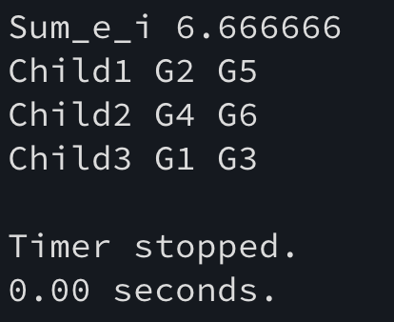
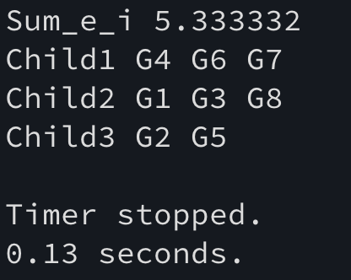
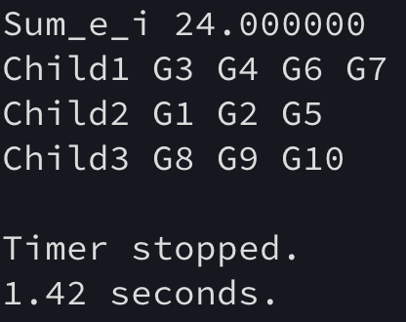
3-Child Results
ex1_3child_6gifts.txt
ex1_3child_8gifts.txt
ex1_3child_10gifts.tx

Slide 5
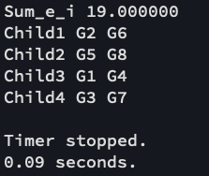
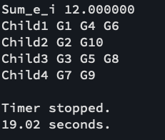
4-Child Results
ex1_4child_8gifts.txt
ex1_4child_10gifts.tx

Slide 6
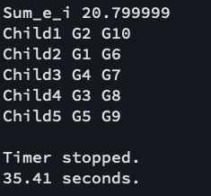
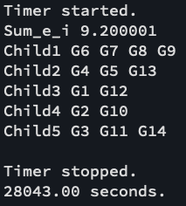
5-Child Results
ex1_5child_10gifts.txt
ex1_5child_14gifts.tx
7.79 Hours

Slide 7
10-Child Results
ex1_10_child_20gifts.txt
ex1_10_child_30gifts.txt
ex1_20_child_40gifts.txt

