Slide 1
MerkleForge
Building a faster, unified data verification toolkit for modern blockchains.
Binary
Sparse
Patricia
Blessing Omosehin Samuel
Software Engineering - Miva Open University - August 2026
MerkleForge final year project defense
01
Notes:
[Sources]
Project documentation PDF supplied by the author.
Repository: https://github.com/dicethedev/MerkleForge

Slide 2
INTRODUCTION
The problem is fragmented Merkle tooling.
Blockchain systems need fast proofs, but Rust developers often combine separate libraries for binary, sparse, and Patricia trees.
Different tree types, different APIs
Developers must switch mental models and dependencies when moving between transaction batches, sparse state maps, and Ethereum-style state.
Research rarely reaches usable crates
Optimizations such as empty-hash caches, shortcut nodes, and batch updates are discussed in papers but are not always available in developer tools.
Benchmarks are hard to compare
Without one repeatable benchmark suite, choosing a hash function or tree variant becomes guesswork.
MerkleForge final year project defense
02
Notes:
[Sources]
Project documentation PDF: Chapter 1, Statement of the Problem.
Research background referenced in the project: Nakamoto, Merkle, Ma et al., Kuznetsov et al.

Slide 3
AIM AND OBJECTIVES
MerkleForge unifies proofs under one Rust API.
The project delivers a typed, modular toolkit for building, proving, verifying, and measuring Merkle data structures.
1
Design one trait-driven architecture
2
Implement binary, sparse, and Patricia variants
3
Support SHA-256, Keccak-256, and BLAKE3
4
Benchmark against existing solutions
5
Publish documentation, examples, and crates
MerkleForge final year project defense
03
Notes:
[Sources]
Project documentation PDF: Chapter 1, Aim and Objectives of the Study.

Slide 4
LITERATURE GAP
The gap is between theory and practical tooling.
Merkle tree research improves proof size, update cost, and hashing speed, but implementation support remains scattered.
Academic progress
Developer reality
MerkleForge answer
Batch updates, shortcut nodes, sparse proofs, and faster hashing reduce verification overhead.
Existing Rust tools often focus on one variant or expose incompatible APIs.
One workspace combines variants, hash adapters, proofs, docs, and benchmarks.
MerkleForge final year project defense
04
Notes:
[Sources]
Project documentation PDF: Chapter 2, Literature Review and research gap discussion.

Slide 5
SYSTEM ARCHITECTURE
The implementation is split into small crates.
Each crate has one responsibility, which keeps the system easier to test, document, and extend.
merkle-core
merkleforge-hash
merkle-variants
Traits, proof types, metadata, errors
SHA-256, Keccak-256, BLAKE3 adapters
Binary, sparse, and Patricia implementations
merkle-bench
website
Criterion benchmarks and comparisons
Docs, examples, benchmarks, live demo
MerkleForge final year project defense
05
Notes:
[Sources]
Project documentation PDF: Chapter 4, System Implementation.
Repository workspace layout.

Slide 6
IMPLEMENTATION
Three tree variants cover three real use cases.
The library exposes familiar operations while allowing each structure to use the storage model that fits its problem.
Binary Merkle Tree
Best for ordered lists such as transactions, files, logs, and block batches.
Common workflow
insert data
compute root
generate proof
verify statelessly
Sparse Merkle Tree
Best for huge key spaces where most entries are empty and absence proofs matter.
Merkle Patricia Trie
Best for Ethereum-compatible account, storage, receipt, and state-root workflows.
MerkleForge final year project defense
06
Notes:
[Sources]
Project documentation PDF: Chapter 4, implemented modules and tree variants.

Slide 7
CODE EVIDENCE
The trait contract is the center of the design.
All tree variants are built around a shared interface for mutation, queries, proof generation, metadata, and stateless verification.
MerkleTree<H>
ProofVerifier<H>
insert(data)
remove(index)
root()
leaf_count()
generate_proof(index)
metadata()
fn verify(
expected_root: &H::Digest,
leaf_data: &[u8],
proof: &MerkleProof<H::Digest>,
) -> bool;
This enables light-client verification: the verifier only needs the trusted root, the target data, and the proof path.
Source: merkle-core/src/traits/merkle_tree.rs
MerkleForge final year project defense
07
Notes:
[Sources]
Trait signatures summarized from merkle-core/src/traits/merkle_tree.rs in the project repository.

Slide 8
METHODOLOGY
The project used iterative, evidence-driven development.
Each phase added a working feature, then backed it with tests, docs, and benchmarks before moving forward.
Build
Implement the core crate, hash adapters, tree variant, and public API.
Verify
Run unit, integration, property-based, and Ethereum vector tests.
Measure
Use Criterion benchmarks, comparison suites, and energy-aware notes.
Publish
Expose docs, examples, release automation, website pages, and live demo.
MerkleForge final year project defense
08
Notes:
[Sources]
Project documentation PDF: Chapter 4, System Development and Testing Strategies.

Slide 9
TESTING STRATEGY
Correctness was tested at multiple levels.
The test suite checks single components, combined workflows, generated random cases, and Ethereum compatibility.
Unit tests
Integration tests
Core functions, errors, hashing, RLP, and tree operations
Combined modules across binary, sparse, and Patricia workflows
Property tests
Ethereum vectors
Randomized invariants using Proptest
Patricia trie roots checked against official test data
MerkleForge final year project defense
09
Notes:
[Sources]
Project documentation PDF: Chapter 4.3 Testing Strategies and Chapter 4.4 Test Cases and Results.

Slide 10
TEST RESULTS
The implementation passed the recorded verification checks.
The report records successful workspace, property, vector, documentation, and website checks.
15 passed
21 passed
105 passed
merkle-core
merkleforge-hash
merkle-variants unit
6 passed
3 passed
passed
binary properties
Patricia vectors
website build
MerkleForge final year project defense
10
Notes:
[Sources]
Project documentation PDF: Chapter 4.3 and Chapter 4.4 local testing results.

Slide 11
PERFORMANCE EVALUATION
Benchmarks show where each design is strongest.
Criterion measurements were used to compare hashing throughput, tree construction, proof generation, and verification.
Hashing
Binary tree
Comparison
BLAKE3 reached the strongest large-input throughput in the recorded benchmark: 5.99 GiB/s.
100K-leaf construction completed in about 268 ms with SHA-256 in the recorded run.
MerkleForge remained competitive on proof size and proof verification while offering more variants.
MerkleForge final year project defense
11
Notes:
[Sources]
Project documentation PDF: Chapter 4.5 Performance Evaluation and benchmark tables.

Slide 12
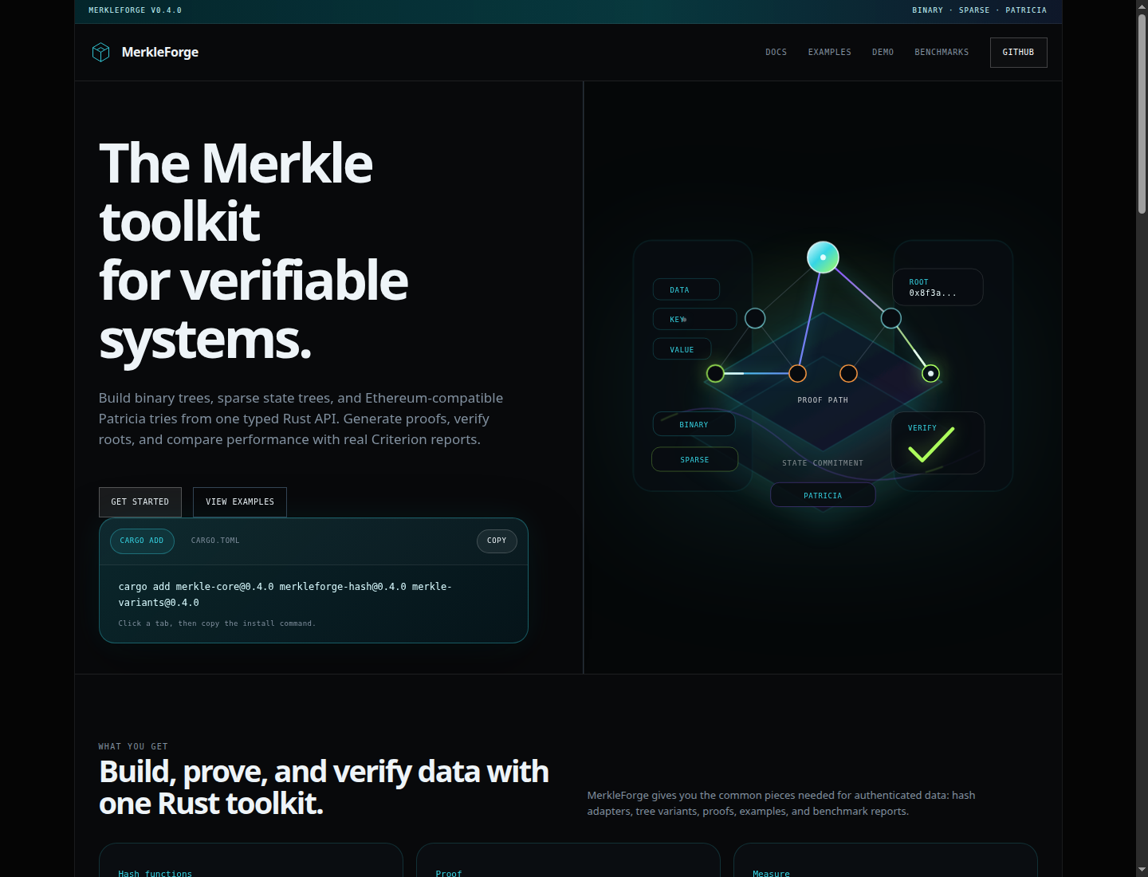
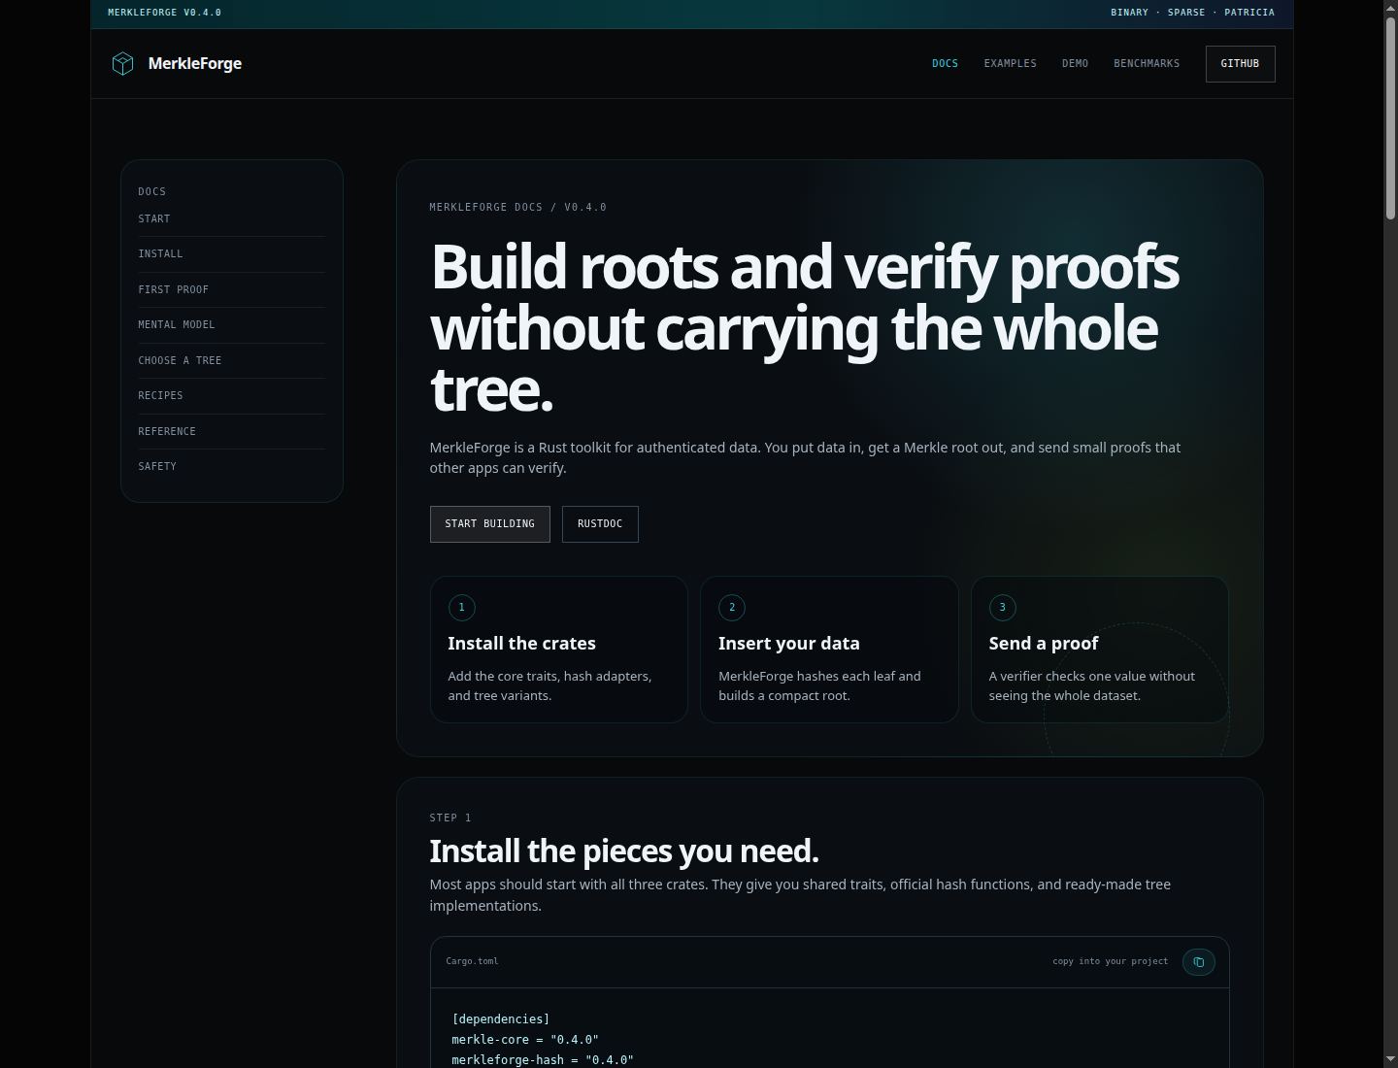
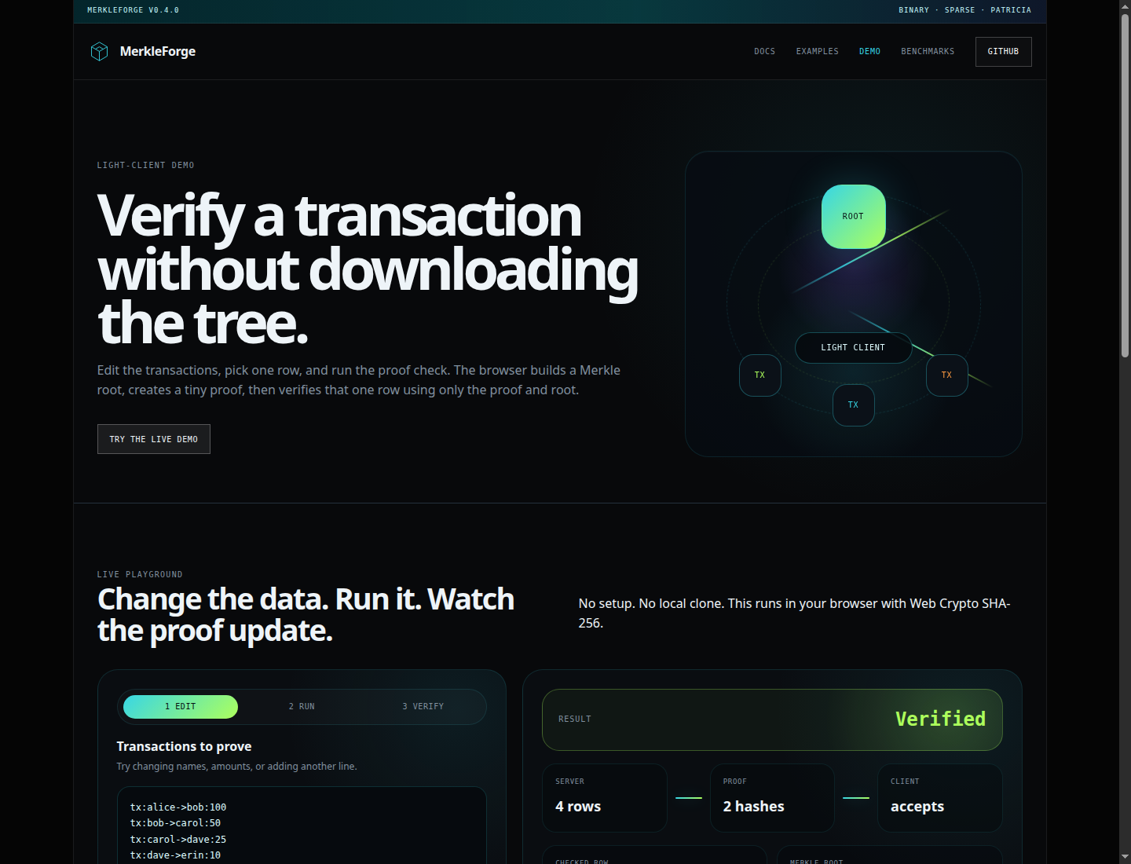
USER INTERFACE
The website makes the artifact easier to evaluate.
The React and Vite website turns the library into something reviewers can inspect without reading every source file first.
Landing page
Docs
Live demo
MerkleForge final year project defense
12
Notes:
[Sources]
Screenshots generated from the local MerkleForge website build.

Slide 13
HOW TO TEST
The panel can verify the artefact with standard commands.
These commands reproduce the main quality checks and demonstrate stateless proof verification.
$ git clone https://github.com/dicethedev/MerkleForge.git
$ cargo test --workspace
$ cargo doc --workspace --no-deps
$ cargo run -p merkle-variants --example light_client
$ cargo bench --bench comparison
$ npm --prefix website run build
MerkleForge final year project defense
13
Notes:
[Sources]
Project documentation PDF: Chapter 4.6 Application Manual.

Slide 14
CONCLUSION
MerkleForge meets the project goal.
It provides a unified Rust toolkit for authenticated data structures, backed by tests, benchmarks, documentation, and a live demo.
Technical contribution
A modular Rust workspace covering binary, sparse, and Ethereum-compatible Patricia structures.
Evidence contribution
Tests, Ethereum vectors, Criterion benchmarks, screenshots, and report-ready documentation.
Practical contribution
A public developer-facing artifact that can be installed, tested, benchmarked, and extended.
Ready for defense and supervisor review.
MerkleForge final year project defense
14
Notes:
[Sources]
Project documentation PDF: conclusion synthesized from the completed implementation, testing evidence, and application manual.

