Slide 1
Single Phase inverter

Slide 2
Objective: To design a 2.2 KW single phase inverter with following specs:
Grid Voltage: 325 Vpeak 50Hz
Grid frequency: 50+-0.5Hz
Grid Current: 10A rms, with steady state error < 10mA (without grid influence) (-40dB)
Reactive Power: 156W (5 percent of peak power (2.2Kw*sqrt(2)))
Switching frequency: 20KHz
Input voltage 1200V (+-600V wrt grid reference)
Grid current at switching harmonics: < 1percent of rated current

Slide 3
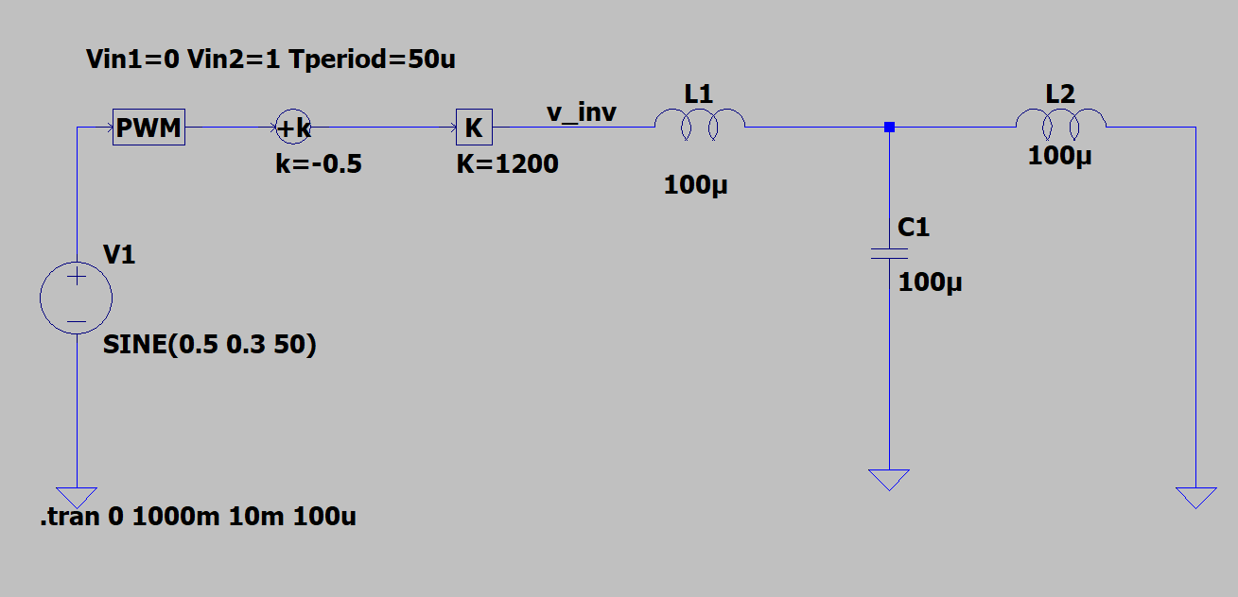
Design of LCL filter with capacitive feedback
The purpose of this simulation is to calculate the grid voltage mangnitude at 20KHz, so an fft of time domain simulation of inverter voltage is done
The above consists a simplified model of inverter with LCL filter.
The max current is 10*sqrt(2)=14.14A, so 1 percent max current at 20KHz would be ~0.1414A (~-17dB)
On the next slide an fft of the inverter voltage is shown

Slide 4
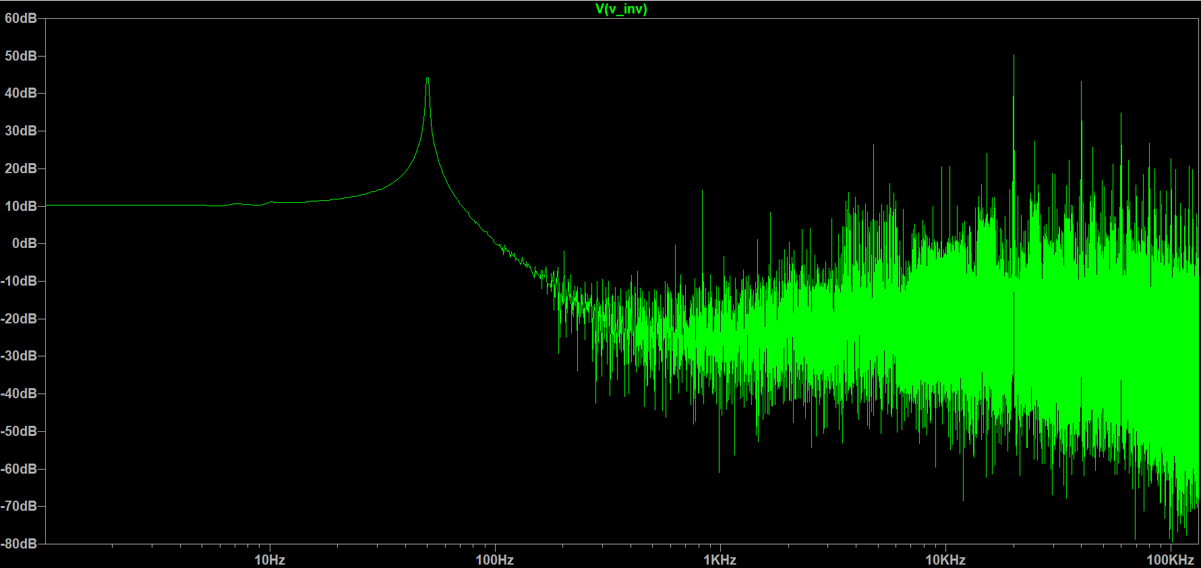
50dB
The inverter voltage magnitude at 20KHz is ~50dB

Slide 5
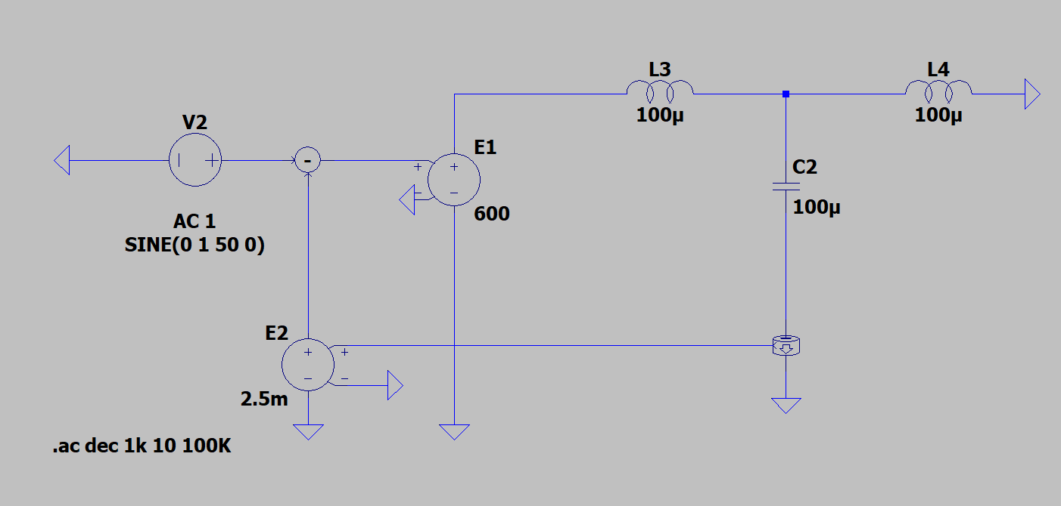
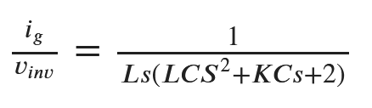
The proposed LCL filter with capacitive feedback, its designed to make the phase margin 120 degree at 1KHz which is the controller Bandwidth
L=100uH, C=100uF (also meets the reactive power requirement), K=2.5m*600
Vg is 50dB, and ig required is ~-17dB

Slide 6
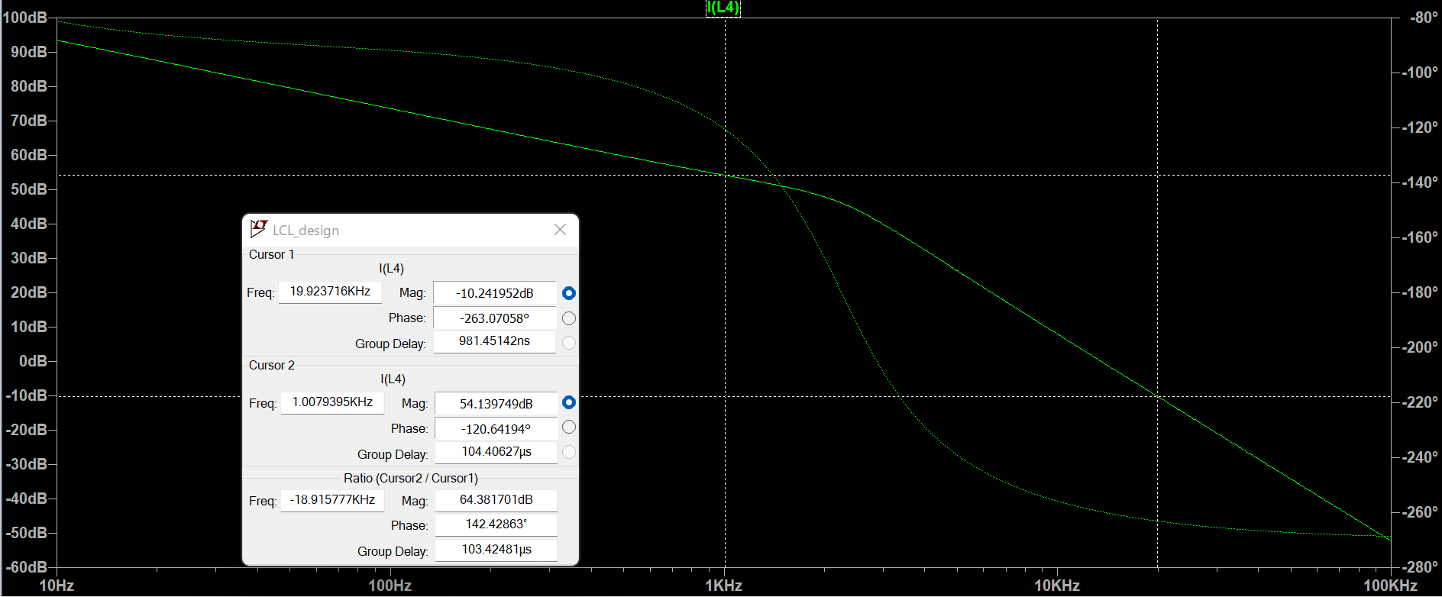
The above plot is ig/vi, at 20KHz, vg is supposed to be 50dB at 20KHz, here since the way simulation is performed vg is 55.56dB at 20KHz, which results in -10.24dB Ig, this means from the filter we have ~67dB attentuation at 20KHz, so if vg is 50dB at 20KHz, we would have ig as -17dB which is the required value

Slide 7
The system block diagram
H2
Vg (grid voltage)
Ggg
+
Gpr
Ggi
+
+
+
+
-
H1

Slide 8
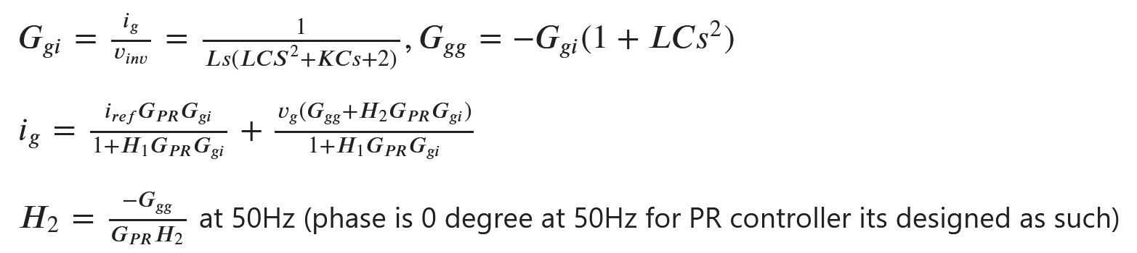
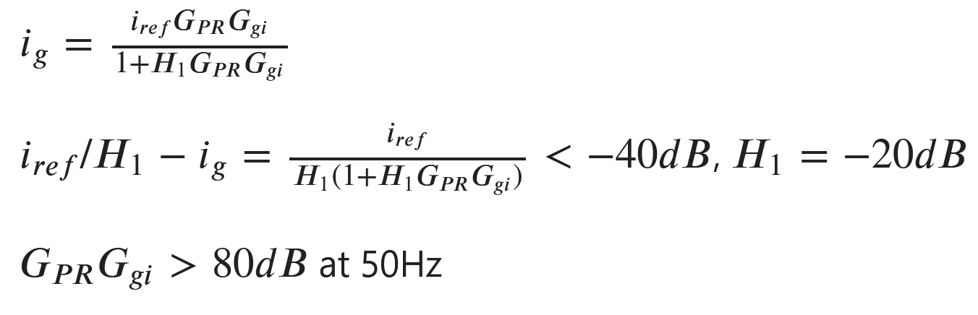
This value of H2 significantly reduces gird voltage influence on grid current at 50Hz. The steady state error in grid current is
The phase deterioration by PR controller is limited to at max 5 degree from -180 and since, the grid frequency can vary, the bandwidth of PR controller is chosen to be 1Hz around 50Hz

Slide 9
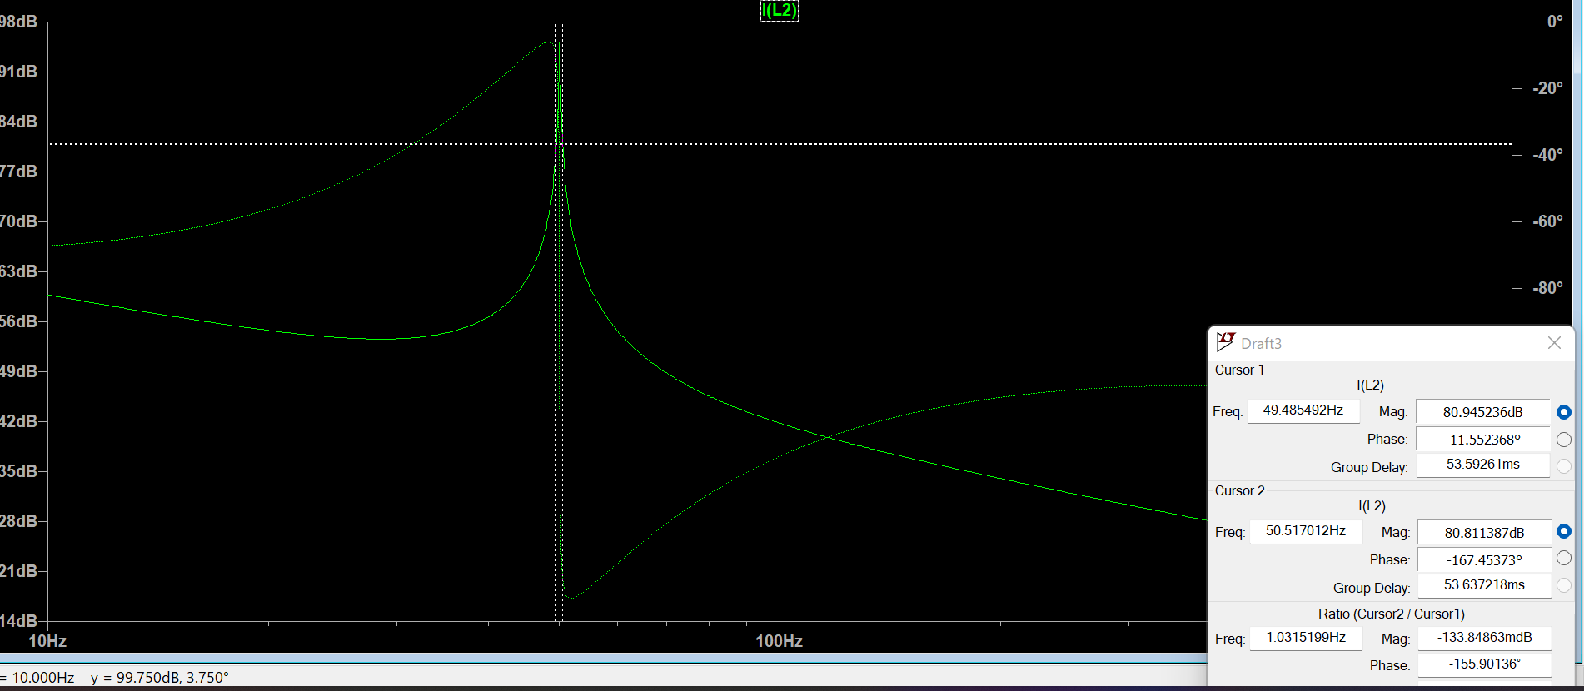
Bode Plot of Gpr*Ggi, the phase margin requirement is met and the magnitude is above 60dB for the required bandwidth

Slide 10
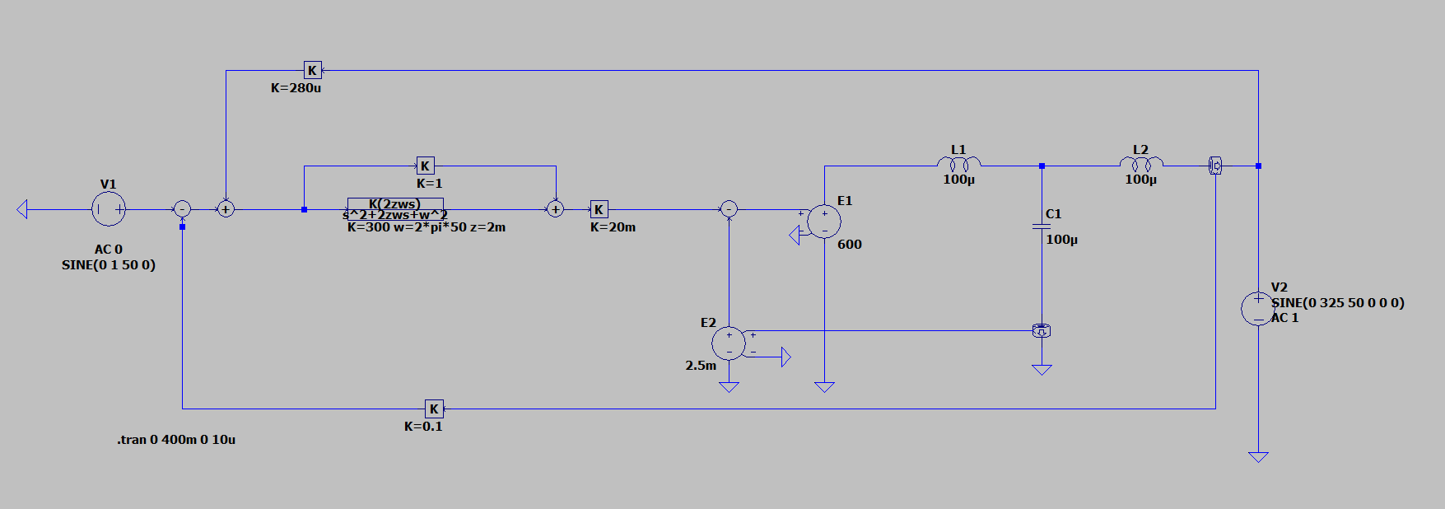
Grid voltage feedforward
Sinusoidal reference
Inverter Model
PR Compensator
LCL filter
Capacitor current feedback

Slide 11
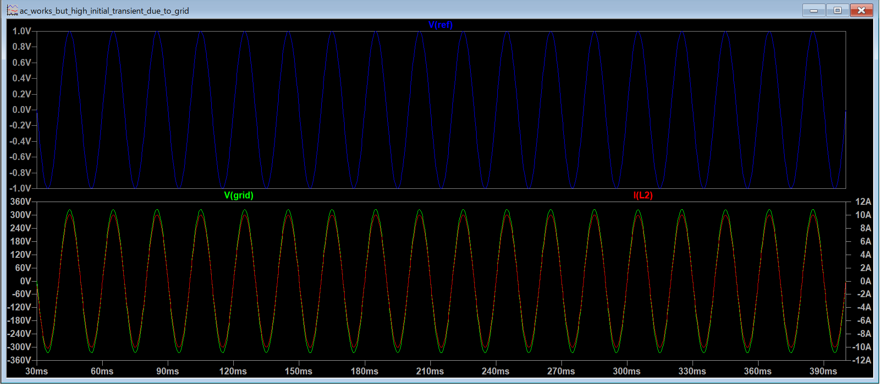
Time domain simulation

