Slide 1
SDD-package
中山大学
数据科学与计算机学院
梁颖霖

Slide 2
目录
include
basic
manager
sdds
vtree_fragments(关于动态最小化)
vtree_operations(关于动态最小化)
vtree_search(关于动态最小化)
vtrees

Slide 3
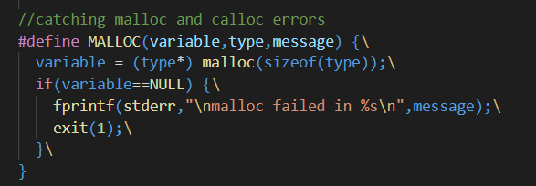
Include
iterators.h
iterator over ALL vtree nodes (linked using ->next, ->prev, ->first and ->last)
迭代器，遍历所有的vtree结点 包括内部结点，叶子结点，祖先结点
macros.h
宏定义，定义错误检测与消息，例如内存分配，判断属性

Slide 4
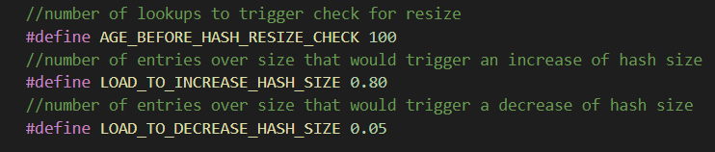
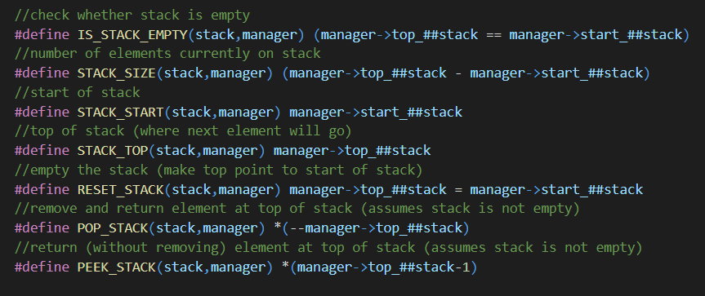
Include
parameters.h
参数，定义一些用到的参数，如hash表（unique node table）的属性
stacks.h
自定义栈的一些函数，栈顶 push pop等
栈的用途之一：后面将uncompressed
的划分转化成compressed, trimmed
的划分

Slide 5
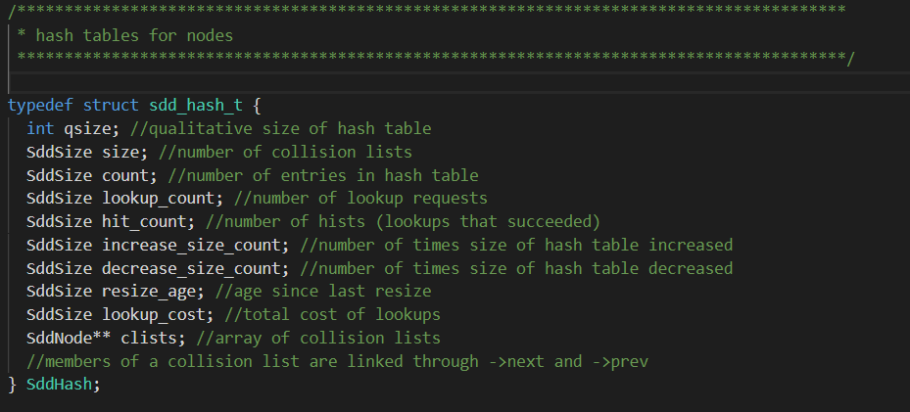
Include
sdd.h
包含sdd，vtree，manager的结构体定义，用到的函数声明
重要的结构体：
Vtree (code:line 73 )
SddNode (code:line 144 )
SddElement (code:line 188 )
SddComputed (code:line 197)
SddHash (code:line 208 )
SddManager (code:line 346 )

Slide 6
basic
computed.c
计算缓存 使用两个hash table（一个是conjoin，另一个是disjoin）
there are two hash tables for caching computations, one for conjoin and one for disjoin
there are no collision lists in these hash tables: just one entry (similar to CUDD)

Slide 7
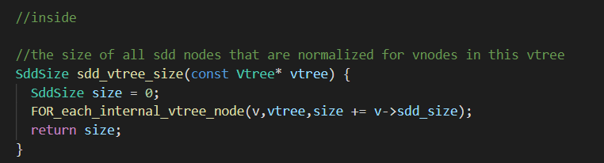
basic
count_and_size.c
统计vtree结点的count跟size
gc.c
内存回收，包括如何标记结点，然后回收（引用计数法）

Slide 8
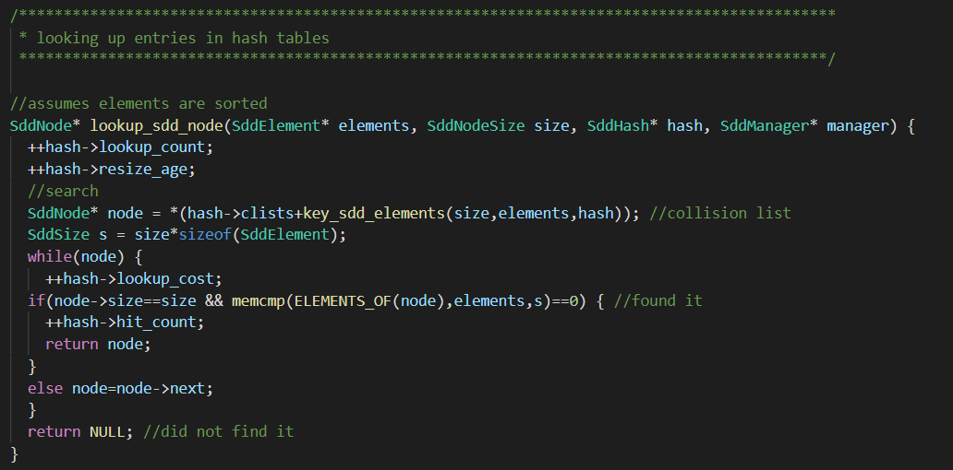
basic
hash.c
哈希表，包括表大小，如何创建表，计算hash值，resize，look-up，插入，删除
例：查找函数

Slide 9
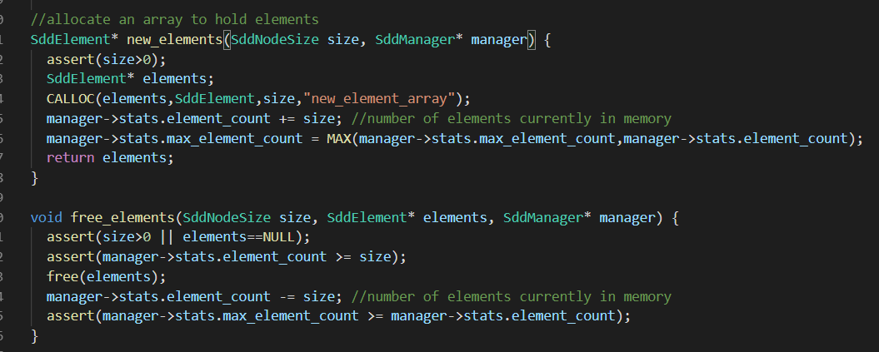
basic
memory.c
内存相关，创建结点，回收结点

Slide 10
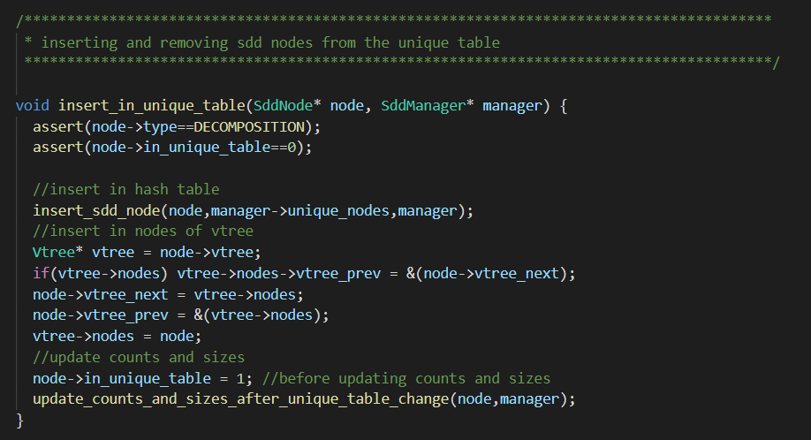
basic
multiply.c
multiplying two decompositions 将两个分解相乘
nodes.c
对于sdd结点，更新父亲数量，从hash表插入或者删除，继续向下分解

Slide 11
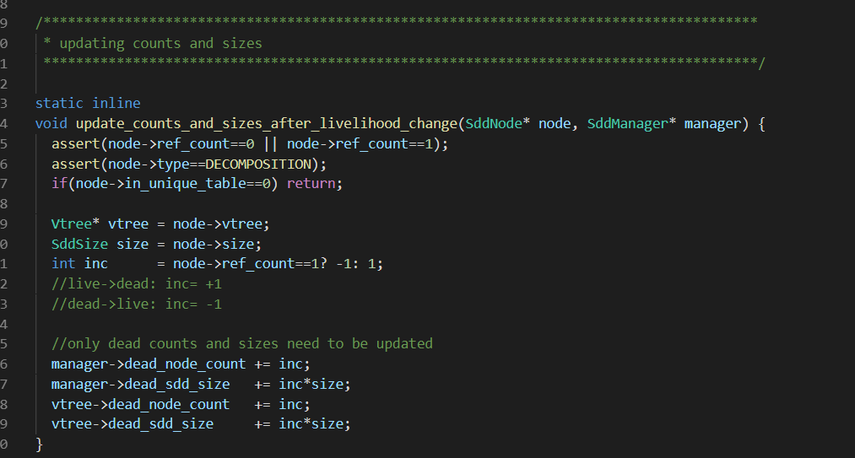
basic
partitions.c
a utility for constructing a compressed, trimmed partition from an uncompressed one
用于从uncompressed的划分转化成compressed, trimmed 的划分
references.c
更新引用计数，ref，deref操作

Slide 12
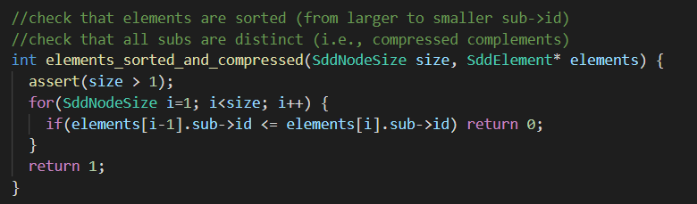
basic
replace.c
replaces the elements and vtree of a (live) decomposition node
替换结点
sort.c
对于node跟element来进行排序

Slide 13
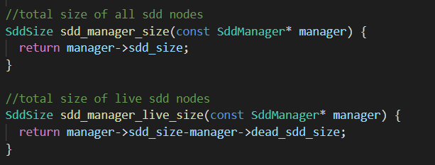
manager
copy.c
copying manager
no external references to nodes in copied manager (all nodes are dead)
new manager has defaults (e.g., auto-mode, etc)
interface.c
一些manager的接口

Slide 14
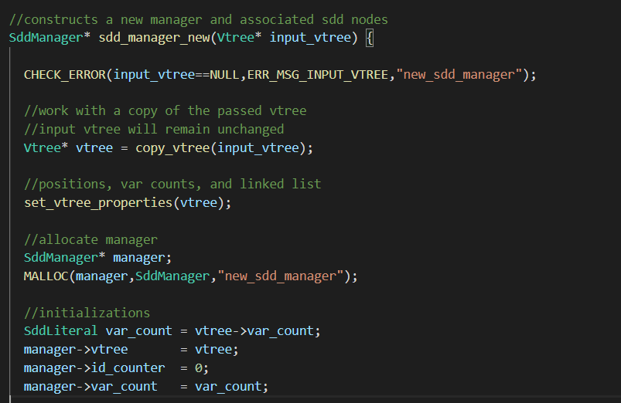
manager
manager.c
构造函数，初始化，清除
stat.c
输出manager的信息,用于debug

Slide 15
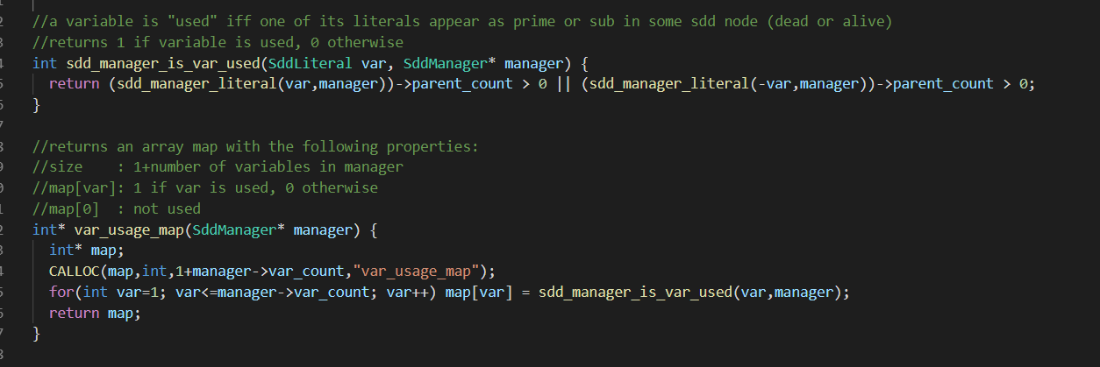
manager
variables.c
变量在manager的使用情况，增删查改
例子：判断变量是否在manager中被使用

Slide 16
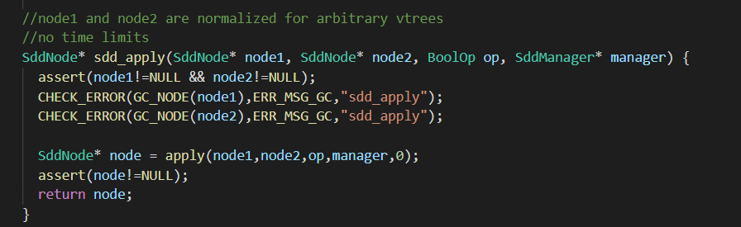
sdds
apply.c
apply算法
apply还有两种版本，有limit与无limit

Slide 17
sdds
bits.c
每一个sdd结点维护两个bit：bit跟cit
every algorithm that uses bits and cits must maintain this invariant after being done
bit cit
0 0 node has not been visited (initial state)
1 0 node visited only once before
1 1 node visited at least twice before (has more than one parent)
0 1 not used

Slide 18
sdds
cardinality.c
cardinality of a model is the number of variables set to true in the model
该函数用于算出该SDD的最小基数
condition.c
forall.c
exist.c
essential_vars.c
size.c
count.c
model_count.c
······

Slide 19
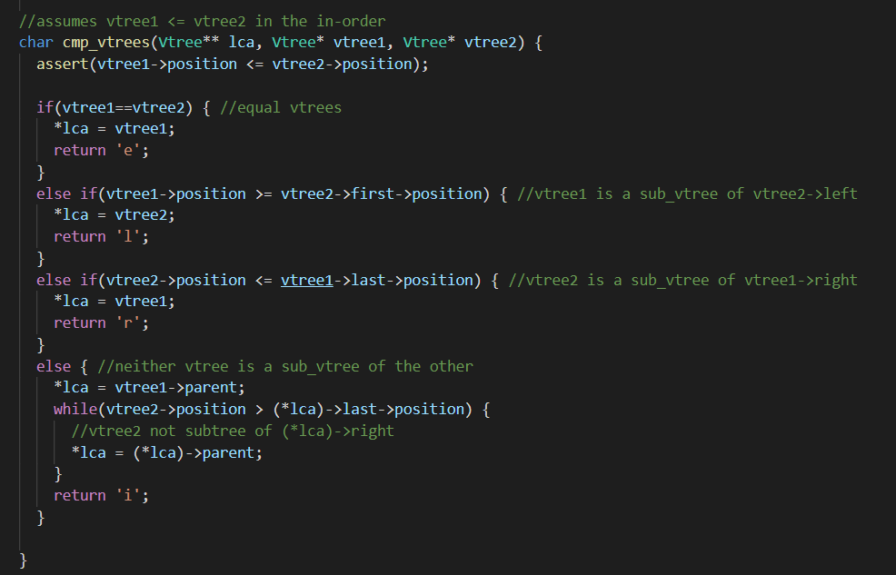
vtrees
compare.c
比较两棵vtree的关系

Slide 20
vtrees
edit.c
对于vtree的操作，例如插入一个新变量，移除一个变量
maps.c
computes a map from vnode positions in inorder to vnodes
将变量映射到vtree上

Slide 21
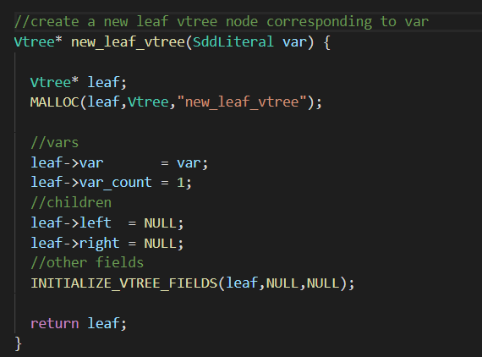
vtrees
moves.c
vtree的左旋，右旋，交换操作（用于动态最小化）
static.c
根据已有变量来构建vtree，包括左线性、右线性、平衡、随机vtree
vtree.c
vtree的构造，初始化，判断属性值

Slide 22
vtrees
vtree.c
vtree的构造，初始化，判断属性值
例子：根据变量值来构造一个叶子vtree

Slide 23
Thanks For Your Listening!

