Slide 1
Spring Batch Configuration
& How to Restart failed Jobs
報告者 : 許家祥

Slide 2
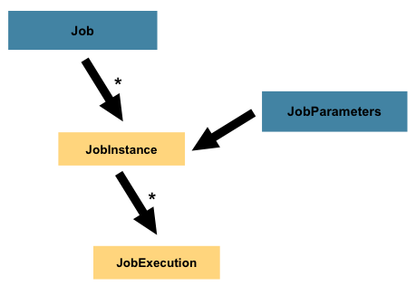


Spring Batch - Job
A job has:
JobId
JobParameters
Steps ➔ every Job is composed entirely of one or more steps
Flow control: Sequential Flow, Conditional Flow
month
dmv
mei.file.path
mei.case.no
batch.submitter
timestamp
CoreBatchService.startJob(String jobId, String arg, ServiceMap<String, Object> params)

Slide 3
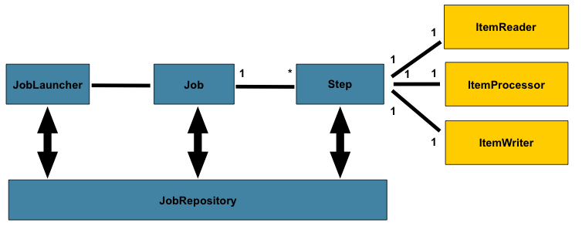
Spring Batch - Step
A Step is a domain object that encapsulates an independent, sequential phase of a batch job

Slide 4

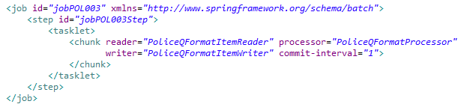
Spring Batch – Step configuration
TaskletStep
Chunk-Oriented Processing

Slide 5

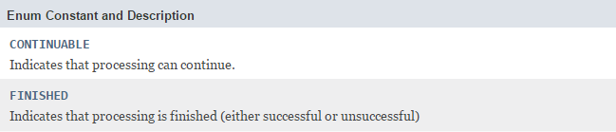
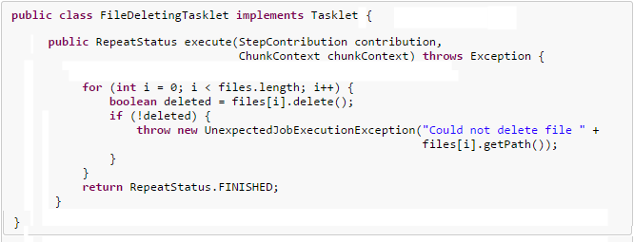
Spring Batch – TaskletStep

Slide 6
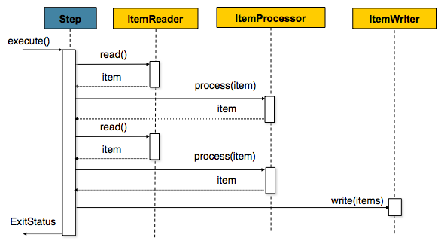



Spring Batch – Chunk-Oriented Processing
Transaction: commit Interval

Slide 7
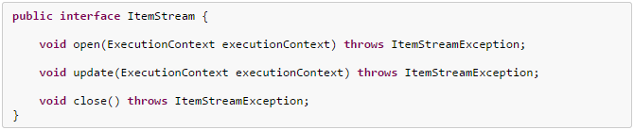
Spring Batch – ItemStream

Slide 8
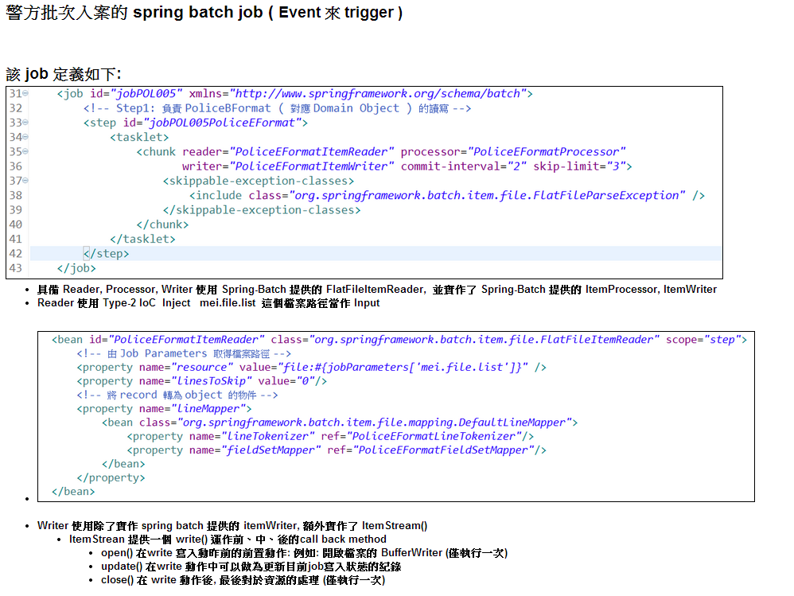

Slide 9
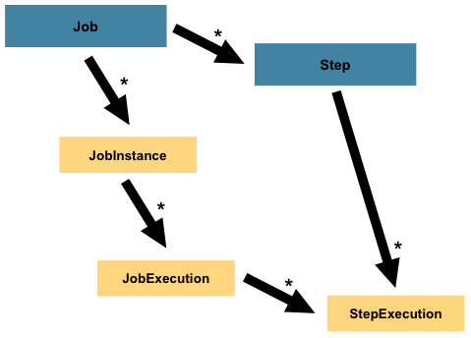
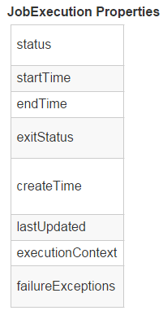
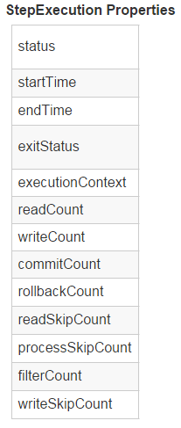
Spring Batch – Job & Step Execution
A Job contains multiple steps
Start a Job → JobExecution
Each Step → StepExecutions
Execution properties / status
A Job execution status may be: COMPLETED, FAILED, STOPPED, UNKNOWN

Slide 10
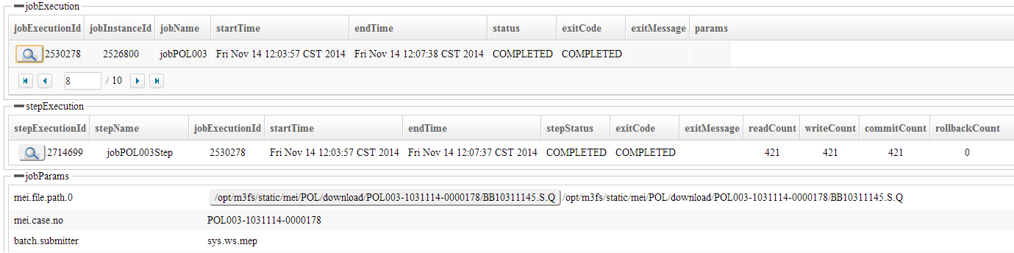
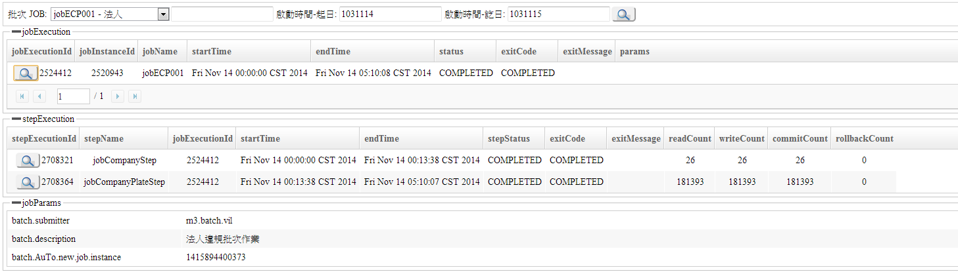
批次管理介面

Slide 11
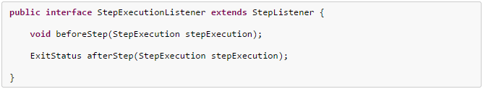
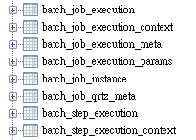
Spring Batch – ExecutionContext
Job ExecutionContext
Step ExecutionContext
ItemStream.open(ExecutionContext)
Database:

Slide 12

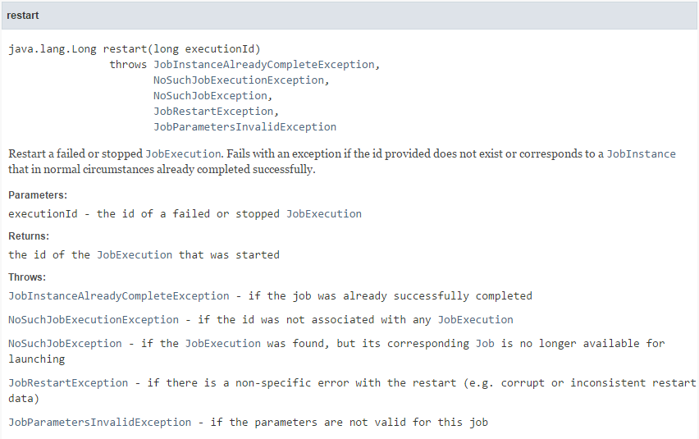
Spring Batch – Job Restart
Spring batch provides a exception handling process, where the task will be stopped incase of a exception.
It can be restarted again using the JobOperator restart method.
CoreBatchService.restartJob(long executionId)

Slide 13
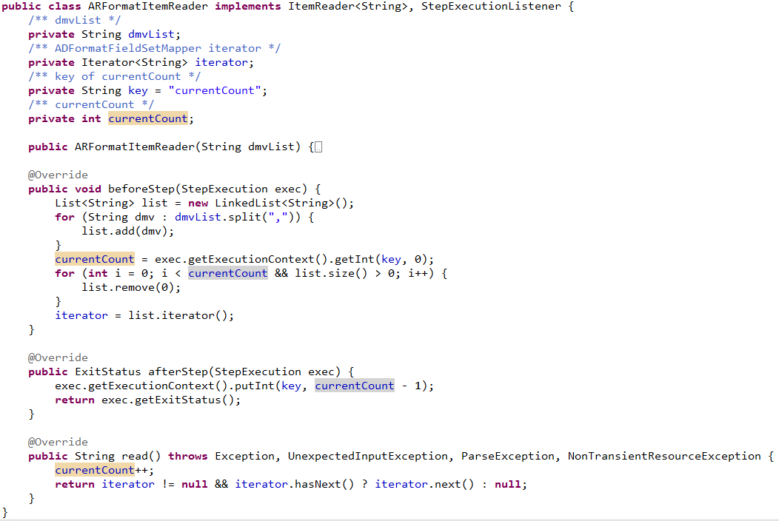
Spring Batch – Job Restart Implement
Restart ➔ start up from where it left off at last execution.

Slide 14
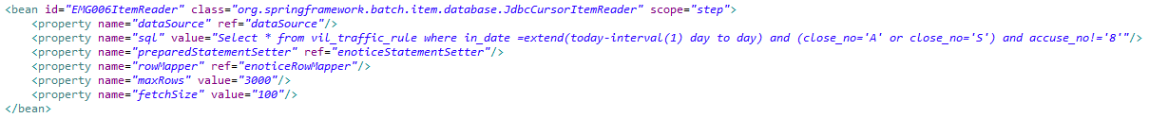
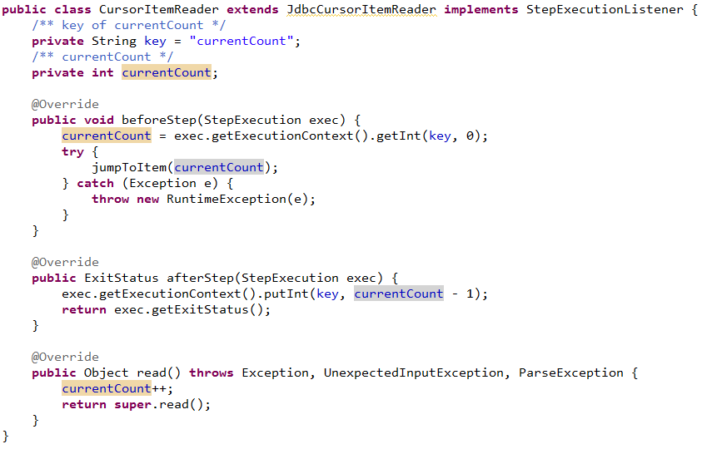
Spring Batch – Job Restart Implement

