Slide 1
Database Systems
SQL Functions

Slide 2
SQL Functions
Aggregate Functions
  AVG() - Returns the average value
  COUNT() - Returns the number of rows
  FIRST() - Returns the first value
  LAST() - Returns the last value
  MAX() - Returns the largest value
  MIN() - Returns the smallest value
  SUM() - Returns the sum

Slide 3
SQL Functions
Scalar Functions
UCASE() - Converts a field to upper case
LCASE() - Converts a field to lower case
MID() - Extract characters from a text field
LEN() - Returns the length of a text field
ROUND() - Rounds a numeric field to the number of decimals specified
NOW() - Returns the current system date and time
FORMAT() - Formats how a field is to be displayed

Slide 4
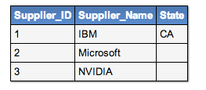
COUNT
Select COUNT(Supplier_ID)
from suppliers;

Slide 5
COUNT
Select COUNT(Supplier_ID)
from suppliers;
Result: 3

Slide 6
COUNT
Select COUNT(State)
from suppliers;

Slide 7
COUNT
Select COUNT(State)
from suppliers;
Result: 1

Slide 8
The SELECT * TRICK!
Select COUNT(State)
from suppliers;
Result: 1
----------------------------------------------------------------
Select COUNT(Supplier_Name)
from suppliers;
Result: 3
Why are these results different?

Slide 9
The SELECT * TRICK!
Select *
from suppliers;
3
1

Slide 10
COUNT (*)
Not sure which column to count on?
SELECT COUNT(*)
FROM employees
WHERE salary > 25000;
This will just count the number of
rows returned by the query.

Slide 11
COUNT (*)
Not sure which column to count on?
SELECT COUNT(Surname)
FROM employees
WHERE salary > 25000;
This will just count the number of
rows returned by the query that have a
Surname value.
NULL rows are not counted.

Slide 12
COUNT (*)
But, be careful!
An empty row doesn’t always mean NULL
‘’ != NULL
Workbench: Example 1

Slide 13
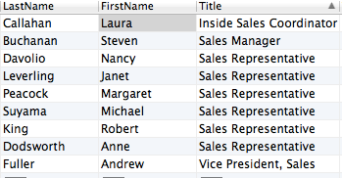
COUNT DISTINCT
SELECT COUNT(Distinct Title)
FROM employees;

Slide 14
COUNT DISTINCT
SELECT COUNT(Distinct Title)
FROM employees;
Workbench: Example 2

Slide 15
SUM()
SUM is not the same as COUNT
COUNT only counts the number of
rows in dataset.
SUM returns the cumulative total.
NULL values are ignored.
Text values are ignored.
Zero (0) is counted, as zero.

Slide 16
SUM()
SUM is not the same as COUNT
COUNT only counts the number of
rows in dataset.
SUM returns the cumulative total.
NULL values are ignored.
Text values are ignored.
Zero (0) is counted, as zero.
Workbench: Example 3

Slide 17
SUM() or COUNT() ?
If we ask you to COUNT,
then use COUNT()
If we ask you to SUM,
then use SUM()

Slide 18
FIRST()
SQL FIRST()
SELECT FIRST(column_name)
FROM table_name;
Simply returns the first value of the selected column.
Does not work in MySQL
Workbench: Example 4

Slide 19
LAST()
SQL LAST()
SELECT LAST(column_name)
FROM table_name;
Simply returns the last value of the selected column.
Also does not work in MySQL
Workbench: Example 5

Slide 20
MAX()
MAX()
Returns the largest value from a column in the result set.
SELECT MAX(column_name)
FROM table_name;
Workbench: Example 6

Slide 21
MAX()
Did you notice the column label?
SELECT MAX(column_name) AS Label
FROM table_name;
Workbench: Example 6

Slide 22
MIN()
MIN()
Returns the smallest value from a column in the result set.
SELECT MIN(column_name)
FROM table_name;
Workbench: Example 7

Slide 23
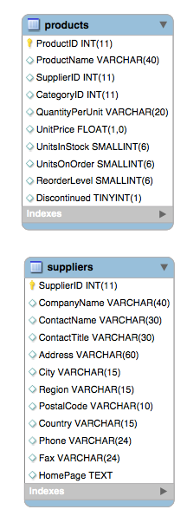
More Complex Queries
All of these functions work with more complex queries.
Workbench: Example 8

Slide 24
Query Optimisation
Functions like MAX(), MIN(), LIMIT(), COUNT() etc. all help us optimise queries and increase performance.
Why?

