Slide 1
CSC7062 – wk08 lecture Web development – CRUD
John Busch
27 Feb 2018
Notes:
Introduce yourself

Slide 2

Session 07
Web Development
CRUD
PHP & MySQL

Slide 3
create
insert
selecting an item
FORM -> SQL
Problem (validation issues on files)
Two table design

Slide 4
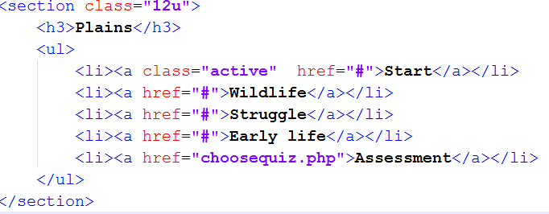
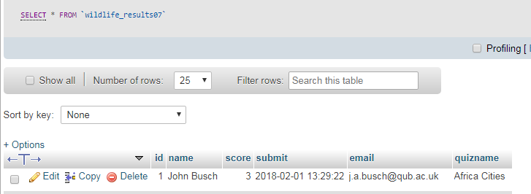
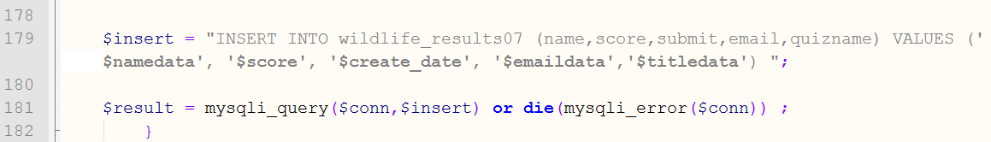
Wildlife07f edits
jbusch.web.eeecs.qub.ac.uk/7062/wildlife07f
Edit navigation to …
New results table name
Code/SQL changed

Slide 5
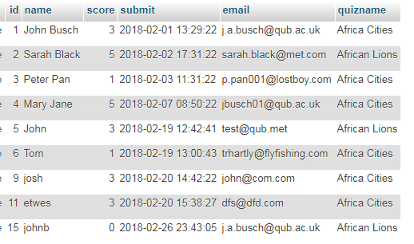
Filter data using column data
Use 'quizname' column to produce unique lists of results…
Created 'quizscores.php'
Filter quiz names using DISTINCT
SELECT DISTINCT quizname FROM wildlife_results07
Build unique URL with this data …
quizname
Africa Cities
African Lions

Slide 6
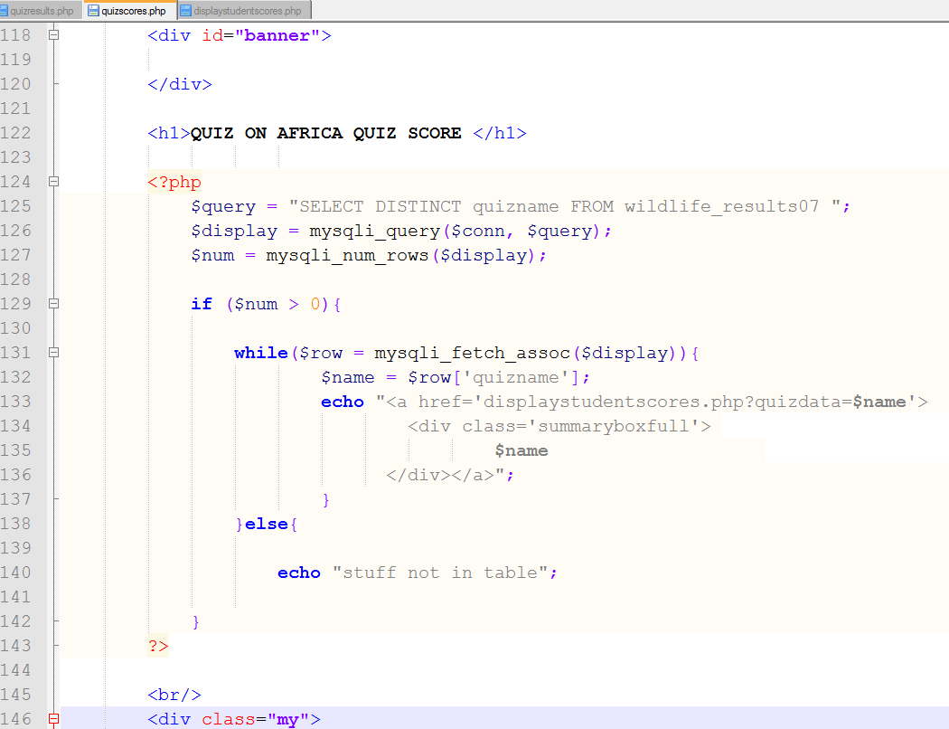
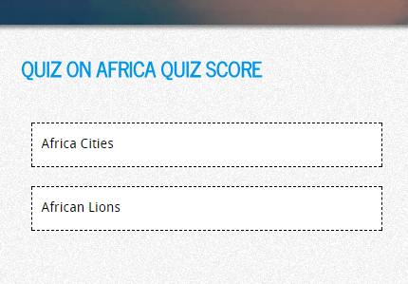
quizname
Africa Cities
African Lions
http://jbusch.web.eeecs.qub.ac.uk/7062/wildlife07f/quizscores.php

Slide 7
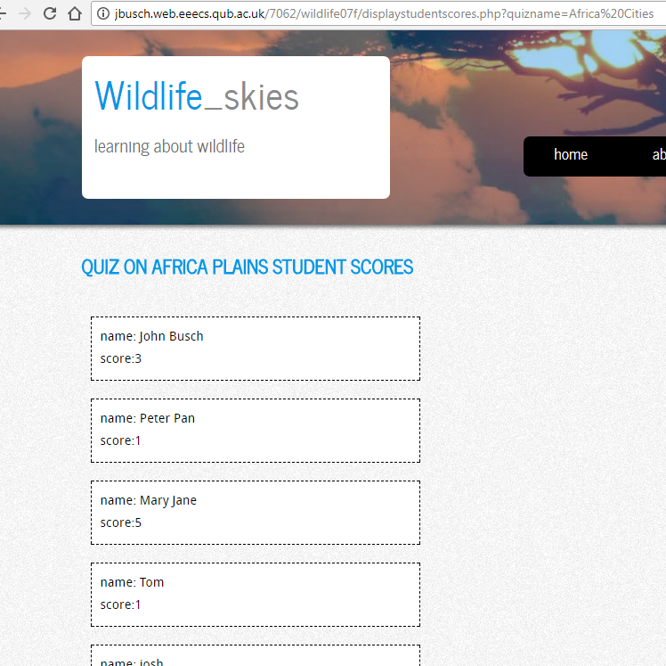
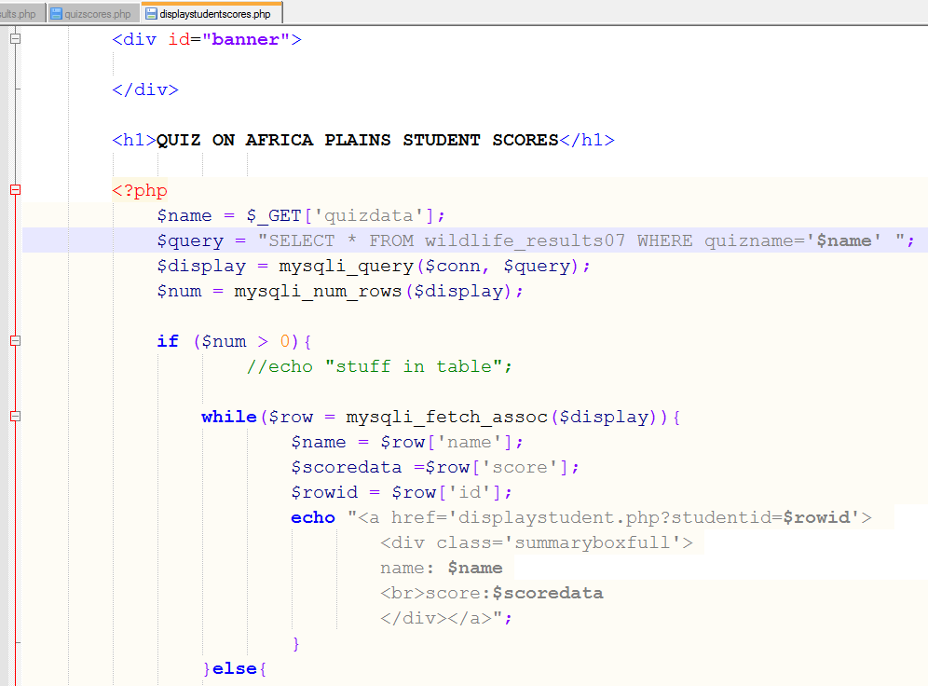
SQL is built using URL data

Slide 8
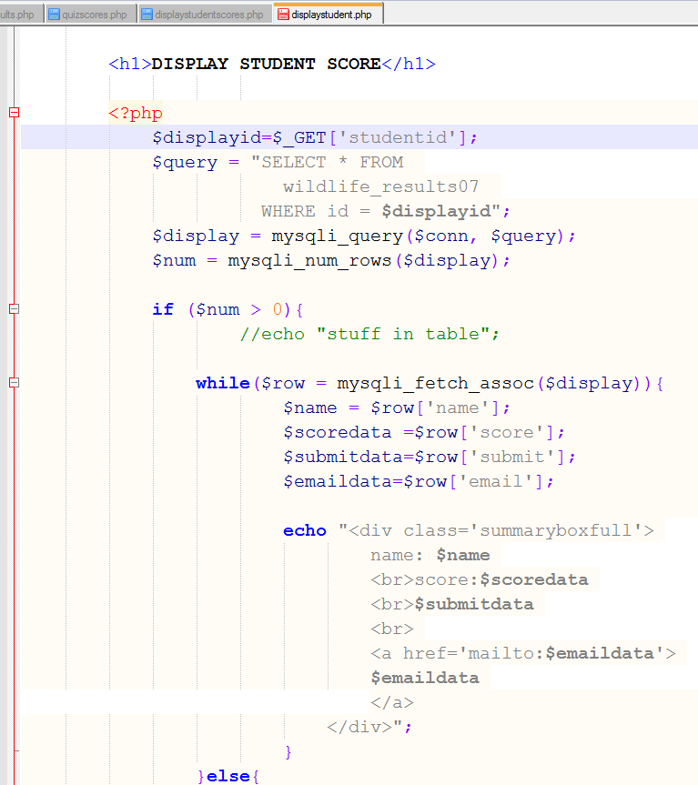
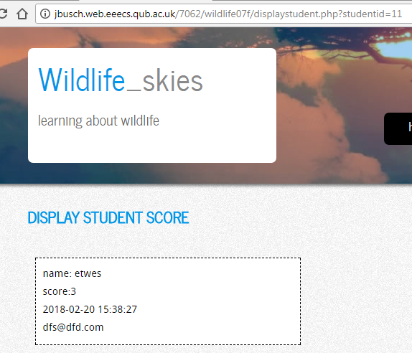

Slide 9
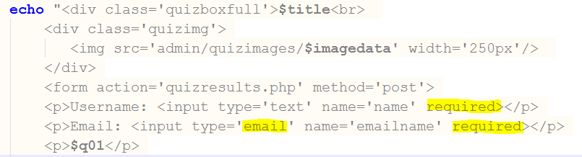
Data Validation
FORM element in is bad…

Slide 10
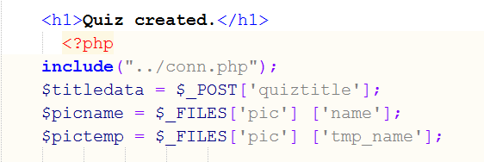
Image file validation?
http://jbusch.web.eeecs.qub.ac.uk/7062/wildlife07f/admin/createquiz.php
insertquiz.php
Takes any file type
bad, potentially insert a bad/hacker file onto web server
Stop all file types apart from .jpg
$_FILES [] can find file type…
$pictype = $_FILES['pic']['type'];
Notes:
$pictype != "png" && $pictype != "gif" &&

Slide 11
check file type using if condition
if($pictype != "jpg" && $pictype != "jpeg" ) {
echo "<p>Sorry, only JPEG files allowed.</p>";
}else{
$query = "INSERT INTO wildlife_quiz07(id, 01question, 01choiceA, 01choiceB, 01correct, 02question, 02choiceA, 02choiceB, 02correct, 03question, 03choiceA, 03choiceB, 03correct, 04question, 04choiceA, 04choiceB, 04correct, 05question, 05choiceA, 05choiceB, 05correct, imagepath, title) VALUES (null,'$q01data','$c01adata','$c01bdata','$a01data','$q02data' ,'$c02adata','$c02bdata','$a02data','$q03data','$c03adata','$c03bdata','$a03data','$q04data','$c04adata','$c04bdata','$a04data','$q05data','$c05adata','$c05bdata','$a05data','$picname','$titledata')";
move_uploaded_file($pictemp, "quizimages/$picname");
$result = mysqli_query($conn,$query) or die(mysqli_error($conn));
echo "<p> Thanks, quiz created. </p>";
}

Slide 12
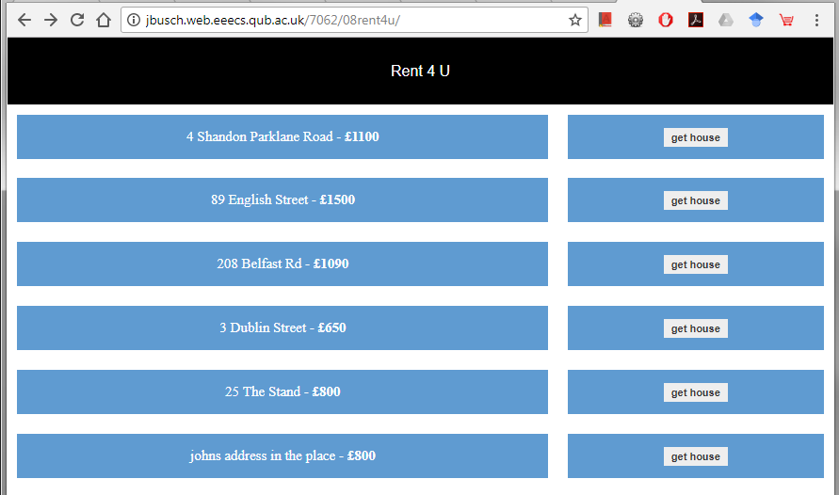
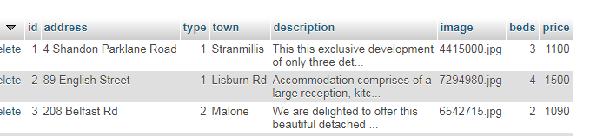
data
End users can insert data into the system
Some data is used to categorise rows of data
SELECT * FROM 08rentlist

Slide 13
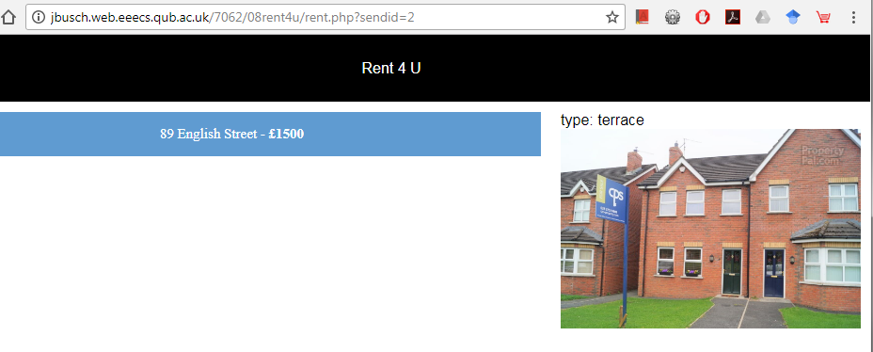
Selecting
SELECT 08rentlist.id, 08rentlist.image,08rentlist.address,08rentlist.price, 08renttype.typename FROM 08rentlist INNER JOIN 08renttype ON
08rentlist.type = 08renttype.id
WHERE 08rentlist.id='2' ";

Slide 14
why go to the bother of categories?

Slide 15
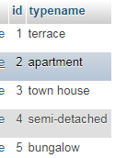
Categories are now scalable
Insert new category
Use category table to populate the INSERT form
http://jbusch.web.eeecs.qub.ac.uk/7062/08rent4u/admin/insert.php

Slide 16
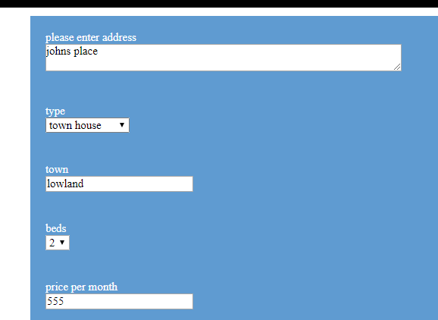
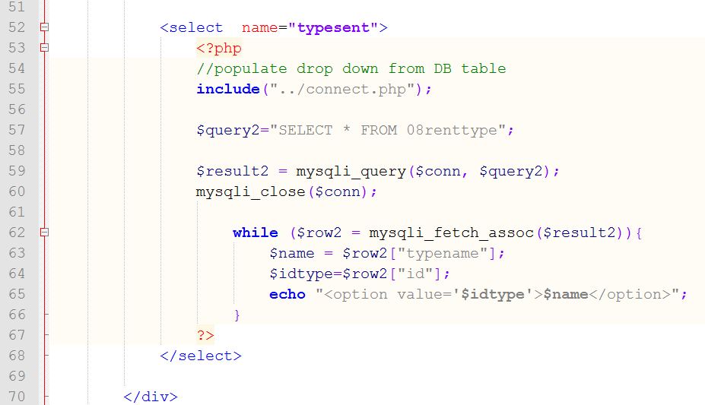
code

Slide 17
mid-term assessment
Practical assessment
1pm – 3pm Ground floor lab
1st March 2018
green room
14 Malone rd lab

