Slide 1
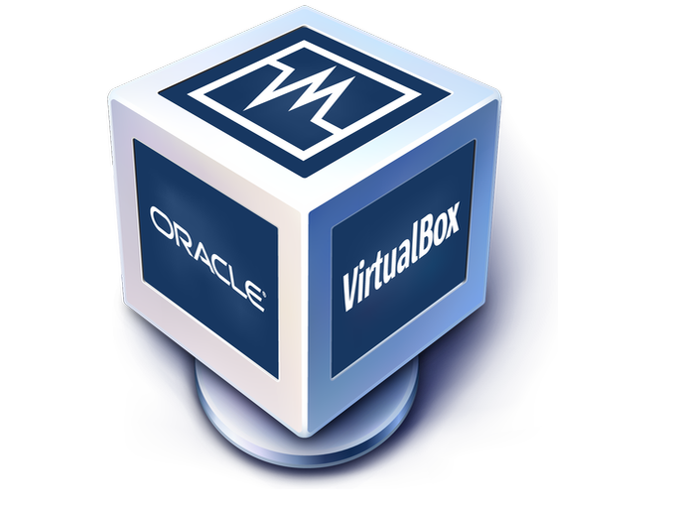
01 – Operating Systems and Linux
COMP 190 – Dickinson College
Spring 2023
Image from: https://www.hiclipart.com/free-
transparent-background-png-clipart-ajzax
Image from: https://www.mychoicesoftware.com/blogs/
news/why-do-so-many-companies-use-windows-os

Slide 2
COMP190 – Tools and Techniques for Software Development An introduction to the Unix command line environment, shell scripting, system administration, debugging tools and version control. Skills developed will be applied in the context of a Humanitarian Free and Open Source Software (HFOSS) project. Case studies of social, legal and ethical issues raised by computing and computing for the greater good will complement the technical skill development.
Notes:
Brief overview of course content.
High practical value of technical skills for internships and jobs
Also provide ability to make an impact on our (and other) communities
HFOSS is FarmData2

Slide 3
Notes:
Place of 190 in the overall curriculum.
On threads for:
W – writing
G – computing for the greater good
- Emphasize the socal power of computing in addition to its business value.
E – social / legal and ethical issues
S – SINE elective
- Social innovation and entrepreurship certificate.
Direct preparation for COMP 290
- Deep engagement with FarmData2 HFOSS project.
Leads to work in HFOSS or FOSS project of your choice in Senior Seminar.
Option for a 390 independent study if interested.

Slide 4
COMP 190 – Course Mechanics
https://dickinson-comp190.github.io/website/
½ Credit
Credit / No Credit
Weekly Work
Reading and Discussion (social/legal/ethical)
Introductory Lecture
Activity Sheet (submit on Moodle)
Scored 0-3, Resubmits for 0-1 within 1 week of return.
~2-3 hours.
Collaborate but do not copy!
Quiz on Moodle
Score 2 (>90%) or 3 (100%) w/ unlimited retries
Individual
Communication on Teams
Notes:
Credit/No Credit – no letter grade.
- learn it because it is important!
Reading and Discussions
- Short ~10min readings and ~15 min discussion
- Come prepared to
- Say something about something you found interesting.
- Ask a question about the content
- Ask a question of your classmates (what did you think about xyz?)
- Not requiring you to post anything…
- but if its clear people are not reading and preparing, that will change
Introductory Lecture
- Big picture and context
- Not everything you need to know
Activity Sheets
- Guide you through a set of experiences
- Build up your experience bank and toolbox
- Not intended that you memorize or master everything
- Instead experience it, know it exists, be able to return to it when you need it.
- This is why credit/no credit instead of letter grade.
- the more you engage it the better you’ll be able to use it
- in future classes / projects
- in internships or jobs
- Talk, Share Ideas, Ask questions… Just learn it / experience it.
Quiz
- reviews the material from lecture and activity
- Use it as a self test.
- Review things you miss and try again.
Show Teams
Show website structure

Slide 5
COMP 190/290 Philosophy
The goal of these courses is to give you a set of experiences with important tools and techniques.
Not expected to master every detail
Remember “what” can be done
“How” it is done is easy to look up and reconstruct
Operate in incomplete information situations
Make mistakes
Practice figuring things out
Develop intuition for future situations
”Ohhh…. This seems like that thing that one time…”
Notes:
Not mastering every detail
- somewhat different than a normal course.
- so you are not expected to understand everything in the same way as a typical course.
- The idea is to experience a lot of things that will be useful to you in the future.
- You’ll need to use them over and over and over again until they are natural.
- We are not going to try to drill them in here.
- But what you want to do is remember what you’ve done, not necessarily how you did it.
- Once you know what you can do and remember that you’ve done it its easy to look up how to do it.
You won’t always have all of the information you need
- you’ll make mistakes
- things will appear not to work
- you’ll get practice figuring them out.
For both of these reasons this is a CR/NC course.
- Don’t want you memorizing commands and such
- Also don’t want to penalize you for working without complete information, when that’s what is expected.
By having lots of experience you develop an intuition about what is happening in future situations.
- Ohhhh yea… I’ve seen something like this before.
- What did do then?
- How did I do that?
Then once you do it a few dozen or a few hundred times, you’ll remember it.
So… bottom line…
- Don’t panic if you feel like you don’t understand everything deeply
- That is okay…
- This is about
- knowing “what” you can do
- having the experience of having done it
- being able to figure things out
- being able to look up “how” to do it again.

Slide 6


Questions
Image from: openclipart.org
Notes:
Will take questions on syllabus next week as well.
Or ask on Teams.

Slide 7
Topic 1: Introduction to Linux (5 weeks)
Operating Systems, Docker & Linux
Linux Command Line Interface (CLI)
Linux Tools, Filters and Scripts
Basic Linux System Administration
Docker: Dockerfiles and Images

Slide 8
The purpose of an operating system is to provide an environment in which a user can execute programs in a convenient and efficient manner. - Silberschatz, Galvin, Gagne Operating System Concepts
Notes:
Provide an environment in which a user can execute programs.
when machine starts (i.e. boots up) it is just bare hardware
That machine can run one only one program
the program it runs is the OS
the OS creates the user experience and allows us to run (execute) programs.
Convenient Manner
What is convenient depends on which user the and the context in which the OS is being used.
- perhaps point and click….
- perhaps touch screen…
- perhaps command line (Terminal)
Efficient Manner
Again what is efficient will again depend upon the user and the context in which the OS is being used.
And efficiency interacts with convenience
- if we are using memory and CPU power to make things look pretty (point and click vs text interface)
- then programs will not be able to run as fast or use a much memory.
The result is that are lots of different operating systems tailored to different environments and purposes.
- OS for a PC is different than for a mobile device is different than for a server.

Slide 9

PC Operating Systems
Tux
Three primary ”flavors”
Target user convenience (point and click)
Also support “power users”
e.g. computer scientists, developers – us!
MacOS X
Windows
Unix / Linux
Image from: https://www.cleanpng.com/
Notes:
We ill be focused on using a PC operating system as that is where the majority of software development occurs.
As you are likely familiar with MaxOS and Windows this course will use a Linux based OS.
- This is also because a lot of software development happens on Linux / Unix
- This is because Linux/Unix is the dominant platform for servers.
- In the cloud application services Linux has up to 70% market share.
Familiarity with the way Unix/Linux operate and the tools they provide will be valuable to you.

Slide 10








What is Linux
Linux is an umbrella term that refers to a huge array of Unix compatible operating systems that are built on the Linux kernel.
Linux comes in many “flavors” (i.e. “distributions” or “distros”)
Images from: https://www.cleanpng.com/
Notes:
Unix Compatible – Unix was a proprietary operating system from AT&T developed in the 60’s and 70’s.
- Had to pay to use it / could not modify it
Kernel is just the core parts of the software that make up the OS.
”Flavors” refers to distributions, which is just a way of saying that a particular group is making it available.
You’ll hear people say things like – ”I’m using the Ubuntu distribution” or “distro” for short.
Fedora, Red Hat, SUSE, gentoo, Ubuntu, Debian, ArchLinux, Puppy Linux
And probably hundreds of others.
You will get familiar with one flavor in this course Debian Linux

Slide 11
Why/How So Many Distros?
The Linux kernel was created by Linux Torvalds in 1991 as licensed as Free and Open Source Software (FOSS).
FOSS
Not only cost free…
but source code is also freely available…
and four freedoms are guaranteed. You are:
Free to run and use it for any purpose
Free to redistribute it
Free to study and modify it
Free to redistribute it with modifications
Notes:
FOSS – More on this later in the course.
But basically, once those freedoms were established
It allowed lots of different groups to customize Linux to their purposes or philosophies
- desktop, servers, embedded systems, mobile devices, old resource constrained PCs
- If you have a set of requirements you can likely find a Linux distro to meet them.
- and if not, you can take the source code and customize it yourself.
MacOS and Windows – and the original Unix - are proprietary and not FOSS
- this is why there is only one “flavor” of each of those
- note: flavor is different than version

Slide 12
Debian Linux
Debian is one of the most widely used and well supported Linux flavors.
Experience with Debian transfers easily to a number of other flavors that use the same or similar tools.
It is smaller and more friendly to lower resource machines than some other flavors.
https://www.debian.org/
Notes:
We will be using Debian Linux in this class.

Slide 13
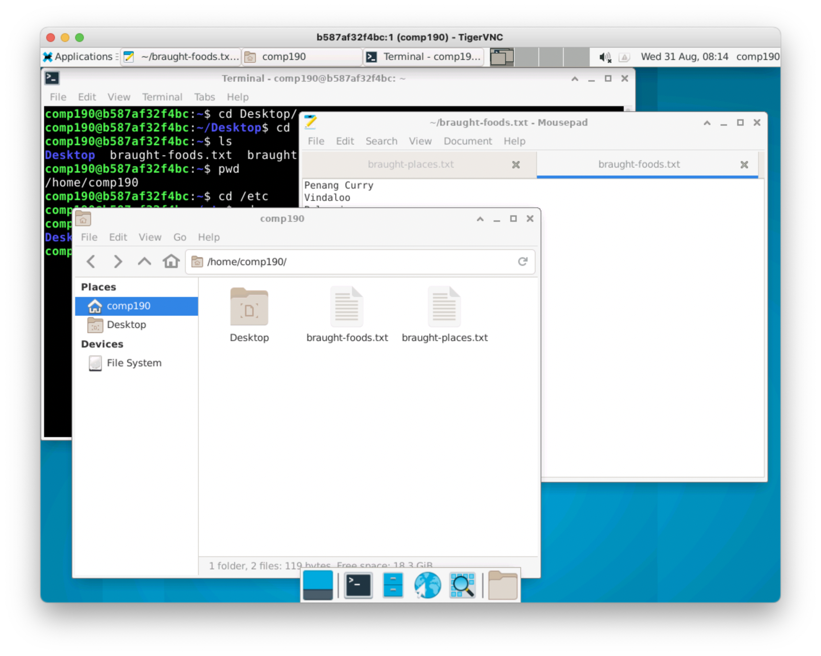
Desktop Managers: XFCE4
Like Mac and Windows Linux can have a graphical user interface (GUI).
Unlike Mac and Windows there are many different windowing environments (i.e. Desktop Managers) for Linux.
XFCE is a basic, light weight Desktop Manager.
Notes:
We often associate the GUI with the OS
- Windows or MacOS have distinctive GUI’s
- However, those are just convenient ways for us to interact with the actual OS.
- e.g. point and click, windows ect.
- With Linux each Distro usually has its own distinct GUI or Desktop Manager
- You can even change the one that comes with your Linux distro
- the Desktop Manager is just a program so there are lots of choices.
We will be using the XFCE4 GUI for Debian Linux in this course.

Slide 14
Running Linux & a Desktop Manager
Debian Linux with XFCE4 running in a Docker Container.
On your Machine:
Replace MacOS or Windows
In a Virtual Machine.
In a Docker Container.
On a server accessed remotely.
Notes:
Virtual machine: program that you run on your computer that pretends to be another complete computer.
- You can then install Linux on that computer and use it in a window on your machine.
- Can be resource intensive (you need lots of ram and a fast processor)
Docker Container
- Similar to a Virtual Machine
- Easier to setup
- Requires less resources
- Runs faster, requires less RAM
- More in a moment…
On a server
- Linux runs on a computer on the network.
- Connect to it over the network
- More complex to setup
- Significant security concerns
We will be running Linux in a Docker Container.
- It will be a lot like if we were running it on a server
- We will interact with it just like you would if it was running somewhere else on the internet
- except that it willl be running, hidden, inside your machine – in a docker container.

Slide 15
Docker/Docker Desktop
Docker (and Docker Desktop) are programs that manage images and containers.
A docker image is a compressed file containing an operating system (e.g. Linux) and application software (e.g. terminal / editors / browser / etc).
A docker container is like a simulated computer or server inside your computer.
When a container is running you can connect to it like a server and use the operating system or services that it provides.
Notes:
I may say docker image or I may just say image, for short.
Similarly, for docker container or just container.

Slide 16
Demo
Demo of our setup once its working.
Pull image (once in Terminal)
Create container (once in Terminal)
Start container using Docker Desktop
Connect to container with TigerVNC Viewer
Stop container using Docker Desktop
Do not Delete your container!
Notes:
Let’s see what this looks like.
- To give you an idea of the big picture.
- Then I’ll talk about some of the details a little more.
- The activity will guide you through it again
Demo:
- the commands are included in the assignment.
Pull:
In terminal:
docker pull braughtg/190-unix-intro:s23
Takes a little while, but not too terribly bad.
Create:
In terminal (for MacOS – different for windows… see assighment)
docker create --name comp190 --publish 5901:5901 --publish 6901:6901 --publish 80:80 --mount type=bind,source=/var/run/docker.sock,target=/var/run/docker.sock braughtg/190-unix-intro:s23
Start:
Start from Docker Desktop
Connect:
Launch TigerVNC Viewer
Connect to localhost:5901
Stop:
Stop from Docker Desktop
Restart:
Restart from Docker Desktop

Slide 17

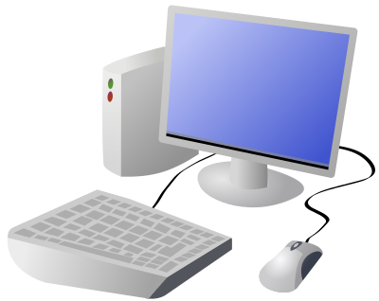





dockerhub & Docker Concepts
Pulled Images
Pull
Pull
Created
Running
Stopped
+
+
Dockerhub is a cloud-based repository of static
Docker Images
Containers
Notes:
We will spend more time on Docker and understanding it more fully in a few weeks.
For now, I’ll just expand a little on some of the basic concepts around what we just did in the demo.
Docker Image: A file containing the OS, tools and applications for a specific machine configuration.
- It’s sort of like a snapshot of a computer that can then be restored.
- Different images will be configured for different purposes
- A web server, a database, a whole e-commerce site, etc…
- Even a machine designed for use in a COMP 190 course at Dickinson College ☺
Images can be Pulled to your computer
- A pull makes a copy of the image on the local machine.
- The same image can be used over and over again by many people to created identical containers.
- This is why we like it… this way you will all have identical machines to work with via Docker and VNC.
An image is turned into a Container
- Think of a container as a machine/server hidden inside in your machine.
- It can be brand new – just out of the box (created)
- It can be running
- When it is running it is like a whole computer running inside your computer
-You can interact with it and change it and work with it
- Run programs
- Create/edit/delete files
- install software
- etc.
- Those changes are represented by the Red + sign in the figure.
- A container that has run, can be stopped
- That is just like shutting down your machine
- Any changes that were made are saved (the + again)
- A stopped container can be started again
- like booting up your machine after it was shut down.
Images (CC)
Mac: https://iconarchive.com/show/cristal-intense-icons-by-tatice/Apple-multicolor-icon.html
Win: https://iconarchive.com/show/mega-pack-2-icons-by-ncrow/Windows-Media-Center-icon.html
DockerHub: https://www.elkoinc.com/docker-hub-registry
Docker: https://freebiesupply.com/logos/docker-logo/

Slide 18
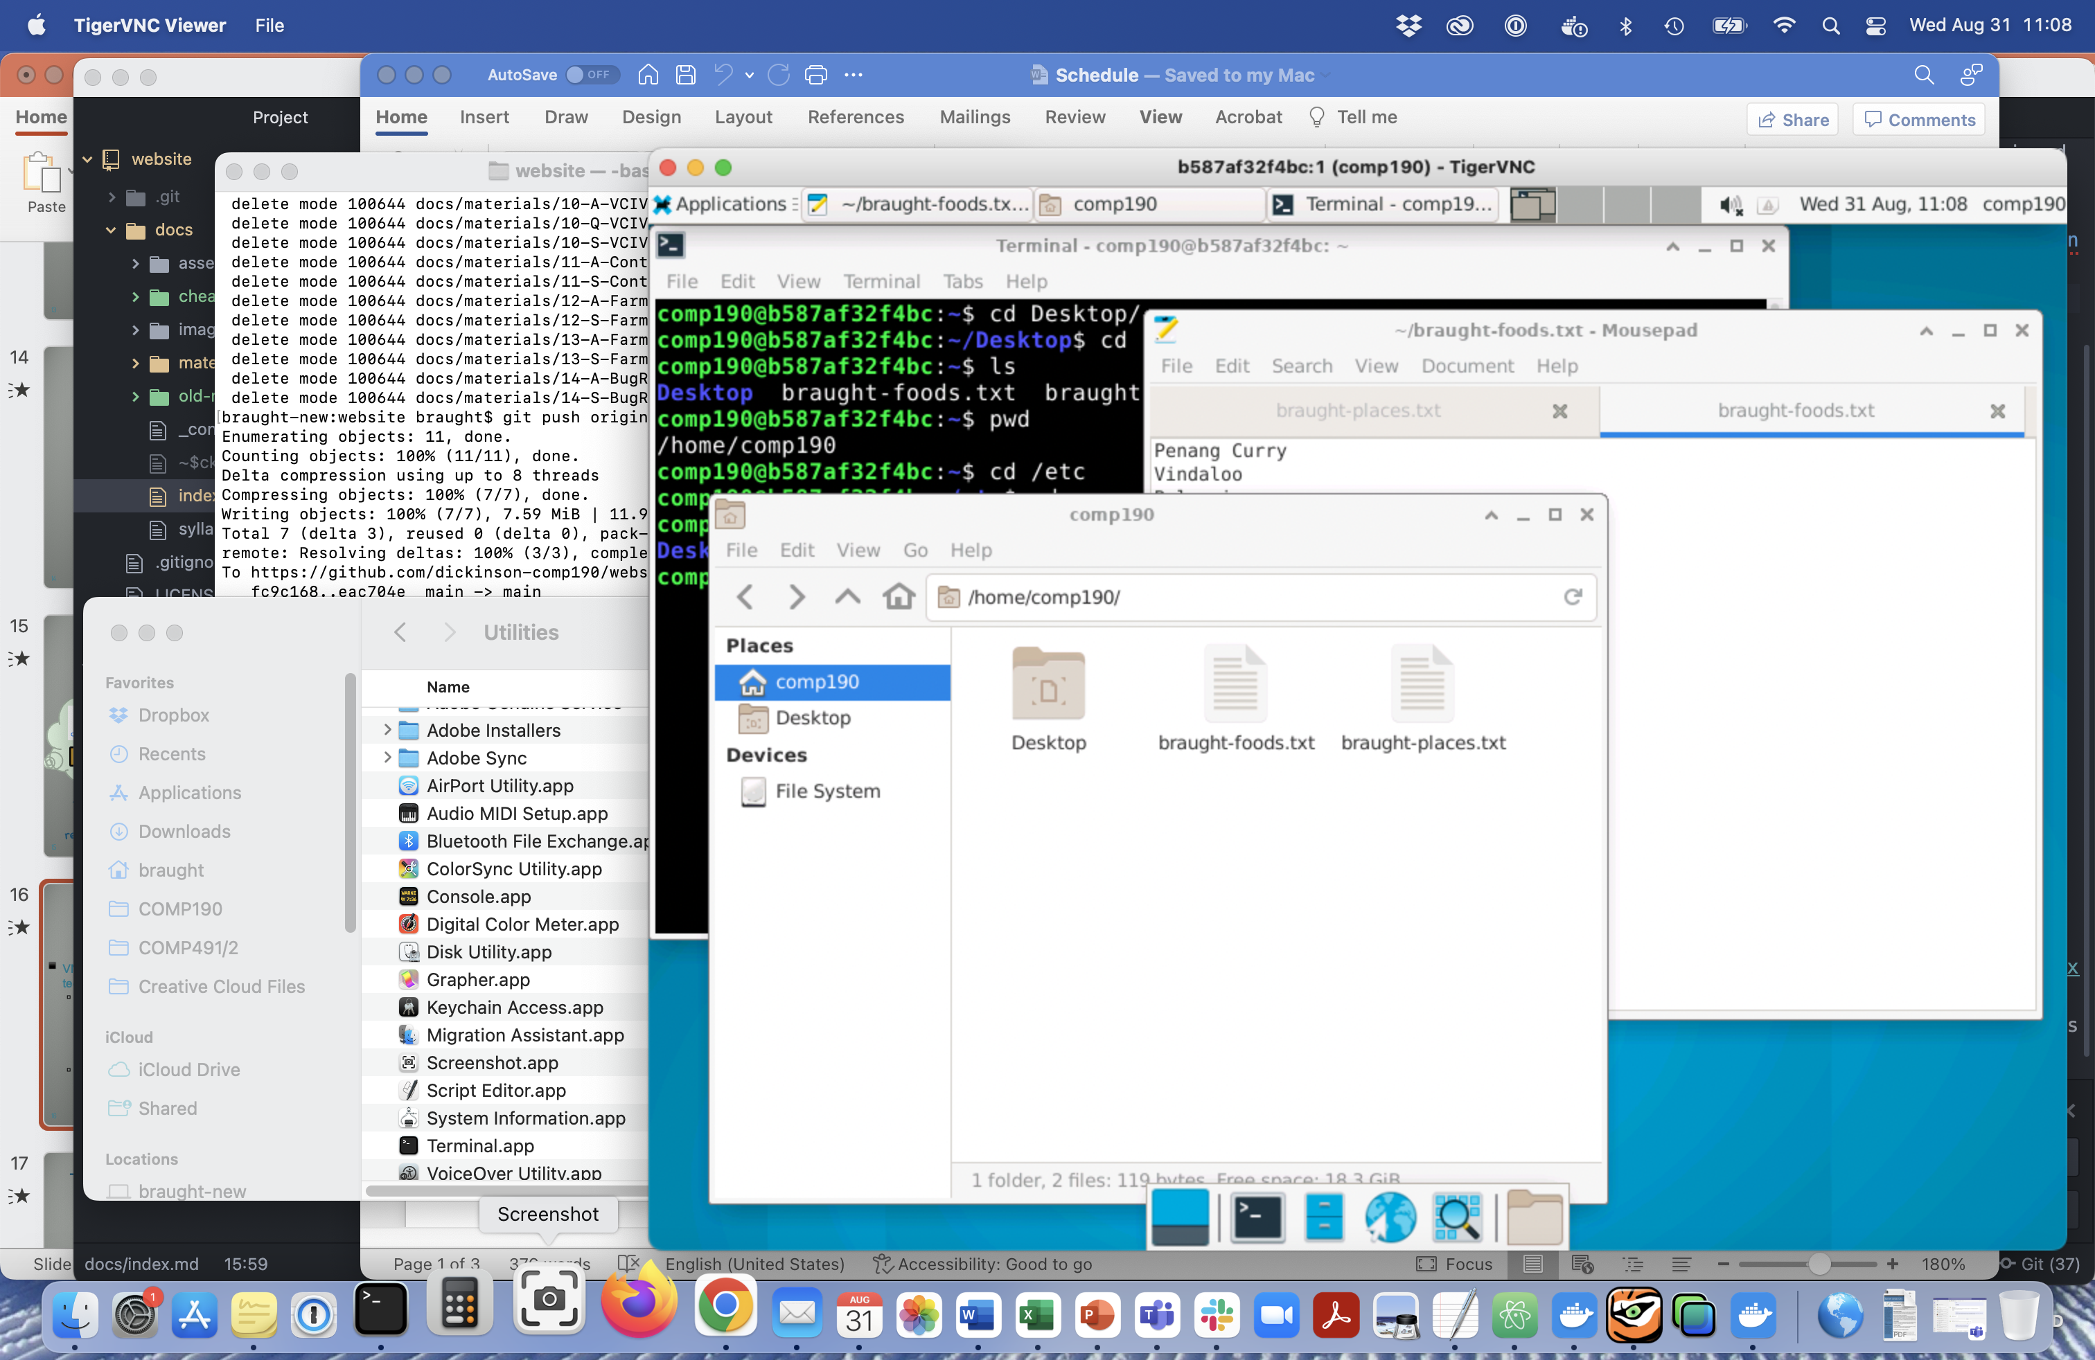
Virtual Network Computing (VNC)
VNC is a “Remote Desktop” technology
Allows us to connect to and interact with another computer
A server
Linux running in a docker container.
Displays the other computer’s desktop in a window on our machine.

Slide 19
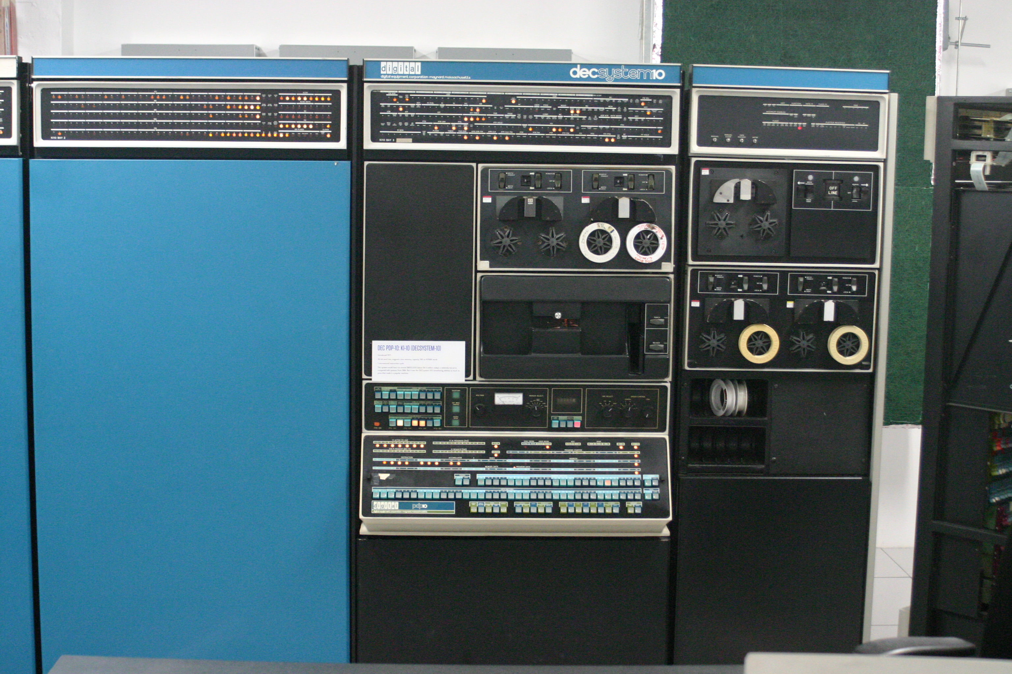
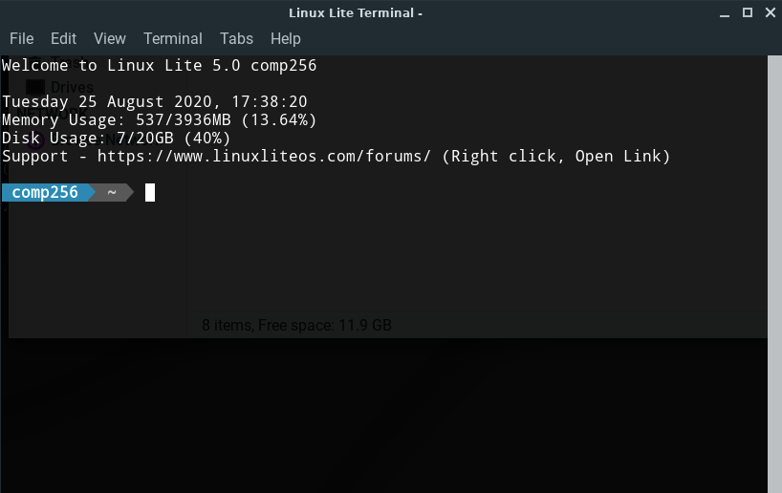
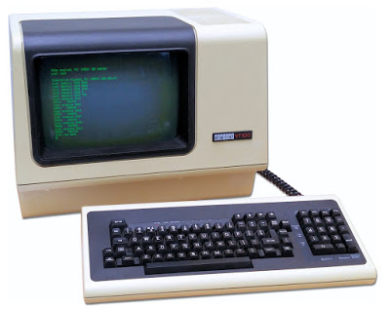
Terminal/Shell/Command Line Interface
Today a Terminal is a program that runs a Shell (another program), which provides a text-based command line interface (CLI) to the operating system.
Image by Gah4 - CC BY-SA 4.0 https://commons.wikimedia.org/w/index.php?curid=38604047.
Image from: https://www.retromobe.com/
2018/08/digital-dec-vt100.html
Notes:
Today these are often seen as the same thing.
Historically a Terminal was a physical device
That device communicated with the big mainframe computer in the other building or room.
That physical device ran a program or was hardwired to have a shell.
The shell provided a command line interface.
Users typed commands, the shell transmitted them to the computer and displayed the computer’s responses.
Today that is all in one. The terminal now is a program that runs a shell which provides the command line interface that talks with the OS.

Slide 20
Shell Flavors
Because the shell is a program run in the terminal a variety of shell programs (i.e. flavors) have been developed.
Each suited to the particular preferences of its designer.
sh Bourne shell
bash Bourne-again shell
csh / tcsh C shell / Tenex C shell
ksh Korn shell
zsh Z shell
If you are interested in the history/details:
https://www.edureka.co/blog/types-of-shells-in-linux/
Notes:
Boune and Korn named for the person who wrote them originally.
mid-1970s by Stephen R. Bourne while he was at AT&T Bell Labs in New Jersey
David Korn – 1983
Bash is a backward compatible extension of sh
Tcsh is an extension of csh made by the company.
Our Debian linux container uses the bash shell by default.

Slide 21
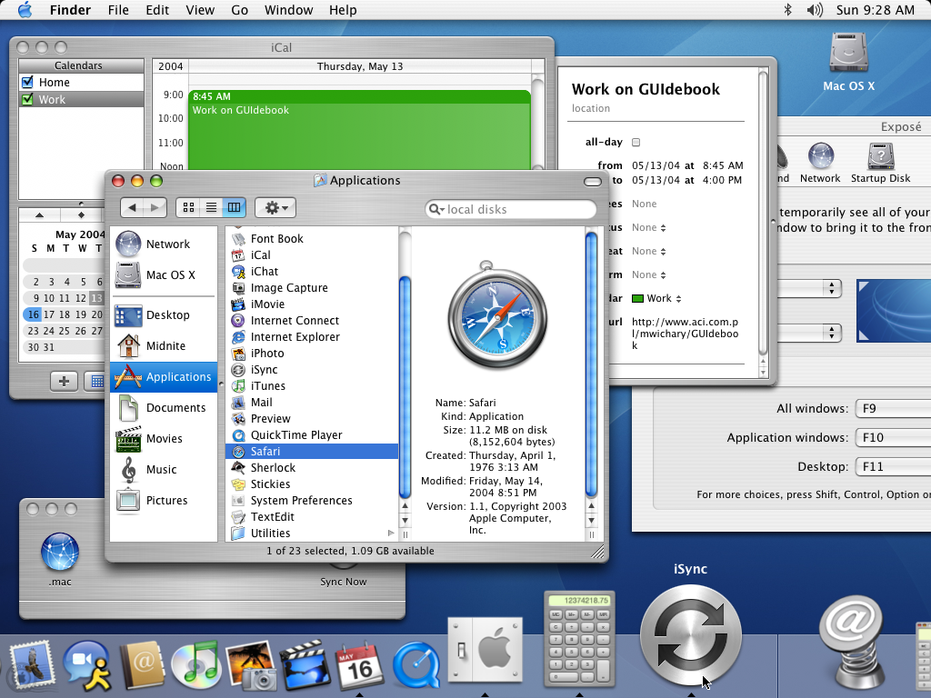
GUI / CLI Equivalence
Interactions with the operating system that can be done with point-and-click through a Graphical User Interface (GUI) can also be done via a Command Line Interface (CLI) and vice versa.
Image from: https://guidebookgallery.org/
screenshots/macosx103
Notes:
Two different ways for accomplishing the same tasks.
Can click and drag files to move – can issue a mv command on the command line that move files.
Can search for files or within files using the search bar – can issue commands like find or grep that search the system.
Things are easier to learn and figure out using a GUI
Things are harder to figure out and remember on a CLI but many are more convenient and efficient once you do.
In particular the more technical things that programmers and developers tend to do.
Thus the popularity of CLIs and importance of leaning to use one.

Slide 22
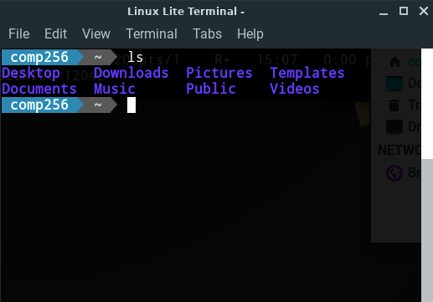
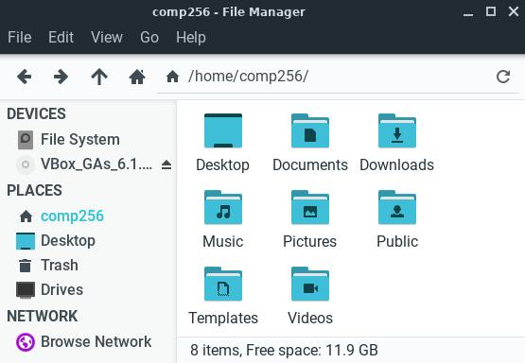
GUI / CLI Equivalence
Notes:
Just as an example, the same information appears in the GUI on the left as in the CLI on the right.
Comp256 directory containing the files Desktop, Documents, etc…
To copy files in the GUI you may need to open mulitple windows and drag and drop.
Not hard to figure out, but cumbersome
In the CLI the same copy would be a one line text command.

Slide 23
Linux CLI Commands:
Lots of Linux CLI commands (e.g. ls)
Many will be introduced in HW Activities
General syntax you’ll see:
<…> - Must replace with a value.
rm <file> rm myfile.txt
[…] – Optional and can be omitted
cd [<dir>] cd cd home
Notes:
I’m not going to introduce the commands here – they are covered in the activities.
But I do want to point out a few little things that are common to all of the commands.
< > - used to indicate values that must be replaced.
- the < > are not included in the final command
- E.g. In rm myfile.txt, the <file> is replaced by the filename myfile.txt
[ ] – used to indicate optional parts of commands.
- the thing inside [ ] can be included or omitted.
- again the [ ] are not included in the final command If this part is used.
- e.g. in cd the optional <dir> part is omitted.
- e.g. in cd home the directory home is used as the <dir>.

Slide 24
Useful Linux/Unix Stuff:
Copy and Paste in Linux/Unix
In the Terminal:
Copy Shift+Ctrl+c
Paste Shift+Ctrl+v
In any other applicatoin:
Copy Ctrl+c
Paste Ctrl+v

Slide 25
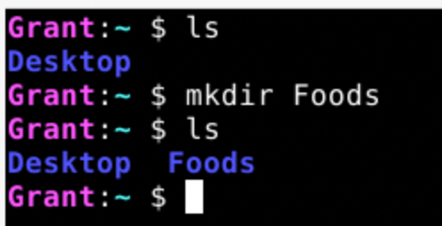
Sample Answers:
Many questions in the activities will ask you to use a screenshot of your work…
A good screenshot will demonstrate that an action occurred and succeeded. This may include:
state before a command is used, if relevant
command that was used
relevant output that was produced
next command prompt
Notes:
Here the mkdir command is making a new directory.
So the screenshot shows the
- current list of files and directories
- so we know the starting point
- command that is used to make the new directory
- the list of files and directories after the command is used
- so we can see that the command worked
- the next command prompt
- so we know that the command completed.

Slide 26
What’s Next?
Complete Pre-Course Survey
Link on Moodle.
Read the Syllabus – post any questions to Teams
Complete Syllabus Quiz on Moodle
Complete A01 - OSandLinux Activity Sheet
Convert to PDF
Submit to Moodle by next Wed 12:00 noon
Do Reading and prepare for discussion
Complete Q01 on Moodle and score 2 (>=90%) or 3 (100%)
Within 1 week of assignment due date.
Notes:
Work on 01-OSandLinux Activity for the rest of the class.
Use teams or office hours to ask questions of me and your classmates outside of class.

Slide 27

Acknowledgments:
Slide Template From:
https://creativecommons.org/licenses/by/4.0/
Slide Content Licensed as:
https://creativecommons.org/licenses/by-nc/4.0/

