Slide 1

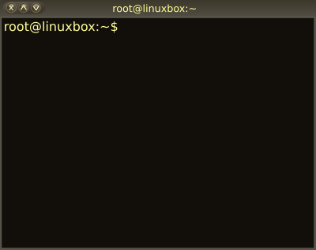

04 – Installing Software
COMP 190 – Dickinson College
Spring 2023
Images from: openclipart.org

Slide 2
Software Installation
Environment Variables
The PATH variable
The Super User
Software Installation
Package Managers
Graphical Interface
Command Line Interface
The Advance Package Tool (APT)

Slide 3
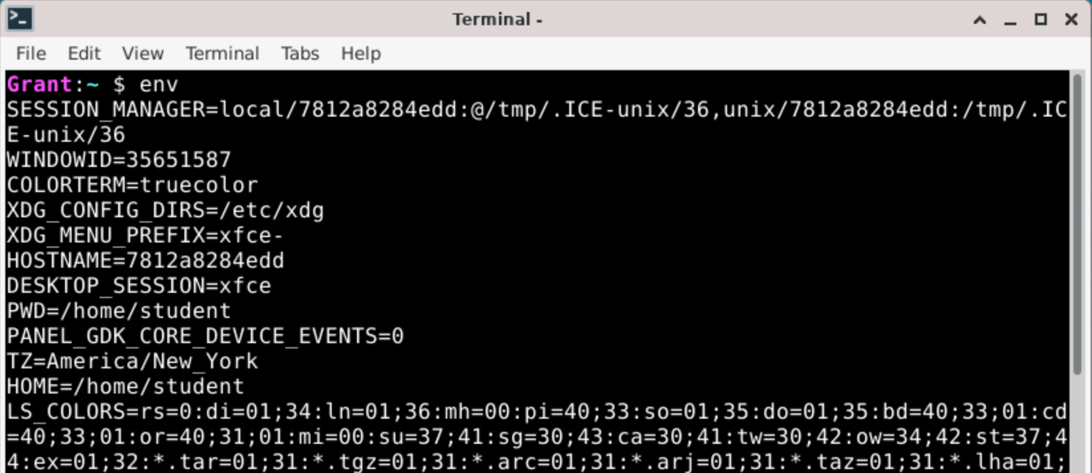
Environment Variables
Environment variables are used by Linux/Unix shells to track information and to customize how the system works.
Notes:
There are some things we need to know about before we get into software installation.
The env command can be used to display all of the defined environment variables.
Each variable has a KEY and a value.
- they are KEY=value pairs
KEY is the variable name
Value is the value of the variable.
We won’t care about most of these… but there are a few that should seem reasonable:
- HOSTNAME= the name of the machine
- for us its that seemingly random string of letters and numbers.
- That is because that is how docker names the containers.
- If you look in Docker Desktop you’ll see that same value associated with the container.
- DESKTOP_SESSION=xfce
- Here we see the value xfce
- Which if you recall is the desktop GUI we are using
- PWD=/home/student
- pwd is the ”present working directory”
- What we have just been calling the “working directory”
- this will change when you use cd.
- HOME=/home/student
- This is your home directory.
- It does not change when you use cd

Slide 4
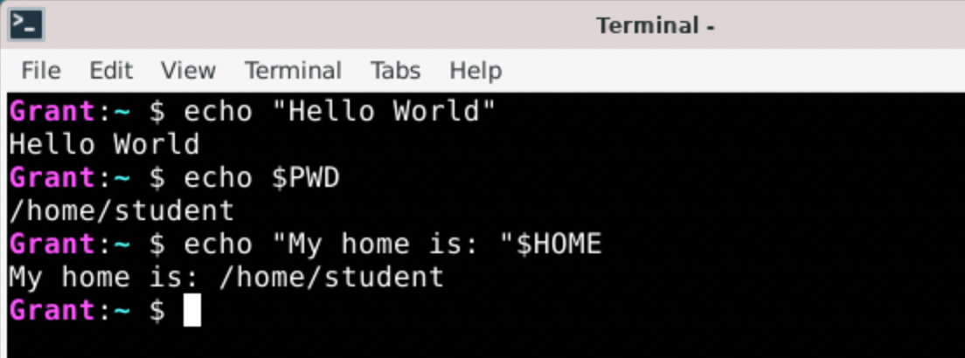
echo and Environment Variables
The echo command is used to write text to standard output.
A $ can be used to access the value of an environment variable (e.g. $HOME)
Notes:
We’ll use the echo command to look at a few environment variables.
It is also very useful in shell scripts.
- If you want to display something in a script you use echo.

Slide 5
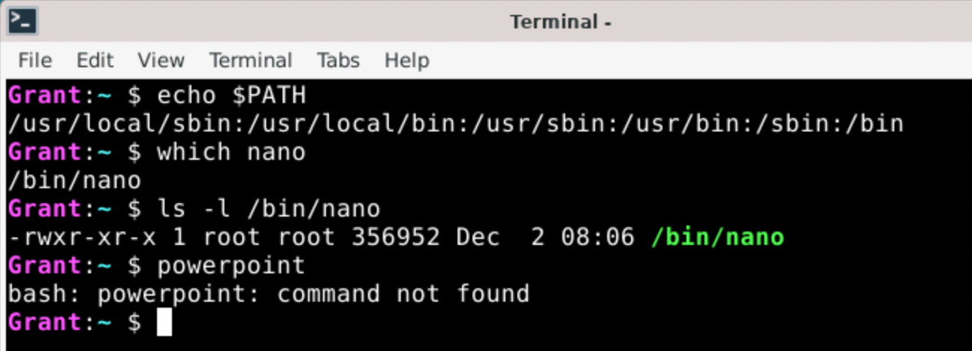
The PATH Environment Variable
The value of the PATH Environment Variable is a : delimited list of absolute or relative paths that the shell will search for executable programs.
Notes:
So when you type the name of a program on the command line (e.g. ls) the PATH is the list of the places that the shell will look for that program.
- here it looks in /usr/local/sbin
- if the program is not found there then it looks in /usr/local/bin
- then in /usr/sbin, /usr/bin, /sbin and finally /bin
The which command will display the absolute path to an executable program file that is found on the PATH.
- It tells you which executable program will run when you type the name of the program.
- For example:
- which nano -> Tells us that the executable nano program is /bin/nano
- because /bin is on the path and that is where then nano program is stored.
- Some others:
which xeyes -> /usr/bin/xeyes
which xclock -> /usr/bin/xclock
If we look at the permissions on the file /bin/nano
- We see it is owned by user root and belongs to group root.
- More on that later
- But we know that’s not us, because we are user student and group student
- That puts us in the other category.
- So, our permissions on nano are the third group of permissions (r-x)
- we can read and execute the program.
- but we cannot change the program nano (i.e. modify or delete it)
- Makes sense since we saw we could run the nano program back in A02.
- This is similar for all of the other commands that we use.
If an executable with the name typed does not appear in any of those locations
- The shell reports an error.

Slide 6
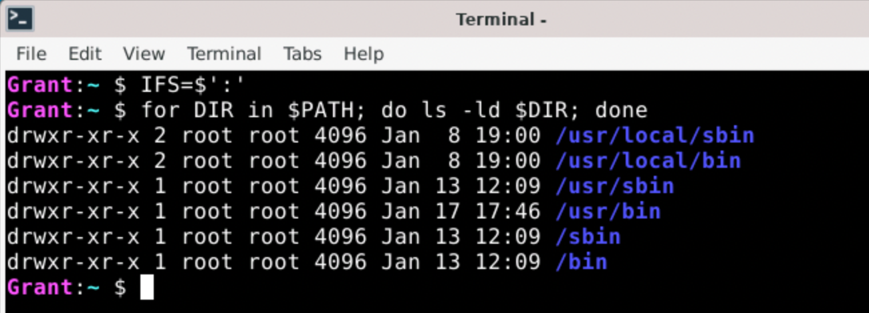
Software Installs & Permissions
All of the directories on the PATH are owned by the user root and belong to the group root.
We do not have write permission to these directories.
Notes:
When new software is installed into the system it is typically installed into the directories listed on the PATH
- That way it can be run just by typing its name on the command line.
- E.g. like nano.
But…
- All of those directories are owned by the user root and belong to the group root.
- Again, as user student and group student, we are in the “other” category.
- So our permissions to these directories are r-x
- So we don’t have write permission to any of the directories on the path.
- This means that as the user student, we cannot add programs to these locations.
So if we are going to install software, we need to have additional privileges…
Not critical… but if you are interested the command I used to list these…
- IFS=$’:’ indicates that we want to use : to break the PATH into pieces.
- for DIR in $PATH is a for-each loop
- DIR takes on the value of the name of each directory in the PATH environment variable
- The loop then uses ls –ld $DIR to display the long listing for that directory.

Slide 7
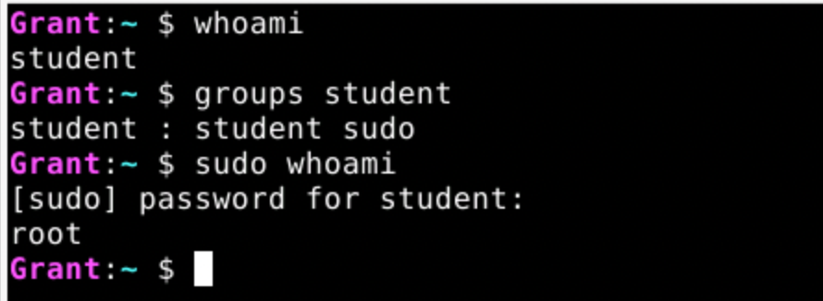
Super User (root) and sudo
Unix is a multi-user system
root is the name of the super user
Permissions checking is disabled
root user cannot log in for security reasons
The sudo command runs commands as the root user.
sudo <command>
Members of the sudo group have sudo privileges
Notes:
A multi-user system means
- multiple accounts
- different users can log into the same system (think servers and shared computers)
- different users will have different permissions
- That is the user / group / other permissions we have been seeing.
- Don’t want everyone being able to change system settings.
The root user is another user on our system – in addition to student.
- All Linux/Unix systems have a user named root.
- root is also called the ”Super User”
- because they can do most anything
- The checking of permissions is essentially disabled for root.
- So the root user can perform any operation on any file.
However, for security reasons on most systems the root user cannot log in directly.
- This prevents someone from discovering the password for the root user
- They could then log into the machine as root and do anything.
Instead, these systems have the sudo command.
- The sudo command executes another command as if it were run by the super user (root).
- Thus, using sudo allows you to override the permission system
- Allows users with normally limited permissions to use sudo to do administrative tasks on the system.
- For example, installing software into directories that they do not normally have write permission to.
Permission to use the sudo command is controlled by being a member of the sudo group.
- The student user is a member of the sudo group.
- This means that your user will be allowed to use sudo to run commands as root.
- So only trusted users (e.g. system administrators) should be in the sudo group.
- Normally you probably would not have this power…
- But here you do… because we are learning about it.
Example:
- If you were a system administrator setting up a machine for multiple people to use (e.g. in a lab)
- Then your user would be in the sudo group
- But the users you create for others would not be in the sudo group
- They might be in a users, staff or student group,
- Which could then be assigned different privileges appropriate to the user.

Slide 8
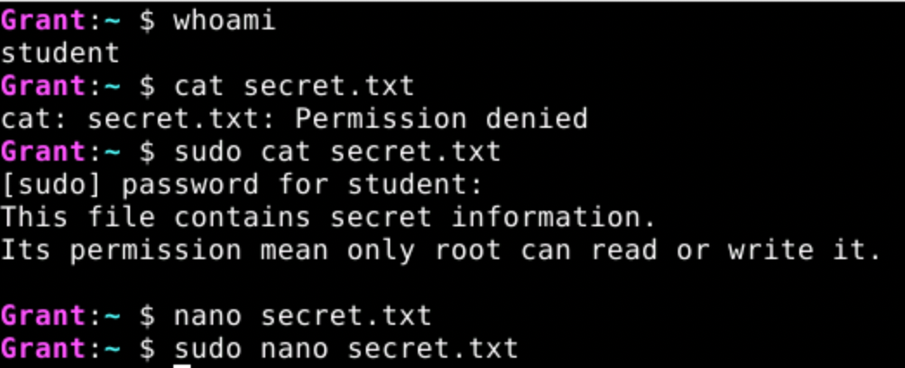
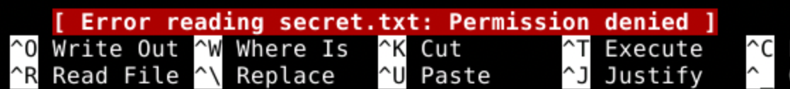
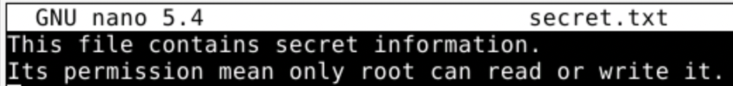
Using sudo
To use sudo, place the command to be run as the Super User on the command line after sudo.
Notes:
Consider the file secret.txt
- The owner of this file is root
- root has rw- permissions
- the group and anyone else (others) have no permissions ---
- So when the student user tries to cat the file
- permission denied because that user does not have read permission
- even though student belongs to the group student and this file belongs to that group
- because the group does not have read permission ---
- But when student uses sudo cat secret.txt
- the file is displayed because the cat secret.txt command is now run as the super user (root)
- and the permission checking is disabled when running as root.
This works similarly with editing.
- When the user student tries to edit the file using nano
- nano cannot read the file because student does not have permission to do so.
- When the user student uses sudo to run nano
- then nano is running as root.
- thus it can read the file
- Note: nano does give a little warning when you try this.
- It lets you know student is actually editing the file and asks if that is okay.

Slide 9
Software Installation
A package manager is a program that uses package repositories to simplify installing, updating and removing software and its external dependencies.
System-Level Package Managers
apt, rpm, yum, pacman, brew, snap
Project-Level Package Managers
JavaScript npm
Python pip conda
Java maven gradle
Notes:
Package Repositories are on-line sites that store installation packages for software.
- This in includes the program itself
- but also information about any external dependencies that the program needs to work.
External dependencies are other programs, tools or libraries that a piece of software being installed requires in order to work correctly.
- It’s like buying something at the store that requires batteries
- But is labeled “batteries not included”
- The batteries are an external dependency
- The package manage keeps track of that
- When you buy that thing that needs the batteries, the dependency manager will automatically also buy the correct batteries.
When a piece of software is installed with a package manager
- That software is installed
- and so are any of the external dependencies that it needs in order to function.
Different Linux Flavors and different OS use different package managers.
Apt – advancd packaging tool
Rpm – redhat package manager
Yum – yellowdog updater – modified
Pacman – archlinux
Brew – macOS
Snap – linux
For now we’ll focus on system software package manager
- We will use APT - the Synaptic Package Manager
- It is a really good one and is what is the default on Debian and a few other flavors.
- What we learn about it generalizes to the others pretty easily.
We will not be looking at the project-level package managers in this course.

Slide 10
The Advanced Packaging Tool (apt)
The apt is the default package manager in Debian Linux.
Updating package information:
sudo apt update
Searching for packages:
apt search <string with wildcards>
Installing a package:
sudo apt install <package>
Removing a package:
sudo apt remove <package>
sudo apt autoremove
Notes:
I pronounce it A P T.
- Some will pronounce it as a word (rhymes with wrapped).
Updating the package information:
- Contacts the on-line repository and gets the latest information about the packages that are available to be installed.
Searching for packages:
- Useful for finding the name of specific packages for software you need.
- Often easier just to search on-line for “Debian apt <what I want to install>”
Installing a package:
- Downloads the package, and the packages for all of its dependencies
- Installs each of them
Removing a package:
- removes the package and all of its dependencies.
- autoremove cleans up a few extra things that sometimes get left behind

Slide 11
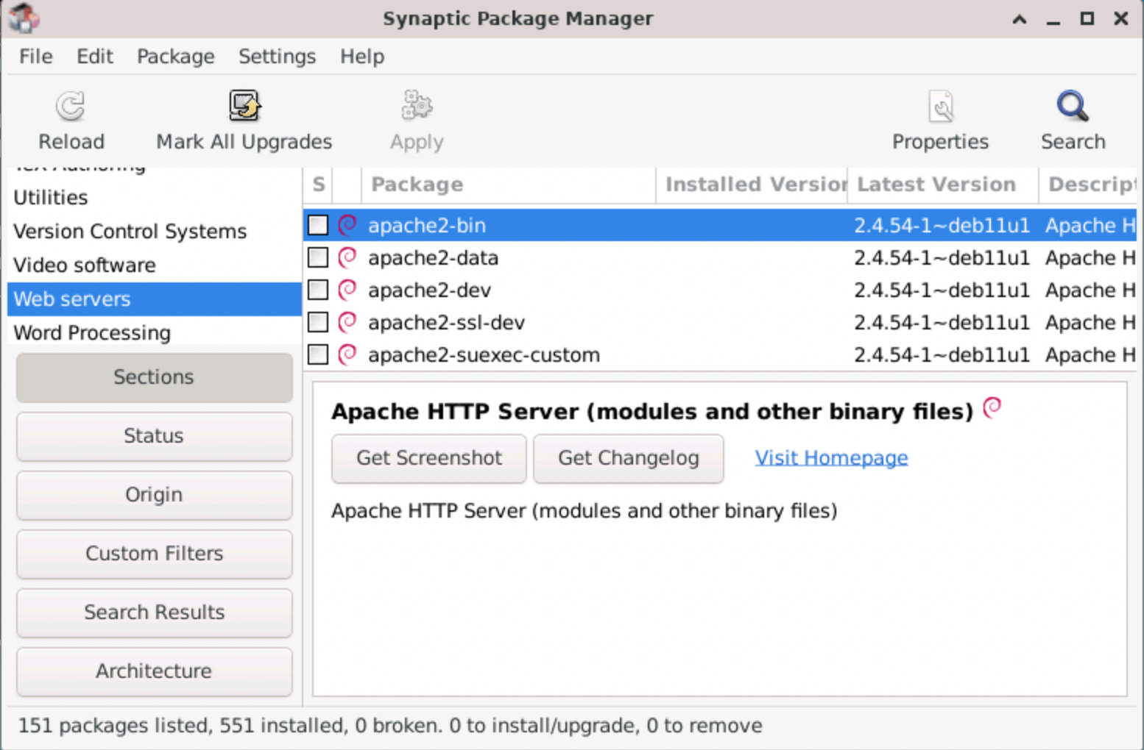
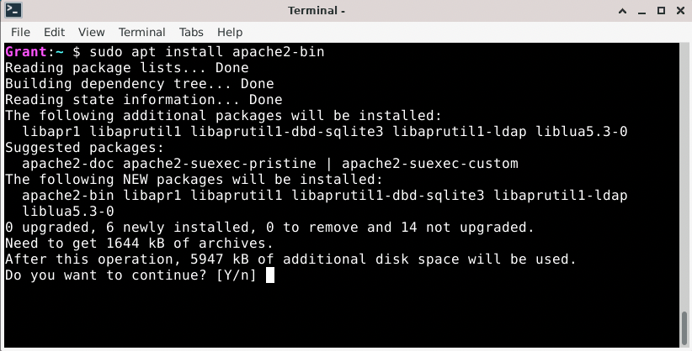
apt & Synaptic Package Manager
Notes:
Like CLI and GUI File manager …
APT and Synaptic are different interfaces to the same thing
APT is a command line tool
Synaptic Package Manger is a GUI too.

Slide 12
What’s Next?
Be sure to complete
Quiz 03
Complete HW 04
Submit to Moodle by next Wed 12:00 noon.
Complete Quiz 04
Do reading and prep for discussion.

Slide 13

Acknowledgments:
Slide Template From:
https://creativecommons.org/licenses/by/4.0/
Slide Content Licensed as:
https://creativecommons.org/licenses/by-nc/4.0/

