Slide 1
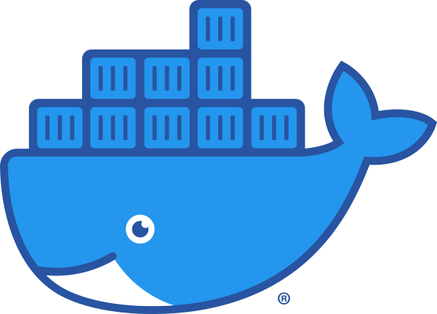
05 – Docker: Dockerfiles and Images
COMP 190 – Dickinson College
Spring 2023
Image from: https://www.docker.com/sites/default/files/d8/2019-07/Moby-logo.png
Notes:
That’s Moby Dock, the Docker logo.

Slide 2
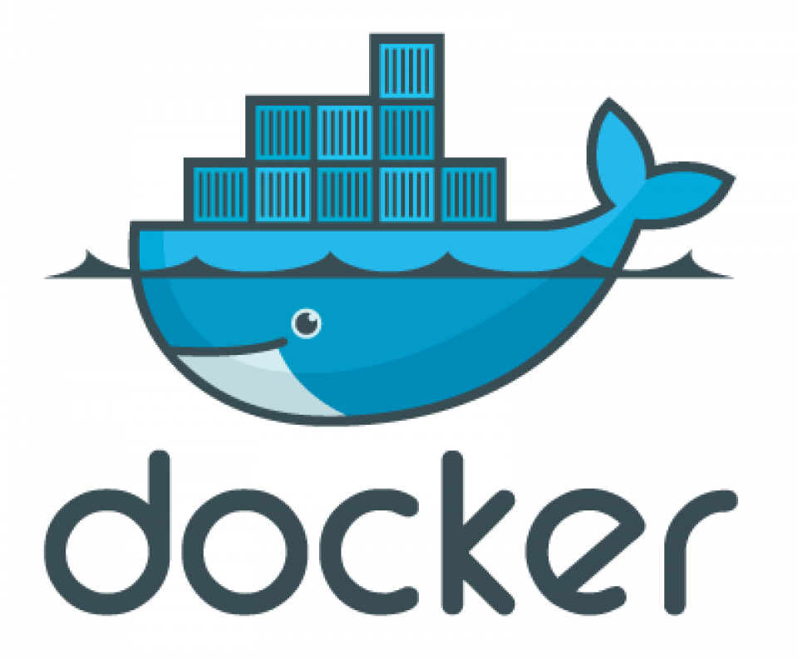
Docker is a set of platform as a service (PaaS) products that use OS-level virtualization to deliver software in packages called containers. Containers are isolated from one another and bundle their own software, libraries and configuration files; they can communicate with each other through well-defined channels. All containers are run by a single operating system kernel and therefore use fewer resources than virtual machines. - Wikipedia
Notes:
Still a lot of work…
- issues with different developers / users on different platforms
- small differences even in same OS can cause big issues.
- E.g. version of a library
Container:
- Conceptually like a simulated computer inside your computer.
- Can be turned off / or on
- When its on you can interact with it and save it
- When its off you cant.
- Can make changes and they are saved when you come back.

Slide 3
Docker is a set of platform as a service (PaaS) products that use OS-level virtualization to deliver software in packages called containers. Containers are isolated from one another and bundle their own software, libraries and configuration files; they can communicate with each other through well-defined channels. All containers are run by a single operating system kernel and therefore use fewer resources than virtual machines. - Wikipedia
Notes:
Software, libraries and configuration files all bundled together.
That is the container has all of the:
- necessary dependencies to use the product
- the right versions of all of the tools and libraries.
- the source or executable programs that make up the product.
That way everyone with the container has everything the user needs.
- they don’t have to install anything.
- It all comes in the container
- won’t forget to install something.
- install things in the wrong order
- all the versions will be correct
- things won’t accidentally be deleted or automatically upgraded.
- just launch the container and off you go.
Eliminates many of the risks associated with dependencies.
Eliminates the need for the user to install and possibly build the product.

Slide 4
Common Container Uses
Deploy (Deployment) Containers:
Container(s) contain all dependencies, libraries and executable files (binaries) needed to run the app.
Container can be run locally or deployed to a cloud service (AWS, Azure, Heroku, DigitalOcean, etc.)
Dev (Development) Containers:
Container(s) contain all dev dependencies, dev libraries and build tools.
Source files may be stored and edited in container or on host machine.
Container(s) are used to build the application and to run tests.
Notes:
Deployment – Making the application available for use by others
- To install on their machine
- To make it available on the web
Development – Working on the application code
- adding new features, fixing bugs, etc.
- compiling
- testing
Containers significantly simplify both of these processes.
- Those deploying or building the app do not have to install any dependencies
- Historically this has been a massive challenge
- Getting all of the 10’s, 100’s or even 1000’s of libraries and tools right
- Even down to specific versions.
- Sometimes even the order in which they are installed makes a difference.
- Now, just start the container and go.
- It comes with everything you need in working order.
Sort of like our 190-unix-intro container
- You didn’t have to install Debian Linux or any of the support necessary to connect to it with VNC.
- Didn’t’ have to install a browser or any of the other basic software.
- Of course, since then you’ve learned how to add new software.

Slide 5
Docker is a set of platform as a service (PaaS) products that use OS-level virtualization to deliver software in packages called containers. Containers are isolated from one another and bundle their own software, libraries and configuration files; they can communicate with each other through well-defined channels. All containers are run by a single operating system kernel and therefore use fewer resources than virtual machines. - Wikipedia
Notes:
Containers are isolated –
- cannot mess with the host machine
- cannot mess with each other
- provides good security
But, containers can be configured to be able to communicate with each other.
- allows them to cooperate
- For example:
- there may be a web application running in one container
- and it can talk to a database running in another container.

Slide 6

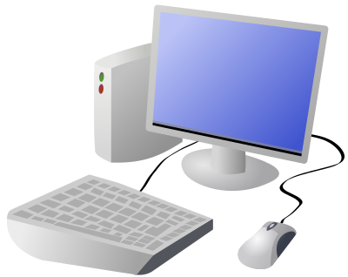
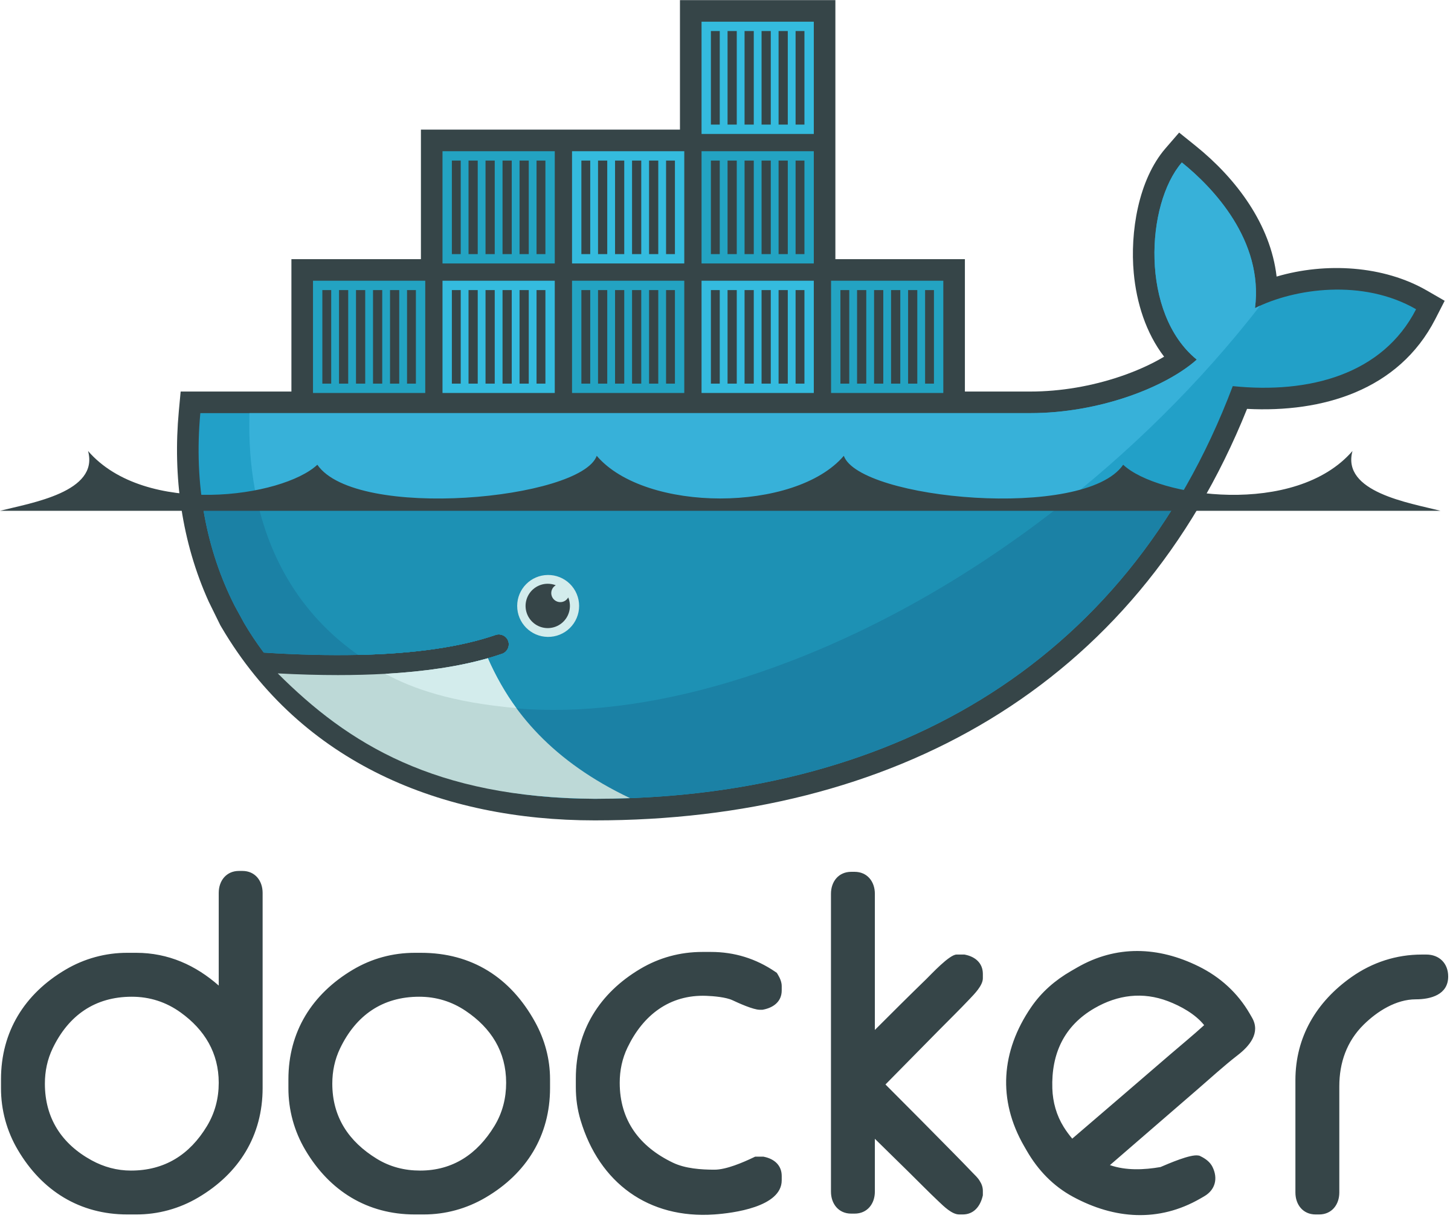
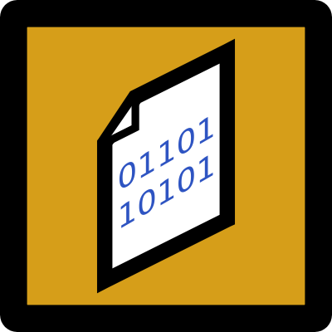
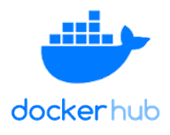


dockerhub / docker Concepts
Pulled Images
Pull
Pull
Created
Running
Stopped
+
+
Dockerhub is a cloud-based repository of static
Docker Images
Containers
Notes:
Recall… This is from the first class…
- maybe easier now that we’ve been using docker for a while.
Docker Image: A file containing the OS, tools and applications for a specific machine configuration.
- It’s sort of like a snapshot of a computer that can then be restored.
- Different images will be configured for different purposes
- A web server, a database, a whole e-commerce site, etc…
- Even a machine designed for use in a COMP 190 course at Dickinson College ☺
Images can be Pulled to a computer
- Just makes a copy of the image on the local machine.
An image can be turned into a Container
- When a container is created it looks just like the image (pristine state)
- A container can be run
- When it is running it is like a whole computer running inside your computer
- It is configured just like the image told it to be
- But you can interact with it and change it and work with it
- Those changes are represented by the Red + sign.
- A container that has run, can be stopped
- That is just like shutting down the machine
- Any changes that were made are saved (the + again)
- A stopped container can be started
- When a container is started that’s like booting up the machine that was shut down.
Images (CC)
Mac: https://iconarchive.com/show/cristal-intense-icons-by-tatice/Apple-multicolor-icon.html
Win: https://iconarchive.com/show/mega-pack-2-icons-by-ncrow/Windows-Media-Center-icon.html
DockerHub: https://www.elkoinc.com/docker-hub-registry
Docker: https://freebiesupply.com/logos/docker-logo/

Slide 7
Docker Vocabulary / Concepts
Image Repository
Dockerhub is “a hosted repository service provided by Docker for finding and sharing container images.”
Image:tag (E.g. 190-unix-intro:f23)
An image is a read-only file containing the libraries, binaries, application and configuration files for creating a container.
A tag is a version label for a specific image.
Container
A container is a runnable/running version of an image that may have additional changes in its writeable layer.
Notes:
More formal definitions.
No need to spend much time here.
Image repository
- Dockerhub is the main one.
- Companies, organization and individuals all put images on Dockerhub
- For their personal use, but also for others to use.
- E.g. our 190-unix-intro image is out there, anyone could use it.
Image:tag
- there can be multiple versions of an image.
- the 190-unix-intro image has the tag/version f22 (for fall 2022)
- next semester there will be one with a tag for s23.
- let’s people continue to use the older versions.
- less likely to break things.
Container
- runnable or running
- Like a computer that is turned on.
- can make changes
- create files, install software, etc.
- on your machine those go on the disk
- in a container they go into the “writeable layer”
- The writeable layer is where docker stores everything that is added to the image.

Slide 8





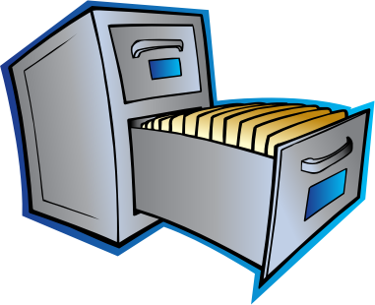


Docker Metaphor
Cookie Container
Stew
Container
Local Images
Image Repository
Writeable
Layer
Cookie:latest
Stew:9.7
pull
start
Stew:10.2
Stew:9.7
Stew:latest
remove
stop
image
remove
printer
Salad:latest
create
container
Cookie:0.9
Cookie:latest
Shredder
Images from: openclipart.org
Notes:
Let’s use a metaphor to try to explain that one more way:
- if docker was for managing recipes instead of software
Repository
- Cloud service that stores recipes
- Images are recipes
- The most recent version will usually be tagged ”latest”
- Older versions will be tagged in other ways.
- read only for the public
Local Images
- Downloaded (pulled) version of the image:tag
- still read only
- kind of like a downloaded pdf file of the reciple
An Image is used to create a container
- like printing the recipe on a piece of paper and putting in a file.
- making it ready to be used.
Starting the container
- the container is running.
- taking the recipe out and putting it on the counter
- can use it
- can modify it and make notes on it
- writeable container layer
Stopping a container
- putting it back in the file
- with all notes on it.
- can start it again and it will come back as is.
Removing a container
- like shredding the paper.
- all notes are lost
- can create a new container from the image
- resets to initial state
- the writeable layer is blank
Removing the image
- Like deleting the pdf file.
- If you want to use it again
- need to pull/download it again.
Another metaphor that might help:
- image is like a plan for a car
- container is the car
- can be running
- can be stopped
- anything you do to it stays with it when restarted (writeable layer)
- scratches, stuff in the trunk, etc…
- can destroy container and create another new one
- new container comes out with blank writable layer.

Slide 9
Docker CLI Commands
docker pull <image:tag>
Makes a local copy of the specified image from Dockerhub.
docker create --name <container> <image>
Makes a container from a specified image.
docker start <container>
Puts a created container into the running state.
docker stop <container>
Shuts down a running container.
docker rm <container>
Deletes a specified container.
docker image rm <image>
Deletes a specified image.
Notes:
Not going to talk about these in detail.
You’ll see these in more detail in the homework.
They are here as a convenient reference.
The point to make is that each of the operations described on the previous slide are accomplished with a command.
- Or alternatively through the GUI in Docker Desktop.
- Though you can’t do everything we need to do through the GUI.

Slide 10
Building Docker Images
Dockerfile
Dependencies
dockerbuild
Docker
Image
Project Source Code
Project Source Code
Project Source Code
Project Source Code
Notes:
So where do the Docker images come from?
The process of building the docker image will likely inclue
- installing dependencies
- running the automated build process.
The Dockerfile as you will see will look similar to a shell script.
- It will be a sequence of commands
- that describe exactly how to build the image.
- Specifies what dependencies to install
- Specifies any source code that is needed
- Anything else that needs to happen to make the application work.

Slide 11
Example Dockerfile
FROM debian:bullseye
RUN apt update
RUN apt install -y apache2
CMD /etc/init.d/apache2 start
FROM Statement
Specifies the base image on top of which the new image is to be build.
Notes:
First… the goal here is not for you to be able to create a Dockerfile from scratch.
- I just want you to understand the idea
- and work though an example so that you have some experience with them.
- That way if at some point in the future you need to create Dockerfiles you will have an idea of what they do.
- so you won’t be starting from scratch.
The FROM statement specifies a base image on top of which the new image is built.
- A base image is an image that already exists
- It is typically available on Dockerhub
- put there by someone else.
- it has some software already installed.
- it is already configured in a particular way.
You typically find a base image that does most of what you want.
Then you customize it with the rest of the Dockerfile.
Here we are starting from a base image
- Debian:bullseye
- note image:tag format.
- It is a basic Debian Linux system
- Not a lot of extras
Any image on Dockerhub can be used as your base image.
- for example you could use our 190-unix-intro image as the base image
- then you would be able to connect via VNC without doing any extra work.

Slide 12
Example Dockerfile
FROM debian:bullseye
RUN apt update
RUN apt install -y apache2
CMD /etc/init.d/apache2 start
RUN Statement
Executes Linux/Unix commands that install dependencies and configure the machine specified by the image.
Commands are run as root by default.
Notes:
The RUN statement is like typing a command on the command line.
- pretty much anything you can do at the CLI you can do in a RUN statement.
Here we are
- First updating the apt package information
- Second installing the apache2 package.
- This is the Apache HTTP Server
- This is a web server.
- Which is the program running on the remote machine that returns a web page to you when you enter a URL.
- You’ll get some experience working with Apache in the homework.
These two commands should look really familiar.
- They are the same types of things that you type on the CLI to do things.
Two small differences
- You do not need to use sudo because the commands in a Dockerfile are executed as the root user
- by default – this can be changed, but we aren’t going that deep.
- The –y in the second apt line
- recall that when you use apt install you were often asked to answer Y/n before the install continues.
- There is no way to do that when building a Docker image from a Dockerfile.
- so we can specify –y here to answer that question in advance.

Slide 13
Example Dockerfile
FROM debian:bullseye
RUN apt update
RUN apt install -y apache2
CMD /etc/init.d/apache2 start && \
sleep infinity
CMD Statement
Specifies the Linux/Unix command(s) that to be run when the container is started.
The container stops, when the command(s) exit.
Notes:
The FROM and RUN statements setup the machine.
- That is they specify what the image will contain.
- They make sure that all of the necessary software is installed.
- They make sure everything is configured properly.
The CMD statement tells the system what it should do when the container is started.
- So it does not change the image at all
- It is executed on the machine in the container when it starts up.
- this CMD statement
- starts the apache2 web server… you’ll see this again in the homework.
- the && allows us to run multiple commands with one statement.
- the \ just allows us to continue onto the next line to make things easier to read.
- Then the sleep command just waits forever.
- this is needed because the ”start” command exits as soon as the server is up and running.
- When the CMD exits, the container stops as well.
- So without the sleep infinity command
- The server would come up, and then the container would immediately stop.
- So we would not be able to connect to it.

Slide 14
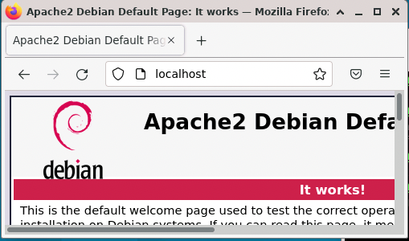
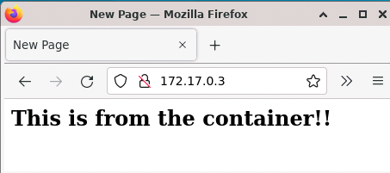
What You’ll Do in HW 05
Debian Linux System
via VNC
Docker
Running Container
Apache
HTTP
Server
Dockerfile
Image
Apache
HTTP
Server
http://localhost
http://172.17.0.3
Notes:
First, you’ll work in your normal Debian Linux environment.
- You will install a web server and create a home page.
- This is to help you understand what is involved in setting up the server and creating a home page.
- This is helpful because creating an image is a lot like installing on a normal machine
- So, this is a good way to figure out what needs to be done when you get to creating the image.
Second, you’ll install Docker inside your Debian Linux system.
- That way you’ll be able to build the image, create the container and run it.
Third, you’ll make a Dockerfile that describes an image for the web server.
- You don’t have to write it from scratch – it is given to you in the homework
Fourth you’ll use that Dockerfile to build an image in Docker.
Fifth, you’ll use that image to create and run the web server in a container
Finally, you’ll get to see the home page being served from within the container.
This will give practice with a lot of the things from the past Homeworks.
- CLI and Linux commands
- Permissions
- Editors
- Software installation
- sudo
Keep in mind as you work….
- The goal here is not for you to become a Docker expert.
- The point is to get a big picture idea of how all of the parts fit together.
- This is so that you have idea of how things work when you encounter them later.
- Gives you some intuition about what is happening, even without all of the details.
- This is notably different than what is expected in say 132/232
- where you are expected to understand everything you are doing in Java
- and be moving toward where you can create significant software on your own.

Slide 15
What’s Next?
Be sure to complete Quiz 04
Complete HW 05
Submit to Moodle by next Wed 12:00 noon.
Do reading and prep for discussion.

Slide 16

Acknowledgments:
Slide Template From:
https://creativecommons.org/licenses/by/4.0/
Slide Content Licensed as:
https://creativecommons.org/licenses/by-nc/4.0/

