Slide 1

07 – FOSS Project Structures and FarmData2
COMP 190 – Dickinson College
Spring 2023
Notes:
Today we shift to beginning to look at the FarmData2 project
But we will also consider general structures of FOSS Projects
- how they are organized
- what information they provide
The idea is that by exploring a few of these projects you’ll
- be equipped to navigate a wide range of projects
- expand your perspective on what types of projects are out there
- and how computing can serve the greater good
- the “useful education for the common good” that you have been promised!
It is also worth note that
- While we may be talking about FOSS projects
- Modern software development uses many or all of the same tools and practices.
- These were developed to support FOSS, but have been adopted into all software development
- Particularly relevant in post-COVID remote-work settings.

Slide 2
Free and Open Source Software (FOSS)
FOSS is software that is created by a community and is released under a FOSS license that guarantees four freedoms for anyone who receives it:
You are:
Free to run and use it for any purpose
Free to redistribute it
Free to study and modify it
Free to redistribute it with modifications
Notes:
This is essentially what we know so far…

Slide 3
FOSS Project Structures
Some key elements of FOSS projects include:
One or more repositories that hold the source code and documentation.
A repository hosting service that provides on-line cloud-based access to a project’s repositories.
A website for marketing and information distribution, most often targeted for users.
Communication channels for the user and developer communities.
An issue tracker where bugs, features and other work to be done is documented.
Notes:
Today, we’ll look a little more at
- common structures between FOSS projects
- they are all al little different but share some commonalities.
- the FarmData2 project that we run here at Dickinson.
Most mature projects have:
- repositories, a repository hosing service, a website, on or more communication channels and an issue tracker.
- There are a wide variety of different software tools for these things
- so different projects may do them differently
- but they all have most of these in some form or another
- Each of them serves a different purpose in the project
- We’ll look at each in a little more detail
- Then you’ll do more in the homework
- And we’ll do quite a bit more with them through the rest of the semester.

Slide 4
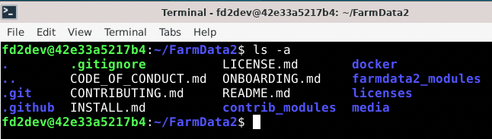
Repository
A repository is a collection of a project’s files and directories managed by a version control tool (e.g. git, svn, cvs) that maintains meta information that tracks the history of changes to the files and directories.
Notes:
There are many different types of version control tools (git, svn, cvs)
- git is by far the most popular at the moment.
They all do basically the same thing…
- maintain the meta data
Files beginning with a . In linux/unix are ”hidden files”
They don’t show up with a normal ls command.
Need to use ls –a to see them.
They are typically used to hold meta or configuration information.
- Here the .git directory holds the repository meta information used by git to track the project’s history.

Slide 5
Repository
While each repository is unique to the project, they typically share some common files/information.
Notes:
These are conventions that projects have adopted so that it is easier to find the same information across projects.
These may be
- plain text files (.txt) files,
- markdown files (.md) – like a plain text file but with a little styling.
README – The starting point for a project. The first place you should go!
LICENSE – The license for the code and documentation in the repository.
CODE_OF_CONDUCT – expectations, policies and processes for how community members are to conduct themselves when working on the project.
- Typically address issues including harassment, inclusivity, respect
INSTALL – how to setup and run the project.
CONTRIBUTING – how to contribute to the project but fixing bugs, adding features, or a wide range of other ways.
ONBOARDING – resources for learning what you need to know to get started.
Not every project has every one of these.
Might be named slightly differently.
Might be in different places.
But most projects have this information somewhere.
You’ll get to explore this in the homework.

Slide 6
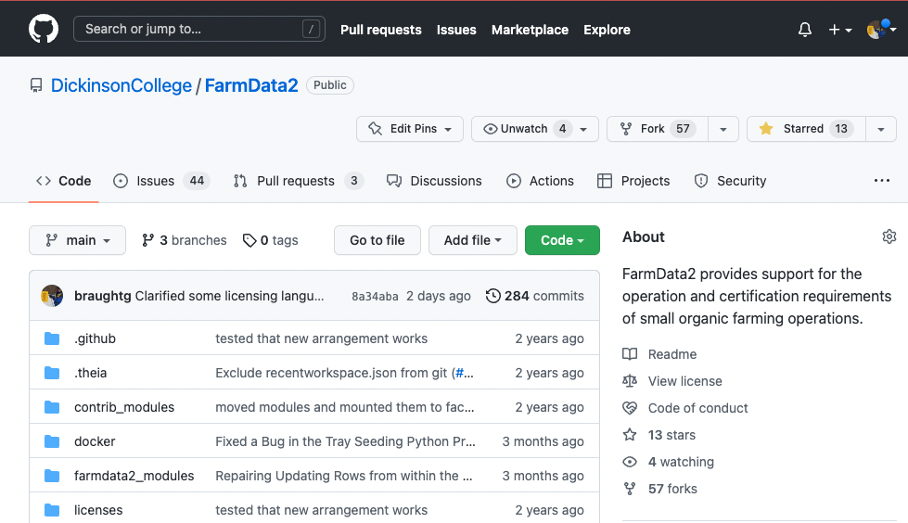
Repository Hosting Service
Repository hosting services store copies of repositories in the cloud, making them easy to share among developers (FOSS communities, project teams).
GitHub, GitLab, SourceForge, …
Notes:
There are lots of different repository hosting services.
- GitHub is by far the most popular
- GitLab and SourceForge are also widely used.
They all do the same thing…
- keep copies of repositories in the cloud so that developers can share them.
GitHub displays the contents of a repository for you like this:
- The same files and directories that you will see on your machine if you are working on the project.
- the nice green “Code” button will make it easy for others to get a copy of the repository.

Slide 7
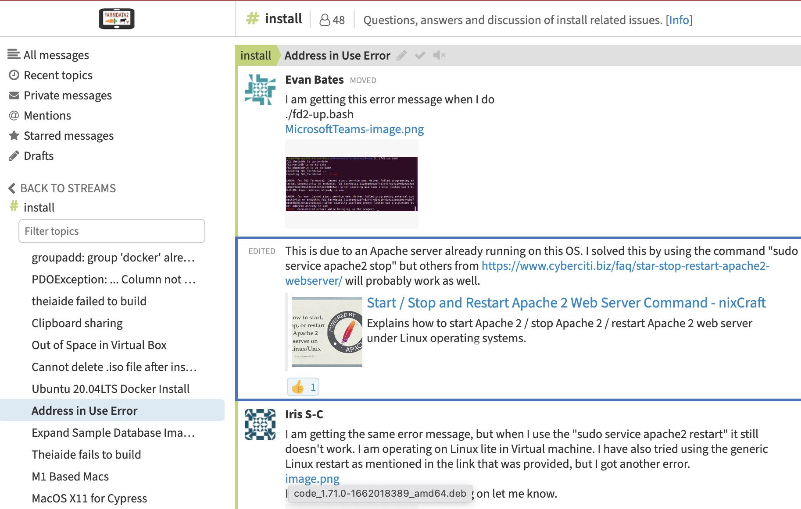
Communication Channels
Projects use a variety of communication channels to to enable their user and developer communities to share information.
E-mail lists, web-forums, …
Slack, Discord, Gitter, Zulip, …
Notes:
Because FOSS projects (and increasingly proprietary projects) are developed by developers distributed across time and space tools are needed to facilitate communication.
Again there are lots of different tools.
- Some are more asynchronous: E-mail or forms
- Some are more synchronous chat-like: Slack, Discord, Gitter, Zulip
- Different channels are used for different purposes.
Each project will pick different tools
But their purpose is the same.

Slide 8
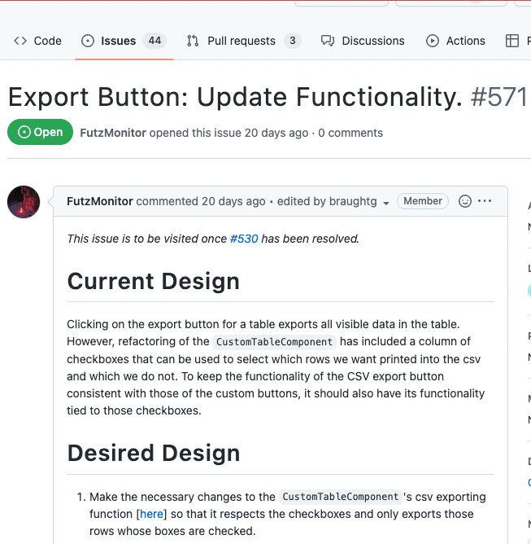
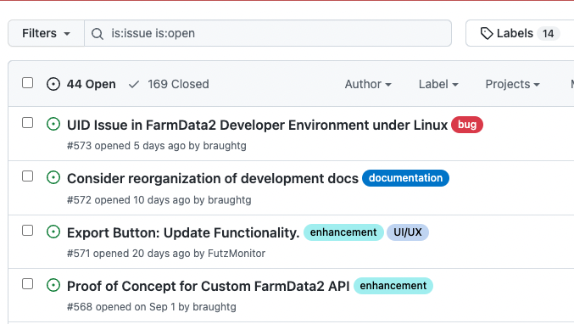
Issue Tracker
An issue tracker stores and organizes tickets that describe work to be done (bugs, features, questions,…).
Notes:
Again there are lots of different issue trackers:
- GitHub/GitLab/Jira/…
They all do the same thing.

Slide 9
FarmData2
Notes:
Want to turn to FarmData now...
- This is a FOSS Project that we run here at Dickinson
- We will use this project as the platform for much of what we do
- in the rest of COMP190
- all of COMP290.

Slide 10
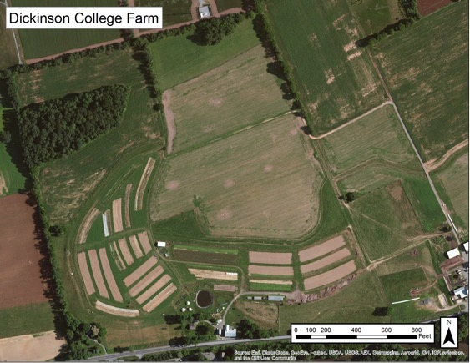
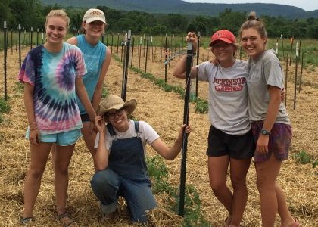
The Dickinson Farm
Dickinson’s College Farm is an 80-acre, USDA-certified organic farm and a living laboratory where students can gain distinctive, hands-on learning experiences.
Notes:
FarmData2 comes out of a collaboration with the Dickinson Farm.
If you haven’t been there
- look for an opportunity to go for an event.
if you are continuing into 290 you will
- take a trip to the farm to see how the farm operates
- learn a little about their processes and vocabulary
- meet the farmer that is helping us with the FarmData2 application.

Slide 11
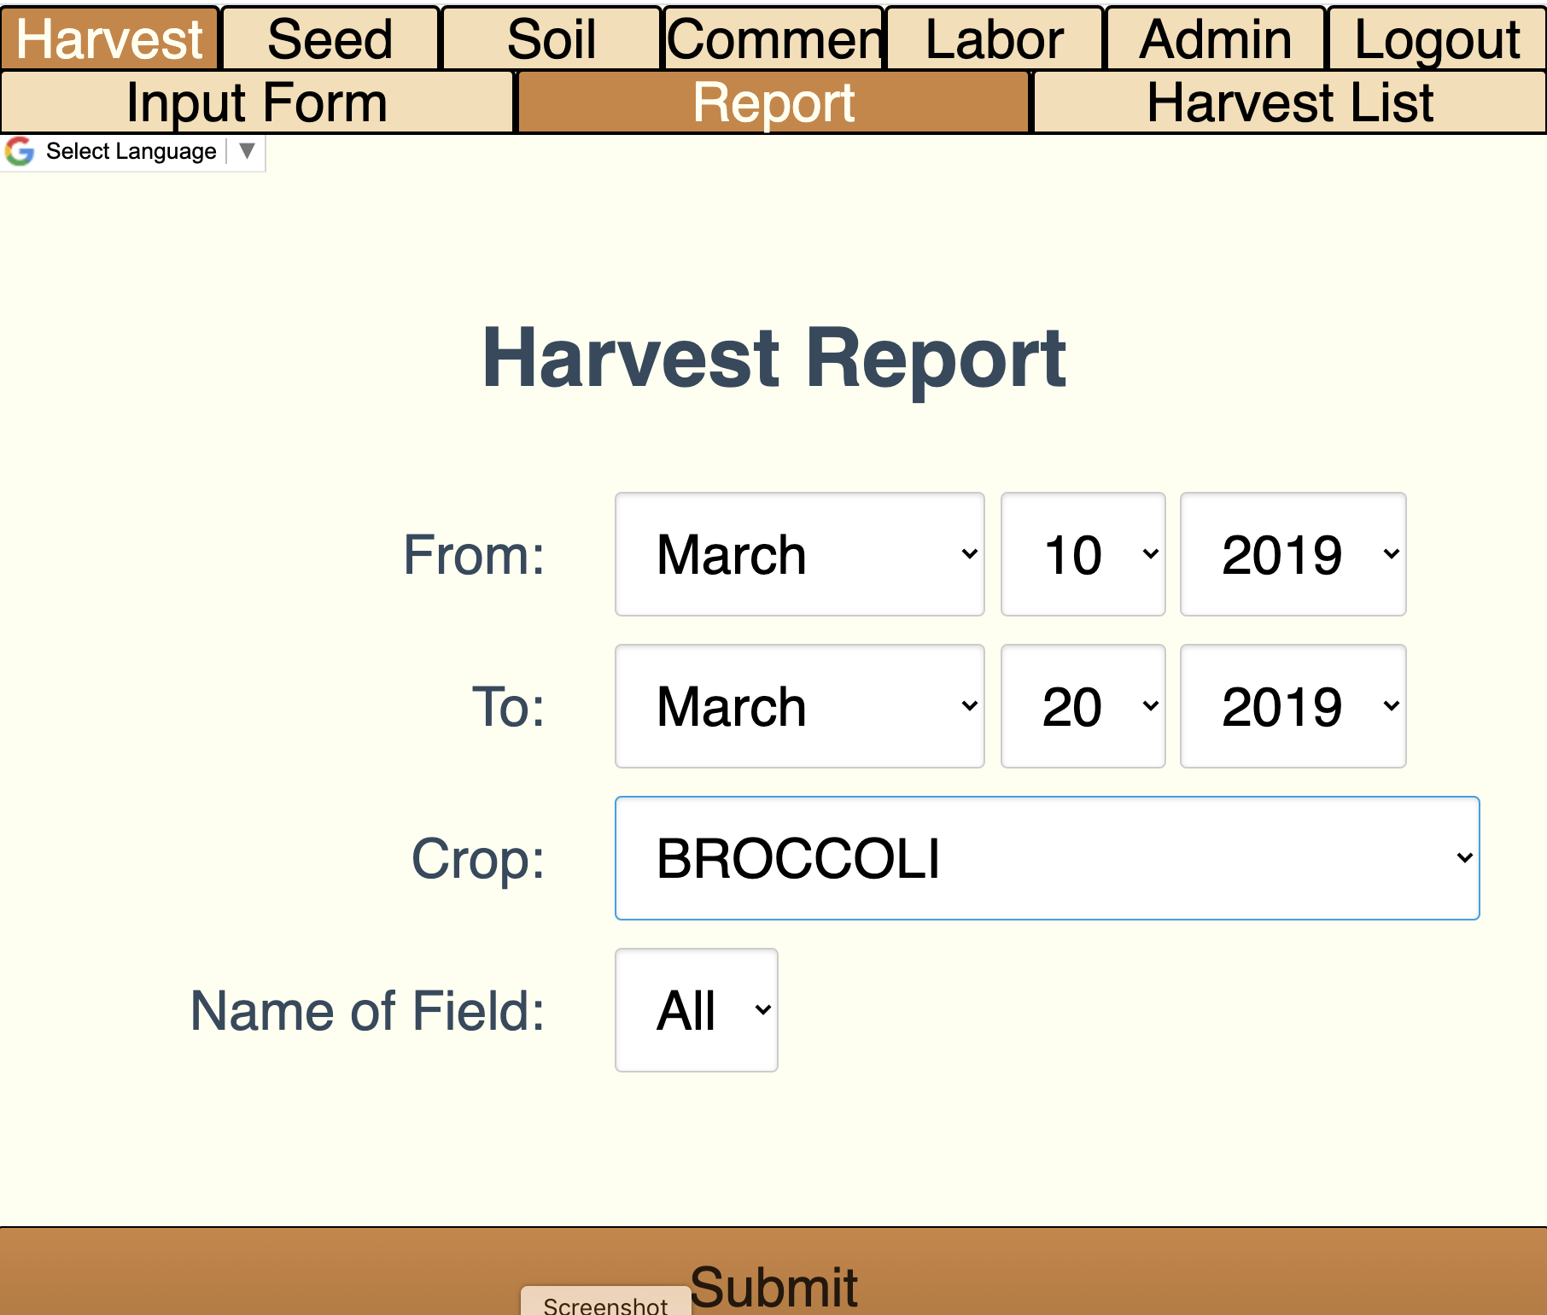
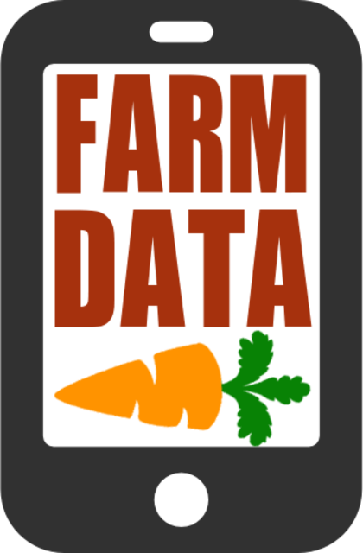
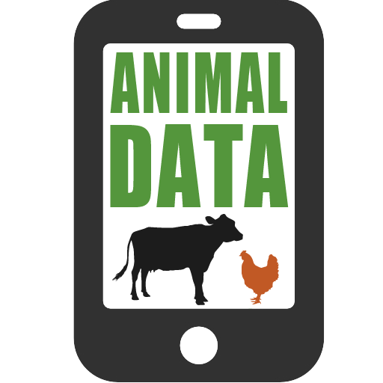
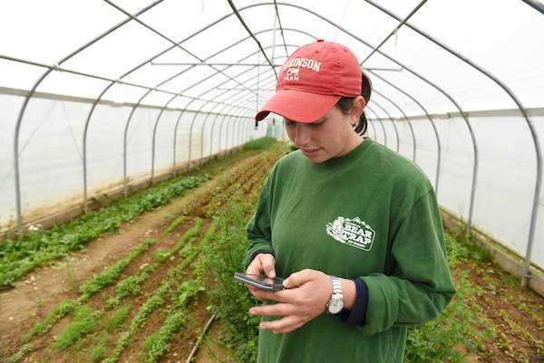
FarmData & AnimalData
Notes:
2011 collaboration between Prof. Tim Wahls and Matt Steiman at the College Farm
Over 5 years
Led to the development of two applications
Used in the field on mobile devices to record data about harvests, growth, pest control, and a host of other things
Used in the barn on desktop machines to plan harvests, track inventory and sales and to maintain records for organic certification.
2016 – We lost Tim to cancer
Development of FarmData and AnimalData stopped.
But interest from the College Farm and other farms that are also using the FarmData app has remained.

Slide 12
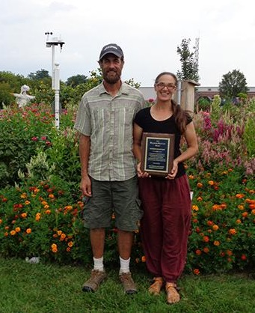
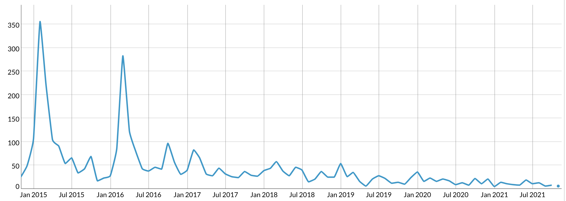
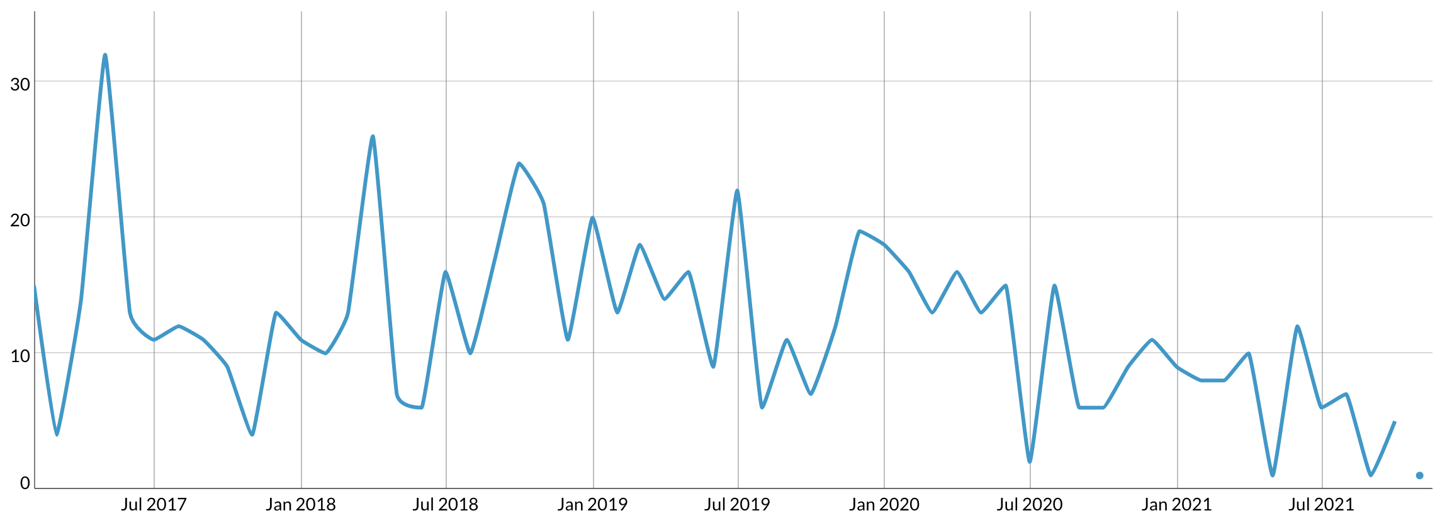
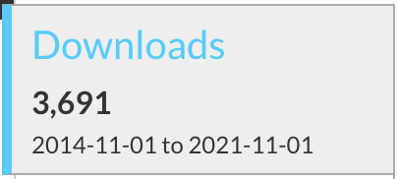
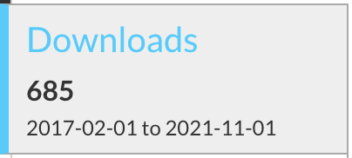
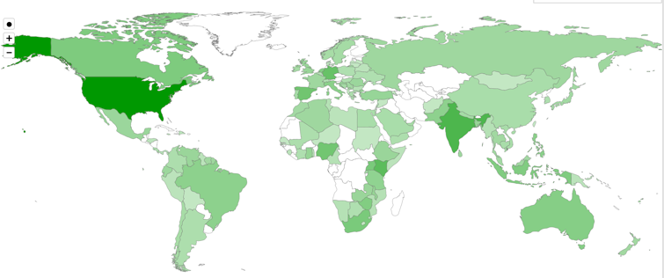
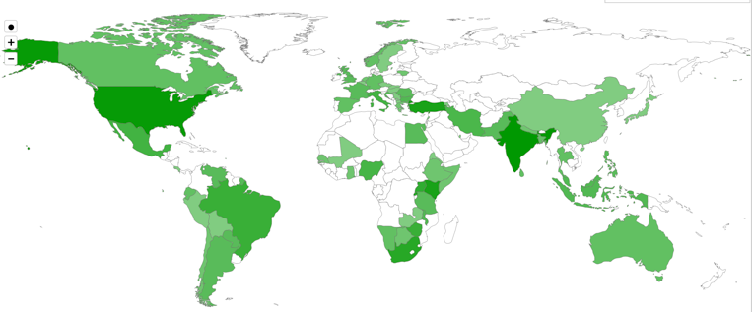
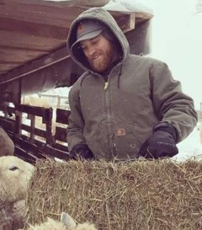
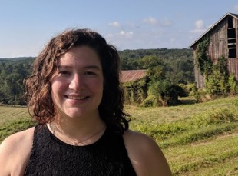
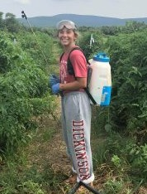
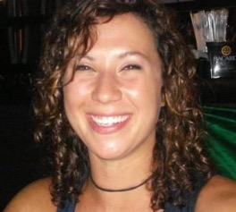
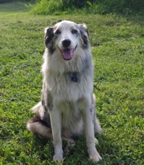
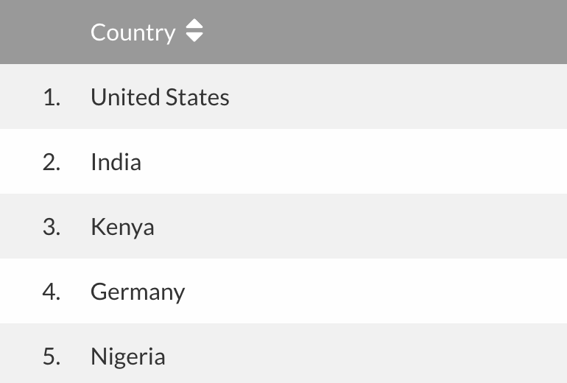
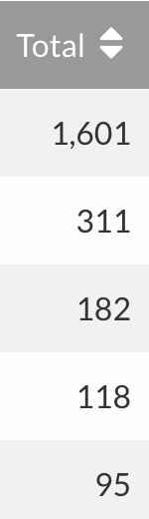
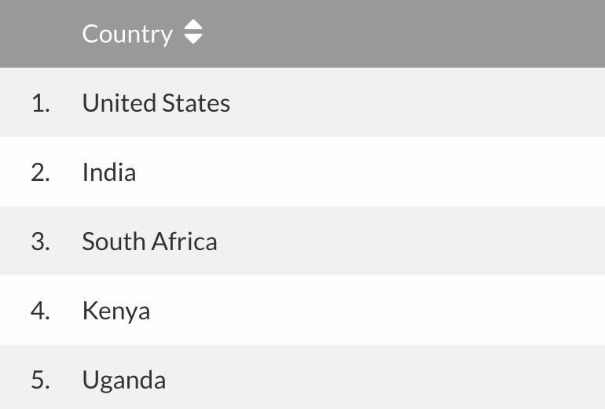
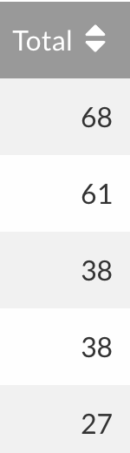
Local Clients, Global Communities
FarmData
AnimalData
Notes:
Matt (Farmer) & Jenn (Farm Manager)
- Tim and Matt talked about the application at a variety of conferences
- Raised awareness of it
- Don’t know how many active users there are
- but it’s been downloaded quite a number of times
- and all over the world.

Slide 13
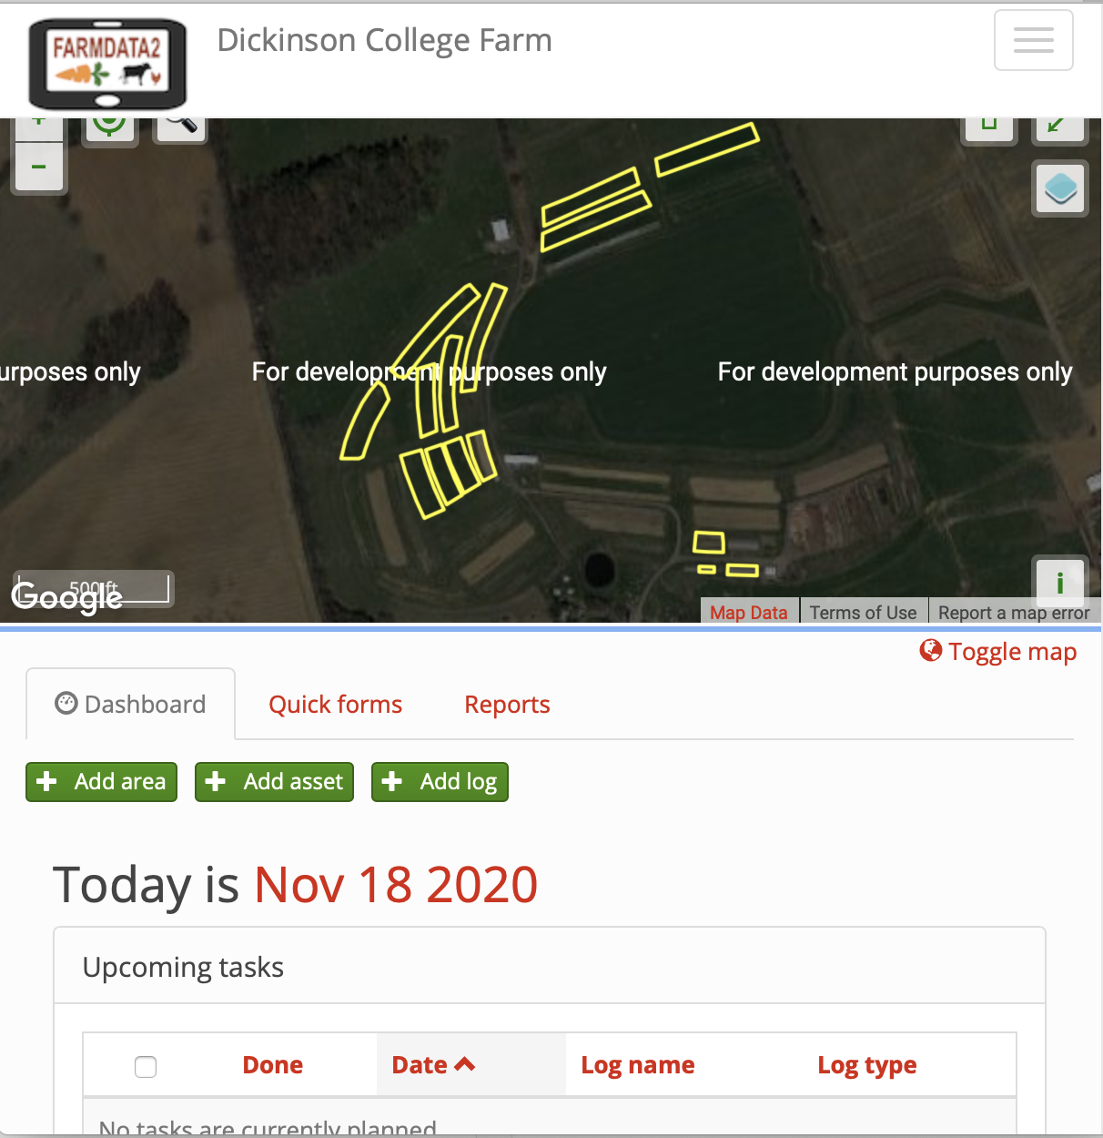
FarmData2
FarmData2 aims to update and combine FarmData and AnimalData, to create a single application that will support the operation and certification requirements for small organic farming operations.
A living FOSS project and community
Notes:
The CS department has been working on launching the FarmData2 FOSS project
It is a redesign and combination of FarmData and AnimalData
It is built using a more modern tool set
- experience for you.
It is a FOSS project - open to the world.
- Lives on GitHub
- used in this course
- and in COMP 290
- Supports summer Software Development Internships
- 2 each summer
- if you take 290 keep an eye open for the advertisement for those
- Academic year developer positions
- 1 or 2 per semester
- But FarmData2 is also a living FOSS project and community
- have had some developers from around the world chip in with contributions
- working toward engage students/courses from other colleges with organic farms as well.

Slide 14
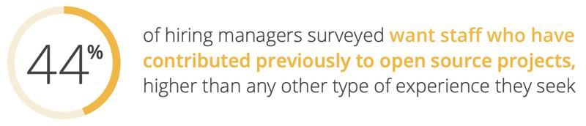
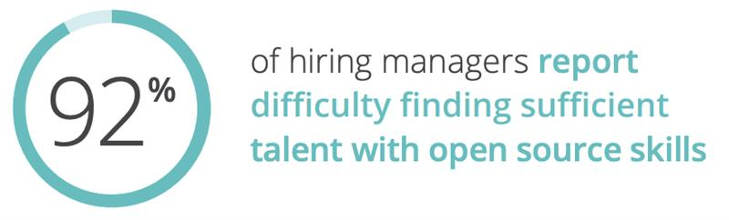
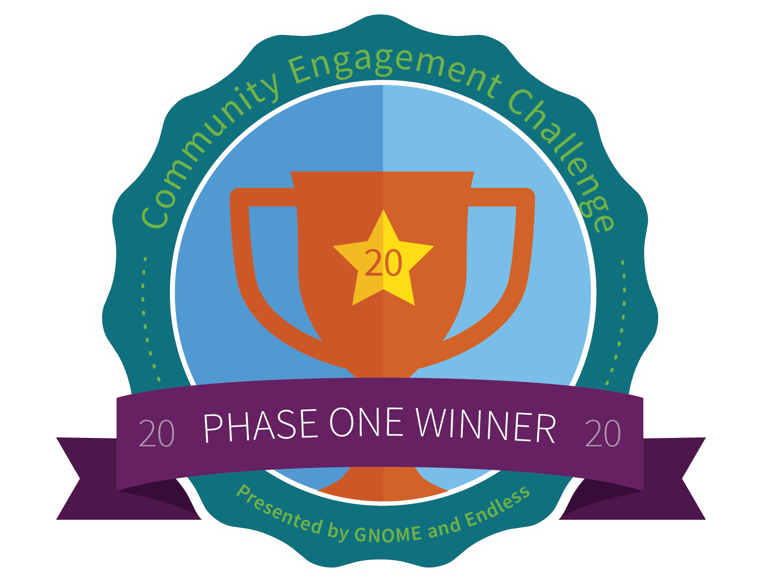
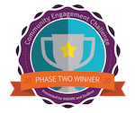
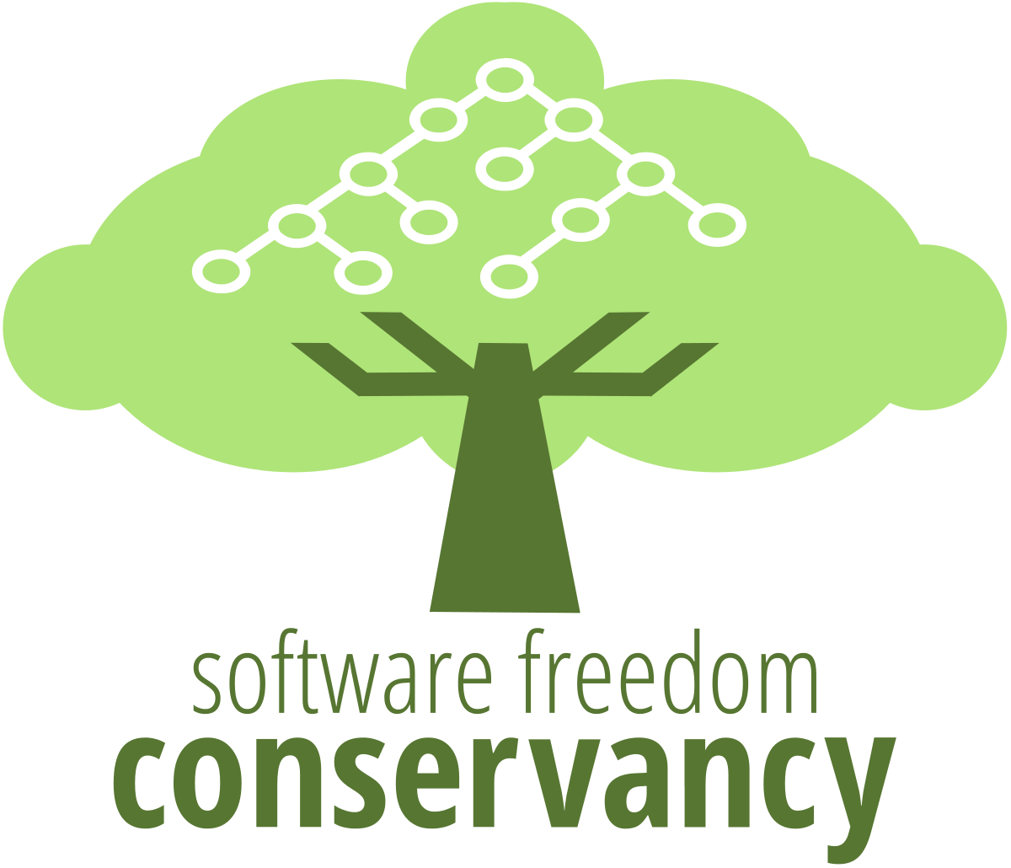



FarmData2 and Dickinson CS
The FarmData2 project and community provide a real-world FOSS platform for authentic experiences in COMP 190 and COMP 290.
Develop skills, knowledge and experiences for FOSS participation and for success beyond Dickinson’s limestone walls.
Connect computing with Dickinson’s mission of an “education in service to the common good”
Broaden Participation in Computing
Our approach has received recognition and support from:
The Non-Profit FOSS Institute (NPFI)
Software Freedom Conservancy (SFC)
National Science Foundation (NSF)
The GNOME Foundation
Teaching Open Source (TOS)
Notes:
Why are we doing it?
Practical Skills
- unix / linix
- version control
- web development
Soft Skills:
- Building an experience bank.
- Working in incomplete information environments.
- teamwork
- n co m munication
Prepares you for the capstone experience in the senior seminar
- FOSS ”in the wild”
- Finding and working in an open source community of interest to you.
Gives you an advantage in pursuing internships and jobs.
- Survey by the Linux foundation found that:
- Hiring managers want candidates with open source experience
- Even more so… FOSS experience was the most listed type of experience desired.
- Most hiring managers say it is hard to find candidates with this experience.
Connect to “education in service to the common good”
- Dickinson’s founding motto.
- By bringing to the fore the ways in which computing can serve society and communities.
- Not just the tech, not just to make money.
Broaden Participation
- Related to the prior point
- Providing multiple avenues for different students to find different interests in computing
- Some like coding and cool tech
- Others may see those as not of intrinsic interest on their own but as useful tools for making an impact on a cause, issue or community that they care about.
- We are raising the profile of this view, because it does not get the same exposure and thus there is less awareness.
What we are doing has gotten some positive attention:
- NPFI – development expertise and support – building engagement with courses at other institutions.
- SFC – supporting development and dissemination of course materials developed here
- NSF – where development of FarmData2, and 190/290/491/491 are part of 5-year $1.9M project looking at using humanitarian foss in the CS curriculum.
- drexel university, western new England college, Worcester State University, Nassau Community College
- GNOME – Our use of FOSS and FarmData in the Dickinson Curriculum selected from 160 international projects as one of 5 finalists in the GNOME Community Engagement challenge – an open source innovation competition – Based on our efforts to broaden participation in computer science through engagement with FOSS with a humanitarian focus.

Slide 15
Notes:
Just a reminder of the place of 190/290 and FarmData2 in the overall curriculum.
- Timely as course selection is getting going now.
190 – learn the skills and background necessary for
- Working on significant software development projects
- Engaging in open source software projects
290 – Learn web development technologies used in FarmData2
- Deep engagement with FarmData2 HFOSS project.
- Fixing bugs, adding new features
491-492 – senior seminar
- Team based work on self-selected HFOSS or FOSS projects
Option for a 390 independent study if interested.

Slide 16
HW 07:
Explore a number of Humanitarian FOSS (HFOSS) projects.
Investigate one of interest in a little more depth.
Learn about and observe some of the common documentation shared by FOSS projects.
In an HFOSS project of interest
In FarmData2
Critically evaluate FarmData2 to help improve it for all members of the project community.

Slide 17

Acknowledgments:
Slide Template From:
https://creativecommons.org/licenses/by/4.0/
Slide Content Licensed as:
https://creativecommons.org/licenses/by-nc/4.0/

