Slide 1



08 –FarmData2 and Issue/Bug Trackers
COMP 190 – Dickinson College
Spring 2023
Bug image from: openclipart.org

Slide 2
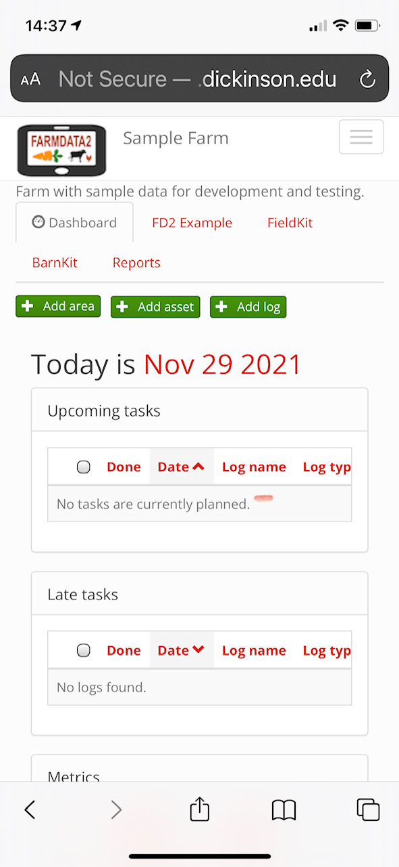

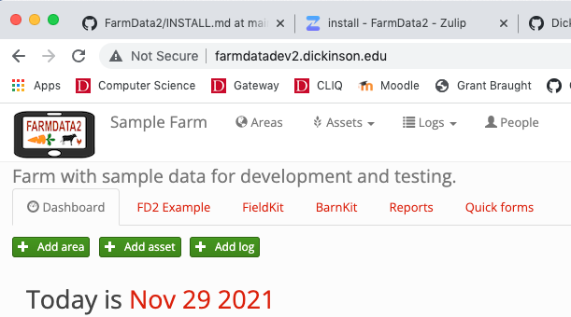
FarmData2
Powered by
http://farmdatadev2.dickinson.edu
Notes:
FarmData2 is a work in progress.
So it contains some bugs…
Today’s class and the associated activity are about how to report those bugs to the developer community.

Slide 3

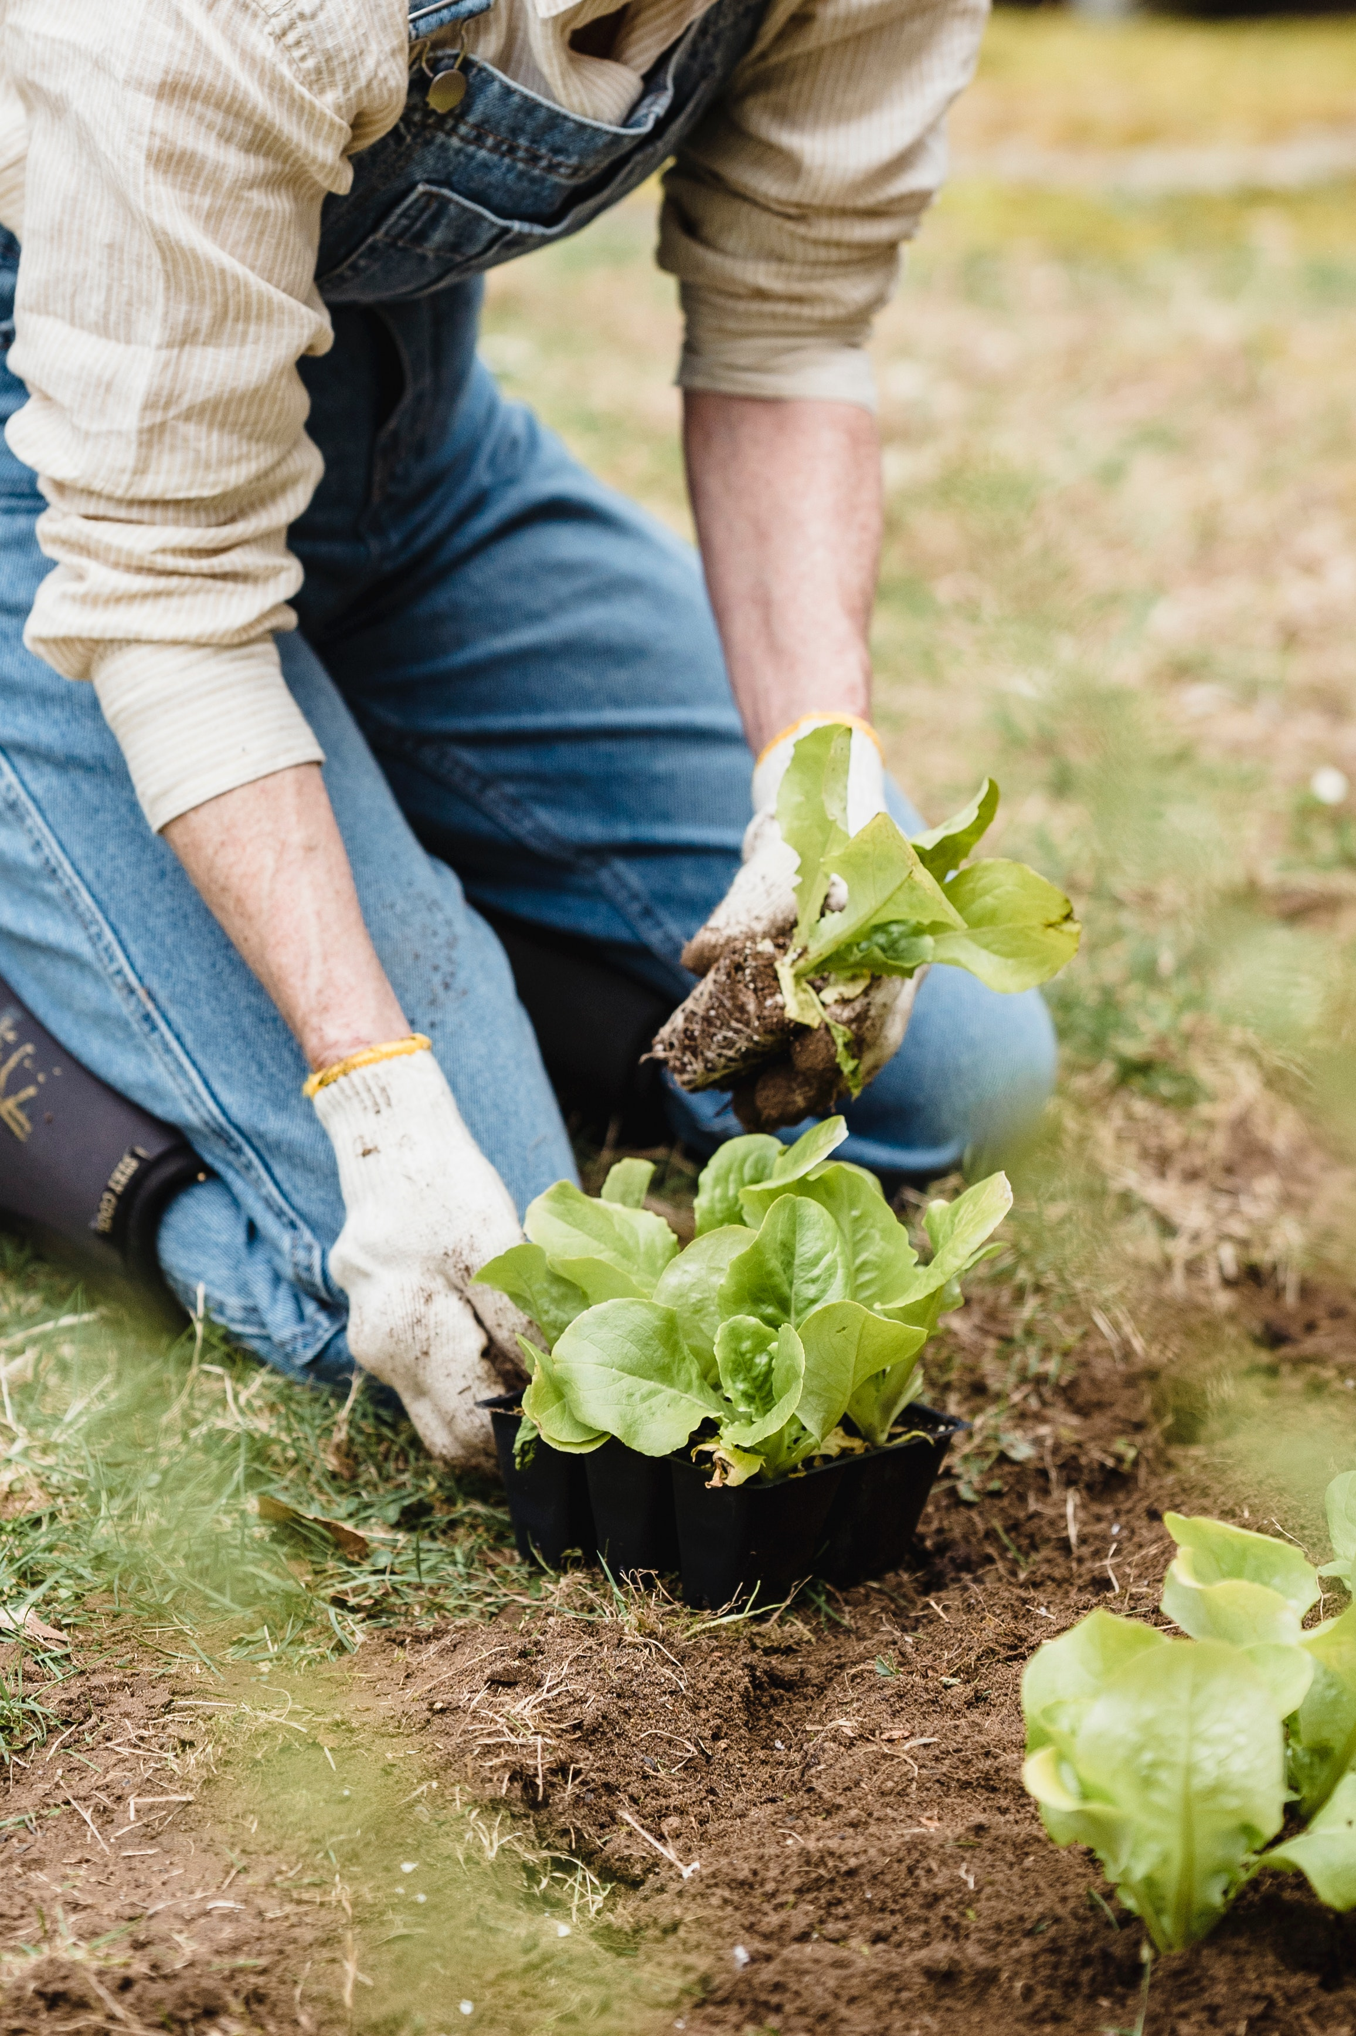
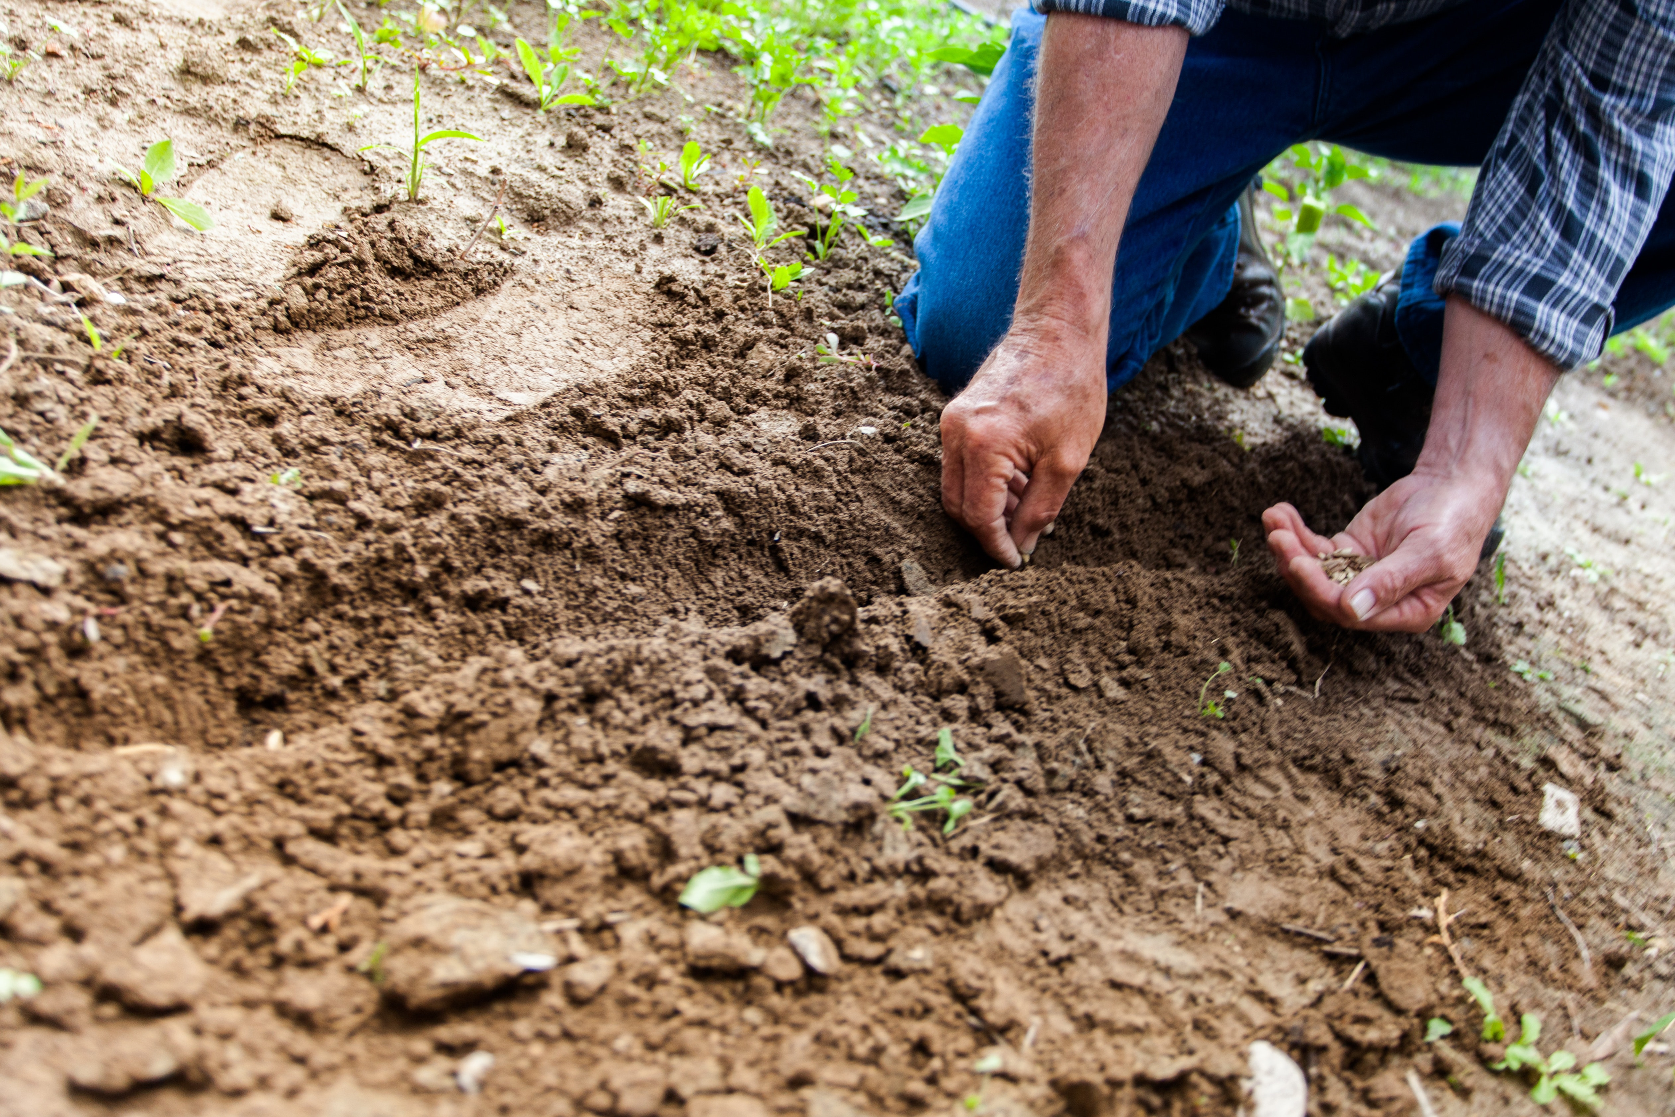
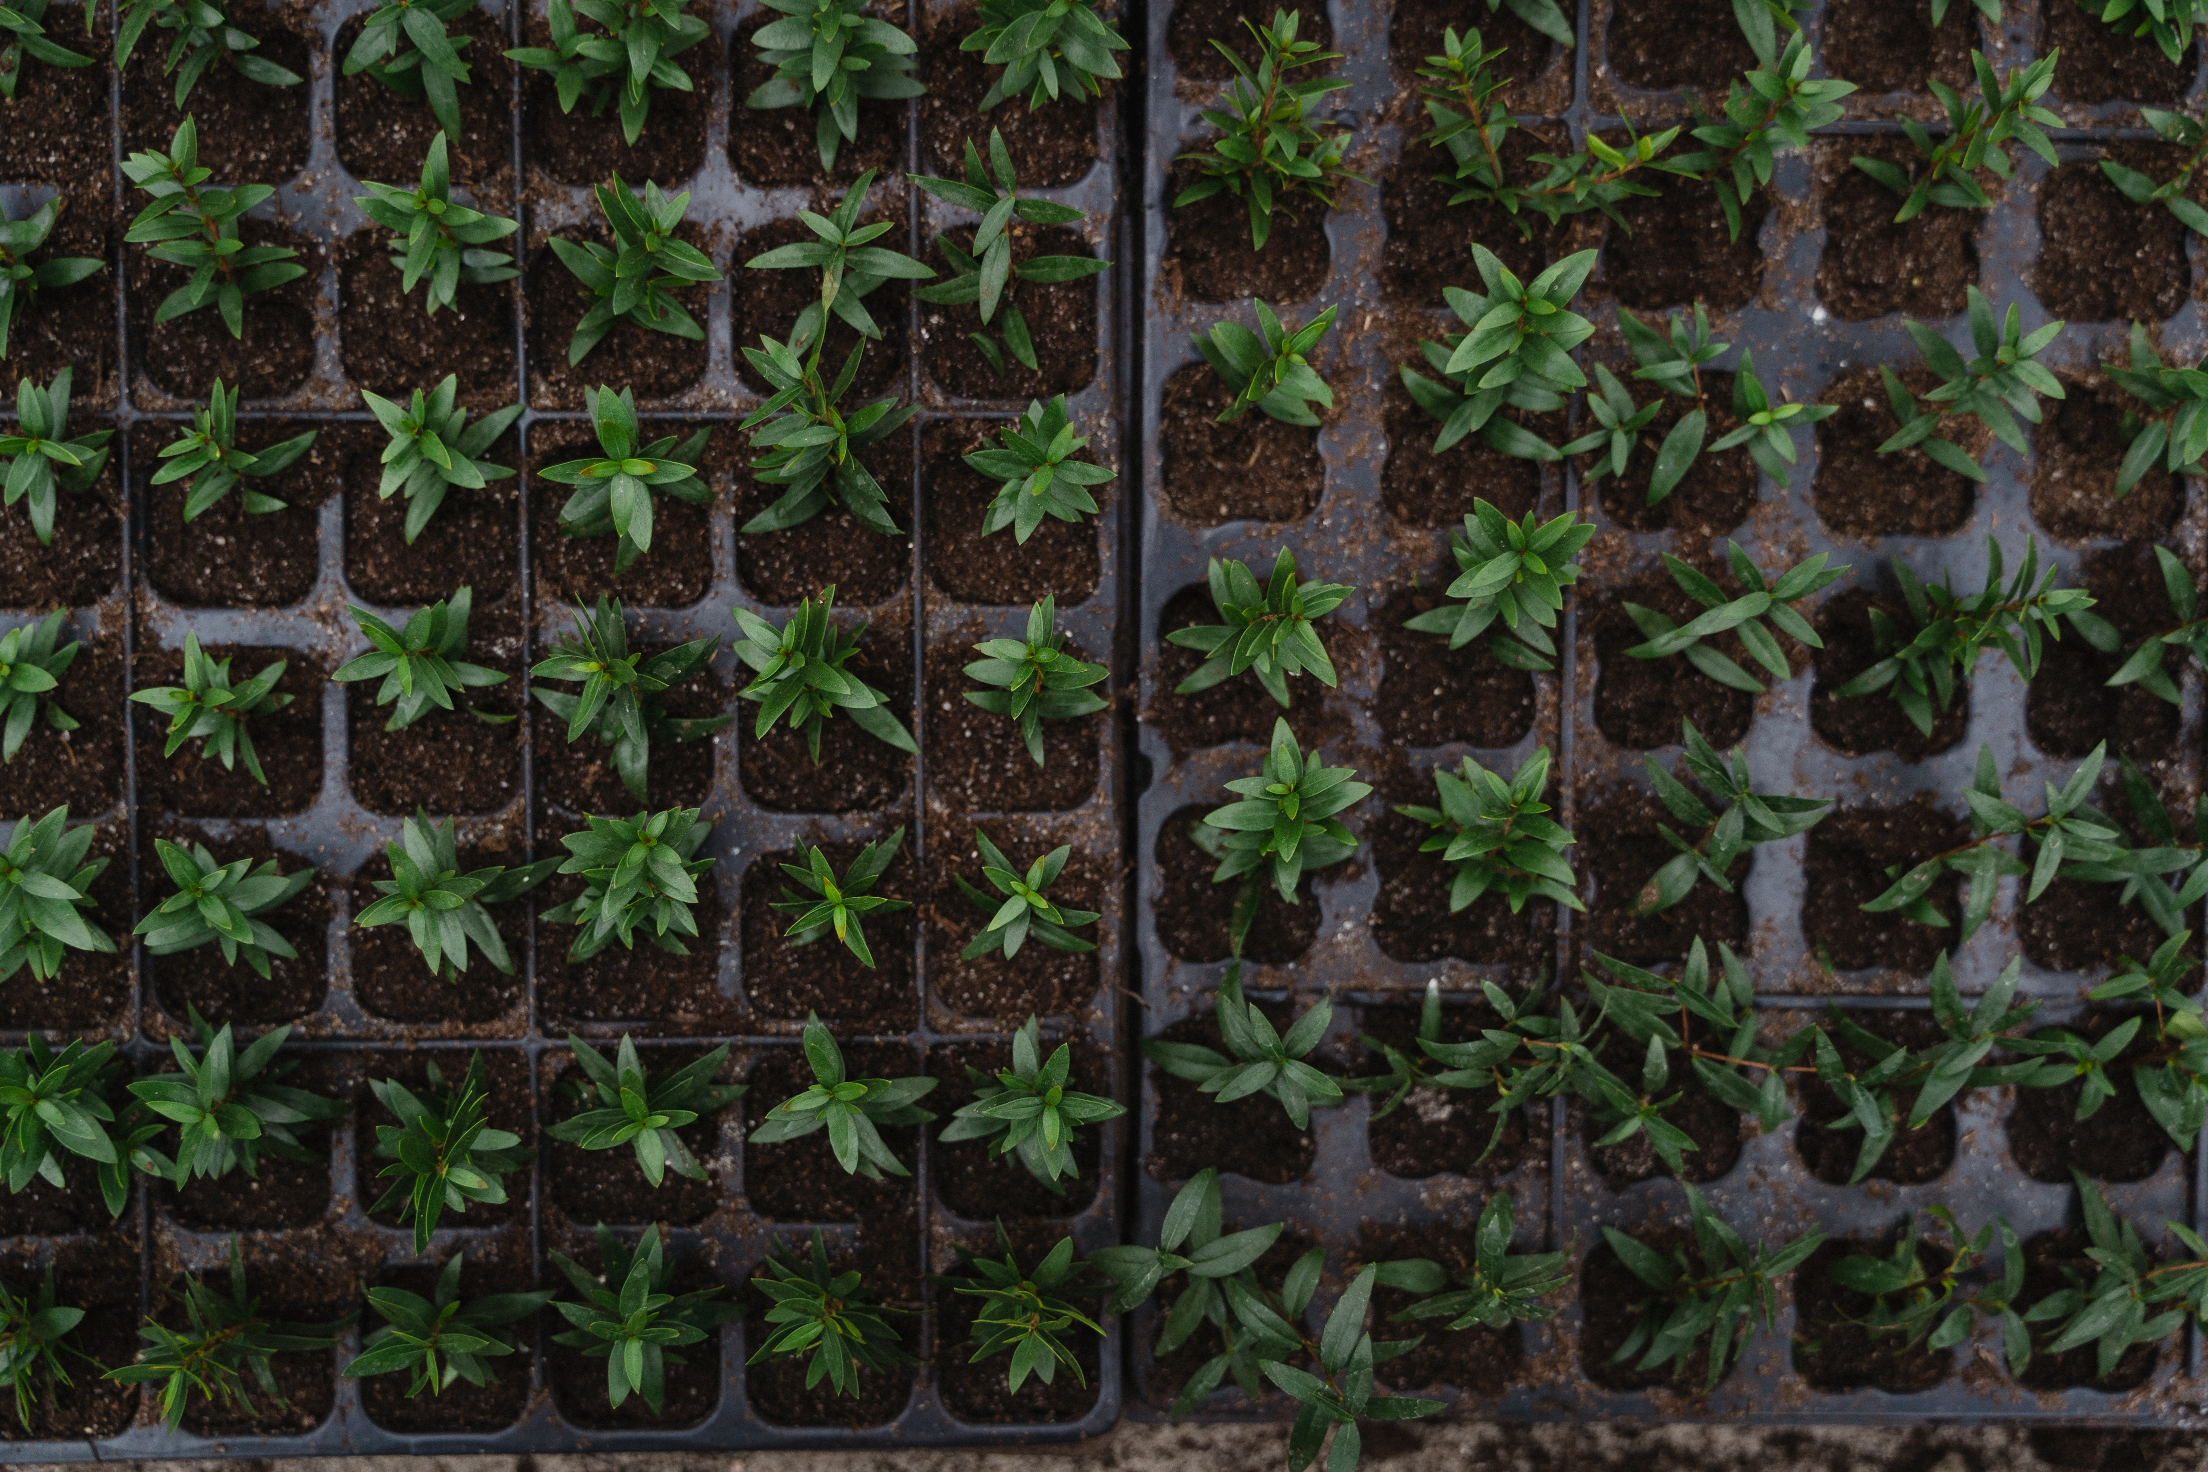
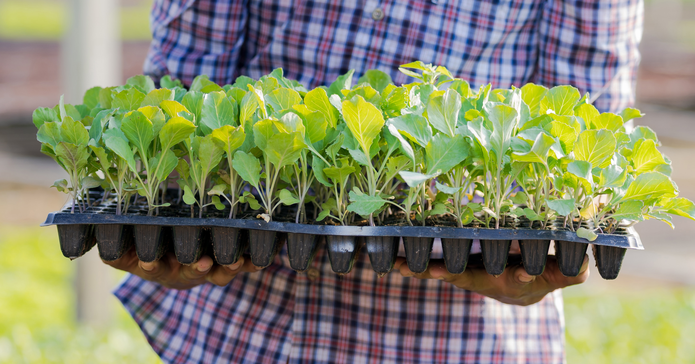
Terminology: Plantings
Tray Seeding
Transplanting
Direct Seeding
Photos by Tima Miroshnichenko from Pexels
Photo by Binyamin Mellish from Pexels
Photo by Greta Hoffman from Pexels
Photo by Sorapong Chaipanya from Pexels
Notes:
We’ll need some minimal farming terminology to work with FarmData2
Direct Seeding
- placing seeds directly in the ground to grow.
Tray Seeding
- planting seeds in cells in a tray to begin growing in a greenhouse.
Transplanting
- Moving plants that were tray seeded into the ground.

Slide 4
Terminology: Beds, Rows, Bed Feet, Row Feet
Notes:
Planting bed is the width of the tractor wheel tracks.
If length of the bed is 100 feet then
- we say we have 100 bed feet.
If we plant one row of crops in the bed then
- we say we have 100 row feet.
If we plant three rows of crops in the bed then
- we say we have 300 row feet.

Slide 5
FarmData2 Demo
Quick demo of FarmData2
http://farmdatadev2.dickinson.edu/
Login
User: worker1, manager1
Pass: farmdata2
BarnKit:
Seeding Report
FieldKit
Seeding Log
Notes:
Login: worker1, farmdata2
BarnKit:
- search for 05/01/2019 to 05/15/2019 works well.
- Filters
- tray seedings vs direct seedings
- Crop
- Area (i.e. field)
- Can edit and delete rows
- Summary Tables
- Useful for future planning
- e.g. how long does it take to plant
Field Kit:
- Make a new planting
Much more to be done…
- transplanting records
- harvest records
- 290!

Slide 6
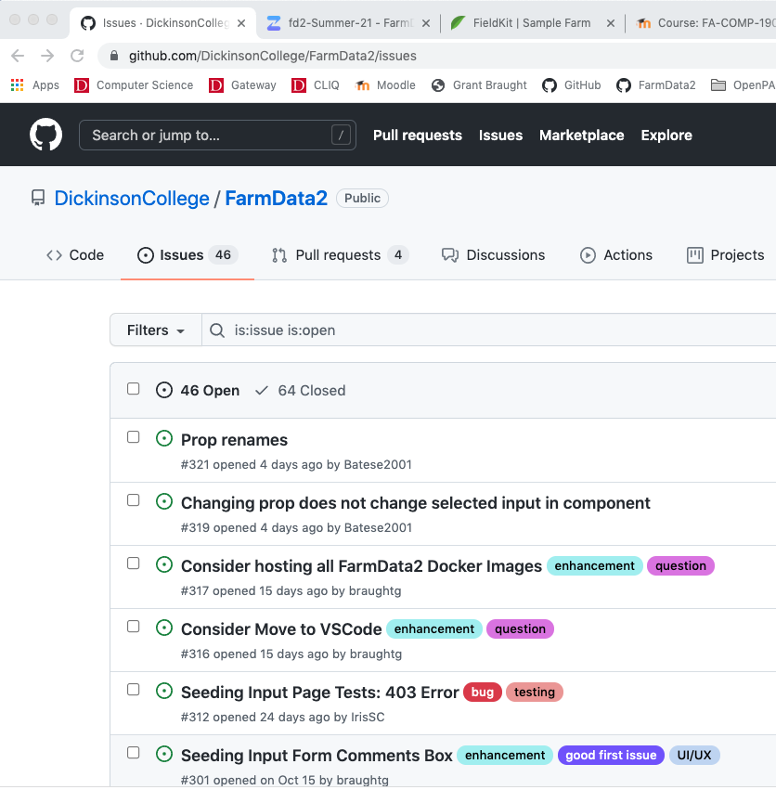
Issue Tracker
Lingo:
Issue
Bug
Ticket
Open
Report
Write
Notes:
You used the issue tracker when learning about Git/GitHub
It is where you found the issues that you fixed.
They told you
- what needed to be done and
- where to make the changes
It is where you claimed and were assigned the issue.
It is also possible for community members to add issues to the issue tracker.
In most projects the issue tracker is public
And anyone can add an issue.
If you go back… that would be the “Reporter” role that we discussed.
Different projects will use different Lingo / terminology for this process.
- The entries in the issue tracker may be called:
- Issue, bug, ticket
- They might describe a bug or an issue in the software.
- You might say:
- Open an Issue, Open a ticket, Open a bug report
- Report an issue, report a bug
- Write a ticket, Write a bug report
- These all essentially mean the same thing.

Slide 7
Bug Reports / Issues / Tickets
“The aim when writing a bug report is that they will get closed quickly.”
Malcom Young, Software Engineer at Capgemini
“The goal … is to reduce the time that developers need to solve the bug report.”
The Gluster project – Issue Triage Guidelines
Notes:
Ask:
- As software developers… what do you think would make a good bug report?
- Compile a list on the board.
Implication here is that
- You invest time in writing good tickets
- That saves time for others
- An hour of your time may 10 others an hour.
- That is a win for the community
- And for you, if the issue you write up gets fixed.

Slide 8
Bug Reports / Issues / Tickets
“Most ticket databases eventually suffer from the same problem: a crushing load of duplicate or invalid tickets filed by well-meaning but inexperienced or ill-informed users.“
Ken Fogel – Producing Open Source Software
Characteristics of a good bug/issue ticket:
Unique
Valid
Atomic
Notes:
Ask what these terms might mean…
Unique:
- Always search the issue tracker to see if your issue has already been reported before opening a new issue.
- If so, add to the current issue if necessary rather than opening a new one.
Valid:
- Make sure your issue is an issue.
- If you are unsure, try communicating with the project in another way to ask.
- E.g. Zulip, Slack, Discord, etc…
Atomic:
- Every bug should have its own issue.
- In general, do not lump together many small bugs.
- If one part, but not all of it gets fixed
- it can create confusion.
- Use judgement here…
- E.g. Multiple instances of the same issue in an isolated location may be fine to lump together.

Slide 9
Writing a Bug Report
A good bug report will, at a minimum, include these elements:
A Title
A Description
Step-by-step directions to reproduce
The expected result
The observed result
Possibly version/OS/configuration information, if relevant
Write with a generous mindset, assume that the:
Original developer did their best
Reader may be ignorant but is intelligent and capable
Write using consistent formatting and conventions
Bold, italic, bullets, numbered lists.
Use markdown in GitHub Issues
Notes:
Most content regarding Bug Reports is based on the following resources:
- https://capgemini.github.io/testing/effective-bug-reports/
- https://textexpander.com/blog/write-better-issue-tracking-tickets-consistency-is-key
- https://docs.gluster.org/en/latest/Contributors-Guide/Bug-Triage/
- https://www.mediawiki.org/wiki/Bug_management/How_to_triage
The next few slides will cover those elements.
There are a few points that apply to all elements of the bug report.
- Be generous:
- No snarky / snide comments or underhanded digs.
- You don’t know the time/ability constraints or specifications given to the original developer
- Be clear, avoid esoteric jargon and shortcuts that are not easily uncovered.
- but you do not need to spell everything out.
- Know your audience – developers
- Formatting:
- Most issue trackers now use markdown, or some other formatting mechanism.
- allows you use basic text formatting - lists are great!

Slide 10
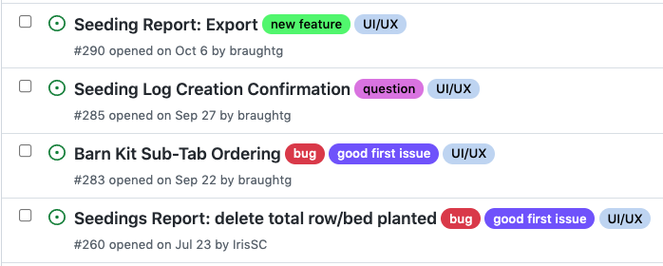
Writing a Bug Report: Title
A good title will:
Identify where in the application where the bug occurs.
Describe the symptoms experienced.
Use consistent terminology
Goal:
Make it easy for “reporters” to search for similar bugs before opening a new ticket.
Notes:
The title should make it easy to search for the bug:
- Reporters will know
- where the bug occurs
- what happened
- Using consistent terminology in the title helps with searching.
- i.e. if there is a particular page or feature, be sure to use its correct name.
- takes a few extra seconds, but saves time for other reporters and developers.
- Also make it less likely to result in duplicate tickets.
Some improvements here would be better consistency.
- In FarmData2:
- It is “BarnKit” not Barn Kit
- it is “Seeding Input” not “Seeding Log Creation”
- it is ”Seeding Report” not “Seedings Report”
For #285 a better title would be:
- Seeing Input: Add confirmation dialog for log creation
These seem like small things.
The author knew what was meant, but will a reader that is new to the project know that Seeding Log Creation is in the Seeding Input tab?

Slide 11
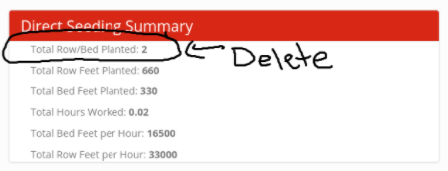
Writing a Bug Report: Description
A good description will:
Be concise
Explain the problem, not the fix
If you have ideas about the fix, put them in comments.
Be complete
Informed developer should not require outside information to understand the issue
Use annotated images
Take screen shot, add text, arrows, highlighting
Ensure that they do not contain confidential information
Notes:
Be concise
- Issue should contain only what is necessary and no more.
Be complete
- someone familiar with the application can understand the issue just from your description.
- they don’t need to go explore the app or figure out which page you are talking about.
Annotated Images
- really helps with being complete and concise.
- Use tools on your machine
- Screen capture
- Annotate (Preview, PowerPoint, whatever)
- Convert to image (save it, or do another screen capture)

Slide 12
Writing a Bug Report: Directions
Good step-by-step directions will:
Be complete, clear, concise, and accurate
Give a minimal example that reliably illustrates the bug
Smallest example you can find
Eliminate extraneous details
Use helpful formatting (e.g. use numbered / bulleted lists)
Use images to illustrate complex hard to describe steps.
Goal:
Ensure that a “contributor” working on the issue can exactly replicate the bug as you have experienced it.
Notes:
Minimal Example
- Invest the time to carve away any irrelevant information.
- E.g.
- in FarmData2 could give an example that uses a large date range.
- Would be better to use the smallest range that illustrates the issue.
- Try binary search to narrow it down.
- Minimize the steps needed to reproduce the bug.
- Helps to get rid of anything irrelevant.
- Will require work on your part
- Greatly increases the chances that the
- developer will see what you saw
- the bug will get fixed

Slide 13
Writing a Bug Report: Expected/Observed Result
A good expected result will:
Describe and/or illustrate with a (annotated) image what the outcome should be.
Give clear criteria for declaring the bug fixed.
A good observed result will:
Describe and/or illustrate with a (annotated) image what the current result is and where the issue is located.
Give sufficient detail so that bug’s existence can be confirmed.
May already be provided by the description.
Provide detailed information about crashes or errors
E.g. Error messages, Stack traces, etc.
Notes:
Expected Result:
- Clear criteria
- You must be able to say when the bug is fixed.
- E.g.
- “Add links to documentation” is no good.
- “Add a link for the farmOS project to the README.md file” is good.
- E.g.
- “Page loads too slowly” is no good.
- “Page loads within 5 seconds” is good.
- Some issues will even include check boxes for each of the criteria that must be satisfied.
Observed Result:
- Illustrate clearly what is undesirable.
- Give sufficient detail so that the issue can be confirmed.
- Sometimes bugs get fixed and tickets don’t get closed.
- helps determine if an issue should still be open.
- If the description already covers this sufficiently
- no need to be redundant.
- If the issue causes a crash or error to be reported
- give the exact error message
- screen shots are good!

Slide 14

Writing a Bug Report: Miscellaneous
Relevant Version / Configuration Information
OS version / Browser version / etc.
Application version or Commit SHA
Linking tickets
Similar to #33
Related to #78
Duplicate / Possible duplicate of #81
Labeling/Tagging tickets
etc.
Priorities
Usually done a “manager” doing bug triage
Claiming / Assigning tickets
Some projects do, some projects don’t
Can be self-assigned or done by a “manager”
Notes:
Relevant Version
- Use your judgement
- If it seems like it might be relevant include it.
- If not don’t – but you may be asked for it by a developer or someone who cannot replicate the issue.
Linking Tickets
- When you report an issue you search first.
- You might not find your issue, but you might find others that are similar.
- Link to them.
- You might find others that seem like duplicates of each other.
- Link to them if you are reasonably sure.
- Auto Linked References in GitHub:
- https://docs.github.com/en/github/writing-on-github/working-with-advanced-formatting/autolinked-references-and-urls
Labeling/Tagging Tickets
- seen these before.
- helpful for categorizing issues
- Usually you won’t have permission to add these.
Claiming / Assigning tickets
- in earlier classes you claimed a ticket by commenting on it.
- some projects work that way
- other will assign a ticket to you when you do that
- these are good ways to avoid duplicate work.
- others will not do anything
- too much maintenance
- people quit working on an issue and remain assigned to it.

Slide 15
Process Recap:
If you think you have a bug to report:
Find an example that illustrates the issue
Reduce it to one (or more) minimal example(s)
Open a ticket
Write a good title
Write a good description
Give directions to replicate your minimal example(s).
Clearly show desired and observed outputs
Add additional relevant information
Use images and formatting effectively.
See issue #24: Seeding Input Erases Selected Area
Notes:
Minimal Example
- boil it down… this takes effort.
- find the smallest example you can that shows the bug.
- e.g. the range of dates during which an error occurs
- In some cases, it may be helpful to have more than one example
- if the bug exhibits in multiple ways.
- E.g. the first and last rows in a table.
Additional relevant information
- version numbers etc…
- thoughts on how to fix, in comments.

Slide 16

Acknowledgments:
Slide Template From:
https://creativecommons.org/licenses/by/4.0/
Slide Content Licensed as:
https://creativecommons.org/licenses/by-nc/4.0/

