Slide 1


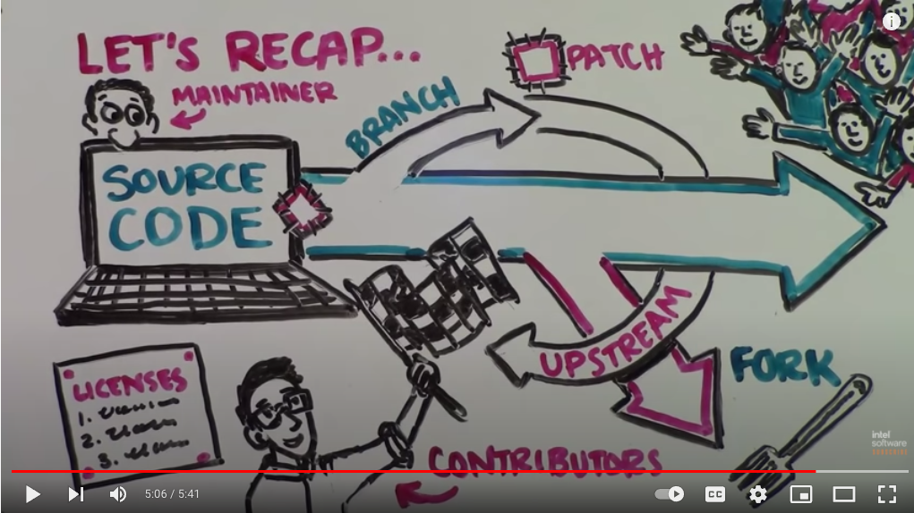

10 – Working Locally and Upstreaming
COMP 190 – Dickinson College
Spring 2023
https://www.youtube.com/watch?v=Tyd0FO0tko8
Images from:
https://git-scm.com/downloads/logos
https://github.com/logos
Notes:
Today will be a quick overview of where you are after the last activity
And how you go from there to upstreaming contributions.
We’ll look at a prototypical way that this happens
But recognize that there are lots of variants that you may encounter if you work on other projects.

Slide 2
GitHub and git: Fork and Clone
The
Upstream
Repository
Your
Origin
Repository
Your
Local
Repository
Notes:
This is your current state after completing the first activity,
ASK: Names for each of the different repos.
- Upstream
- Origin
- Local
Notes:
- These terms are conventions – some use different terms.
- They are also relative to the project.
- You will have a local for each project
- That local will have its own origin.
- It is the origin, because that's where the local was cloned from.
- I.E. It is the ”origin” of your local repo.

Slide 3
GitHub and git: Make Changes*
Simplified
for now
Notes:
You claimed an issue that needs to be fixed in the version of FarmData2 we are using as the upstream.
So you are ready to make some changes to your local copy
And then to upstream those changes.
Last time we said this was a simplified view.
- that making changes was a little more complicated than just editing the files.
- This is because we are using version control
- Version control keeps a history of all changes.
- That adds some overhead that we must manage
- But provides benefits in return.
Today we’ll see the details of how that works.

Slide 4
git: Branches and Commits
Time
main
Tip: Can also think of a commit as
a copy of all the files
in the repo at a given point in time.
Commits
Branch: A branch is a named sequence of commits.
Commit: Each commit describes a set of changes to the project.
The changes made.
Who made them.
When they were made.
A short description of the changes and their purpose.
A unique identifier.
Notes:
To understand how version control (e.g. git) tracks changes and keeps a history
We need to know about branches and commits.
Branches will also play an important role in upstreaming.
The contents of a repository are organized into branches.
A Branch is a named sequence of commits.
We often represent branches and commits using
- a line for the branch
- a dot for each commit
A commit describes a set to changes.
- includes the changes
- who made the changes,
- when the changes were made
- a description of the changes and their purpose
- a unique id for the commit.
You can think of this sort of like track changes in Word or Google Docs if you have used that.
Branches grow over time:
- Developers add new features, fix bugs, revise code, delete unused things, etc.
- Each change is described by a new commit that becomes part of the branch.
It is this sequence of commits that documents the history of the project.
- Another way to think of it is that you could start from an empty project
- then go along and apply each commit in order
- when you have applied all of the commits you have the current state of the project.
TIP: Even though it is not quite accurate, it is often useful to just think of every commit as its own full copy of the files at that point in time.
- Because each commit has a unique identifier, then we can think about resetting the project to any commit as reverting to that point in time.
- Useful for
- understanding changes
- undoing undesirable changes

Slide 5
git: Main and Feature Branches
Time
main
newColorScheme
RULE: Only commit to feature branches. Maintainers will merge accepted changes into the main branch.
newColorScheme2
nullPointerFix
main Branch: the designated starting point for new work.
feature Branch: a copy of the main branch on which a new feature, bug fix, or other changes are made.
Notes:
Repositories will usually have multiple branches.
One branch in the upstream project will be designated as the point from which new work should begin
- This branch is often called the main branch.
- also likely to see it called:
- the master branch – outdated terminology
- the dev branch indicating its where new development is occurring.
- there is nothing special about the name – it is just a convention.
- different projects will do it differently.
When you want to do some work (e.g. add a feature, fix a bug, etc)
- you create a new branch
- the new branch is like a full copy of the repository.
- you then add commits for the work you want to do to the new branch.
- these branches on which you do work are generically called feature branches.
- but you will give them specific names that are descriptive of what they do.
- e.g. newColorScheme – to develop a new color scheme for the user interface.
You may be working on multiple different tasks at the same time.
- When doing so you can have multiple feature branches simultaneously.
- e.g. stop working on the new color scheme to fix a null pointer exception that was discovered.
- You can even make a branch of a branch.
- e.g. started working on the new color scheme
- but after a while decided you wanted to try it a different way.
- instead of deleting what you’ve done
- you can go back and create a new branch from any commit and try something different.
- that way if you later decide the first way actually was better you can jump right back to it.
- You can switch back and forth between branches to
- work on different tasks
- to try different approaches
RULE: You should only ever make commits to feature branches.
- Only project maintainers will change the main branch.
- We’ll see that this happens via the pull requests that we’ve mentioned.
- we’ll see how that works in a bit…
- but basically if they accept your changes
- then they will merge them into to the main branch

Slide 6
GitHub and git: Repos and Branches
Notes:
So let’s now see how the idea of branches translates into work with GitHub and git.
- we’ll do it conceptually here
- Then you’ll do it hands on in the activities.
- Always try to connect what you are doing back to the concepts
- To help, these images are included in the activity too.
When you fork and clone a repository you get a copy of its main branch
- You can get copies of the other branches in the repo also if you request them,
- the main branch includes all of the commits and all of the history of the changes in that branch.
So this a more accurate picture of where you are.
Your origin and local clone repos contain a copy of the main branch and its commits from the upstream.

Slide 7
git: Branch/Repo vs Local Files
Tip: Think of your local files as a copy of the last commit.
Notes:
So now you have your local repository.
- it contains the main branch copied from the upstream
- but the commits in there are fixed
- they are part of the project history
- so you can’t change them.
Instead, what happens is that you have a yet another copy called your local files.
- You saw these in the last activity.
- When you changed into the repository directory and looked at the files
- You should have noticed that they look exactly the same as what is in the repo.
- That is because they behave pretty much like a copy of the last commit in the repo.
- Now, because the local files are a copy, and not a commit
- you can change them.
- so as you work you are making changes to your local files.
- the commits in the repository (i.e. the history) do not change.
Tip: Think of your local files as a copy of the last commit
- at least until you change them, then they will differ.
- it is then the changes that you make to the local files that will become future commits.

Slide 8
git: Create Feature Branch
Notes:
As said earlier – as a RULE you will not work on code in the main branch.
Instead, when you re ready to start a new task you will:
- create a new feature branch in your local repo
Note: there are no commits in the feature branch yet
- that is because you haven’t made any changes
- and you haven’t committed them to this branch yet.

Slide 9
git: Switch to Feature Branch
Switching to a feature branch makes it the “Active Branch” and the target for new commits.
Notes:
Before you can commit any changes to this branch you need to tell git that you want to use it.
This is called switching to a feature branch.
- Switching to a feature branch makes it the target for future commits.
But notice:
- the Local Files are still green
- They still match the last commit from main here.
- This is because we have not yet changed them.

Slide 10
Local Files: Edit Local Files
Notes:
Now when you edit your local files
- they will be become different from the last commit
- here they are colored blue to indicate a set of changes.
- note that the commit in the main branch from which they were copied didn’t change
- it is still green.
- It is part of the project history.

Slide 11
git: Stage Changes and Commit
ProTip: Each commit should contain a nameable unit of work.
Notes:
When you have completed some work
- You need to commit it to the feature branch.
Committing a set of changes to a feature branch is a two-step process:
- First you add the files that you have changed to the Staging Area using the stage command.
- The set of blue changes is on the stage.
- Then you commit those changes to the feature branch.
- The set of blue changes is added to the feature branch.
Why two steps?
- It may take a number of logical changes to implement a feature
- You could do it all in one big commit.
- But better to stage and commit smaller changes
- That way each change has it own record in the project history.
- For example:
- Maybe you write some code to do something (one commit)
- Then you write code to test it (another commit)
- Or:
- There are multiple parts to implementing a feature
- added the text field for name (commit)
- added a drop down for class year (commit)
- added a button for submit (commit)
- ProTip: Commits should be nameable units of work.
- Nameable – can describe them with a short phrase.
- I.e. the message.
- they should hang together in some way.

Slide 12
git: Edit/Add/Commit Cycle
ProTip: If It takes multiple nameable units of work to complete a feature or bug fix. Give each its own commit.
Notes:
Can repeat the edit, stage, commit cycle as many times as is necessary.
Try not to think of a commit as a save.
- When you save, it changes your Local Files
- You should do that constantly!
- Make a commit when you have completed a nameable unit of work.
- I.e. when you complete some cohesive sub-task.
- E.g. adding a text field, writing a test, etc…
- This ensures that you will be able to give every commit a meaningful message
- If you can’t think of a short description of what you’ve done, maybe its not a commit.

Slide 13
GitHub and git: Push Branch to Origin
Notes:
Now in order to upstream
- you need to get your changes into the cloud.
- that way you can ask the upstream maintainers to consider them.
To do that
- you push your branch to your origin.
- this makes a copy of your branch and any commits it contains to your GitHub space.

Slide 14
GitHub: Make Pull Request
A Pull Request asks the maintainers to consider merging your changes into the main branch.
Notes:
Once your branch is in the cloud (I.e. on GitHub)
- you can notify the upstream of your changes
- ask them to consider merging them into main branch.
- This is called a Pull Request
This is the point to which you will get in the associated activity.
You will:
- Make and switch to a feature branch
- Fix the issue that you claimed.
- Stage the changes that you make.
- Commit your changes to your feature branch
- Push that feature branch to your origin
- Make a pull request for it.
Then next time we will see:
- what PRs look like to the upstream maintainers
- how your changes get into the main branch
- what you have to do after that to keep working on the project.

Slide 15
Upstreaming: The Whole Picture
Notes:
We can put all of that into one figure.
- Make feature branch.
- Switch to it.
- Edit your files
- Stage your changes.
- Commit your staged changes.
- Push your feature branch to your origin.
- Make a pull request to the upstream.
Notice that everyone else will be doing the same thing!
- We’ll see what that looks like from the maintainer’s perspective next class.

Slide 16

Acknowledgments:
Slide Template From:
https://creativecommons.org/licenses/by/4.0/
Slide Content Licensed as:
https://creativecommons.org/licenses/by-nc/4.0/

