Slide 1
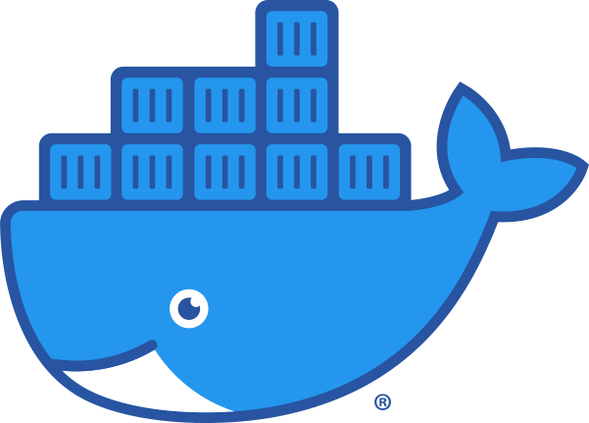
10 – Dependency Management, Build Tools, and Containerization
COMP 190 – Dickinson College
Fall 2021
Image from: https://www.docker.com/sites/default/files/d8/2019-07/Moby-logo.png
Notes:
That’s Moby Dock, the Docker logo.
Going to treat much of this at a high level.
- much of it has to do with dealing with complex software systems
- writing little programs with a few or even 10’s of files is pretty easy to manage.
- large projects incorporate tons of libraries and rely on lots of other tools
- managing all of that is complex
Dependency management, build tools and containerization
- are automation tools
- that help deal with this complexity
These are also typically performed by a specialty team known as Dev/Ops.
- They have detailed knowledge of how to build and automate these processes
What they create is then used by the development team.
- So understanding what things are and how to use them is important for developers
Or if you get into a project and it uses a particular dependency management or build tool
- then you can learn the details of that particular tool.
We will dig just a little into the details of containers
- and in the process learn a little bit about automation.

Slide 2
Dependencies
A dependency is a broad software engineering term used to refer when a piece of software relies on another one.
Simply put, if Program A requires Program B to be able to run, Program A is dependent on Program B. This makes Program B a dependency of Program A.
What might be some dependencies for Grandma May’s Cookie Recipe?
Definition from: https://coderslegacy.com/what-are-dependencies-in-programming/
Notes:
List out as many dependencies as we can:
- Flour
- Chocolate chips
- Sugar
- Eggs
- Mixing bowl
- Oven
- Baking sheet

Slide 3
Types of Dependencies
How might we divide the dependencies for Grandma May’s Cookie Recipe into these categories?
Prerequisites: External tools, programs or platforms that are required to build/test/run/distribute the product.
Dependencies: programs, libraries, services that are integrated into or accessed by the running product.
(Deploy) Dependencies: required to run the product in production.
Dev(elopment) Dependencies: required to develop, test, build the product.
What kind of things would fall into these categories for a software project?
Notes:
Grandma May’s dependencies:
- prerequisites: Stove, Mixing Bowl, Baking Sheet
- Development Dependencies: Flour, Sugar, Chocolate Chips, Eggs
- Deploy Dependencies:
- May not have had any of these yet…
- Serving tray, napkins, glass of milk, packaging for sale?
In Software:
- Prerequisites
- Specific OS, compiler,
- IDE, code formatting tools, static analysis tools, testing tools
- git / GitHub
- Dependencies
- good bit of overlap here…
- Dev will need to run the app to test it, so most deploy dependencies are also dev dependencies.
- Development and deployment may required different versions of a library.
- might be able to deploy your product using other’s pre-compiled code
- but may need the actual source code files to compile your product.
- Might require different external services
- Developer key for Google Maps API (free)
- To deploy, may need commercial production key (pay service)
-

Slide 4
Dependency Tradeoffs:
Advantages:
Disadvantages:
What are some advantages and disadvantages of incorporating dependencies into a project?
Notes:
Some content adapted from: https://coderslegacy.com/what-are-dependencies-in-programming/
Advantages:
- Faster development – prewritten code.
- Proven code – pretested and verified code, used in a wide range of circumstances.
- Support - regular updates, bug fixes, patches, new features.
Disadvantages:
- Compatibility – Changes to the dependency don’t work with your code
- Project shutdown – dependency will become outdated
- not work with new technology
- contain security vulnerabilities that do not get fixed.
Ask: So what should we look for in choosing dependencies:
- maximize advantages, minimize disadvantages
- Pick dependencies that:
- have been around for a while.
- are widely used
- are regularly updated
- Makes them:
- Unlikely to go away
- less likely to make breaking changes
- likely to be compatible with new technology
Dependency Hell!
- Often dependencies bring their own additional dependencies
- Can lead to all sorts of issues.
- https://en.wikipedia.org/wiki/Dependency_hell

Slide 5





Dependency Management
Dependency Management: The use of repositories and tools for automating the process of storing, retrieving, specifying and installing dependencies (and dependencies of dependencies).
Configuration
File / Script
PIP
Dependency / Package Management Tool
Install
Repository
Image from: openclipart.org
Notes:
Dependency management
- Idea is to leverage the benefits while mitigating the risks of using dependencies.
- Make it easy to get them, keep them up to date and avoid them vanishing
You will recall this from:
- apt / synaptic package management
- often used for prerequisites
- git / meld / compilers / IDE / tools / etc…
- But can also install system libraries that are dev or deploy dependencies
- Some other common dependency managers:
- npm – node package manager – JavaScript – installs from NPM Registry
- pip – python – installs from Python Package Index & others
- Maven – Java
- RubyGems – Ruby
- Ridiculous number of them…
- A search turned up a site called The top 220 Dependency Management Open Source Projects on GitHub.
General idea is:
- a configuration file will specify what the dependencies are for the project
- that is fed to a tool
- the tool
- uses repositories to retrieve the dependencies
- installs the dependencies on the system.
- also installs dependencies of dependencies…

Slide 6
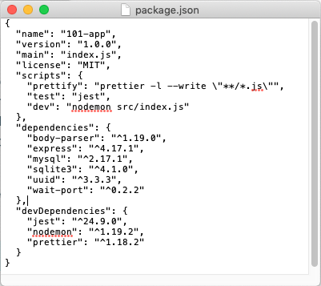
Configuration
File / Script
Notes:
Simple example of an npm configuration file.
- always named package.json
- can see sections that declare
- the dependencies
- Database stuff (mysql, sqlite3, etc)
- the devDependencies
- testing (jest)
- code styling (prettier)
- Each line is key value pair:
- names a dependency using its package name (like apt)
- indicates a version
- ^ means newer than version…
- Can also specify specific versions or version ranges.
Keep in mind that the goal here is not to fully understand or be able to create one of these.
- Just the idea that there is a configuration file
- and it specifies the dependencies for the project.
- It is fed to the npm tool which installs the dependencies from a repository.
package.json adapted from Docker 101 Tutorial
- https://www.docker.com/101-tutorial

Slide 7
Build Process
The build process “converts files and other assets under the developers’ responsibility into a software product in its final or consumable form.”
“The build may include:
compiling source files
packaging compiled files into compressed formats (such as jar, zip)
producing installers
creating or updating of database schema or data”
…
Definition From: https://www.agilealliance.org/glossary/automated-build
Notes:
Can be a complex processes
- requiring multiple steps
- in a precise order
Can include things like…
Overall goal is to produce a “software product in its final or consumable form”
- could be
- an executable program
- a package for a dependency repository
- a web application
- with a database, web server, and all the pages and code.

Slide 8
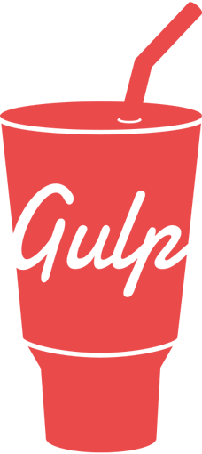


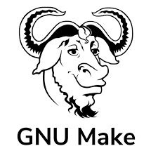

Automated Build Process
Build tools are programs that automate the build process.
There can be multiple targets for a given product. E.g. different OS versions; test vs production…
Dependencies
Build
File / Script
Build Tool
Target
/ Product
Project Source Code
Project Source Code
Project Source Code
Project Source Code
Notes:
The build process is repeated frequently.
- Every time the dev wants to test
- Every time the product is created for use
Lots of steps and sequencing:
- makes it tedious and error prone.
- automating it makes it more reliable and faster
Like dependency management
- there are tons of tools out there.
- but they all fundamentally operate in the same way
- They take an input
- a build file or script
- Instructions that direct the process
- all the product code
- necessary dependencies
- Build tool reads the file / script
- follows the instructions
- spits out the product – often called a target.
What is the build process for the cookies?
- It is the steps in the recipe.
- mix the flower, eggs, milk , chips
- spoon onto a baking sheet
- bake for exactly 7.5 minutes
- place the warm cookies on a cooling rack
- box them up to hand out.
Build files/scripts can specify multiple targets
- different version
- mac vs win vs linux
- android vs iOS
- version with / without debugging info
- version instrumented for testing
- etc…
Notice there are some of the same tools listed here.
Dependency management and build can be handled by a single tool.
- checks / installs dependencies as a step in the build process.

Slide 9
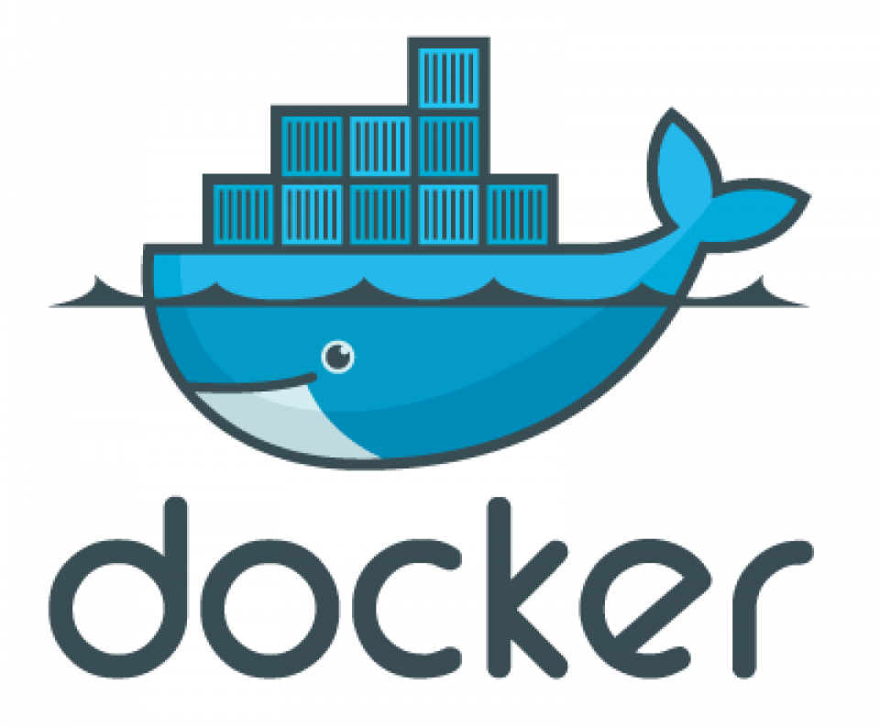
Docker is a set of platform as a service (PaaS) products that use OS-level virtualization to deliver software in packages called containers. Containers are isolated from one another and bundle their own software, libraries and configuration files; they can communicate with each other through well-defined channels. All containers are run by a single operating system kernel and therefore use fewer resources than virtual machines. - Wikipedia
Notes:
Still a lot of work…
- still doesn’t address portability or compatibility of deps.
- issues with different developers on different platforms
- small differences can cause big issues.
Think: Docker = Containerization
- it is the dominant technology
Think: Container = Virtual Machine
- similar – produces a controlled environment
- with everything we need
- guaranteed to look / work the same anywhere

Slide 10
Docker is a set of platform as a service (PaaS) products that use OS-level virtualization to deliver software in packages called containers. Containers are isolated from one another and bundle their own software, libraries and configuration files; they can communicate with each other through well-defined channels. All containers are run by a single operating system kernel and therefore use fewer resources than virtual machines. - Wikipedia
Notes:
Software, libraries and configuration files all bundled together.
That is the container has all of the:
- necessary prerequisites
- necessary dependencies
- product of the build
That way everyone with the container has everything they need.
- they don’t have to install prereqs, deps or even build.
- they all come in the container
- correct versions
- can’t disappear
- just launch the container and off you go.
Eliminates many of the risks associated with dependencies.
Eliminates the need to build.

Slide 11
Docker is a set of platform as a service (PaaS) products that use OS-level virtualization to deliver software in packages called containers. Containers are isolated from one another and bundle their own software, libraries and configuration files; they can communicate with each other through well-defined channels. All containers are run by a single operating system kernel and therefore use fewer resources than virtual machines. - Wikipedia
Notes:
Containers are isolated –
- cannot mess with the host machine
- cannot mess with each other
- provides good security
But, containers can be configured to be able to communicate with each other.
- allows them to cooperate
- a web application running in one container
- could talk to a database running in another container.

Slide 12
Docker is a set of platform as a service (PaaS) products that use OS-level virtualization to deliver software in packages called containers. Containers are isolated from one another and bundle their own software, libraries and configuration files; they can communicate with each other through well-defined channels. All containers are run by a single operating system kernel and therefore use fewer resources than virtual machines. - Wikipedia
Notes:
They are lighter weight than VMs.
- Run faster
- take up less memory (RAM)
- use less storage (disk)

Slide 13
OS Level Virtualization: Virtual Machines vs Containers
Virtual Machines
App
App
App
App
Containers
App
App
App
App
Libs/Bins
Libs/Bins
App
App
App
App
Guest OS
Guest OS
Libs/Bins
Libs/Bins
Libs/Bins
Hardware Virtualization
Virtual Machine (hypervisor)
Libs/Bins
OS Kernel Virtualization
Container Daemon (containerd)
Host Operating System
Host Operating System
Hardware
Hardware
Virtual Machines
Containers
Notes:
Normal system, hardware, os, libraries and binary files used by applications that run on the system.
With VM:
- software layer that pretends to be the computer hardware
- Can install OS on that virtual hardware
- Comes with its own libs/bins
- Apps run on that.
- Can have multiple VMs running on the same physical machine.
- Each can have its own full OS – mac / win / linux
With Containers:
- Each container still acts just like a full machine.
- It thinks it has its own OS
- It runs aps just like a VM
- But it is using the host OS
- So eliminates the Guest OS and the hardware virtualization pieces.

Slide 14
Virtual Machines vs Containers
Virtual Machines
Slow boot-up
Slower execution
Larger images
Apps are sandboxed*
Multiple OSs
Full GUI*
Containers
Fast spin-up
Faster execution
Smaller images
Apps are sandboxed*
OS Limitations
CLI access*
Notes:
Comparing the two…
Sandboxed
- don’t have to install everything on your machine
- Some argue that VMs may be more secure
- virtualized hardware and separation from host OS files and services.
Multiple OS’s / OS Limitations
- VMs: Can run MacOS in one VM and Windows in another and Linux in another.
- Containers –at least currently via docker.
- Linux / MacOS can run only Linux-based containers.
- Windows can run Windows and/or Linux-based containers.
GUI / CLI
- technically possible to run VMs without GUI – often done on servers
- also possible to run GUI on containers – less useful – more cumbersome.

Slide 15
Common Container Uses
Deploy (Deployment) Containers:
Container(s) contains all dependencies and binaries needed to run the app.
Container can be run locally or easily “deployed” to a cloud service (AWS, Azure, Heroku, DigitalOcean, etc.)
Dev (Development) Containers:
Container(s) contain all dev dependencies and build tools.
Source files are stored and edited on host machine.
Container(s) are used to run tests and the build process.

Slide 16
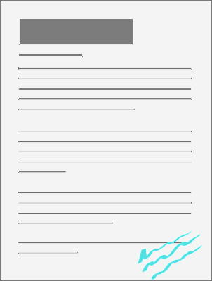


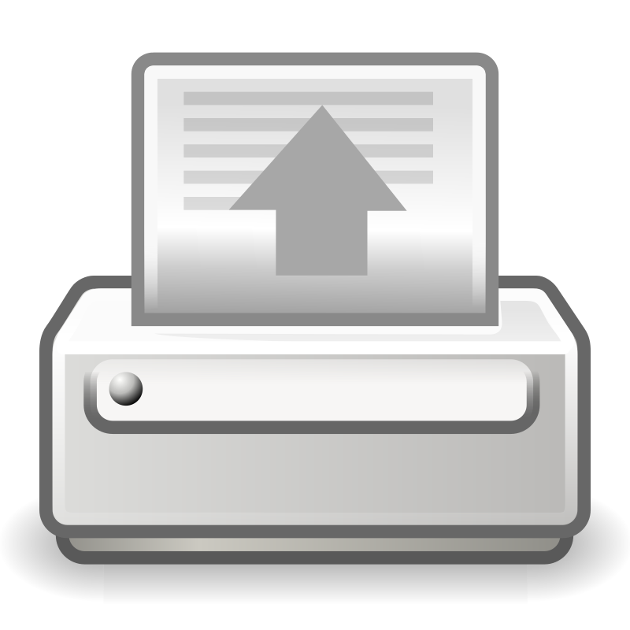
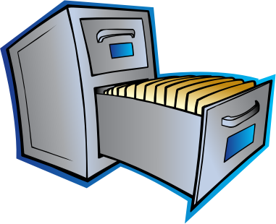
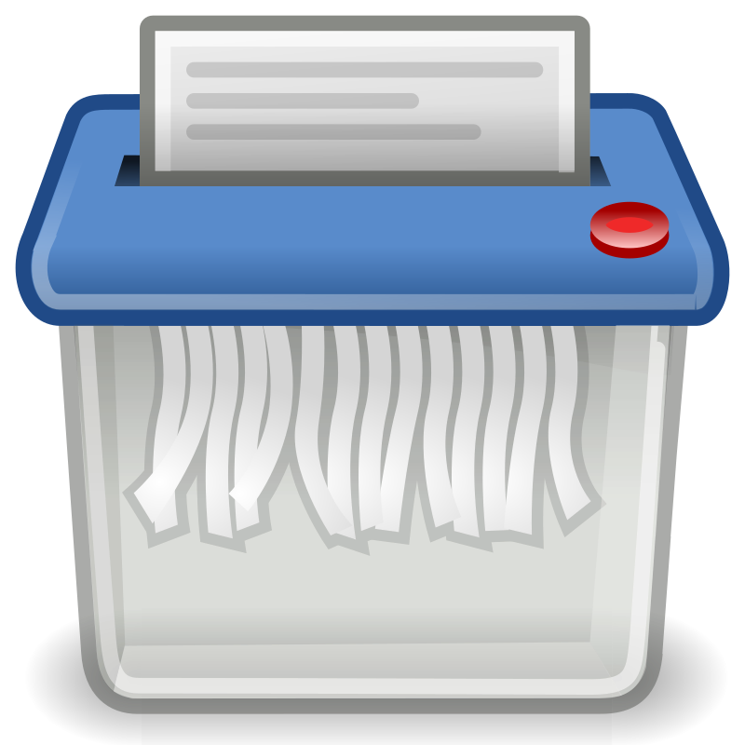
Docker Vocabulary /Concepts
Cookie Container
Stew
Container
Local Images
Image Repository
Writeable
Layer
Cookie:latest
Stew:9.7
pull
start
Stew:10.2
Stew:9.7
Stew:latest
remove
stop
image
remove
printer
Salad:latest
create
container
Cookie:0.9
Cookie:latest
Shredder
Images from: openclipart.org
Notes:
Sticking with a recipe metaphor…
- if docker was for managing recipes instead of software
Repository
- Cloud service that stores recipes
- Images are recipes
- The most recent version will usually be tagged ”latest”
- Older versions will be tagged in other ways.
- read only for the public
Local Images
- Downloaded (pulled) version of the image:tag
- still read only
- kind of like a downloaded pdf file of the reciple
An Image is used to create a container
- like printing the recipe on a piece of paper and putting in a file.
- making it ready to be used.
Starting the container
- the container is running.
- taking the recipe out and putting it on the counter
- can use it
- can modify it and make notes on it
- writeable container layer
Stopping a container
- putting it back in the file
- with all notes on it.
- can start it again and it will come back as is.
Removing a container
- like shredding the paper.
- all notes are lost
- can create a new container from the image
- resets to initial state
- the writeable layer is blank
Removing the image
- Like deleting the pdf file.
- If you want to use it again
- need to pull/download it again.
Another metaphor that might help:
- image is like a plan for a car
- container is the car
- can be running
- can be stopped
- anything you do to it stays with it when restarted (writeable layer)
- scratches, stuff in the trunk, etc…
- can destroy container and create another new one
- new container comes out with blank writable layer.

Slide 17
Docker Vocabulary / Concepts
Image Repository
Docker Hub is “a hosted repository service provided by Docker for finding and sharing container images.”
Image:tag
An image is a read-only file containing the libraries, binaries, application and configuration files for creating a container.
A tag is a version label for a specific image.
Container
A container is a runtime version of an image that may have additional changes in its writeable layer.
Notes:
More formal definitions.
No need to spend much time here.

Slide 18
Creating Docker Images
Dependencies
Dockerfile
docker build
Docker
Image
Project Source Code
Project Source Code
Project Source Code
Project Source Code
Notes:
Looks a lot like like the diagram for a build tool.
- because it is!
- Here we are just building a docker image.
- And that image will contain the software product.
The process of building the docker image will likely:
- include installing dependencies
- running the automated build process.
The Dockerfile as you will see will look similar to a shell script.
- It will be a sequence of commands
- that describe how to build the image.

Slide 19
What’s Next?
A11/Q11 – 1 week
Revise and resubmits
Reading for discussion
Notes:
A11 will have you using an app via a docker image
Then building it manually:
- uses dependency management tools
- uses a build tool
Then create a docker image for it yourself.
- learn about important docker commands in the process.
- build a Dockerfile to create an image for it.
- then create a PR to upstream your Dockerfile.

Slide 20

Acknowledgments:
Slide Template From:
https://creativecommons.org/licenses/by/4.0/
Slide Content Licensed as:
https://creativecommons.org/licenses/by-nc/4.0/

