Slide 1

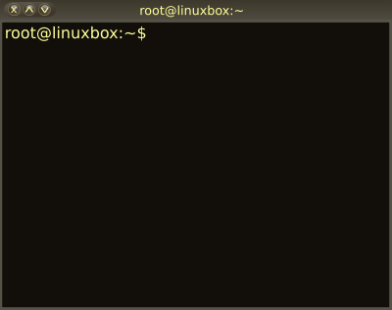

03 – Filters, Pipes and Scripts
COMP 190 – Dickinson College
Fall 2022
Images from: openclipart.org
Notes:
Look at some of the specific tools and utility programs that come with all (or nearly all) Unix distributions
And see how they are used.

Slide 2
The Unix philosophy recommended utilizing small, purpose-built programs in combination to do complex overall tasks. Phil Estes Linux vs. Unix: What's the difference?
Notes:
In A02 you learned a bit about Linux/Unix commands and paths.
- Those are some of the small, purpose-built programs.
Today, we’ll see how to put them into combination with each other
- To do more complex things.
- And in A03 you’ll learn a few more commands.

Slide 3
One of the underlying principles of Linux is that every item should do one thing and one thing only and that we can easily join these items together. Think of it like a set of building blocks that we may put together however we like to build anything we want.
Ryan Chadwick Ryan’s Linux Tutorial – Filters!
in combination
small, purpose-built
programs
Notes:
Here’s another definition…
This is the real power of the Unix/Linux command line.
Being able to connect together these “small, purpose-built” building blocks to build what we want.
Now we just need to learn about a few more blocks and and how to join them together.

Slide 4
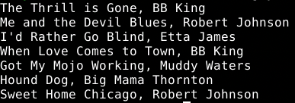

Linux/Unix Filters (i.e. commands)
A filter is a “small, purpose-built program” that a accepts a stream of text as input, processes it in some way and generates a stream of text as output.
Input Stream
Filter
head --lines=3
Output Stream
Notes:
So a filter is just a special type of command.
- takes a stream of text as input
- processes it in some way
- generates a stream of text as output.
Here is an example using the head filter
- We saw head last time but didn’t define it as a filter, but it is…
- The input is a list of songs and artists, one per line.
- The head filter, as we know, just outputs the first so many lines.
- in this case 3.
Will use command and filter mostly interchangeable.
- technically some commands are not filters (because they have no input)
- but all filters are commands.

Slide 5
Linux/Unix Standard Streams
Linux/Unix filters (and programs more generally) use three standard streams:
Standard Input (stdin)
Filters read their input from stdin.
Standard Output (stdout)
Filters print their output to stdout.
Standard Error (stderr)
Filters print error messages to stderr.
All three standard streams default to the terminal.
Input read from keyboard
Output printed to terminal window.
Notes:
Demo with head –n3
- Type 3 lines
- Each line is
- read from the keyboard.
- echoed to the terminal
- Once three lines have been read the head program terminates.
Demo with wc –l
- Counts the number of lines read
- Reads lines from keyboard
- Terminate with CTRL-D
- Prints the number of lines read.
But that’s not all that useful…
- would like to have these filters process the contents of files!
- Give me the first 3 lines in a file
- Tell me how many lines are in a file
- etc…

Slide 6

Redirection
The standard streams can be redirected so that filters get their input from a file (<) or send their output to a file (>, >>)
head --lines=3 < guyb-music.txt
guyb-music.txt
head --lines=3 < guyb-music.txt > top3.txt
guyb-music.txt
top3.txt
Notes:
In the first one:
- Standard input is redirected from the file guyb-music.txt
- So head uses the contents of that file as its input to be processed.
- The < says, use the contents of this file as the input to the filter.
- So when that filter reads from standard input, it will get lines from the file instead of from the keyboard.
- Note: In HW02 we used head --lines=3 <file>
- That is doing the same thing as <.
- The contents of the <file> are used as the input to the filter.
- Most commands will allow some way to specify the name of a file to use.
- Can check the man pages.
- But any filter will allow redirection.
In the second one
- The input to head comes from the file guyb-music.txt
- The output goes to the file top3.txt
- The > says that when the filter prints to standard output
- Send that output to the file top3.txt instead of displaying it in the terminal.
We can also use >> to redirect output
- Using two >> instead of one > causes the output to be appended to the file, if it exists.
Do a demo here?
- Show text file.
- Show first one
- Show second one
- Cat top3.txt
- Do it again
- Show file is emptied and refilled.
- Do it again with >>
- Show file is appended
- Do it again with >
- Show file is emptied and refilled.

Slide 7

Redirection
Redirection can allow you to use the output of one filter as the input to the next.
head --lines=3 < guyb-music.txt > top3.txt
guyb-music.txt
top3.txt
sort < top3.txt
top3.txt
Notes:
The first line:
- Provides the contents of guyb-music.txt to head as its input
- Sends the output of the head filter to the file top3.txt
The second line:
- Provides the contents of top3.txt to the sort filter
- The sort filter just sorts the input lines
- The output is not redirected
- So it appears in the terminal.

Slide 8
Spot Check:
The prior example alphabetized the first 3 lines of guyb-music.txt and displayed the result in the terminal.
Write commands using redirection that place the first three lines alphabetically from guyb-music.txt into a file named ordered3.txt.

Slide 9
Shell Scripts
A shell script is a text file containing a list of commands to be interpreted by the shell (e.g. bash)
Shell provides a command line interface (CLI)
Is also an interpreter for shell scripts.
A list of commands executed in order.
Also includes full language features
Variables / conditionals / loops / functions…
Syntax is a bit idiosyncratic and particular
Read: Frustrating!

Slide 10
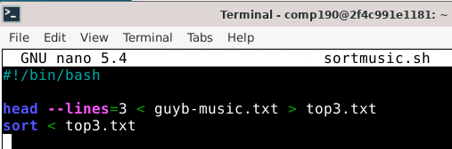
An Example Script
File extension
typically indicates type
(e.g. sh = shell script)
#!
Sha-Bang
Commands executed
from top to bottom
Notes:
Commands in the script are saved in a file.
- Often named .sh or .bash or something such.
- The .sh doesn’t matter to unix at all.
- It is there as a clue to the human reader that this file contains a shell script.
The Sha-Bang line defines the interpreter to be used to execute the commands.
- Sharp-Bang (i.e. exclamation)
- Sometimes you’ll also hear Shebang – as in ”the whole shebang”
- Here the Bash shell (/bin/bash) is being used.
- Recall that there are lots of shells
- Any one can be used, can even use python.
Commands appear one after the other and are executed top to bottom.
- in a basic script that has no loops, conditionals for functions.

Slide 11
Running Shell Scripts
A shell script can be run from the command line using ./<script>
./sortmusic.sh
Note: ./ is a relative path.
“In the current directory, run the program sortmusic.sh”
Will need to set the permissions before a script can be run!
Notes:
Demo:
- cat the script file.
- try to run it, show the permission error.
- use chmod u+x sortmusic.sh on the command line
- For now, this is what we need to do to tell Linux/Unix that this file is an executable program.
- I’ll cover the details of that in a moment.
- Then run it and show the output.

Slide 12
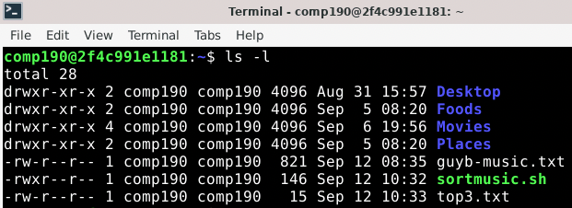
File Permissions:
Every file and directory in Unix has permissions
The group
to which
the file
belongs.
Username
of the file’s
owner
Date/time the
file was
last modified
Permissions
Notes:
The ls –l command shows the “long” version of the file listing.
- This includes a lot of extra information.
- permissions – more in a moment.
- username – who owns the file
- Typically this is whomever created it, but that can be changed.
- Group
- The group is often the same as the username.
- Every user has their own group by default.
- When you create a file it is owned by you as the user.
- And it belongs to your group.
-It is possible to create other groups
- This allows files and directories to be shared with other users.
- E.g. maybe a students group, or a faculty group
- All users in that group could then have access to the file.
- Last modified date and time.
- Filename
The other columns are:
- Number of hard links… don’t worry about it.
- The size of the file in bytes.

Slide 13
File Permissions: User
User permissions appear first.
d = Directory
r = Read
w = Write
x = Execute
- = no permission
User (u)
Permissions
Notes:
Permissions are read/write/execute
- rwx. In that order
- a – means the permission is not granted
The first 3 specify the permissions for the user.
So the comp190 user can
- read/write/execute the sortmusic.sh script
Note that:
- Execute permission on directory means that you can change into it.
- Can have directory without execute
- If it has write but not read permission then it would be like a drop box.
- Can put stuff into it, but can’t see what’s there.
- Usually done for the “other” users.
The comp 190 user can only read/write the guyb-music.txt and top3.txt files.

Slide 14
File Permissions: Group
Group permissions appear second.
d = Directory
r = Read
w = Write
x = Execute
- = no permission
Group (g)
Permissions
Notes:
Users that are in the comp190 group can
- only read the sortmusic.sh script
- they cannot write or execute
- as indicated by the – where the w or x would appear.

Slide 15
File Permissions: Others
Permissions for others (users not in the group) are third.
d = Directory
r = Read
w = Write
x = Execute
- = no permission
🚫
Others (o)
Permissions
Notes:
All other users on the system may only read the sortmusic.sh file.

Slide 16
Changing Permissions
User must have execute permission for a script to run it.
chmod u+x sortmusic.sh
Can add and remove other permissions (e.g.):
u-w u+rwx
g-r o+x-w
u-x,g+w,o-rwx
a+rw-x
Notes:
u-r
- remove read permission from the user.
u+rwd
- add read, write and execute permissions for the user.
g-w
- remove write permission from the group members.
o+rx-w
- give others not in the group read and execute, and remove write, permissions.
u-x,g+r,o-rw
- remove execute permission from user, add read permission to the group, remove read and write permission from others not in the group.
a+rw-x
- a - sets permission for user, group and others all at once.
- give user, group and others read and write, and removes execute permission.
These are just some examples…
- you can combine u, g, o with +/- rwx however you need to.
- things that are not explicitly mentioned are left unchanged.

Slide 17
Spot Check:
Consider the file and permissions shown below:
Who is the owner of this file?
To which group does this file belong?
What permissions does the owner have?
What permissions does the group have?
What permissions do others have?
What command would give execute access to the owner?
What command would give read access to others?
What command would remove execute access and provide write access to the group?

Slide 18
Pipes
A pipe connects the output of one filter directly to the input of another filter.
head --lines=3 < guyb-music.txt
guyb-music.txt
sort
Notes:
Saw how to do this indirectly using redirection to an intermediate file.
- We usually don’t care about that intermediate file.
- In those cases we can use a pipe instead.
Here:
- The guyb-music.txt file is directed into the head filter
- The output of the head filter,
- instead of being saved to a file, is sent directly to the sort filter.
- The output of the sort filter is displayed in the terminal
- because it was not redirected.

Slide 19
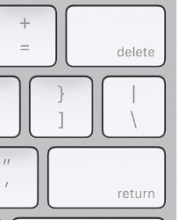
Writing a Pipe
A pipe is created by placing a pipe character ( | ) between two filters on the command line.
head --lines=3 < guyb-music.txt | sort
Notes:
The command line shown at the top
- Implements the pipe illustrated on the last slide
- and shown here in miniature form
The pipe character is a vertical bar
- It typically appears on the keyboard above the enter or return key.
It is also possible to
- pipe through multiple filters by using multiple | characters
- You can also redirect the output of the final filter into a file.

Slide 20
Spot Check:
The prior example alphabetized the first 3 lines of guyb-music.txt and displayed the result in the terminal.
Write a command using a pipe that places the first three lines alphabetically from guyb-music.txt into a file named ordered3.txt.

Slide 21
What’s Next?
Be sure to complete
Syllabus Quiz
Quiz 02
Complete HW 03
Submit to Moodle by next Wed 12:00 noon.
Complete Quiz 03
Do reading and prep for discussion.

Slide 22

Acknowledgments:
Slide Template From:
https://creativecommons.org/licenses/by/4.0/
Slide Content Licensed as:
https://creativecommons.org/licenses/by-nc/4.0/

