Slide 1
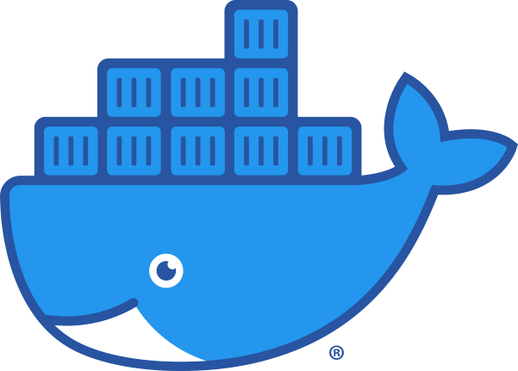
10 – Dependency Management, Build Tools, and Containerization
COMP 190 – Dickinson College
Fall 2021
Image from: https://www.docker.com/sites/default/files/d8/2019-07/Moby-logo.png
Notes:
That’s Moby Dock, the Docker logo.
Going to treat much of this at a high level.
- much of it has to do with dealing with complex software systems
- writing little programs with a few or even 10’s of files is pretty easy to manage.
- large projects incorporate tons of libraries and rely on lots of other tools
- managing all of that is complex
Dependency management, build tools and containerization
- are automation tools
- that help deal with this complexity
These are also typically performed by a specialty team known as Dev/Ops.
- They have detailed knowledge of how to build and automate these processes
What they create is then used by the development team.
- So understanding what things are and how to use them is important for developers
Or if you get into a project and it uses a particular dependency management or build tool
- then you can learn the details of that particular tool.
That said, we will dig just a little into the details of containers
- and in the process learn a little bit about automation.

Slide 2
Dependencies
A dependency is a broad software engineering term used to refer when a piece of software relies on another one.
Simply put, if Program A requires Program B to be able to run, Program A is dependent on Program B. This makes Program B a dependency of Program A.
What might be some dependencies for Grandma May’s Cookie Recipe?
Definition from: https://coderslegacy.com/what-are-dependencies-in-programming/
Notes:
List out as many dependencies as we can:
- Flour
- Chocolate chips
- Sugar
- Eggs
- Mixing bowl
- Oven
- Baking sheet

Slide 3
Types of Dependencies
How might we divide the dependencies for Grandma May’s Cookie Recipe into these categories?
Prerequisites: External tools, programs or platforms that are required to build/test/run/distribute the product.
Dependencies: programs, libraries, services that are integrated into or accessed by the running product.
(Deploy) Dependencies: required to run the product in production.
Dev(elopment) Dependencies: required to develop, test, build the product.
What kind of things would fall into these categories for a software project?
Notes:
Grandma May’s dependencies:
- prerequisites: Stove, Mixing Bowl, Baking Sheet
- Development Dependencies: Flour, Sugar, Chocolate Chips, Eggs
- Deploy Dependencies:
- May not have had any of these yet…
- Serving tray, napkins, glass of milk?
In Software:
- Prerequisites
- Specific OS, compiler,
- IDE, code formatting tools, static analysis tools, testing tools
- git / GitHub
- Dependencies
- good bit of overlap here…
- Development and deployment may required different versions of a library.
- might be able to deploy your product using other’s pre-compiled code
- but may need the actual source code files to compile your product.
- Might require different external services
- Developer key for Google Maps API (free)
- To deploy, may need commercial production key (pay service)
-

Slide 4
Dependency Tradeoffs:
Advantages:
Disadvantages:
What are some advantages and disadvantages of incorporating dependencies into a project?
Notes:
Some content adapted from: https://coderslegacy.com/what-are-dependencies-in-programming/
Advantages:
- Faster development – prewritten code.
- Proven code – pretested and verified code, used in a wide range of circumstances.
- Support - regular updates, bug fixes, patches, new features.
Disadvantages:
- Compatibility – Changes to the dependency don’t work with your code
- Project shutdown – dependency will become outdated
- not work with new technology
- contain security vulnerabilities that do not get fixed.
So in adding dependencies to a project you want to:
- maximize advantages, minimize disadvantages
- Pick dependencies that are:
- have been around for a while.
- widely used
- regularly updated
- Makes them:
- Unlikely to go away
- less likely to make breaking changes
- likely to be compatible with new technology
Dependency Hell!
- Often dependencies bring their own additional dependencies
- Can lead to all sorts of issues.
- https://en.wikipedia.org/wiki/Dependency_hell

Slide 5





Dependency Management
Dependency Management: The use of repositories and tools for automating the process of storing, retrieving, specifying and installing dependencies (and dependencies of dependencies).
Configuration
File / Script
PIP
Dependency / Package Management Tool
Install
Repository
Image from: openclipart.org
Notes:
Dependency management
- Idea is to leverage the benefits while mitigating the risks of using dependencies.
- Make it easy to get them, keep them up to date and avoid them vanishing
You will recall this from:
- apt / synaptic package management
- often used for prerequisites
- git / meld / compilers / IDE / tools / etc…
- But can also install system libraries that are dev or deploy dependencies
- Some other common dependency managers:
- npm – node package manager – JavaScript – installs from NPM Registry
- pip – python – installs from Python Package Index & others
- Maven – Java
- RubyGems – Ruby
- Ridiculous number of them…
- A search turned up a site called The top 220 Dependency Management Open Source Projects on GitHub.
General idea is:
- a configuration file will specify what the dependencies are for the project
- that is fed to a tool
- the tool
- uses repositories to retrieve the dependencies
- installs the dependencies on the system.
- also installs dependencies of dependencies…

Slide 6
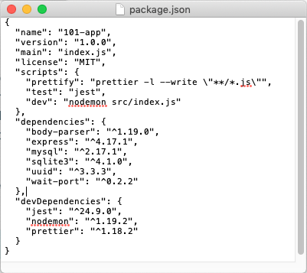
Configuration
File / Script
Notes:
Simple example of an npm configuration file.
- always named package.json
- can see sections that declare
- the dependencies
- the devDependencies
- Each line is key value pair:
- names a dependency using its package name (like apt)
- indicates a version
- ^ means newer than version…
- Can also specify specific versions or version ranges.
Keep in mind that the goal here is not to fully understand or be able to create one of these.
- Just the idea that there is a configuration file
- and it specifies the dependencies for the project.
- It is fed to the npm tool which installs the dependencies.
package.json adapted from Docker 101 Tutorial
- https://www.docker.com/101-tutorial

Slide 7
Build Process
The build process “converts files and other assets under the developers’ responsibility into a software product in its final or consumable form.”
“The build may include:
compiling source files
packaging compiled files into compressed formats (such as jar, zip)
producing installers
creating or updating of database schema or data”
…
Definition From: https://www.agilealliance.org/glossary/automated-build
Notes:
Can be a complex processes
- requiring multiple steps
- in a precise order
Can include things like…
Overall goal is to produce a “software product in its final consumable form”
- could be
- an executable program
- a package for a dependency repository
- a web application
- with a database, web server, and all the pages and code.

Slide 8
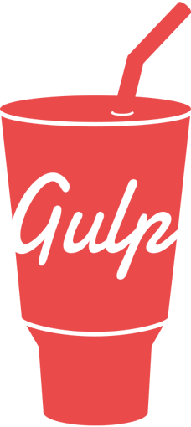


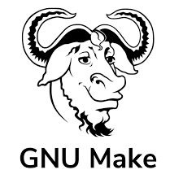

Automated Build Process
Build tools are programs that automate the build process.
There can be multiple targets for a given product. E.g. different OS versions; test vs production…
Dependencies
Build
File / Script
Build Tool
Target
/ Product
Project Source Code
Project Source Code
Project Source Code
Project Source Code
Notes:
The build process is repeated every time the product is created
- Can be tedious and error prone.
- automating it makes it more reliable and faster
Like dependency management
- there are tons of tools out there.
- but they all fundamentally operate in the same way
- They take an input
- a build file or script
- Instructions that direct the process
- all the product code
- necessary dependencies
- Build tool reads the file / script
- follows the instructions
- spits out the product – often called a target.
What is the build process for the cookies?
- It is the steps in the recipe.
- mix the flower, eggs, milk , chips
- spoon onto a baking sheet
- bake for exactly 7.5 minutes
- place the warm cookies on a cooling rack
- box them up to hand out.
Notice there are some of the same tools listed here.
Dependency management and build can be handled by a single tool.
- checks / installs dependencies as a step in the build process.

Slide 9
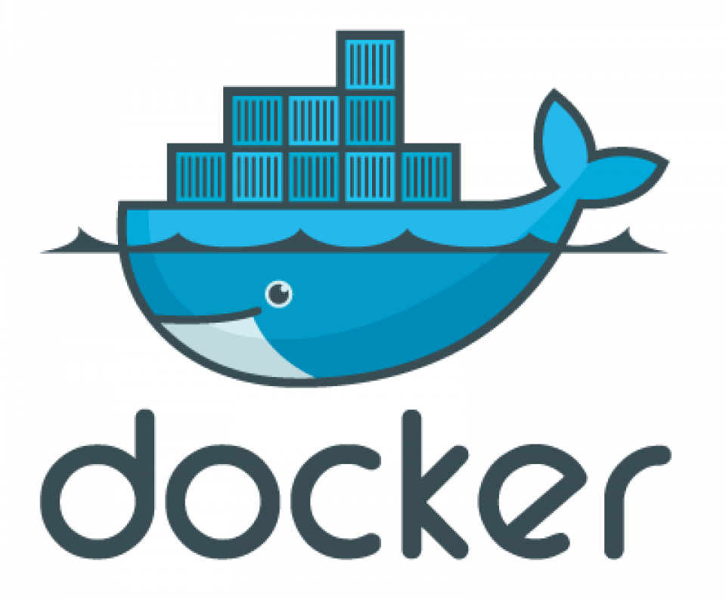
Docker is a set of platform as a service (PaaS) products that use OS-level virtualization to deliver software in packages called containers. Containers are isolated from one another and bundle their own software, libraries and configuration files; they can communicate with each other through well-defined channels. All containers are run by a single operating system kernel and therefore use fewer resources than virtual machines. - Wikipedia
Notes:
Still a lot of work…
- still doesn’t address portability or compatibility of deps.
Package all dependencies
With a working build
Simple to deploy
Guaranteed to be the same and to just work.
Docker is one (the most popular) container system.

Slide 10
Docker is a set of platform as a service (PaaS) products that use OS-level virtualization to deliver software in packages called containers. Containers are isolated from one another and bundle their own software, libraries and configuration files; they can communicate with each other through well-defined channels. All containers are run by a single operating system kernel and therefore use fewer resources than virtual machines. - Wikipedia
Notes:
Software, libraries and configuration files all bundled together.
That is the container has all of the:
- necessary prerequisites
- necessary dependencies
- product of the build
That way everyone with the container has everything they need.
- they don’t have to install prereqs, deps or even build.
- just launch the container and off you go.
Eliminates many of the risks associated with dependencies.
Eliminates the need to build.

Slide 11
Docker is a set of platform as a service (PaaS) products that use OS-level virtualization to deliver software in packages called containers. Containers are isolated from one another and bundle their own software, libraries and configuration files; they can communicate with each other through well-defined channels. All containers are run by a single operating system kernel and therefore use fewer resources than virtual machines. - Wikipedia
Notes:
Containers are isolated –
- cannot mess with the host machine
- cannot mess with each other
- provides good security
But, containers can be configured to be able to communicate with each other.
- allows them to cooperate
- a web application running in one container
- could talk to a database running in another container.

Slide 12
Docker is a set of platform as a service (PaaS) products that use OS-level virtualization to deliver software in packages called containers. Containers are isolated from one another and bundle their own software, libraries and configuration files; they can communicate with each other through well-defined channels. All containers are run by a single operating system kernel and therefore use fewer resources than virtual machines. - Wikipedia
Notes:
They are lighter weight than VMs.
- Run faster
- take up less memory (RAM)
- use less storage (disk)

Slide 13
OS Level Virtualization: Virtual Machines vs Containers
Virtual Machines
App
App
App
App
Containers
App
App
App
App
Libs/Bins
Libs/Bins
App
App
App
App
Guest OS
Guest OS
Libs/Bins
Libs/Bins
Libs/Bins
Hardware Virtualization
Virtual Machine (hypervisor)
Libs/Bins
OS Kernel Virtualization
Container Daemon (containerd)
Host Operating System
Host Operating System
Hardware
Hardware
Virtual Machines
Containers
Notes:
Normal system, hardware, os, libraries and binary files used by applications that run on the system.
With VM:
- software layer that pretends to be the computer hardware
- Can install OS on that virtual hardware
- Comes with its own libs/bins
- Apps run on that.
- Can have multiple VMs running on the same physical machine.
- Each can have its own full OS – mac / win / linux
With Containers:
- Each container still acts just like a full machine.
- It thinks it has its own OS
- It runs aps just like a VM
- But it is using the host OS
- So eliminates the Guest OS and the hardware virtualization pieces.

Slide 14
Virtual Machines vs Containers
Virtual Machines
Slow boot-up
Slower execution
Larger images
Apps are sandboxed*
Multiple OSs
Full GUI*
Containers
Fast spin-up
Faster execution
Smaller images
Apps are sandboxed*
OS Limitations
CLI access*
Notes:
Comparing the two…
Sandboxed
- don’t have to install everything on your machine
- Some argue that VMs may be more secure
- virtualized hardware and separation from host OS files and services.
Multiple OS’s / OS Limitations
- VMs: Can run MacOS in one VM and Windows in another and Linux in another.
- Containers:
- Linux / MacOS can run only Linux-based containers.
- Windows can run Windows and/or Linux-based containers.
GUI / CLI
- technically possible to run VMs without GUI – often done on servers
- also possible to run GUI on containers – less useful – more cumbersome.

Slide 15
Common Container Uses
Deploy (Deployment) Containers:
Container(s) contains all dependencies and binaries needed to run the app.
Container can be run locally or easily “deployed” to a cloud service (AWS, Azure, Heroku, DigitalOcean, etc.)
Dev (Development) Containers:
Container(s) contain all dev dependencies and build tools.
Source files are stored and edited on host machine.
Container(s) are used to run tests and the build process.

Slide 16
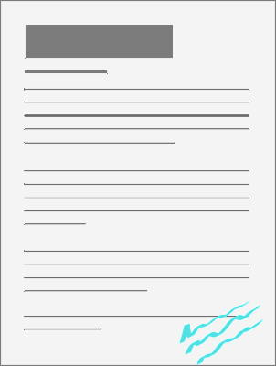


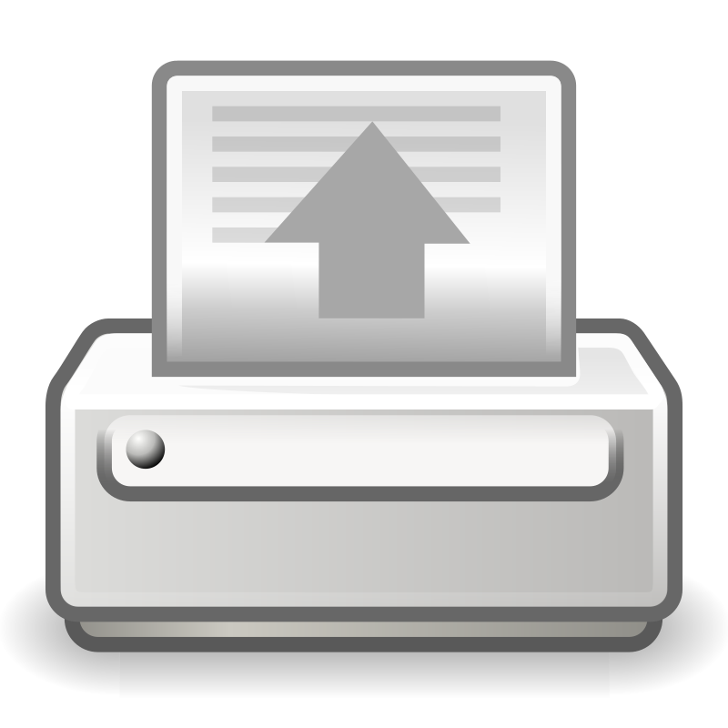
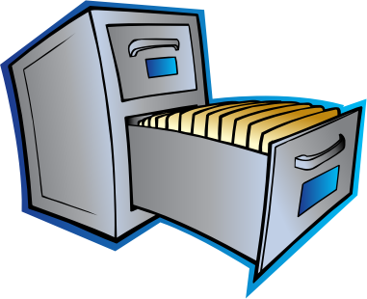
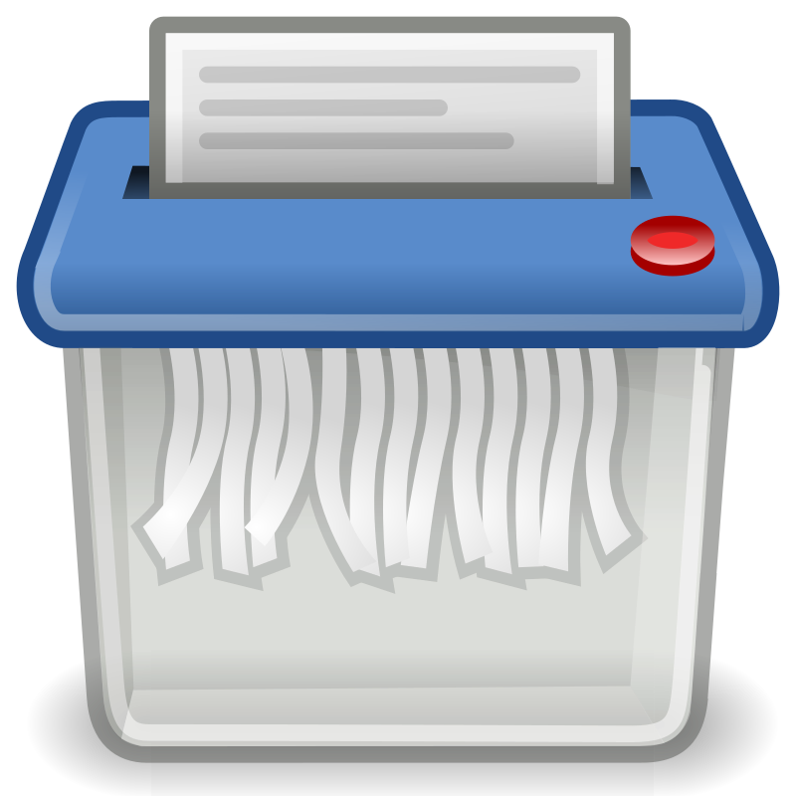
Docker Vocabulary /Concepts
Cookie Container
Stew
Container
Local Images
Image Repository
Writeable
Layer
Cookie:latest
Stew:9.7
pull
start
Stew:10.2
Stew:9.7
Stew:latest
remove
stop
image
remove
printer
Salad:latest
create
container
Cookie:0.9
Cookie:latest
Shredder
Images from: openclipart.org
Notes:
Sticking with a recipe metaphor…
- if docker was for managing recipes instead of deployment or development containers
Repository
- Cloud service that stores recipes
- Images are recipes
- The most recent version will usually be tagged ”latest”
- Older versions will be tagged in other ways.
- read only for the public
Local Images
- Downloaded (pulled) version of the image:tag
- still read only
- kind of like a downloaded pdf file
An Image is used to create a container
- like printing the recipe on a piece of paper and putting in a file.
Starting the container
- taking the recipe out and putting it on the counter
- can use it
- can modify it and make notes on it
- writeable container layer
Stopping a container
- putting it back in the file
- with all notes on it.
- can start it again and it will come back as is.
Removing a container
- like shredding the paper.
- all notes are lost
- can create a new container from the image
- resets to initial state
- the writeable layer is blank
Removing the image
- Like deleting the pdf file.
- If you want to use it again
- need to pull/download it again.

Slide 17
Docker Vocabulary / Concepts
Image Repository
Docker Hub is “a hosted repository service provided by Docker for finding and sharing container images.”
Image:tag
An image is a read-only file containing the libraries, binaries, application and configuration files for creating a container.
A tag is a version label for a specific image.
Container
A container is a runtime version of an image that may have additional changes in its writeable layer.
Notes:
More formal definitions.

Slide 18
Creating Docker Images
Dependencies
Dockerfile
docker build
Docker
Image
Project Source Code
Project Source Code
Project Source Code
Project Source Code
Notes:
Looks a lot like like the diagram for a build tool.
- because it is!
- Here we are just building a docker image.
- And that image will contain the software product.
The process of building the docker image will likely:
- include installing dependencies
- running the automated build process.
The Dockerfile as you will see will look similar to a shell script.
- It will be a sequence of commands
- that describe how to build the image.

Slide 19
What’s Next?
A11/Q11 – 1 week
Revise and resubmits
Reading for discussion
Notes:
A11 will have you using a docker image
- to learn about docker and its commands.
Then you’ll fork and clone a project
- build a Dockerfile to create an image for it.
- then create a PR to upstream your Dockerfile.

Slide 20

Acknowledgments:
Slide Template From:
https://creativecommons.org/licenses/by/4.0/
Slide Content Licensed as:
https://creativecommons.org/licenses/by-nc/4.0/

