Slide 1

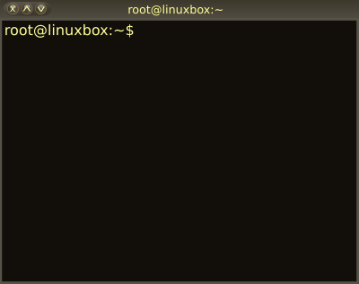

02 – Linux Command Line Interface (CLI)
COMP 190 – Dickinson College
Fall 2022
Images from: openclipart.org
Notes:
In this class and the activities, you will be learning to interact and work with Linux through the command line.

Slide 2
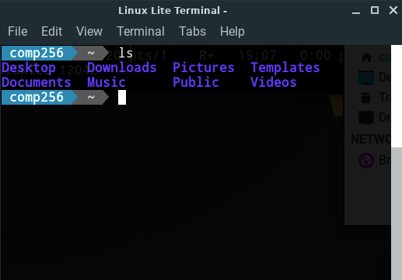
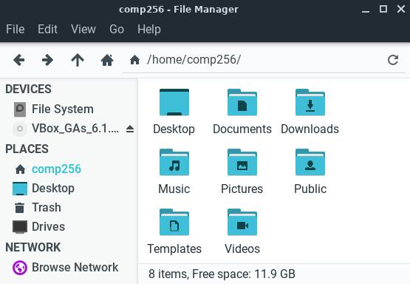
Directories (Folders) and Files

Slide 3
Linux/Unix CLI File Paths
A path expresses the location of a directory (i.e folder) or file using text.
/home/comp190/Notes.txt
Absolute paths
Give directions from a common reference point called the root.
Always begin with a /
Relative paths
Give directions from your current location called the working directory.
Do not begin with a /
Notes:
An absolute path is like directions to your destination from the center of campus.
- To get to the Coffee Shop: From the Union building, go out the front door, turn left, go to the corner, etc…
- To get to the Gym: From the Union building, go out the back door, turn right, go to the alley, turn left, etc…
- The directions to the same place will always be the same.
A relative path is like directions from where you are right now.
- So the directions depend on where you are.
- Thus directions to the same place will be different depending upon where you are.
- To get to the Coffee Shop: turn around, go to the corner, turn right, cross the street, etc…
- To get to the Coffee Shop: Go out the front door, turn left, go to the corner, etc…

Slide 4
Linux/Unix vs Windows File Paths
Path Separator:
Linux/Unix: home/comp190/Notes
Windows: home\comp190\Notes
Root:
Linux/Unix; /
Windows: C:\ D:\ etc.
Case sensitive
Paths are case sensitive
Notes:
We won’t be using Windows, but I wanted to mention this as some of you may have before or may encounter it.
Anytime you are working in Linux, even if it is in Docker w/ VNC on Windows, you will use the Linux style.

Slide 5
Absolute and Relative Paths
Which of the following are relative paths and which are absolute paths?
/home/comp190/Movies
comp190/Food/Lunches.txt
../Movies/Drama/Crawdads.txt
/usr/bin/ls
../../
/etc/passwd
Notes:
It doesn’t matter what these refer to at this point.
Just identify them as relative or absolute.

Slide 6


Unix File System Structure
root
Files and directories are organized into a tree structure.
Tree begins at the root.
A sub-directory is a directory inside another directory.
hoppergm and ritchied are sub-directories of home.
A parent directory is the directory that contains a sub-directory.
home is the parent directory of hoppergm and ritchied.
/
bin
etc
home
hoppergm
Documents
Project1
FileA
FileB
Images
FileC
ritchied

Slide 7
Absolute File Paths
Absolute paths: Start with a / and specify location starting from the root of the file system.
/bin
/home/hoppergm
/home/hoppergm/Images/FileC
root
/
bin
etc
home
hoppergm
Documents
Project1
FileA
FileB
Images
FileC
ritchied

Slide 8
Absolute File Paths
Absolute paths: Start with a / and specify location starting from the root of the file system.
/bin
/home/hoppergm
/home/hoppergm/Images/FileC
root
/
bin
etc
home
hoppergm
Documents
Project1
FileA
FileB
Images
FileC
ritchied

Slide 9
Absolute File Paths
Absolute paths: Start with a / and specify location starting from the root of the file system.
/bin
/home/hoppergm
/home/hoppergm/Images/FileC
root
/
bin
etc
home
hoppergm
Documents
Project1
FileA
FileB
Images
FileC
ritchied

Slide 10
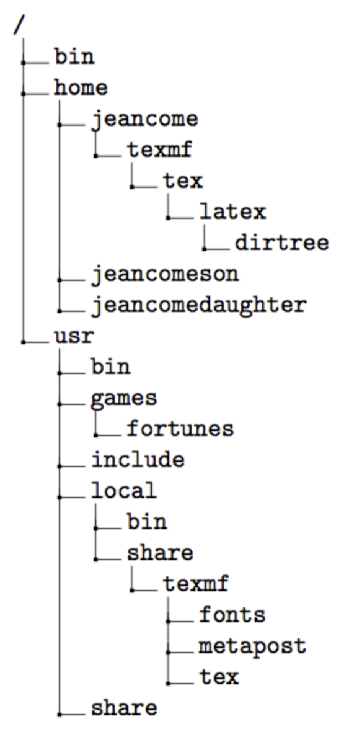
Path Practice
Write the absolute path for the following files or directories:
The usr directory
The fortunes program
The latex directory
The fonts directory
Notes:
File tree from: https://texblog.org/2012/08/07/semi-automatic-directory-tree-in-latex/

Slide 11
Relative File Paths
root
Relative path: Do not start with a / and specify location starting from the working directory.
We will assume the working directory is /home/hoppergm
Documents
Documents/Project1/FileB
../ritchied
../../bin
/
bin
etc
home
hoppergm
Documents
Project1
FileA
FileB
Images
FileC
ritchied

Slide 12
Relative File Paths
root
Relative path: Do not start with a / and specify location starting from the working directory.
We will assume the working directory is /home/hoppergm
Documents
Documents/Project1/FileB
../ritchied
../../bin
/
bin
etc
home
hoppergm
Documents
Project1
FileA
FileB
Images
FileC
ritchied

Slide 13
Relative File Paths
root
Relative path: Do not start with a / and specify location starting from the working directory.
We will assume the working directory is /home/hoppergm
Documents
Documents/Project1/FileB
../ritchied
../../bin
/
bin
etc
home
hoppergm
Documents
Project1
FileA
FileB
Images
FileC
ritchied
Notes:
.. Refers to the parent directory.
- at hoppergm it refers to home.
- at home it refers to root
- at project1 it refers to Documents
- at Documents it refers to hoppergm
- etc.

Slide 14
Relative File Paths
root
Relative path: Do not start with a / and specify location starting from the working directory.
We will assume the working directory is /home/hoppergm
Documents
Documents/Project1/FileB
../ritchied
../../bin
/
bin
etc
home
hoppergm
Documents
Project1
FileA
FileB
Images
FileC
ritchied

Slide 15
Path Practice
Assume that the working directory is jeancome.
Write a relative path for the following files or directories:
The latex directory
The jeancomeson directory
The share directory
The games directory

Slide 16
Some Special Linux/Unix CLI Paths
root
/
~ Home Directory
Shortcut for an absolute path
Expands based on user:
/home/hoppergm
/home/ritchied
.. Parent Directory
. Current Directory
Relative to current location.
bin
etc
home
hoppergm
Documents
Project1
FileA
FileB
Images
FileC
ritchied
Notes:
There is only one root.
Every user has a home directory.
- So the expansion of the shortcut ~ depends on which user is logged in.
- /home/hoppergm
- /home/ritchied
We’ve seen ..
.. Refers to the parent directory.
- at hoppergm it refers to home.
- at home it refers to root
- at project1 it refers to Documents
- at Documents it refers to hoppergm
- etc.
The . for the current directory has some uses that we’ll see later.
- at home it refers to home.
- at Images it refers to Images
- etc…

Slide 17
The Unix philosophy recommended utilizing small, purpose-built programs in combination to do complex overall tasks. Phil Estes Linux vs. Unix: What's the difference?

Slide 18
Linux/Unix Commands
The Unix/Linux commands you have used are small purpose-built programs that run when their name is entered at the command prompt.
mkdir
ls
mv
rm
rmdir
whoami
cp
pwd
Notes:
Saw some of these in the first HW
Will see more of them in this homework.

Slide 19
Command Line Flags & Arguments
Unix/Linux commands often have options (i.e. flags) and/or arguments that can be added to modify their behavior.
Short Form (-)
Long Form (--)
ls -l
ls --all
head -n5 Notes.txt
head --lines=5 Notes.txt
Notes:
Doesn’t matter here what the flags or the commands are…
Important point is you’ll be adding flags to commands
- They go right after the command
- They modify the command’s behavior.
- for ls the -a or --all flags tell ls to show us all files (including the . and .. entries and hidden files, which we’ll learn about a little later).
- Sometimes the flag/option requires an argument
- E.g. head displays some number of lines from the top of a file.
- flag -n or --n specify how many lines.
Here the flags are
-a
--all
-n
--lines
The arguments are:
5
=5
Notes.txt

Slide 20
Useful Linux/Unix Stuff:
Copy and Paste in Linux/Unix
In the Terminal:
Copy Shift+Ctrl+C
Paste Shift+Ctrl+V
Anywhere else:
Copy Ctrl+C
Paste Ctrl+V
Command History
Tab Completion
Clear the Terminal
Ctrl + L

Slide 21
What’s Next
Be sure to complete
Syllabus Quiz
Quiz 01
Complete A02
Submit to Moodle by next Wed 12:00 noon.
Complete Quiz 02
Do reading and prep for discussion.

Slide 22

Acknowledgments:
Slide Template From:
https://creativecommons.org/licenses/by/4.0/
Slide Content Licensed as:
https://creativecommons.org/licenses/by-nc/4.0/

