Slide 1

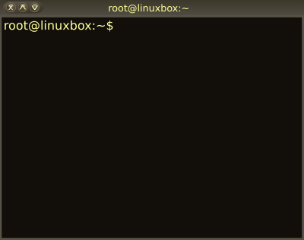

04 – Shell (e.g. bash) Scripting
COMP 190 – Dickinson College
Fall 2021
Images from: openclipart.org
Notes:
Look at some of the specific tools and utility programs that come with all Unix distributions
And see how they are used.

Slide 2
The Unix philosophy recommended utilizing small, purpose-built programs in combination to do complex overall tasks. Phil Estes Linux vs. Unix: What's the difference?
Notes:
Only gets us so far…
- more complex tasks may require doing the same thing to multiple files
- or doing to to some files and not others
- these things are often more easily controlled using more traditional programming constructs
- that is shell scripting

Slide 3
Shell Scripts
Shells (e.g. bash)
Provide a command line interface (CLI)
Are also interpreters for programs (i.e. scripts)
File containing a list of commands
Full featured languages
Variables / if / for / while / functions / etc.
A bit idiosyncratic and particular
Notes:
Point out some of the big ideas and main concepts.
Then you’ll work through the tutorials to pick up some more.
- Try things in Linux Lite!
- Experiment
Remember, not only learning a little bit of scripting
Developing valuable skills
- Detailed reading and lifelong learning.
- Will be picking up new tools and languages all the time.

Slide 4
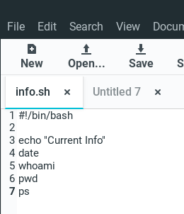
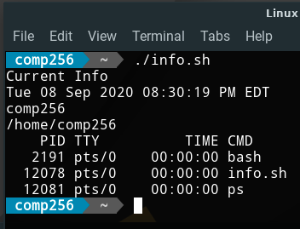
A Small Example:
Notes:
In simplest form it is just like typing each command into the terminal.

Slide 5
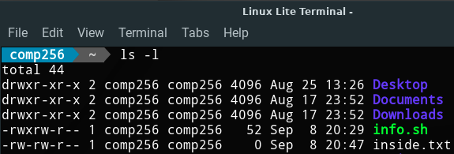
File Permissions
Every file and directory in Unix has permissions
d = Directory
r = Read
w = Write
x = Execute
User
Other
Group
Notes:
Each user has own group by default.
Can use groups for things like Students
- All students users would be assigned to the student group
- Programs that are usable by students but not everyone can
- Have the group student
- Have execute permission for the group

Slide 6
Changing Permissions
Must have execute permission to run a script.
chmod u+x info.sh

Slide 7
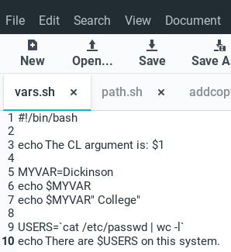
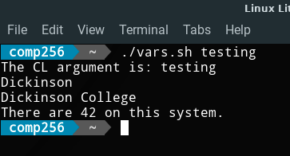
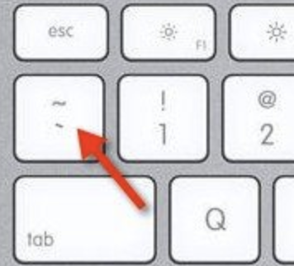
Variables and Back Ticks
Notes:
Pre defined variables for some things.
Use $ to prefix use of any variable
- Ask: If second command line variable is given how would we reference it? $2
Defining variables – critical NO SPACE before or after the =
Use $ to use the variable’s value.
Concatenation is just putting $var in pretty much wherever you want.
Back ticks are command substitution
- Result of executing the command is put into the variable.
- This cats the passwd file and counts the lines using wc.

Slide 8
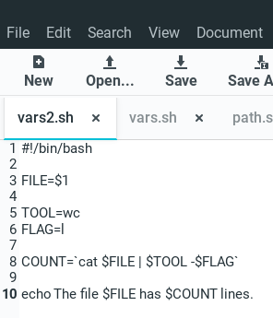
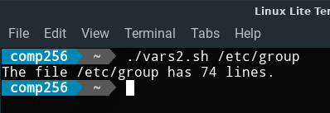
Variables Substitute (nearly) Anywhere
FILE=/etc/group
COUNT=`cat /etc/group | wc -l`

Slide 9
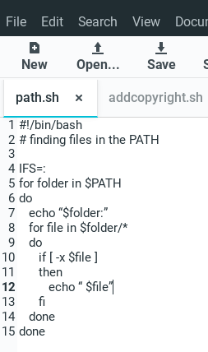
A More Complex Script Example
Scripts can also use common programming structures:
for loops
Nested loops
if statements
if/else
Script from: http://unixadminschool.com/blog/2016/03/bash-scripting-some-real-time-examples-of-loops/
Notes:
Point is not to explain functionality here, that happens in the tutorials.
Just see that a script can be more than a list of commands.

Slide 10
What’s Next?
A04 / Q04 – Due 1 week
Revise and Resubmits (A01, A02, A03)
Quizzes (Syllabus, Q01, Q02, Q03)
Do reading and prepare for discussion

Slide 11

Acknowledgments:
Slide Template From:
https://creativecommons.org/licenses/by/4.0/
Slide Content Licensed as:
https://creativecommons.org/licenses/by-nc/4.0/

